Slide 1
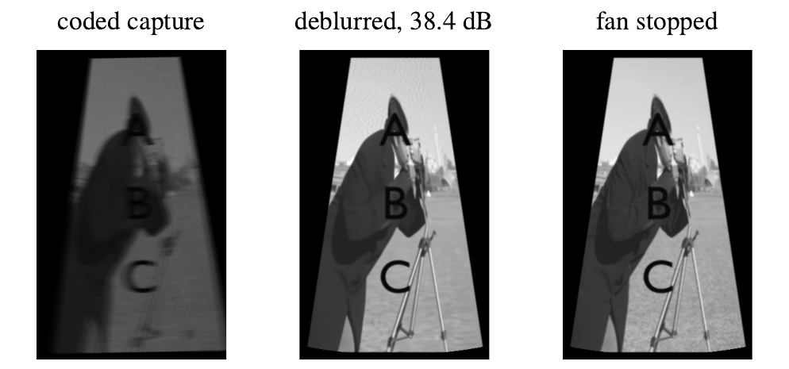
Reading a spinning fan from one blurry photo
Coded illumination with global and rolling shutter cameras
Simulation: coded capture, our reconstruction, fan stopped
Jack Thompson, Oliver Turner, Krish Singh, Daniel Chung, Ben Ritchie
MECH5720 Major Project, Group 10
Notes:
(20 s) We are Group 10. Photos of fast things blur. We built a rig that lets us undo that blur, and read the letters on a spinning fan from a single photo.

Slide 2
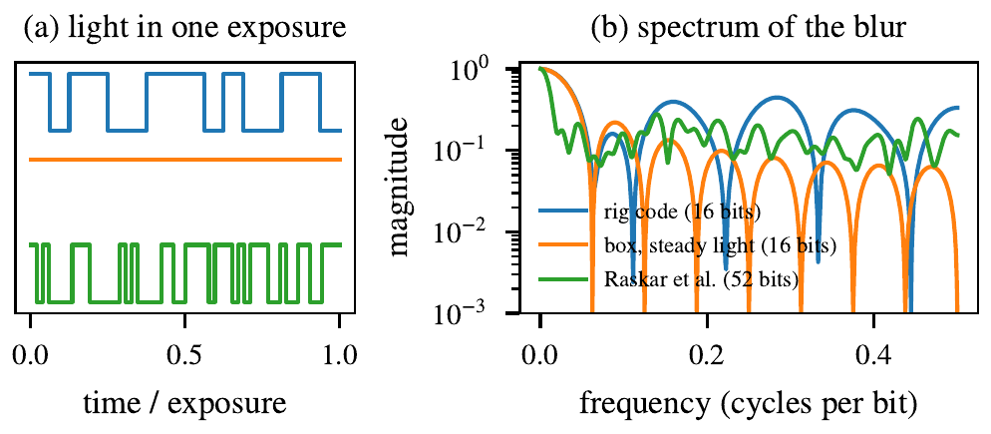


Steady light erases detail; a flashing code keeps it
Long exposure: bright but blurred. Short exposure: sharp but noisy.
Steady light
The blur is a box. Its spectrum hits zero, so that detail is gone for good.
Flashing code
The monitor flashes a designed on/off pattern during one exposure. No zeros, so the blur can be undone.
Right: the spectrum of each blur. Steady light (orange) dips to zero; the 52-bit code (green) never does.
Notes:
(60 s) Every camera trades blur against noise. Under steady light a moving point smears into a box, and a box blur has zeros in its spectrum: detail at those frequencies is erased, and no algorithm brings it back. If the light flashes a well-chosen code during the exposure, the spectrum stays above zero everywhere, so the blur becomes reversible. That is the flutter shutter idea; we do it with light instead of the shutter.

Slide 3




An ordinary camera, made into a flutter shutter
Rig photo or short video: monitor, fan with letter cards, black backing, camera. Add after the lab.
Monitor flashes the code
Raspberry Pi shows 16 black/white bits during one long exposure
Stepper-driven fan
Arduino and a 28BYJ-48 motor turn it at a known speed
Two cameras
Global shutter (Sony IMX296) and rolling shutter (OV5647)
One click to capture, one command to deblur
Logs every flash, finds the hub itself, deblurs, estimates speed
Notes:
(60 s) The rig: a Raspberry Pi drives a monitor beside the fan, flashing the code while the camera holds one long exposure. An Arduino and stepper spin the fan at a known speed. We compare a global shutter camera, which exposes every row at once, with a rolling shutter camera, which exposes row by row; we correct the rolling shutter either once per image or row by row. One click captures and logs exactly when each flash appeared; one command calibrates the fan's centre automatically, deblurs, and estimates the speed.

Slide 4
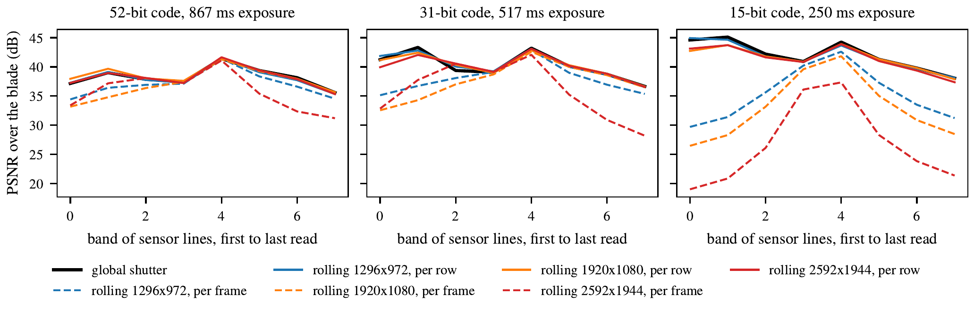
Simulation: we recover the blade and its speed
SIMULATION
38.4 dB
0.7 dB
0.1%
reconstruction against the stopped blade (short exposure: 30.2 dB)
row-by-row rolling shutter behind global shutter, frame average (target 1 dB)
speed error from a single photo (target 5%)
Correcting once per image (dashed) fails away from the rows it was timed for: 15.4 dB lost with a short code.
Notes:
(70 s) Before the rig existed we tested everything on Blender renders, so these are simulation numbers. We recover a textured blade to 38.4 dB against the stopped blade. Correcting the rolling shutter row by row stays within 0.7 dB of the global shutter on average, our first target. In single bands it can miss by up to 1.9 dB, so we only claim the average. Correcting once per image fails badly away from the rows it was timed for. And the speed comes out of the photo itself, within 0.1%.

Slide 5
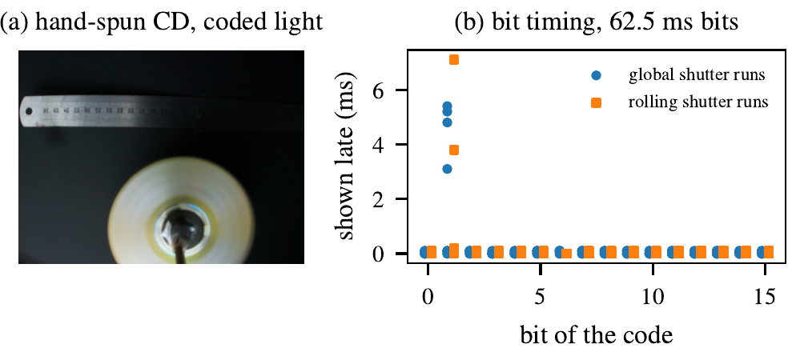
On the rig: the code is on time; fan results next
MEASURED
Deblurred fan from the rig, next to the stopped fan, with PSNR and letters read. Add after the lab.
298 / 304
flashes within 1 ms of schedule over 19 captures (worst 7.1 ms), from the display log
Our first target, a CD spun by hand, changed speed mid-exposure, so no single blur fitted. That is why we built the stepper rig.
Notes:
(50 s) Real data so far. Across 19 captures the monitor showed 298 of 304 flashes within a millisecond; the worst was 7.1 ms late, always the first switch to black. These times are the display software's own log, not an optical measurement. Our first target, a CD spun by hand, changed speed during each exposure, so no single blur explained it; that negative result is why we built the stepper rig. [After the lab: show the deblurred fan here, with PSNR and the share of letters read.]

Slide 6


What we learned, and what we would do next
Learned
Next
Our 16-bit code has spectral zeros
An LED instead of the monitor
It loses detail like steady light; the 52-bit code does not
Microsecond switching allows codes hundreds of bits long
The background must be dark
Codes designed for rolling shutter
A white stand behind the fan drops quality to 8 to 11 dB
Use the row timing instead of correcting for it
Pad the rolling shutter exposure
Real moving scenes
Then every row sees the whole code
Continuous motor drive, then motion estimated per object
Notes:
(40 s) Three lessons. The 16-bit code we started with has spectral zeros, so it throws detail away like steady light; [say here whether the lab used the 52-bit code instead]. Anything bright behind the fan ruins the reconstruction, so the background must be black. And padding the rolling shutter exposure makes every row see the whole code. With two more months: an LED for far longer codes, codes designed for the rolling shutter, and real moving scenes. Thank you.

