Slide 1
冒險故事 (VTube Studio)

Slide 2
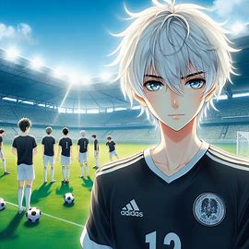

Notes:
A white-haired, blue-eyed young man japanese anime style wearing a football shirt stands in front of his soccer team on a green field, preparing for an intense match. Behind him, teammates are warming up, and the stadium is filled with cheering fans. The bright sun shines over the field, and the tension of the upcoming game is palpable."

Slide 3
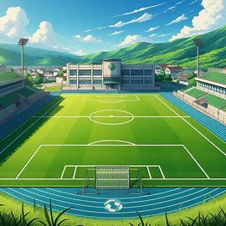
Notes:
japanese anime style green football field

Slide 4
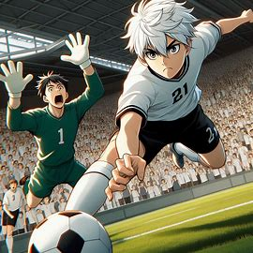
Notes:
The white-haired young man, japanese anime style, sprints toward the goal, about to strike the ball with power, but the opposing goalkeeper dives, barely managing to save the shot. The ball is just beneath the keeper's hands as the crowd holds its breath. The player's expression is intense, with a slight hint of disappointment, but his determination is unshaken."

Slide 5
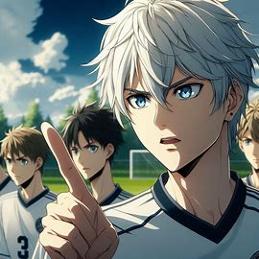
Notes:
The white-haired young man with blue eyes, japanese anime style, stands with his soccer teammates on the field, pointing toward a weak spot in the opposing defense. His face is serious and focused as he leads the team, with his teammates listening attentively. The atmosphere on the field is intense, and everyone is deeply concentrated.

Slide 6
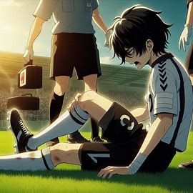
Notes:
The black-haired young man kneels on the grass, japanese anime style, clutching his injured ankle with a pained expression on his face. The referee and medical staff rush onto the field, while the audience gasps in concern. The sun still shines, but the atmosphere has grown tense as the player struggles with the sudden injury.

Slide 7
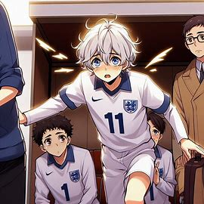
Notes:
A substitute player japanese anime style, slightly nervous but determined, steps onto the field to take the place of the injured white-haired player.

Slide 8
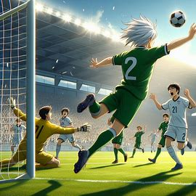
Notes:
The white hair substitute player makes a powerful shot, japanese anime style, sending the ball flying toward the top corner of the goal. The opposing goalkeeper dives but misses, and the ball hits the net. The substitute player throws his arms up in celebration as his teammates rush to congratulate him. The crowd erupts in cheers under the bright sunlight, and the sense of victory fills the stadium.

