Slide 1
DSD Final Project
Group 1
B12901008 鍾佳聿
B12901137 楊祐宇

Slide 2
Score
Area: 769950.832599 um²
Synthesis Cycle time: 2.7 ns
Gate simulation Cycle time: 2.7 ns
Qsort: 193798.947 ns
Conv: 34423.347 ns
LFSR_HIST: 722164.647 ns
Score: 3.71e21

Slide 3
Cache Size - CPP Experiment
Cache Size | I-cache Miss Rate | D-cache Miss Rate
16 blocks, 1-way | 2.5498% / 3.6880% / 18.4577% | 6.7210% / 21.2606% / 37.5730%
16 blocks, 2-way | 3.7602% / 4.4479% / 9.6515% | 5.0275% / 10.9595% / 37.7028%
32 blocks, 1-way | 0.0541% / 0.9164% / 0.0130% | 3.8209% / 2.9163% / 36.5347%
32 blocks, 2-way | 0.0541% / 0.9164% / 0.0130% | 2.7837% / 3.0574% / 36.2103%
64 blocks, 1-way | 0.0541% / 0.8941% / 0.0130% | 1.7041% / 2.9163% / 35.4964%
64 blocks, 2-way | 0.0541% / 0.8941% / 0.0130% | 0.9843% / 1.3641% / 34.7826%
Data: Qsort / Conv / LFSR HIST
I cache miss rate saturate at 32block in two cases, since there’s less than 128 instructions.

Slide 4
Cache Size - RTL Experiment
Data:
Qsort / Conv / LFSR HIST , all 1 way cache
Cache Size | Total Cycles | MEM I Stall Cycles | MEM D Stall Cycles
I16 / D16 | 112201 / 21300 / 1226355 | 24241 / 1045 / 902177 | 19538 / 11754 / 18891
I32 / D16 | 87807 / 20873 / 278220 | 545 / 566 / 604 | 19538 / 11754 / 18891
I32 / D32 | 79718 / 14678 / 277771 | 545 / 566 / 604 | 11833 / 5845 / 18449
I32 / D64 | 73561 / 10965 / 277357 | 545 / 566 / 604 | 5945 / 2284 / 18025
I64 / D32 | 79718 / 14678 / 277771 | 545 / 566 / 604 | 11833 / 5845 / 18449
I64 / D64 | 73561 / 10965 / 277357 | 545 / 566 / 604 | 5945 / 2284 / 18025
Compare I16 / D16 and I32 / D16, 32 block I cache decrease LFSR cycle time a lot.
Compare I32 / D32 and I32 / D16, 32 block D cache decrease Qsort, Conv cycle time.
Final Decision: 32 block 1-way I cache + 32 block 2-way D cache

Slide 5
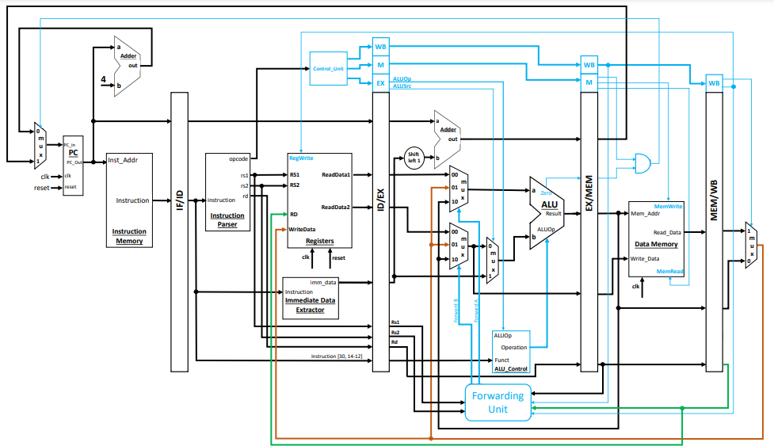
Design - Multiplication Support
When mul in Ex stage, stall other stage for 2 cycle to wait multiplication result to finish.

Slide 6
Branch Prediction - CPP Experiment
Pattern\Algorithm | Always Not Take | Always Taken | BTFNT | 3-bit counter
BrPred | 37.97% | 62.02% | 73.42% | 68.35%
Qsort | 72.44% | 27.56% | 72.44% | 70.48%
Conv | 63.58% | 36.42% | 66.05% | 63.58%
LFSR_HIST | 85.46% | 14.54% | 85.46% | 85.43%
BTFNT (Backward Taken, Forward Not Taken) predicts backward branches as taken and forward branches as not taken.
Conclusion: Always Not Take achieve high accuracy in the 3 patterns with least hardware cost.

Slide 7
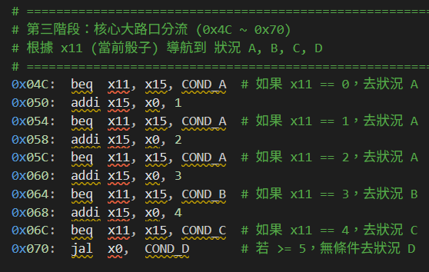
Branch Prediction - Assembly Code Analysis
Example: LFSR_HIST
Branch taken or not highly depends on random numbers. => Complicated dynamic branch predictors are not suitable.
Final Decision: Always Not Taken

Slide 8
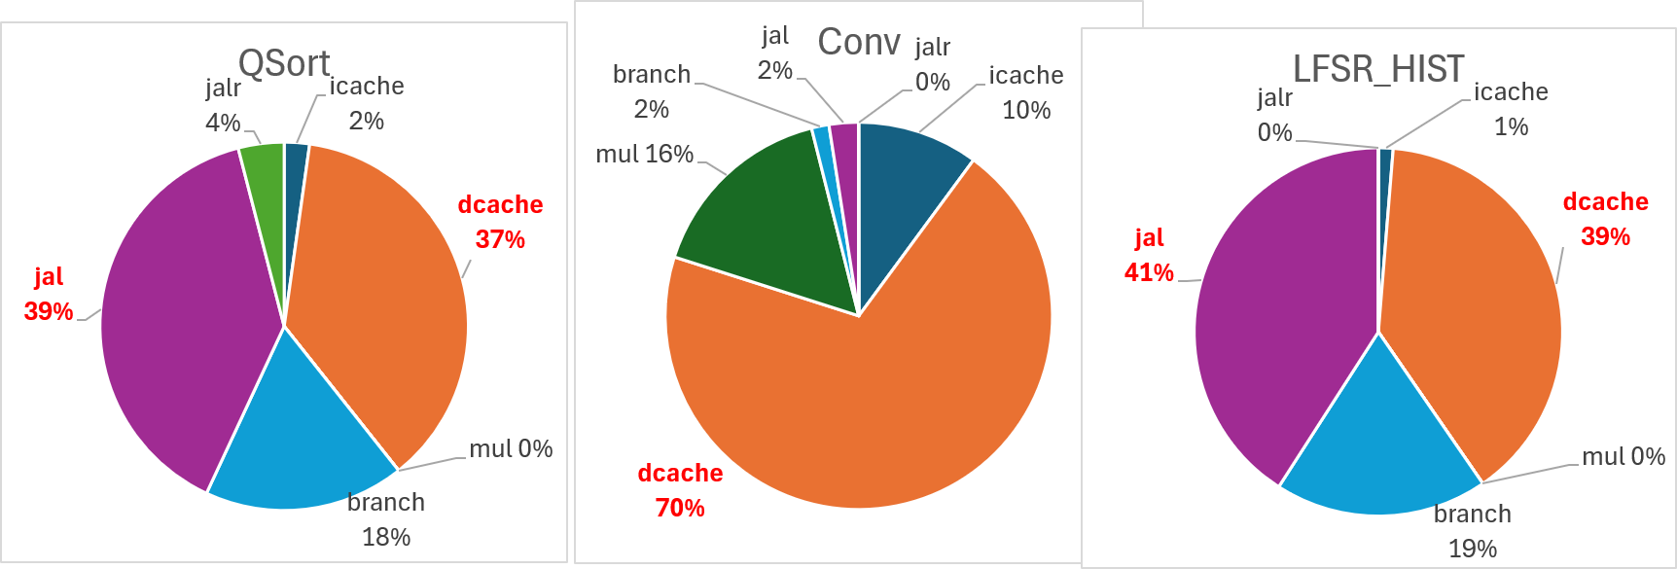
Task Analysis -Stall reason

Slide 9
Design - ID stage JAL Resolution
Move JAL resolution from EX stage to ID stage.
Penalty:
2 cycles (resolution at EX, flush IF and ID) -> 1 cycle (resolution at ID, only flush IF)
Extract a dedicated JAL immediate (fast_jal_imm) directly from instruction bits, bypassing the general immediate generation MUX to shorten the critical path.
Branch and JALR stays in EX stage since they require additional forwarding unit, which may extend the critical path.

Slide 10
Discarded Optimization Method (Future Works)
Branch Target Buffer (BTB) for JAL at IF Stage
Idea: Records JAL instruction PCs and their target addresses to enable immediate redirection during the Instruction Fetch (IF) stage.
Benefit: Completely eliminates pipeline stalls for recurring JAL instructions, achieving zero-penalty jumps.
Write Buffer (WB) for D-Cache
Idea: Temporarily stores evicted dirty blocks from the D-cache, allowing the cache to proceed with memory refills immediately.
Benefit: Decouples slow memory writebacks from the pipeline critical path, significantly reducing dcache_stall cycles.
Discarded due to long critical path
Discarded due to large area

Slide 11
How do we utilize AI?

Slide 12
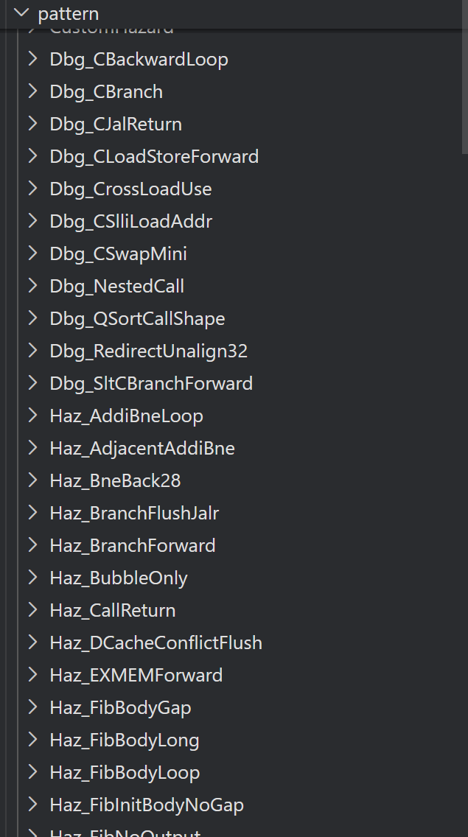
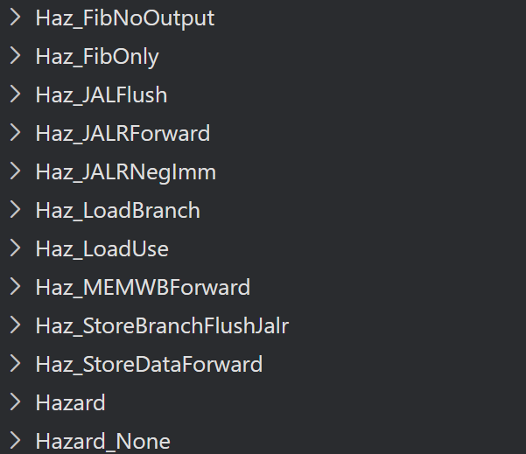
Generate Baseline Verilog Code
Tell the AI what to do step by step. Check the code between each step.
Step1 : Add Instruction Support, and complicate random latency memory support, and hazard detection, forwarding unit.
Step2 : Add a baseline cache.
Step3 : Cut pipeline.
After RTL simulation, ask AI to generate test pattern to simulate different scenario for debugging.
Then, PASS!!!
*Highly recommand codex or something like that that can “live” in your IDE, so it can change your file automatically. Or you’ll have to copy and paste a lot.

Slide 13
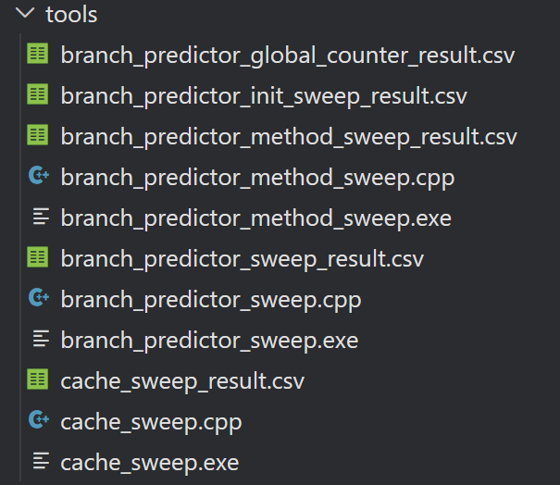
Optimization Experiment
Experiment on cache size, branch prediction……
Ask AI to generate C++ code to read the pattern, and simulate memory or branch prediction unit behavior.
Help us determine direction to improve without writing verilog (and perhaps heavy debugging coming after every modification……)
FAQ : Why not use Python?
C++ is considered faster, and … I’m not the one who have to write it, so why Python?

Slide 14
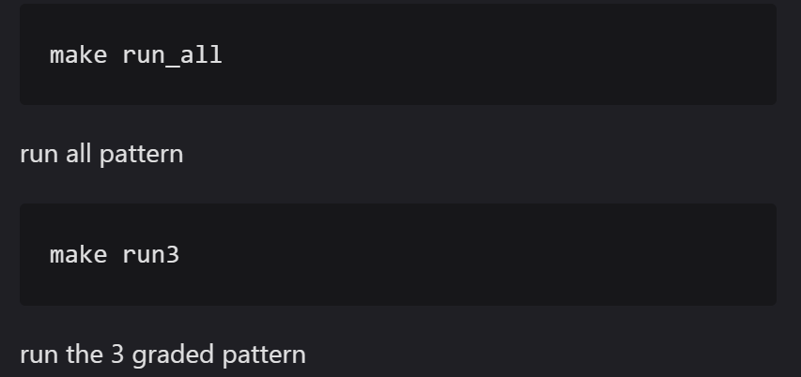
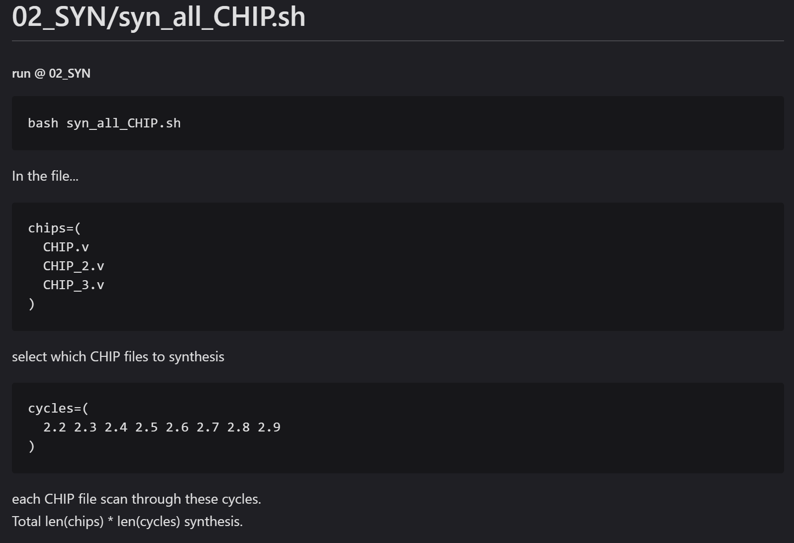
Some helper file
I’m not good at Linux command (recently learned how to stop a background process, “kill -9”! ) and writing Makefile, and I’m lazy opening multiple sessions to run synthesis simultaneously and automatically.
I use AI to generate shell script or modify Makefile, so that I can type less command.
ex.
screenshot from .md for my teammate.

Slide 15
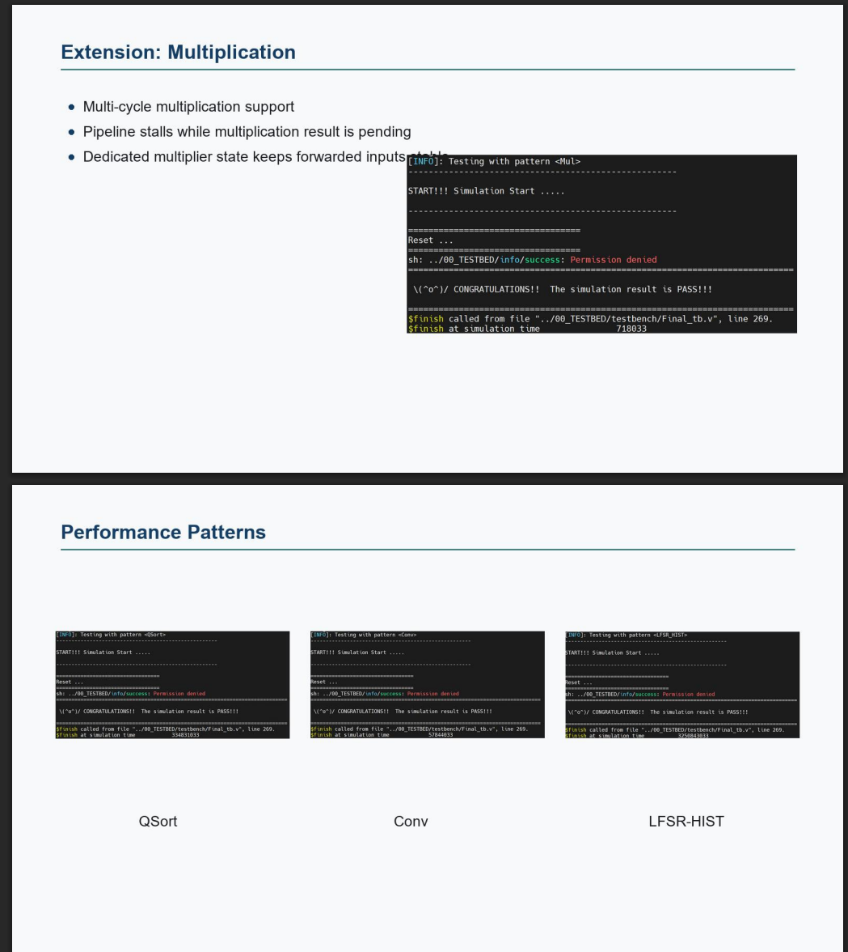
Use AI but fail:
I tried asking AI to generate slide for checkpoint presentation and this presentation.
But give up since its awful layout and terrible aesthetic taste.
Words too small, and pictures are at weird position…
Not even close to this handmaded elaborated slide!!!

Slide 16
Work Assignment Chart
鍾佳聿 | Cache Size Experiment Branch Prediction Experiment Compressed Instruction Extension Multiplication Extension
楊祐宇 | Cache Associativity Experiment Assembly Code Analysis ID stage JAL Resolution Synthesis and Optimization

Slide 17
Thanks

