Slide 1
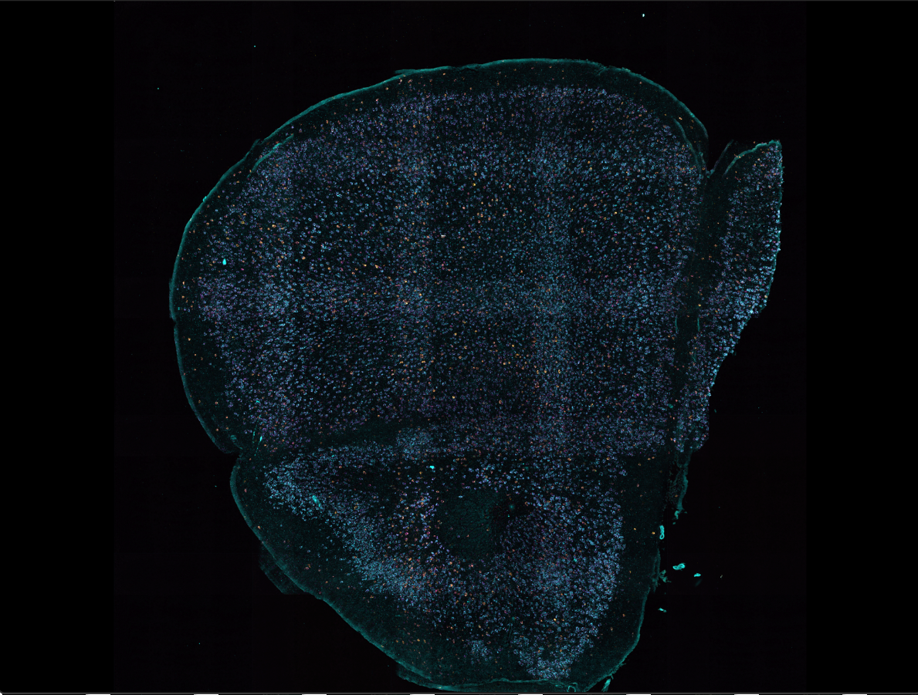
3 FOVs in X
Image Filename: Pos10RGBalignedn2vhyb01.tif
2 FOVs in Y
Using this saved stitched image, you will be able to find the FOV of interest (red box) in the folder “MAX_Pos10_002_001”
For MAX_PosXX_00m_00n:
For PosXX, use the Pos number in for the image filename.
For 00m, use the number of X-axis FOVs from the top right minus 1 (due to zero indexing).
For 00m, use the number of Y-axis FOVs from the top right minus 1 (due to zero indexing).

