Slide 1
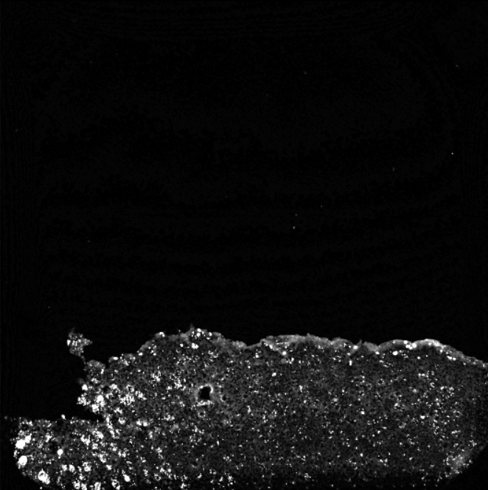
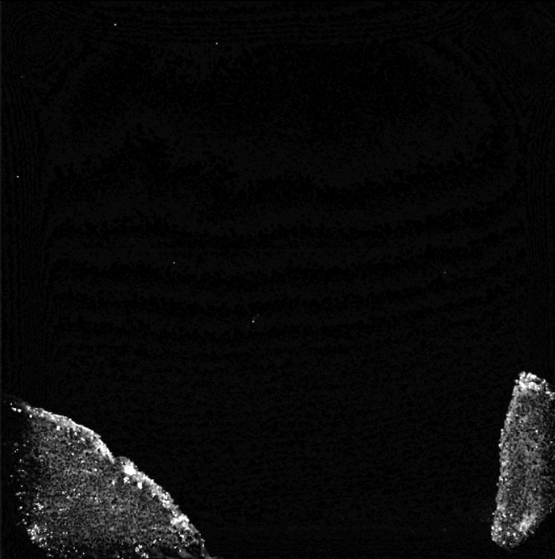
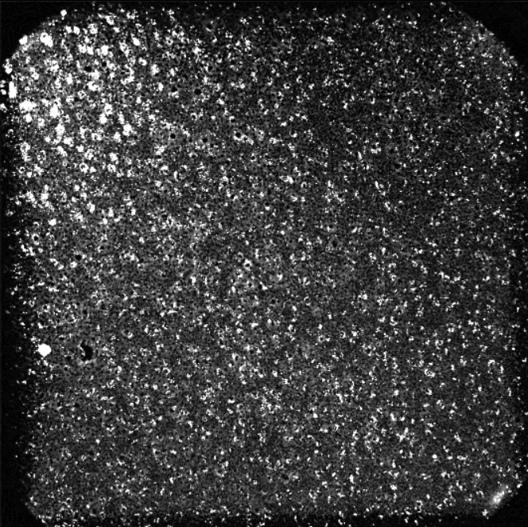
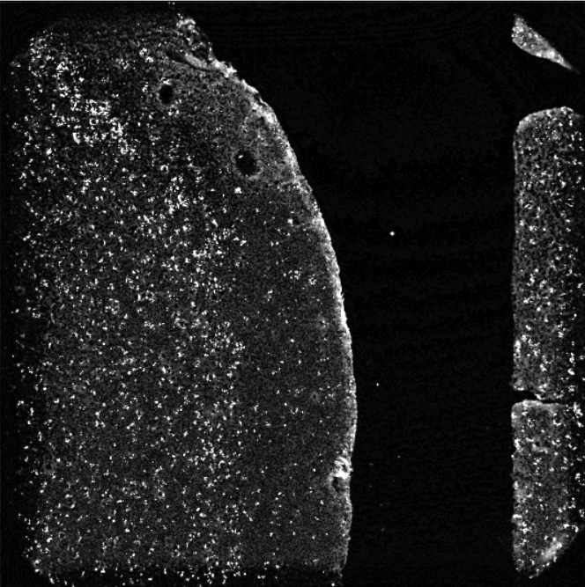
Step 1
Stitching of HYB FOVs to create section image
This will provide cellmasks in the raw HYB
test_align_in_situ_stack.m
Use this script to stitch HYB
test_align_in_situ_generate_stitchedHYB.m
346
Overlap seems variable from section to section
331

Slide 2
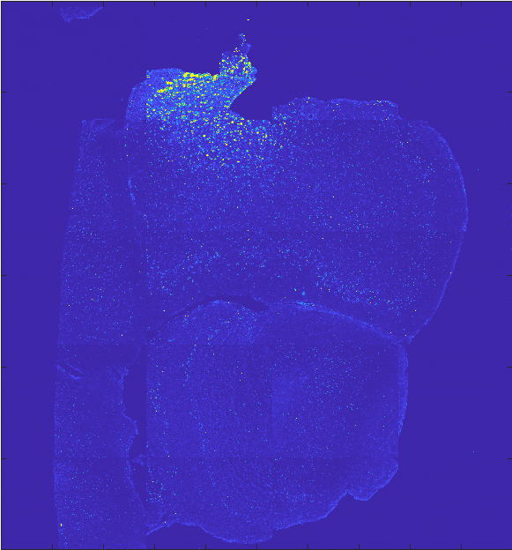
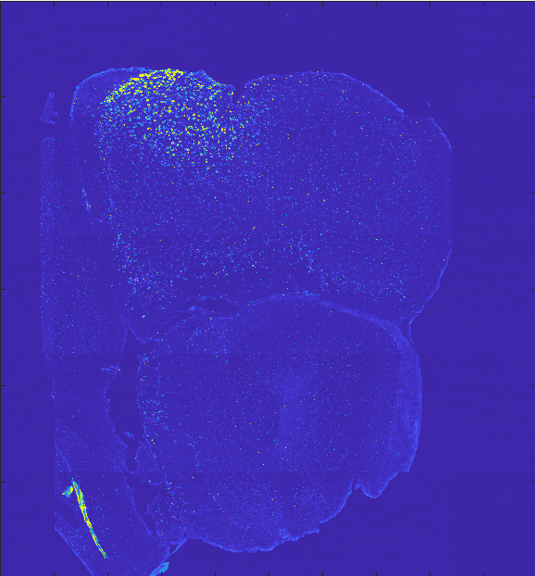
Step 2
Align the raw section images
This will create a 3D volume for the in situ data, as well as cell masks
It seems only a rotation and translation is needed
Try manual ?
Pos 1 section 1 and 2

Slide 3
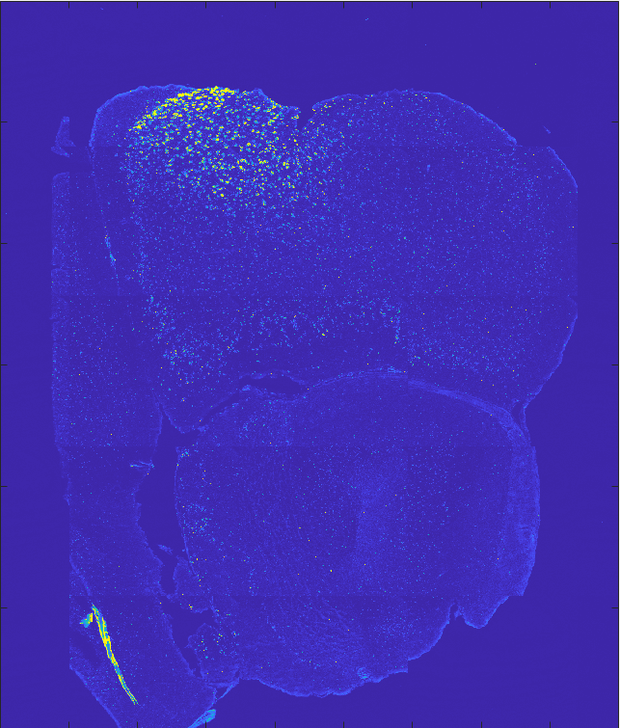
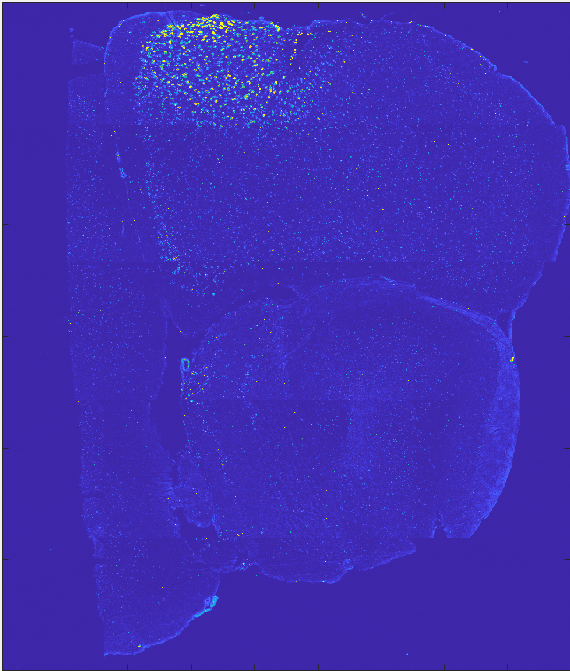
Step 2
Align the raw section images
This will create a 3D volume for the in situ data, as well as cell masks
It seems only a rotation and translation is needed
Try manual ?
Stitch raw image sections
HYB + cell mask
Save all sections in cell array -> section image are a fixed size
For each section output the HYB + cell masks as TIFFs (color)
In photoshop or PPT, manually try to align adjacent sections
only rotation and translation
Find optimal angle and offset (in units of pixels)->save
Pos 1 section 1 and 2

Slide 4
Step 3
Align the in situ volume to in vivo volume
Harris paper
Jerry Chen paper

