Slide 1
TSDV TOSSPEDIA BASIC TRAINNING
NGO THE CHUNG

Slide 2
Project analysis slide 2
TABLE OF CONTENTS
LINUX BASIC COMMANDS
1
2
GIT
3
DOCKER

Slide 3

LINUX BASIC COMMANDS

Slide 4
Project analysis slide 2
1. LINUX BASIC COMMAND
WHAT IS A LINUX COMMAND?
1.1
1.2
HOW TO USE
SHORTCUT IN VIM
1.3

Slide 5

Project analysis slide 10
WHAT IS A LINUX COMMAND
A Linux command is a program or utility that runs on the command line. A command line is an interface that accepts lines of text and processes them into instructions for your computer.
Any graphical user interface (GUI) is just an abstraction of command-line programs. For example, when you close a window by clicking on the “X,” there’s a command running behind that action.
A flag is a way we can pass options to the command you run. Most Linux commands have a help page that we can call with the flag -h. Most of the time, flags are optional.
An argument or parameter is the input we give to a command so it can run properly. In most cases, the argument is a file path, but it can be anything you type in the terminal.
You can invoke flags using hyphens (-) and double hyphens (--), while argument execution depends on the order in which you pass them to the function.

Slide 6
Project analysis slide 10
HOW TO USE
ls:
[ ls ] : list all files and directories.
[ ls -a ] : Adding -a shows you the hidden files also. Hidden files are the files beginning with a dot(.)
[ ls -l ] : gives you various information like permissions, owner of the file, size of the file or directory ( in bytes ), date and time of modification.
cd:
[cd Downloads] : takes you to the home Downloads directory.
[cd ..] : takes you up one directory level.
[cd -] : takes you to the previous directory.
mv:
[mv file1 a_dir] : move file into directory .
[mv oldfile.txt newfile.txt] : rename a file .
[mv -n file1 some_dir] : avoid overwrite an existing file.

Slide 7

Project analysis slide 10
HOW TO USE
rm: rm [OPTION] FILE
[rm file.txt] : remove file.
[rm -rf] : takes you up one directory level.
[ ls -l ] : gives various information like permissions, owner of the file, size of the file or directory ( in bytes ), date and time of modification.
mkdir: mkdir [OPTION] DIRECTORY
create new directories if they do not already exist on the file systems.
cat: cat [OPTION] FILE
[cat –n filename] : to display the contents of a file with each line numbered.
[cat filename] : read file.
[cat > filename] : write to file.

Slide 8
Project analysis slide 10
HOW TO USE
sed: sed [OPTIONS] [SCRIPT] FILE
[sed ‘-s/old_word/new_word/g’ filename ] : Replacing all the occurrence of the pattern in a line.
[sed –n ‘-s/old_word/new_word/p’ filename] : Printing only the replaced lines
grep: grep [OPTION] [PATTERN] FILE
[grep –i “text” filename] : displays lines that contain strings to look for.
[grep –c “text” filename] : display the count of number.
cut: cut [OPTION] FILE
[cut –b 1-3 filename] : To extract the specific bytes.
[cut –d “ “ –f 1 filename] : used then it considered space as a field separator or delimiter.
curl: curl [OPTION] URL
[curl example.com] : print the source code of url.

Slide 9
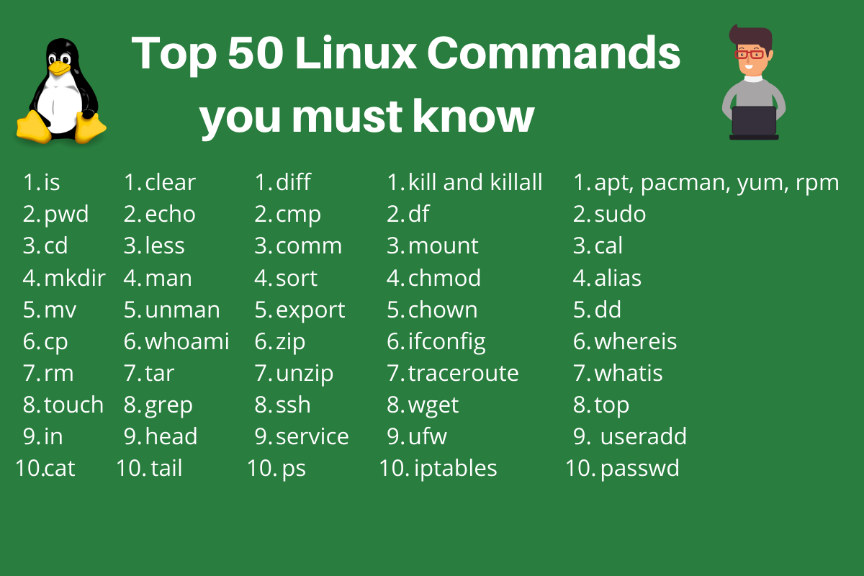
Project analysis slide 10
HOW TO USE

Slide 10

Project analysis slide 10
SHORTCUT IN VIM
Vim is an advanced and highly configurable text editor built to enable efficient text editing. Vim text editor is developed by Bram Moolenaar. It supports most file types and vim editor is also known as a programmer’s editor. We can use with its plugin based on our needs
To install vim on Ubuntu
$ sudo apt-get install vim
To open file in vim editor
$vim file.txt

Slide 11
Project analysis slide 10
SHORTCUT IN VIM
VIM COMMAND
DESCRIPTION
I | Enter insert mode
X or Del | Delete a character
u | Undo changes
yy | Copy a line
dd | Delete a line
p | Paste the content of the buffer
Ctrl + r | Redo changes
Esc + :w | Save changes
Esc + :q! | Force quit Vim discarding all changes
Esc + :wq or Esc + ZZ | Save and quit vim

Slide 12


Slide 13
Project analysis slide 2
2. GIT
WHAT IS GIT?
1.1
WHY GIT?
1.2
1.3
GOAL OF COMMANDS
1.4
HOW TO USE

Slide 14

Project analysis slide 10
WHAT IS GIT?
Git is a distributed version control system. This means that a local clone of the project is a complete version control repository. These fully-functional local repositories make it is easy to work offline or remotely. Developers commit their work locally, and then sync their copy of the repository with the copy on the server. This paradigm differs from centralized version control where clients must synchronize code with a server before creating new versions of code.
Git's flexibility and popularity make it a great choice for any team. Many developers and college graduates already know how to use Git. Git's user community has created many resources to train developers and Git's popularity make it easy to get help when needed. Nearly every development environment has Git support and Git command line tools run on every major operating system.

Slide 15
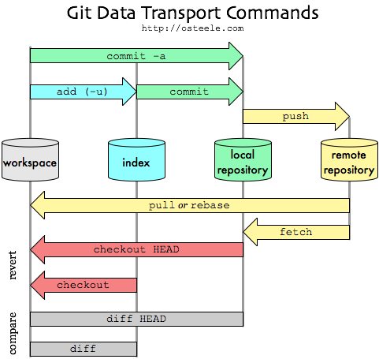
Project analysis slide 10
WHY GIT?
Git has many advantages over earlier systems such as CVS and Subversion
More efficient, better workflow, etc.
See the literature for an extensive list of reasons
Of course, there are always those who disagree
Best competitor: Mercurial
I like Mercurial better
Same concepts, slightly simpler to use
In my (very limited) experience, the Eclipse plugin is easier to install and use
Much less popular than Git

Slide 16
Project analysis slide 10
HOW TO USE
git init will create a new local GIT repository.
$ git init
git clone is used to copy a repository.
$ git clone username@host:/path/to/repository
Conversely, run the following basic command to copy a local repository:
$ git clone /path/to/repository
git add is used to add files to the staging area.
$ git add <temp.txt>
git commit will create a snapshot of the changes and save it to the git directory.
$ git commit –m “Message to go with the commit here”

Slide 17
Project analysis slide 10
git status
HOW TO USE
git config can be used to set user-specific configuration values like email, username, file format, and so on
$ git config --global user.email youremail@example.com
git status displays the list of changed files together with the files that are yet to be staged or committed.
$ git status
git push is used to send local commits to the master branch of the remote repository
$ git push origin <master>
git checkout o switch from one branch to another.
$ git checkout <branch-name>
git remote lets you view all remote repositories
$ git remote –v
To connect the local repository to a remote server
$ git remote add origin <host-or-remoteURL>

Slide 18
Project analysis slide 10
git status
HOW TO USE
git branch will list, create, or delete branches:
$ git branch
If you want to delete a branch
$ git branch –d <branch-name>
git pull merges all the changes present in the remote repository to the local working directory
$ git pull
git merge is used to merge a branch into the active one
$ git merge <branch-name>
git diff lists down conflicts. In order to view conflicts against the base file
$ git diff
git log is used to see the repository’s history by listing certain commit’s details
git reset command will reset the index and the working directory to the last git commit’s state
$ git reset --hard HEAD

Slide 19
Project analysis slide 10
git status
HOW TO USE
git stash will temporarily save the changes that are not ready to be committed
$ git stash
git show used to view information about any git object
$ git show
git fetch allows users to fetch all objects from the remote repository
$ git fetch origin
git rebase is used to apply certain changes from one branch to another
$ git rebase master

Slide 20

DOCKER

Slide 21

Project analysis slide 10
WHAT IS DOCKER
Docker is an open source containerization platform. It enables developers to package applications into containers - standardized executable components combining application source code with the operating system (OS) libraries and dependencies required to run that code in any environment

Slide 22
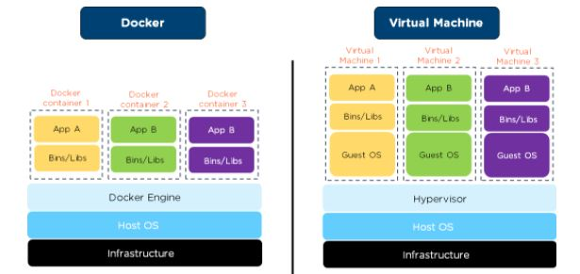
Project analysis slide 10
COMPARE DOCKER & VIRTUAL MACHINE
- Infrastructure : is laptop and delicate server
- Host Operating System : able macOS, Linux, Window
- Hypervisor: manage 1 or more virtual machines
- Guest OS : operating system virtual
- Docker Engine : service active in server
- Bins / Libs : files and necessary library
- App (application – service): source code

Slide 23
Project analysis slide 5
DIFFERENT DOCKER & VIRTUAL MACHINE
DOCKER
VIRTUAL MACHINE
OS level process isolation
Each container can share OS
Boots in seconds
Containers are lightweight (KBs/MBs)
Pre-built docker containers are easily available
Containers can be created in seconds
Less resource usage
Hardware-level process isolation
Each VM has a separate OS
Boots in minutes
VMs are of few GBs
Ready-made VMs are difficult to find
Creating VM takes a relatively longer time
More resource usage

Slide 24
Project analysis slide 5
WHAT CAN I USE DOCKER FOR?
Fast, consistent delivery of your applications
Responsive deployment and scaling
Running more workloads on the same hardware

Slide 25
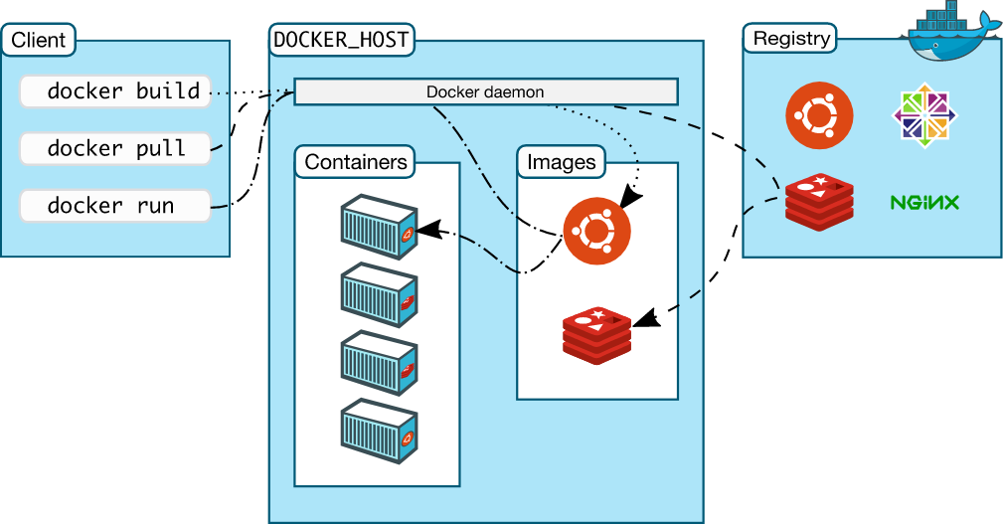
Project analysis slide 5
DOCKER ARCHITECTURE
The Docker daemon: listen request API Docker, manage object such image, container, networks, and volumes.. also communicate with other daemons to manage Docker services.
The Docker client: users interact with Docker.(docker build, pull, run). Docker client can communicate with more than one daemon.
Docker registries: stores Docker images, can look for images on Docker Hub

Slide 26
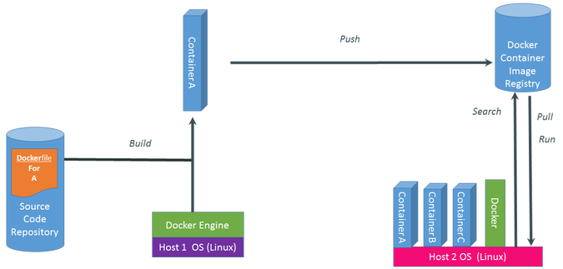
Project analysis slide 6
DOCKER PROCESS

Slide 27
Project analysis slide 7
Docker Images: is the result of running Docker File, contains source code, libraries, dependencies, tools and necessary files to run the application
Docker Container: is running instance of aa Docker Image , is runtime environment, able run standalone apply and allows to run the application quickly
Docker Volumes: are the preferred mechanism for persisting data generated by and used by Docker containers
Docker Network: Docker containers and services can connect them together
DOCKER OBJECT MAIN

Slide 28
Project analysis slide 7
Pull image from Docker Hub
$ docker pull {image_name}
Show list image is running
$ docker images
Remove image
$ docker rmi {image_id/name}
Show list container
$ docker ps $ docker ps -a
Remove container
$ docker rm -f {container_id/name}
Rename container
$ docker rename {old_container_name} {new_container_name}
DOCKER COMMAND

Slide 29
Project analysis slide 7
Start a container
$ docker start {new_container_name}
Create and start a container with custom port
$ docker run --name {container_name} -p {host_port}: {container_port} {image_name}
Show container changes
$ docker diff {container_name}
Commit container and image changes
$ docker commit -m "message" {container_name} {image_name}
Build an image from a dockerfile
$ docker build -t {container_name} .
DOCKER COMMAND

Slide 30
Project analysis slide 7
DOCKERFILE
DOCKER COMMAND
FROM: base images purpose build new images
WORKDIR: define directory for CMD
VOLUME: allow access / link directory with container and host machine
RUN: used when want execute command in progress build image
COPY: Copy file from host machine to docker image. Can used URL file need copy
ENTRYPOINT: define commands will first run when container run.
CMD: define commands default when haven't ENTRYPOINT and Extra COMMANDS

Slide 31
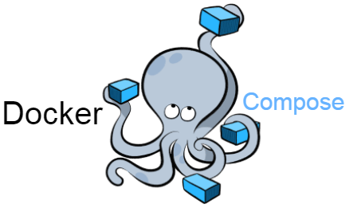
Project analysis slide 5
DOCKER COMPOSE
Compose is a tool for defining and running multi-container Docker applications.
With compose, you use a YAML file to configure the application’s services.
Using Compose is basically a three-step process:
1. Define app’s environment with a Dockerfile so it can be reproduced anywhere.
2. Define the services that make up app in docker-compose.yml so they can be run together in an isolated environment.
3. Run docker compose up and the Docker command starts and runs entire app. You can alternatively run docker-compose up using the docker-compose binary.

Slide 32
Project analysis slide 7
Start defined components in docker-compose.yml
$ docker-compose up
$ docker-compose up
Stop and remove components are created by docker-compose up
$ docker-compose down
Show services's log
$ docker-compose log [service]
DOCKER COMPOSE
COMMAND

Slide 33
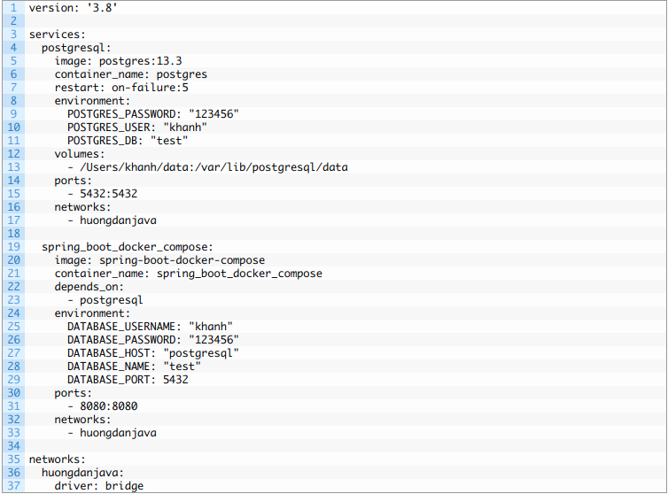
Project analysis slide 7
DOCKER-COMPOSE.YML

Slide 34
Thank You

