Slide 1
ShoutOut: know who is around you and connect to them.
Michael Chung
chungmojo@gmail.com
https://www.linkedin.com/in/chungmojo/
917-680-6870
Santa Clara, CA
Sept. 2018

Slide 2
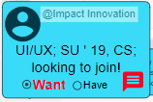


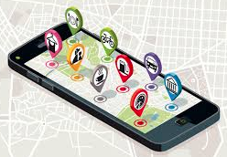



Value proposition and UI overview
When we are at a location or event, or are unable to attend:
Connect and message others.
See a bulletin board with announcements or postings.
Share slides and pictures, e.g. of the speakers’ presentations.
Engage with location-group (x/personal) ads and pinned tasks.
Earn tokens based – participation and ads.

Slide 3
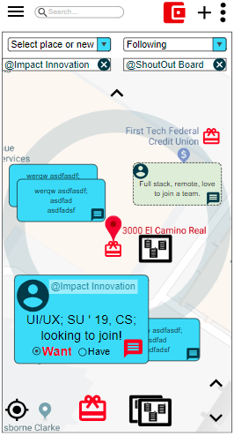
Architectural design
Location is hard!
Several fails: YikYak, Square, etc.
The innovations:
Use the APIs of --- Google maps and Google Places; Meetups; Twitter; Yelp --- and AI to automatically offer events to check into or follow.
To determine the location of the users --- we will emulate the Google map experience --- users can have GPS on or not and manually select their location or event of interest.
This information is used to pull data from the APIs so that, the users can more easily select the event or place and check-in or follow.

Slide 4
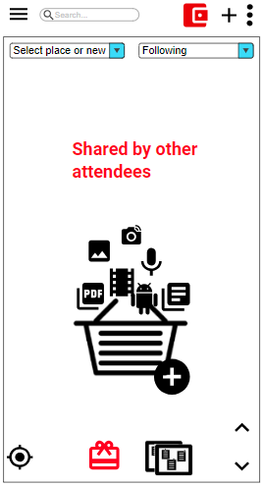

ShoutOut User Experience
No registration; no personal information; group and location based marketing; earn tokens.
First time user opens app
Sees the Landing Page (LP) with bubbles of people there.
User can zoom to see and read the text in the bubbles.
Can create profile – no personal information. Only 3 to 5 descriptors.
Quickly show: Have and Want.
User can select a bubble and message it.
The has shared things -

Slide 5
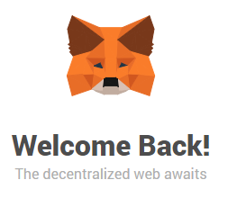
Tokenomics – POC with Brave and MetaMask
Basic Attention Token and Brave Browser.
https://github.com/brave-intl
https://github.com/brave-intl/basic-attention-token-crowdsale
info@basicattentiontoken.org
http://slack.basicattentiontoken.org/
https://coingate.com/accept/bat/basic-attention-token
“To get started with accepting Basic Attention Token as well as Bitcoin, Litecoin and other coins, first, sign up with CoinGate. Then, create API credentials if you are planning to use our e-commerce plugins or the API; if not, go ahead and create your first payment button.

