Slide 1

You can see who and what is around you; communicate with them; and earn tokens from the location targeting advertisers.
A personal virtual bulletin board for locations.
Know who and what is around you at anyplace and connect with them.
HyperLocal Location marketing and awarding tokens to users.
Michael Chung
chungmojo@gmail.com
Santa Clara.
Sept 2018
TM

Slide 2
Technologies/Skills needed for the Hackathon
Blockchain and protocol implementation
Front application, i.e. one of: native, or hybrid or web application.
Google Map and Places API; or another map/geo.
AR: To overlay images on the live streaming scene at the location.
Backend.
Founder is Michael Chung.
(Not an engineer; “I design use cases and business models” https://www.linkedin.com/in/chungmojo/)

Slide 3
The ShoutOut in a nutshell
You can see who and what is around you; communicate with them; and earn tokens from the location targeting advertisers.
Users will allow themselves to be “found” at events, or even as they move around in the public.
The user will hold up her phone and scan an event, she will see who and what is around her and be able to engage.
Users will use the app to see who and what is around them, and their approx. direction and distance. (Not exactly, and approximately.)
Users will be able to directly message other users of interest.
Users can share a common virtual bulletin board for that place to share general.
Location based target marketing. The users will earn points (ala Waze) and tokens.

Slide 4
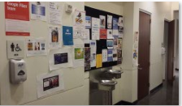
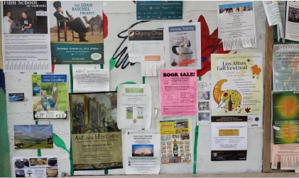
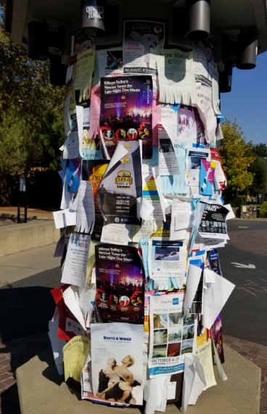
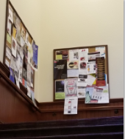
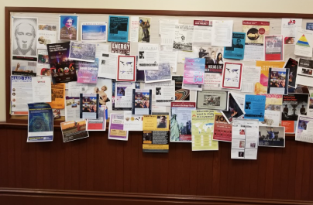
We need a digital version of bulletin boards

Slide 5
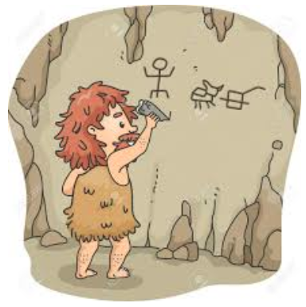

The bulletin board technology has evolved very slowly…
to
The State-of-the-Art.

Slide 6
ShoutOut tokenomics model helps to solve one of the “BIGGEST” challenge of the Blockchain space ---- i.e. the practical use cases, or is a way for earning tokens while doing needed and practical activities.
A location-social app for daily use, combined with the benefits of the tokenization and tokenomics.
Extending the Blockchain marketing (Brave, BitClave, etc.) to hyperlocal marketing and groups.

Slide 7
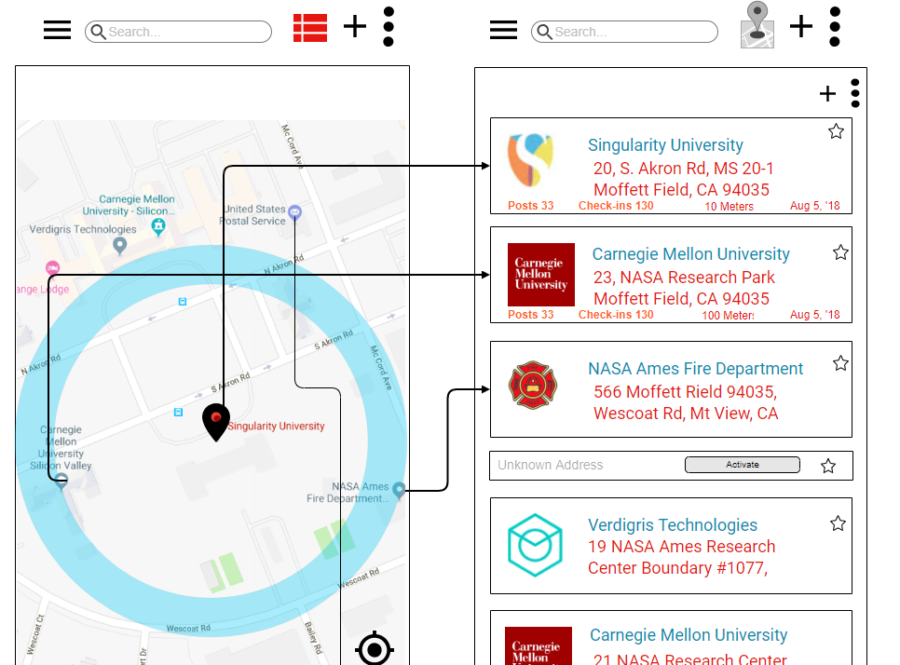
User opens app or goes to web site.
Slack, fb

Slide 8
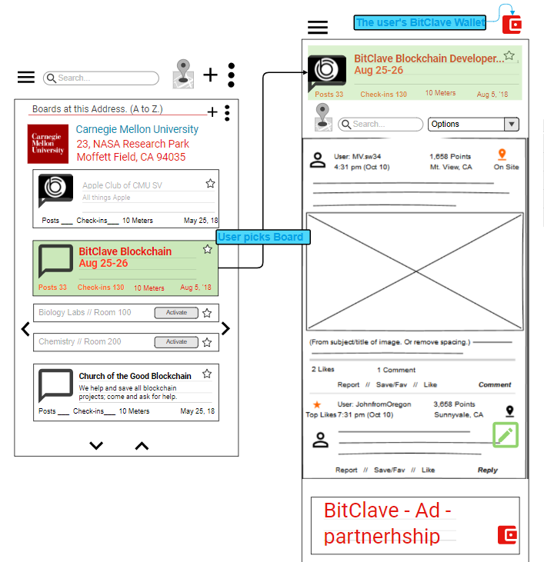
Example of: Marketing partnership with such as Brave (BATokens) and BitClave ADBits + CAT tokens.
BitClave ADBits + CAT tokens.
Slack, fb

Slide 9
Brave/BitClave
 | Location & Group Based ShoutOut
Location is optional | Location is very valuable
The individual | Group profile/preferences
Individual profile & preferences | The individuals BASE IDs > Group Profile and Preferences.
Individual preferences | Preferences of the group
Personal | Anonymized as a group!
Individually benefits. | Both group and the members, based on their activities.
Individually | “Group data sets”: the number of users at the location; typical profile; GDPR complments.
Location Based Advertising is HUGE.
$30 Billion in 2020.
Opportunity to be Leader: Blockchain space is not yet targeting Location or Groups.
~~~~~~~~
Solving the “BIGGEST” challenges of the Blockchain space:
Combining daily use application/ use case with the benefits of the tokenization and tokenomics.

