Slide 1

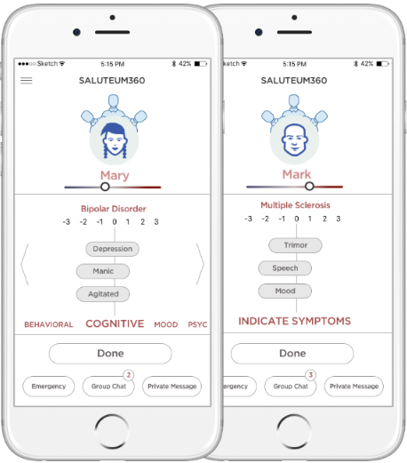
Using the power of social network for new data

Slide 2
waveformanalytics.com
Current Team: Data/ML expert, Researcher
Looking for Teammates/Cofounders:
Healthcare professionals – PhDs, Psychiatrist
Mental Health professionals
Developers
Contact: chungmvp@gmail.com

Slide 3
The IDEA
Trusted Social Network
New data source
Power of the Community / Crowd
New Insights

Slide 4
Trusted Social Network
USE CASES
Mental Health patients and at risk people
Physical degenerative illness – e.g., Alzheimer
Senior citizens – at home, by their concerned neighbors
Juveniles – behavioral issues

Slide 5
Trusted Social Network – New Social Data
The Problem Addressed – Current Treatments
Burden is on Doctors and professionals only
Controlled settings in the clinic / office
Have limited views or looks at the subject
Professionals are Costly

Slide 6
Trusted Social Network – A New Channel
The Opportunity and Benefits
Friends and Family are asked to participate
Daily and normal environment
Unlimited looks at the subject / patient
“Zero costs”

Slide 7
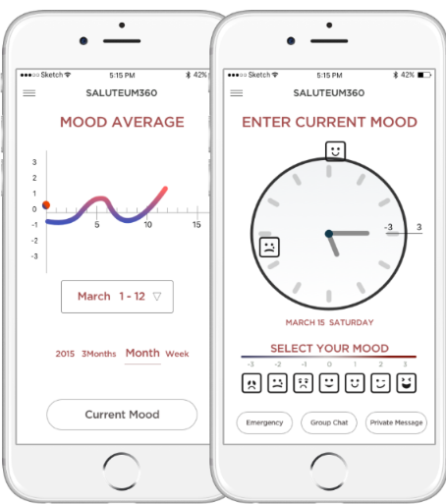
Prototype Example:
BIPOLAR MOOD/
EPISODE
SELF - MONITORING

Slide 8
Social Example:
TOPIC SPECIFIC
Mental Health
Physical
SOCIAL

Slide 9
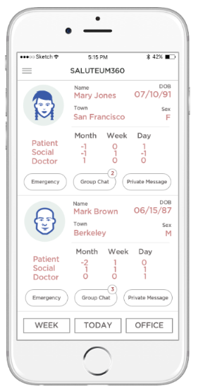
Doctor’s dashboard/View
Monitor and Observe
Connect to the
Social network via
Chat, get alerts, etc.

