Slide 1
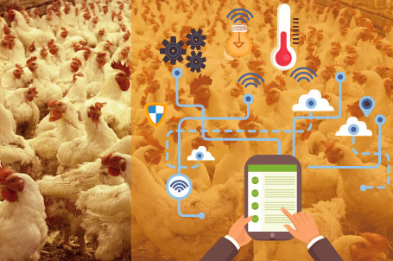
POULTRY FARM
Leader : Chung Nguyen Ngoc
Member: Chuong Le Van
Vu Nguyen Son
Phat Nguyen Cu
G3

Slide 2
Content
Introduction
1.1 Current situation
1.2 Solutions
Poultry Farm
2.1 Overall System
2.2 Components and Functions
Demo
The End

Slide 3
1. Introduction
1.1 Current situation
Currently Vietnamese farmers are still raising poultry in a traditional way. Therefore, the productivity of products is not high. The causes can be mentioned are: Environmental factors, epidemics, temperature ....
2.2 Solution
Poultry Farm as an appropriate solution for poultry households. It will help reduce time, control growth and development in poultry production.
Poultry Farm is the application of science and technology in agriculture, It includes feeding device, sensors, timer mode, manual mode and humidity temperature warning for growth in breeding.

Slide 4
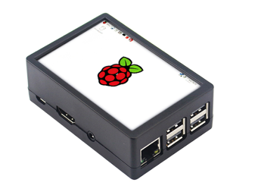
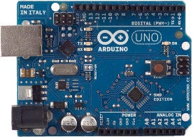

2. Poultry Farm
2.1 Overall System
Worker
DB
MQTT API
Device

Slide 5
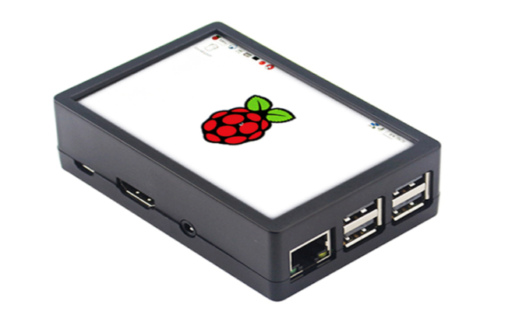

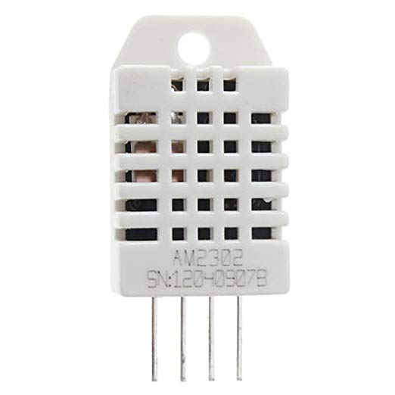
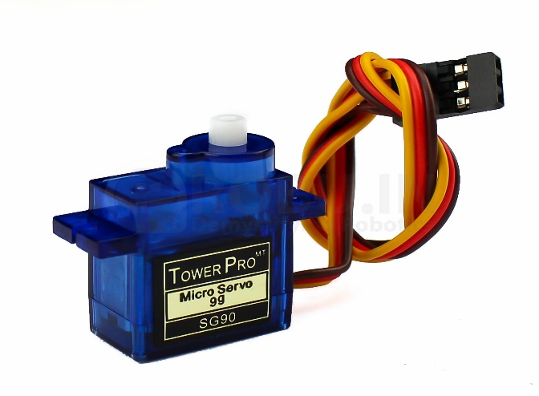
2. Poultry Farm
2.2 Components
Rasperry Pi
Arduino Uno
DHT22
Servo

Slide 6
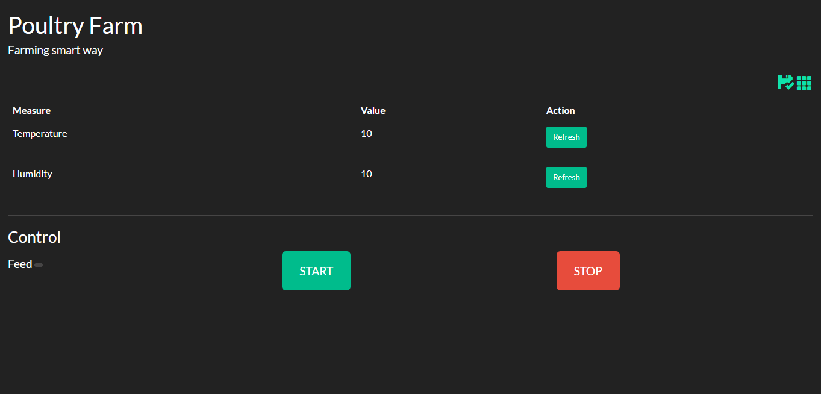
2. Poultry Farm
2.2 Components and Function

Slide 7
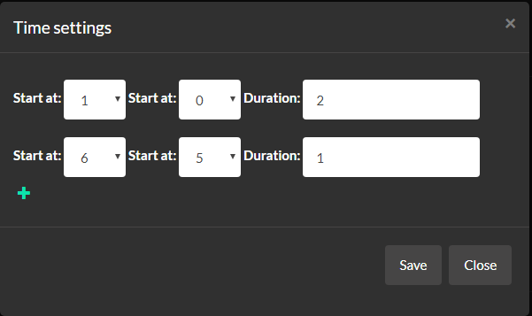
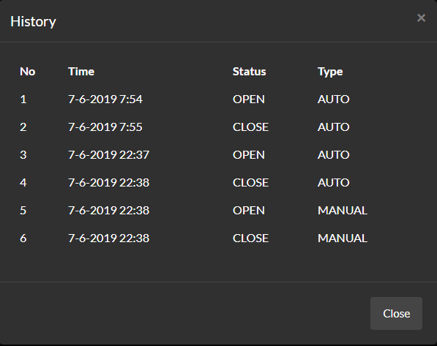
2. Poultry Farm
2.2 Components and Function

Slide 8
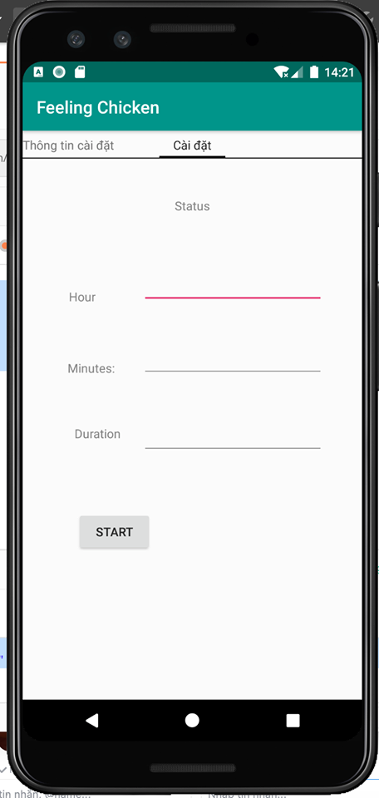
2. Poultry Farm
2.2 Components and Function

Slide 9
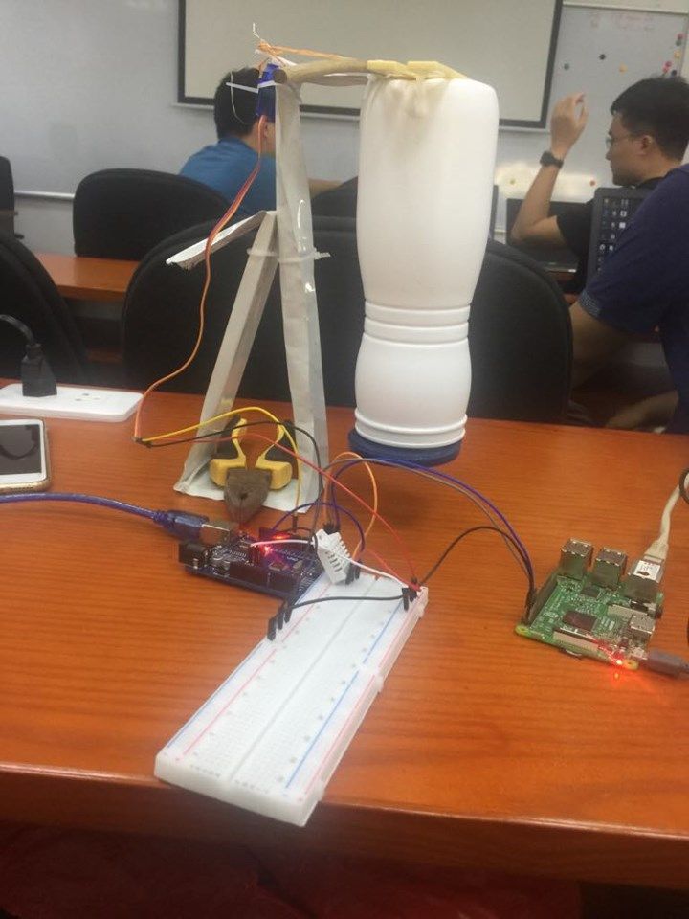
3. Demo

Slide 10
THANKS FOR YOUR LISTEN

