Slide 1
Car plate number detection and recognition
Nguyễn Ngọc Chung
Đặng Phúc Nghĩa
Nguyễn tuấn Tùng

Slide 2
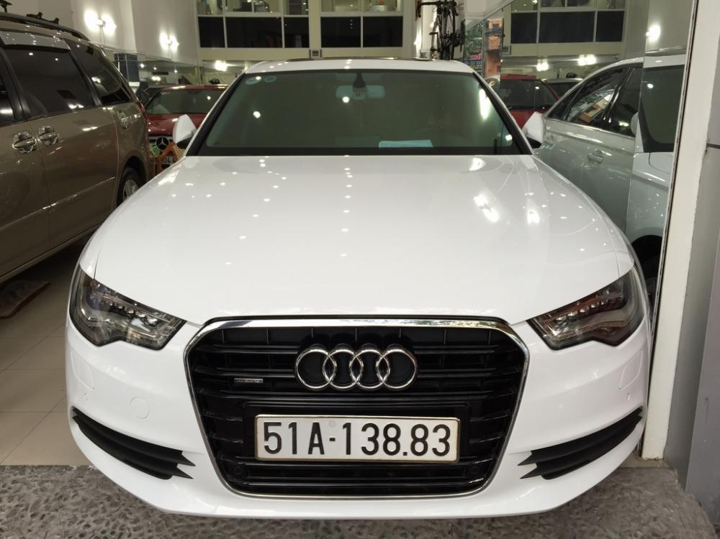
Problem to resolve
51A13883

Slide 3
Work flow
Detection
Edge detection
Dilation
Try hard
Repeat the detection step
Recognize character and number
Using Correlation coefficient
Erosion
Fill hole
Get the region

Slide 4
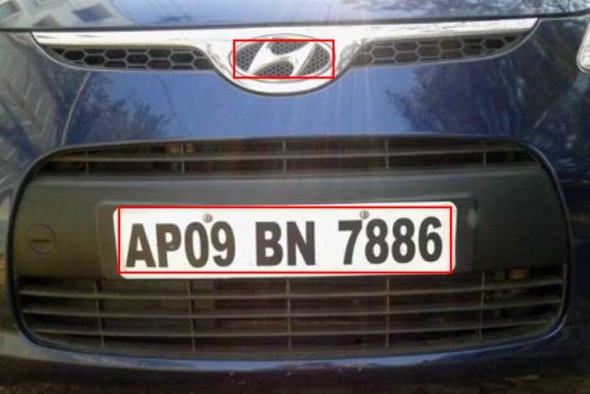
The detection phase
This phase we need to determine which region in the image include the number plate
The largest region → How to get that

Slide 5
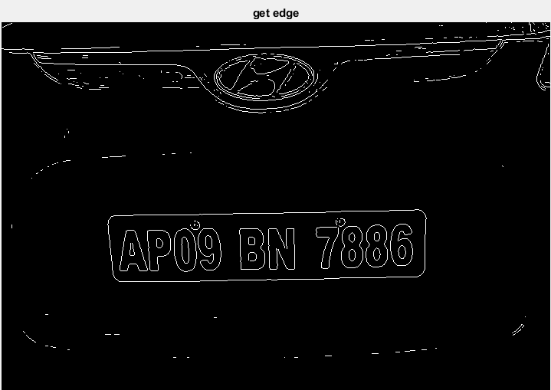
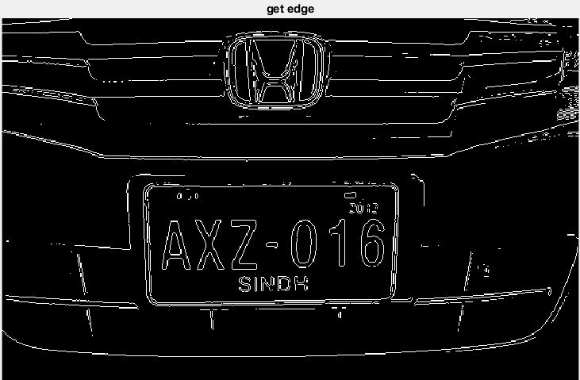
Get edge with sobel

Slide 6
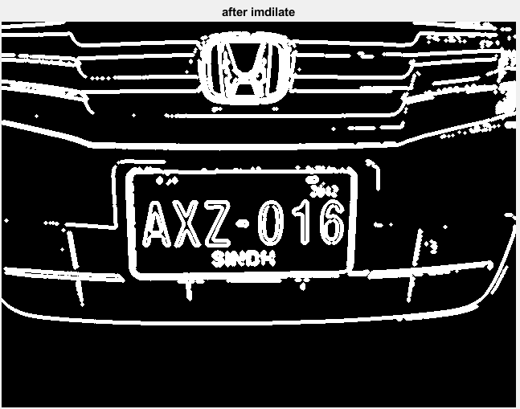
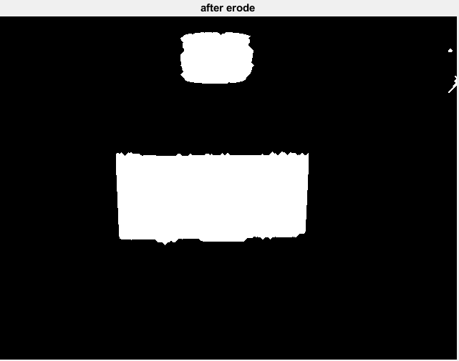
Dilation & Fill & Erosion

Slide 7
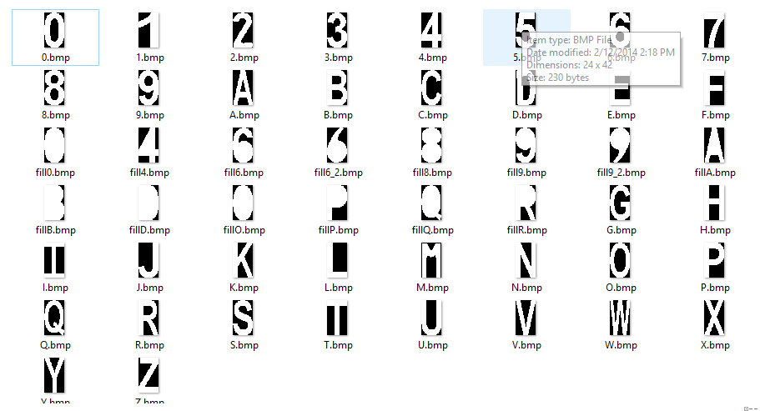
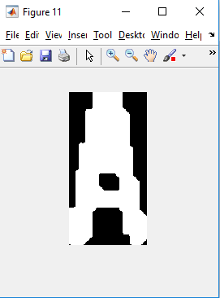
Recognition
Using Correlation coefficient

