Slide 1

Stringee
Communication platform for Voice, Video, Messaging

Slide 2
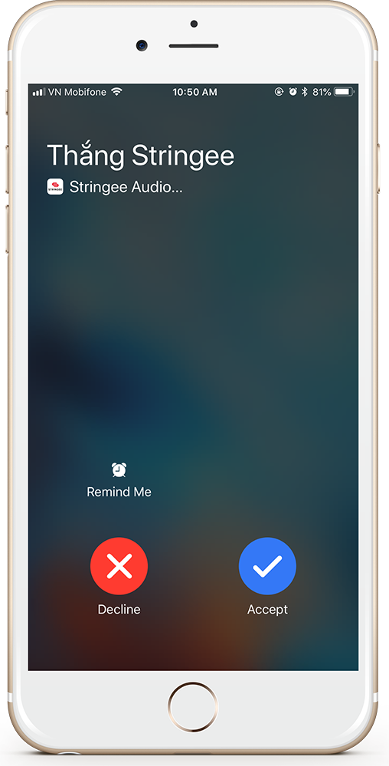
#1 Stringee
Overview
Stringee is a communication platform which provides APIs that help developers, businesses build Voice, Video, Messaging into their apps (Web apps and mobile apps).
Stringee Call API enables apps to make phone calls:
app-to-app (voice/video)
app-to-phone
phone-to-app
phone-to-phone (via masked phone number)
Automate voice alerts
IVR
...

Slide 3

#1 Stringee
Overview
Stringee Video Conference API enables apps to make a video conference, online meetings, online classes…
Supports recording.
Supports iOS, Android, Web và REST API for backend server.

Slide 4
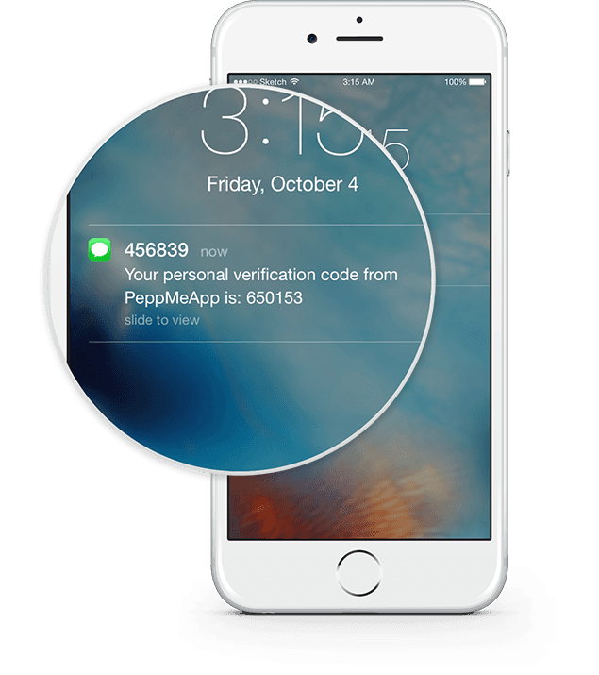
#1 Stringee
Overview
Stringee SMS API enables apps to programmatically send/receive SMS:
Verification SMS
SMS marketing, SMS Brand Name
…

Slide 5
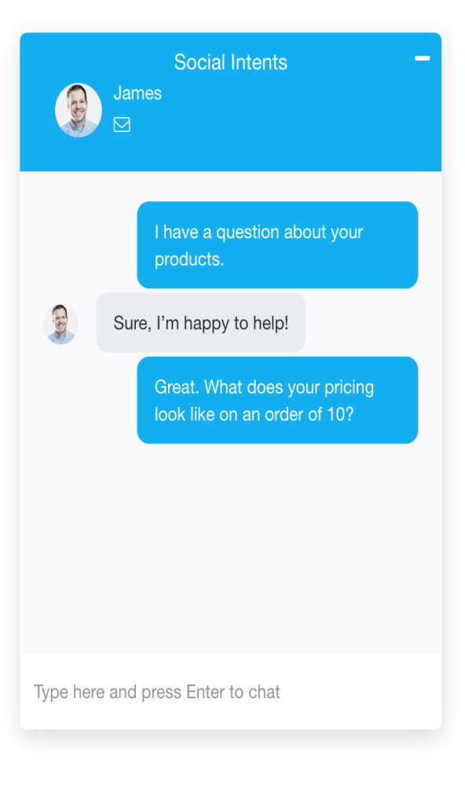
#1 Stringee
Overview
Stringee Chat API enables apps to send/receive in-app messages
Send/receive text, image, location, file, contact...
Chat bot
…

Slide 6

#2 Profile
Stringee profile
Stringee has many big customers in Vietnam such as: Viettel, VOV, Mobifone, MISA ,Mediamart, PVI, Blacasa, VayMuon,...
Stringee has (per day):
More than 1 million call minutes
More than 700 thousands calls
More than 800 thousands active users
More than 2000 concurrent calls

Slide 7
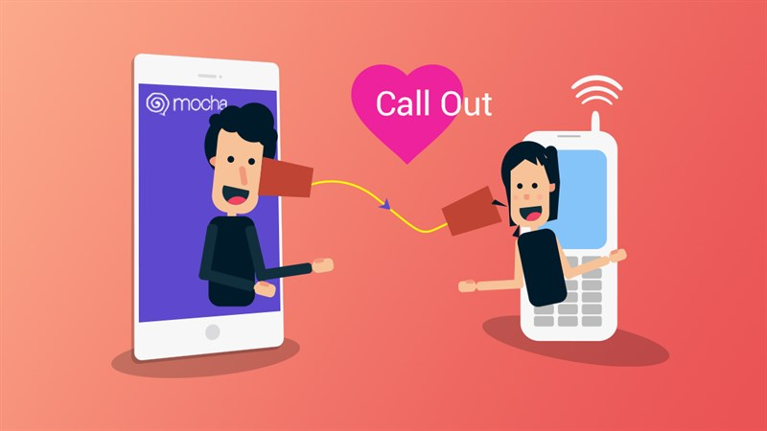
#3 USE CASES
Media & Entertainment
Messaging apps, dating apps…
Customers: Mocha Viettel (https://mocha.com.vn/), …

Slide 8

#3 USE CASES
Customer service
Cusomer support via video call, Contact center…
Customers: Mobifone clound contact center (https://3c.mobifone.vn/), Misa support app (http://www.misa.com.vn/)...

Slide 9

#3 USE CASES
Insurance
Video appraisal
Customers: PVI, Viettinbank…

Slide 10
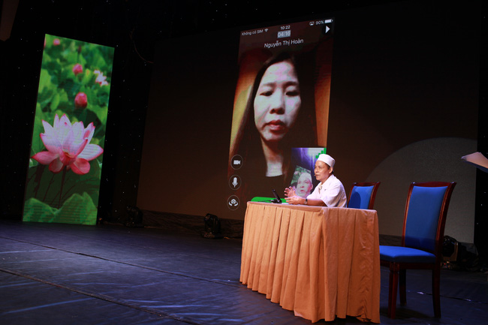
#3 USE CASES
Healthcare
Online doctor consultation
Customers: VOV (https://vovbacsi24.com/)...

Slide 11

#3 USE CASES
Online education
Create online classes

Slide 12
#4 Technique
Main flows
Make call from client: app-to-app
Make call from client: app-to-phone
Inbound call: phone-to-app
Video conference

Slide 13
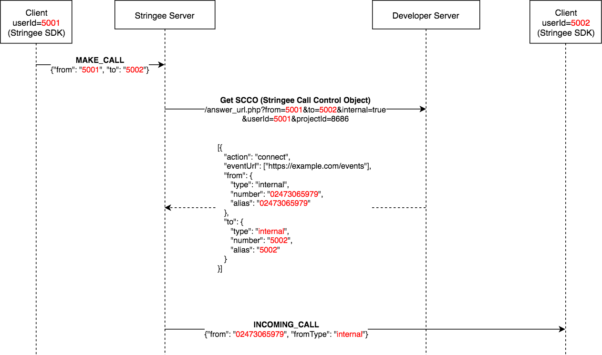
Make call from client: app-to-app

Slide 14
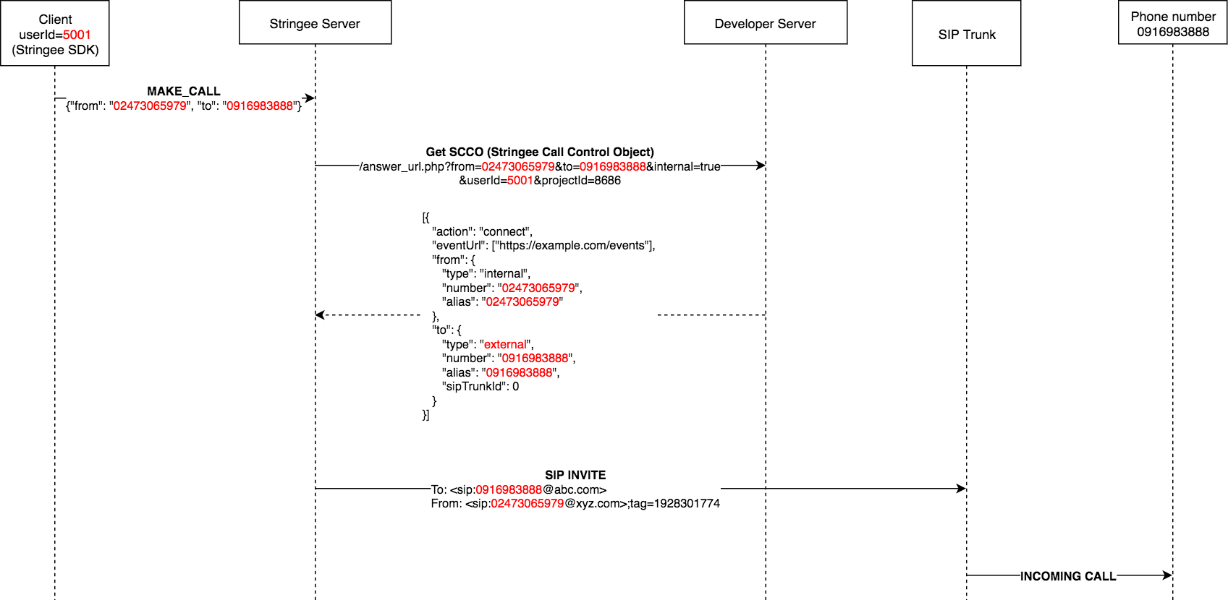
Make call from client: app-to-phone

Slide 15
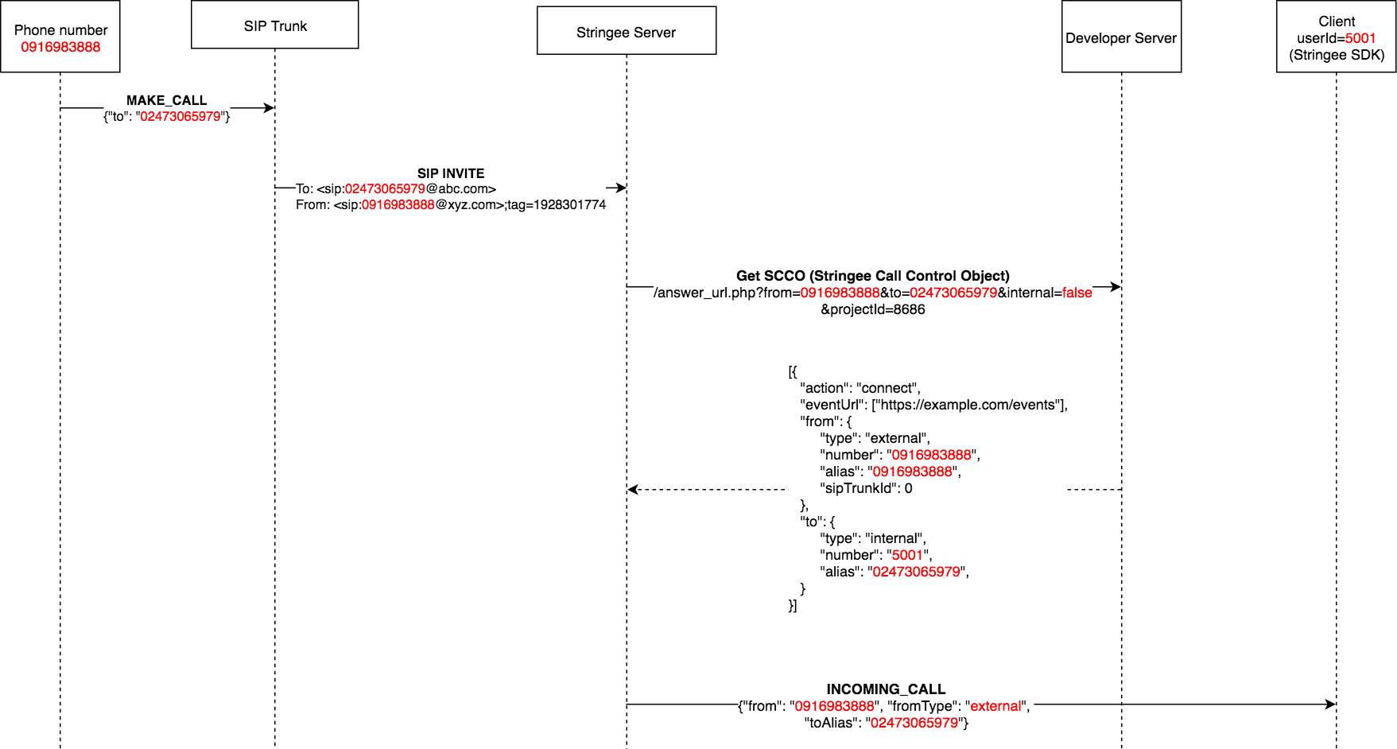
Inbound call: phone-to-app

Slide 16
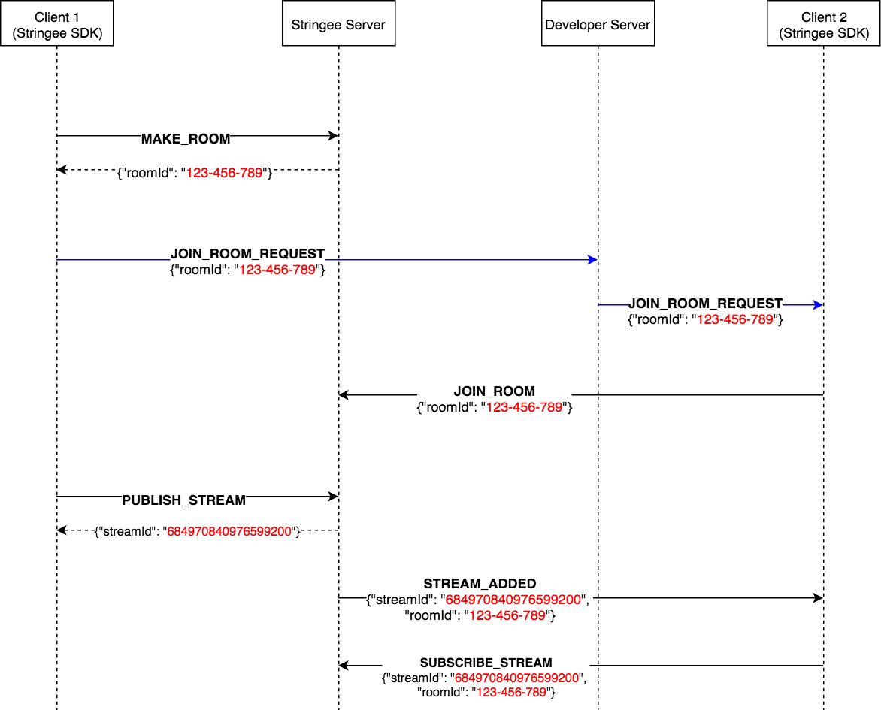
Video conference

Slide 17
#4 Technique
Capacity & Perfomance
Dell R220 (Intel(R) Xeon(R) CPU E3-1220 v3 @ 3.10GHz - 4 cores):
30MB / call
Opus <-> G711 (transcoding): 120 concurrent calls
Opus <-> Opus: 1500 concurrent calls

Slide 18











#5: Customers

Slide 19
#7 Năng lực
Many thanks for your attention

