Slide 1
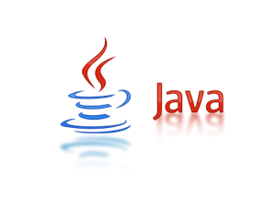


Intern: Chung Phat Tai
Mentor: Bach Chan Minh
RESTFUL API SERVICE
TMA Solutions
www.tmasolutions.com

Slide 2
INDUSTRY INTERNSHIP
Contents:
Introduce Restful API Service
Server side with Spring Boot framework
Client side with Angular 7
References
TMA Solutions
www.tmasolutions.com

Slide 3
INDUSTRY INTERNSHIP
Describe my project
I received a request from my mentor about building a web to management film list (with GET, POST, PUT, DELETE methods).
Frameworks are used:
Server side: Spring boot 2.1.4
Client side: Angular 7
TMA Solutions
www.tmasolutions.com

Slide 4
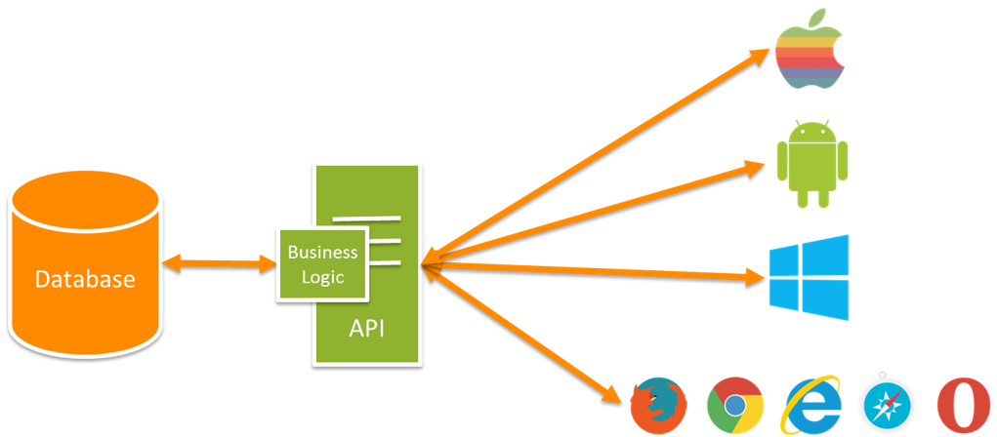
INDUSTRY INTERNSHIP
What is RESTful API?
TMA Solutions
www.tmasolutions.com

Slide 5
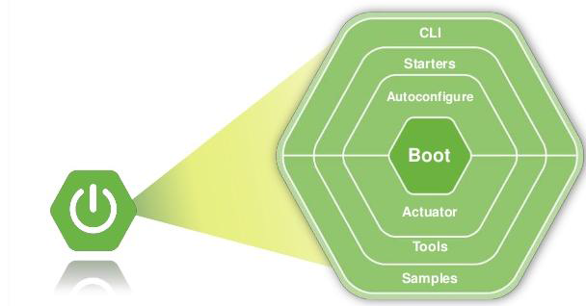
SERVER SIDE
What is Spring Boot?
Spring Boot provides a simpler and faster way to set up, configure, and run both simple and web-based applications.
Advantages:
Easy to understand and develop spring applications
Increases productivity
Reduces the development time
TMA Solutions
www.tmasolutions.com

Slide 6


SERVER SIDE
Why Spring Boot?
Auto
Configurator
Embed
Server
Container
Use of POJO
AOP
support
Why Spring Boot?
Open
Source
Lightweight
& Fast
TMA Solutions
www.tmasolutions.com

Slide 7
SERVER SIDE
Structure
Structure:
TMA Solutions
www.tmasolutions.com

Slide 8
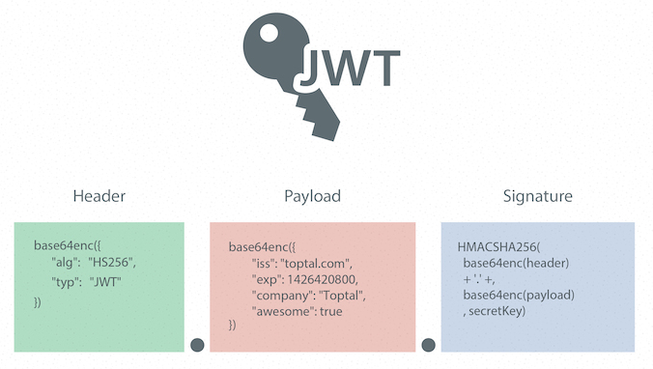
SERVER SIDE
Spring Security with JWT
What is JWT?
JWT (JSON Web Token) is a JSON object that is defined in RFC 7519 as a safe way to represent a set of information between two parties.
Simply put, a JWT is just a string with the following format:
header.payload.signature
TMA Solutions
www.tmasolutions.com

Slide 9
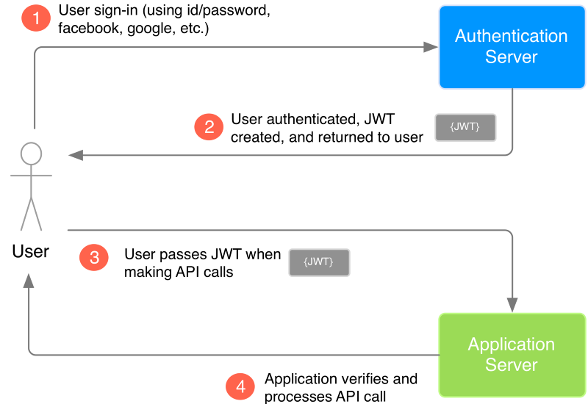
SERVER SIDE
Spring Security with JWT
How does it work?
1. The user login into authentication server
2. The authentication server then creates the JWT and sends it to the user
3. When the user makes API calls to the application, the user passes the JWT along with the API call
4. Application Server before executing the command called from the User side, will verify the posted JWT. If OK, continue executing the called command.
TMA Solutions
www.tmasolutions.com

Slide 10
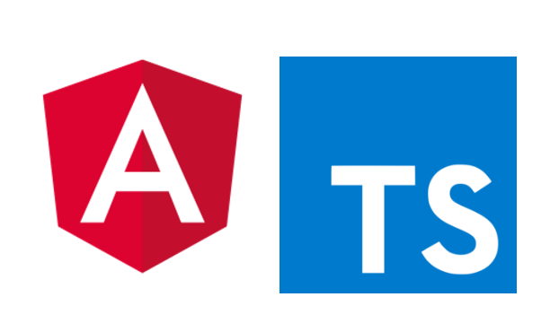
CLIENT SIDE
Introduction Angular
What is Angular?
Angular is a framework for building client applications in HTML,CSS and JavaScript/TypeScript.
Benefits of using Angular:
Gives our application a clean structure
Modular development
Two-way data-binding
Great for SPA (Single-Page Applications)
TMA Solutions
www.tmasolutions.com

Slide 11
Spring Framework
References
https://vi.wikipedia.org/wiki/Spring_Framework
https://spring.io/projects/spring-framework
https://github.com/spring-projects/spring-boot
https://jwt.io/
https://angular.io/
TMA Solutions
www.tmasolutions.com

Slide 12
THANKS FOR LISTENING !
TMA Solutions
www.tmasolutions.com

