Slide 1










WASTE FREE LIVING
Sean Hung, Tiffany Filawo, Raph Chung, Roma Paranjpe

Slide 2





People are busy and do not have time to manage what is in their kitchen.
Lack of organization leads to unnecessary spending and excess in the kitchen.
Leads to major amounts of food waste.
PROBLEM

Slide 3




FoodForAll
Takes food thrown out by restaurants, users order food not sold and buy it for a reduced price.
EXISTING SOLUTIONS
FlashFood
Targets grocery stores that throw out food that is too close to "best before date" by selling it to customers.
Olio
Connects users based on location and allows them to upload a picture of food items that are unopened to see if anyone else would like it.

Slide 4

















OUR SOLUTION: STOCKSMART
COMPETITOR: OLIO
User uploads picture of food item
User can view the items currently in their kitchen based on food group, the purchase date, expiration, and item status
Neighbors view item on home page
User can build grocery lists, and after shopping automatically update items in their kitchen
Neighbor claims item from user after user agrees for pickup
User can move items that are unopened and in good condition to donation list

Slide 5


MULTI-FACETED
Users can use this app for organizational purposes, after grocery shopping, figuring out what to donate, or all three.
WHY STOCKSMART
EASY ITEM QUALITY TRACKING
Color codes indicating item status and recommendation messages within the app make it easy for user to manage items
NO DEPENDENCIES
Apps that allow users to connect can cause users to experience delays in service. StockSmart is personalized for a single user to avoid these problems.

Slide 6




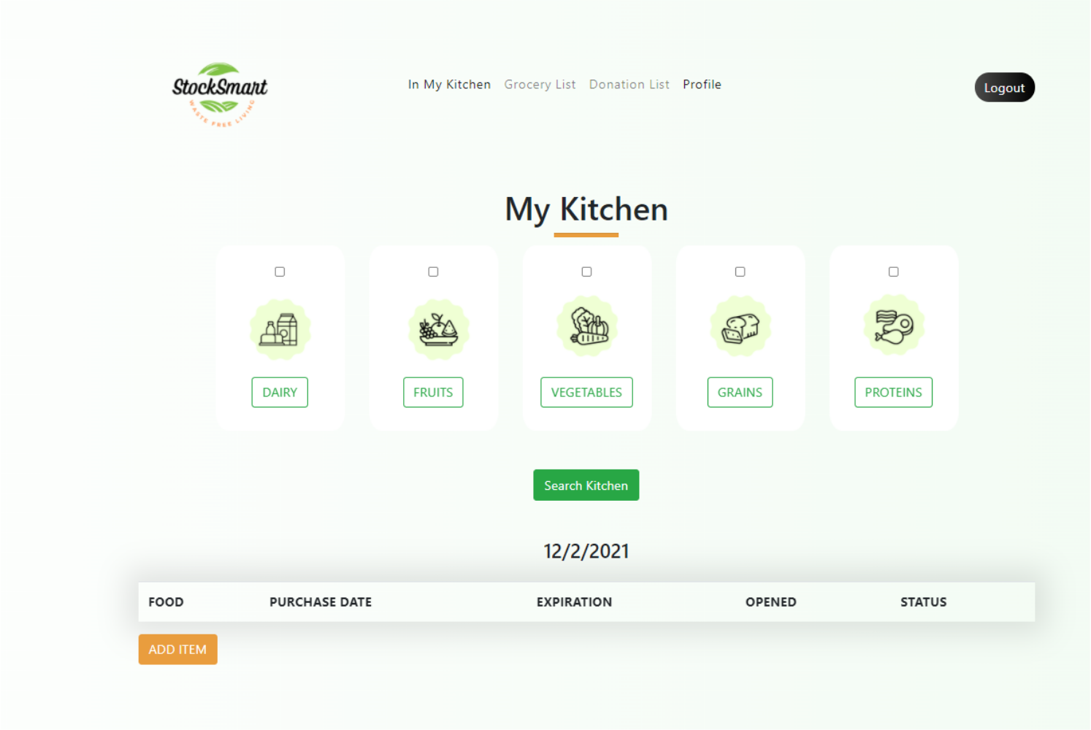


STOCKSMART DEMO

Slide 7






EXPAND TO FRIEND GROUPS
Allow user to create a group (roommates, family members, etc.) to see what other members have purchased, share common grocery lists, etc.
INCORPORATE DATE SCANNER
Allow users to scan dates directly off the product instead of manually entry.
NEXT STEPS
CREATE MORE EXTENSIVE
DATABASE
Get an extensive database of food items, their food groups, and accurate expiration windows for each food item instead of each food group
SELECT DONATION CENTER BASED ON LOCATION
Allow user to select a donation locations closest to them

Slide 8




THANK YOU!
QUESTIONS?

