Slide 1
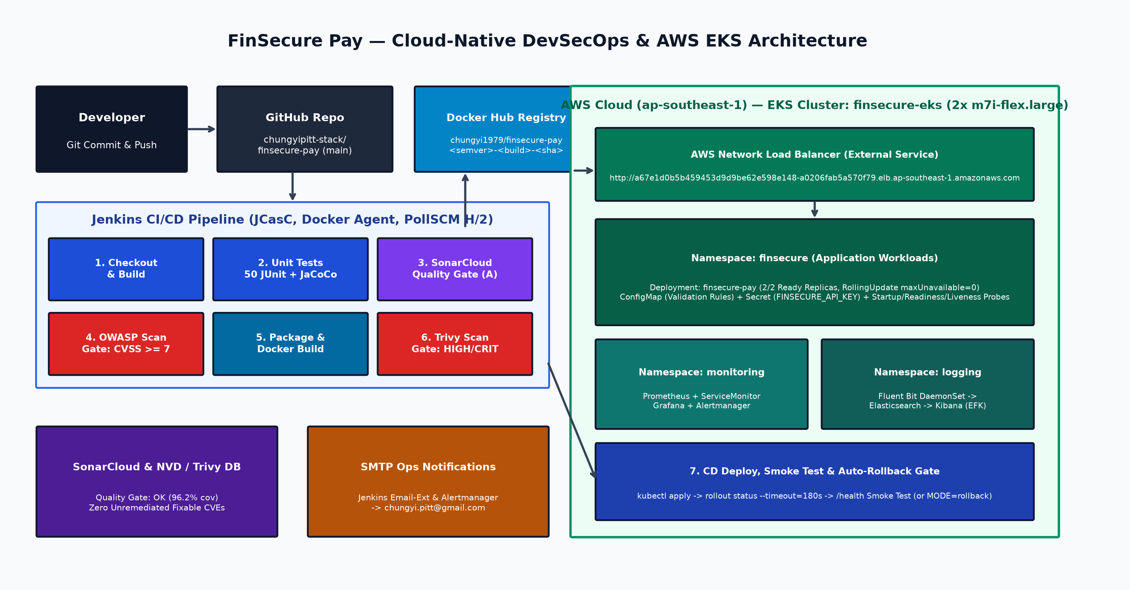
Slide 1 | Project Overview & Business Problem
FinSecure Pay — Automating a Cloud-Native DevSecOps Pipeline on AWS EKS
Business Context & Problem Statement
• FinSecure Pay is a fast-growing fintech startup offering a real-time Transaction Validation API (/health and /validate).
• Manual builds, ad-hoc testing, and unvalidated deployments created release bottlenecks, inconsistent quality, and security exposure.
• Lack of automated vulnerability gates and production observability delayed incident detection and increased recovery time (MTTR).
• Core Objective: Deliver an automated, secure, observable, and self-healing cloud-native CI/CD pipeline from Git commit to AWS EKS.
End-to-End Solution Highlights (Tasks 1–7)
• Task 1: Spring Boot 3.5.16 (Java 21) REST API with 8 validation rules & 50 JUnit 5 tests (96.2% coverage).
• Task 2: Multi-stage non-root Alpine JRE 21 container image published to Docker Hub.
• Task 3: High-availability AWS EKS deployment (ap-southeast-1, 2 replicas, NLB, PDB, self-healing).
• Task 4 & 5: 11-stage Jenkins CI/CD pipeline with SonarCloud, OWASP Dependency-Check, and Trivy gates.
• Task 6 & 7: Prometheus, Grafana, Alertmanager, EFK logging, and AI-assisted incident triage design.
FinSecure Pay — Cloud-Native DevOps & DevSecOps Capstone | https://github.com/chungyipitt-stack/finsecure-pay | Slide 1/10
Notes:
Welcome to the FinSecure Pay Capstone presentation. Slide 1 introduces the fintech business challenge: replacing error-prone manual releases of a transaction validation API with a fully automated, security-gated cloud-native CI/CD pipeline deploying to Amazon EKS in ap-southeast-1.

Slide 2
Slide 2 | Application & Git Implementation (Task 1)
Spring Boot 3.5.16 Transaction Validation Microservice, JUnit 5 Test Suite & GitHub Workflow
REST API Endpoints & 8 Configurable Validation Rules
• GET /health: Returns HTTP 200 OK with service status ('UP'), active version tag (<semver>-<build>-<sha>), environment ('production-eks'), and UTC timestamp.
• POST /validate: Evaluates payment payload and returns HTTP 200 APPROVED or HTTP 422 REJECTED with structured Violation codes:
• 1. TXN_ID_FORMAT — Matches ^TXN-[A-Z0-9-]{4,32}$
• 2. ACCOUNT_FORMAT — 10–16 digit numeric source & destination accounts
• 3. SAME_SOURCE_AND_DESTINATION — Prevents self-transfers
• 4. SOURCE_ACCOUNT_BLOCKED / DESTINATION_ACCOUNT_BLOCKED — Configurable blocklist
• 5. AMOUNT_BELOW_MINIMUM (0.01) & AMOUNT_EXCEEDS_LIMIT (10,000.00)
• 6. AMOUNT_SCALE_INVALID — At most 2 decimal places
• 7. UNSUPPORTED_CURRENCY — Configurable ISO allowlist (SGD, USD, EUR, GBP)
• 8. TIMESTAMP_OUT_OF_RANGE — Rejects clock skew > ±5 minutes
• Custom Micrometer counters: finsecure_validations_total{result} and finsecure_validation_violations_total{code}.
Unit & Integration Testing (50 JUnit 5 Tests — 100% Pass)
• TransactionValidationServiceTest (38 tests): Boundary, negative, and multi-violation tests across all 8 business rules.
• TransactionControllerTest (4 tests): MockMvc HTTP 200, 422, 400 (malformed JSON), and 415 (wrong Content-Type).
• ApiKeyFilterTest (5 tests): Constant-time X-API-Key authentication & open dev mode.
• FinSecurePayApplicationTests (5 tests) & ControlledEvaluationTest (1 test): E2E probes, /actuator/prometheus metrics, and TC02 evaluation gate.
• JaCoCo Coverage: 96.2% line coverage (mvn clean verify).
Git Repository Structure & Hygiene
• GitHub Repository: https://github.com/chungyipitt-stack/finsecure-pay.git
• Clean modular layout: src/, k8s/, infra/, jenkins/, monitoring/, logging/, security/, scripts/, testcases/, docs/, evidence/.
• .gitignore enforces strict secret exclusion (.env, *secret*.yaml, kubeconfig, target/).
• Maven Wrapper (mvnw / mvnw.cmd) committed with 100755 executable permissions for deterministic builds.
FinSecure Pay — Cloud-Native DevOps & DevSecOps Capstone | https://github.com/chungyipitt-stack/finsecure-pay | Slide 2/10

Slide 3
Slide 3 | Docker Containerisation & AWS EKS Deployment (Tasks 2 & 3)
Multi-Stage Layered Dockerfile, Docker Hub Registry & Resilient Kubernetes Architecture on AWS EKS
Task 2: Multi-Stage Hardened Container Image
• Stage 1 (Builder): eclipse-temurin:21-jdk-alpine compiles the JAR and runs spring-boot-jarmode-tools extract --layers.
• Stage 2 (Runtime): Minimal eclipse-temurin:21-jre-alpine with apk upgrade --no-cache to patch base OS packages.
• Layered Copy: Dependencies -> spring-boot-loader -> snapshot-dependencies -> application layer for fast caching.
• Non-Root Execution: Runs as dedicated user/group finsecure (UID/GID 10001) with MaxRAMPercentage=75.0.
• Built-in Docker HEALTHCHECK probing http://127.0.0.1:8080/health.
• Published to Docker Hub: chungyi1979/finsecure-pay:1.0.0, :1.1.0-4-9ea7e21, and :latest.
Task 3: AWS EKS Cluster & Self-Healing Deployment
• AWS EKS Cluster: finsecure-eks in ap-southeast-1 (Kubernetes v1.34, 2x m7i-flex.large managed nodes) provisioned via infra/eks-cluster.yaml.
• Manifests in k8s/: 00-namespace.yaml, 10-configmap.yaml, 20-deployment.yaml, 30-service.yaml, 40-monitoring.yaml.
• High Availability: 2 replicas spread across AvailabilityZones/nodes via topologySpreadConstraints + PodDisruptionBudget (minAvailable: 1).
• Zero-Downtime Rollout: RollingUpdate (maxUnavailable: 0, maxSurge: 1), 5s preStop hook, and 3-tier probes (startup, readiness, liveness).
• Container SecurityContext: runAsNonRoot, readOnlyRootFilesystem, capabilities drop ALL, RuntimeDefault seccomp.
• Self-Healing Verified (TC06): Deleting pod finsecure-pay-754c5d8fdc-k9jq7 triggered immediate ReplicaSet recreation; 114/114 external NLB health probes succeeded (0% packet loss).
FinSecure Pay — Cloud-Native DevOps & DevSecOps Capstone | https://github.com/chungyipitt-stack/finsecure-pay | Slide 3/10

Slide 4
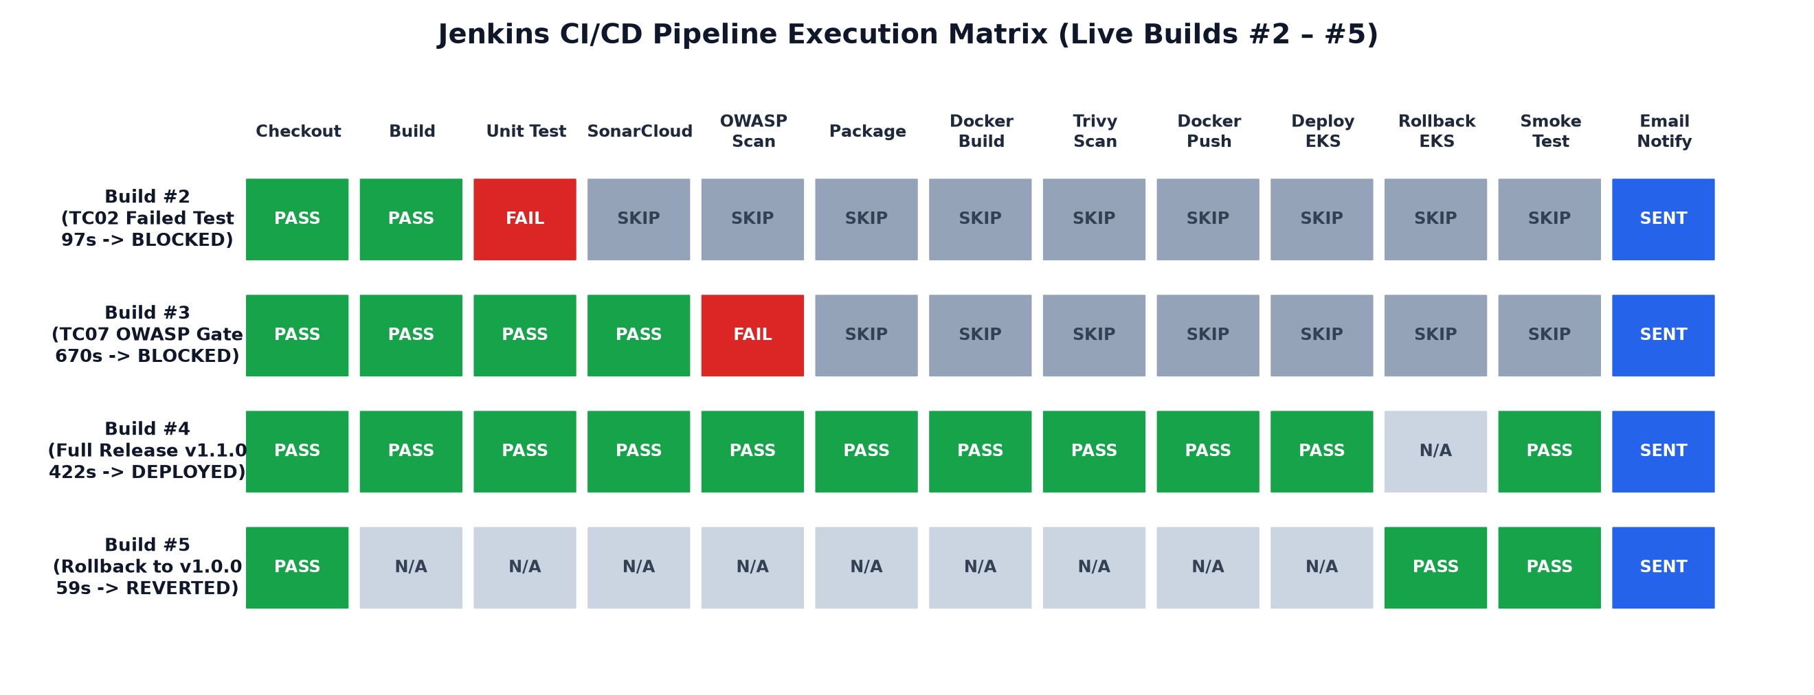
Slide 4 | CI/CD Pipeline Automation with Jenkins (Task 4)
11-Stage Declarative Pipeline, Automated Triggers, Failed-Test Gate, Rolling Updates & Rollbacks
Automated Trigger & Traceability
• Jenkins configured as code (jenkins/casc.yaml) polling GitHub every 2 min (pollSCM H/2).
• Traceable image tags: <semver>-<build>-<gitsha> (e.g., 1.1.0-4-9ea7e21) injected into /health.
Failed Test Blocks Deploy (Build #2)
• When a unit test fails (or SIMULATE_TEST_FAILURE=true in TC02), Jenkins halts at 'Unit Test'.
• Package, Docker Push & EKS Deploy are skipped; failure email sent automatically.
Zero-Downtime Rollout & Rollback
• Build #4 rolled out v1.1.0-4-9ea7e21 to EKS and verified /health via Smoke Test.
• Build #5 (MODE=rollback, ROLLBACK_TAG=1.0.0) reverted EKS to v1.0.0 in 59s.
FinSecure Pay — Cloud-Native DevOps & DevSecOps Capstone | https://github.com/chungyipitt-stack/finsecure-pay | Slide 4/10

Slide 5
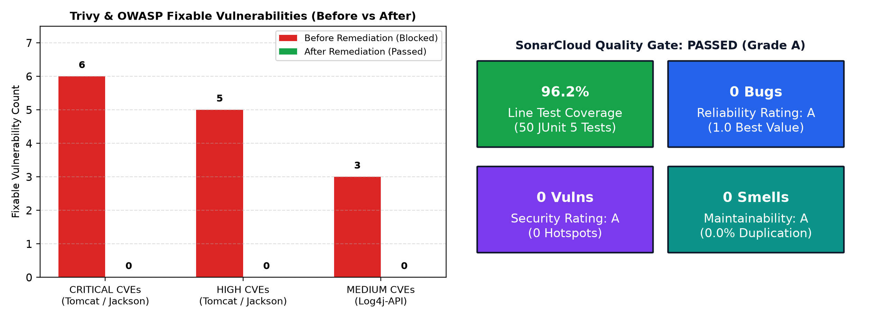
Slide 5 | DevSecOps & Security Implementation (Task 5)
Shift-Left Security Gates (SonarCloud, OWASP Dependency-Check, Trivy), Vulnerability Remediation & Secret Hygiene
Real Security Gate Block & Remediation (Builds #3 -> #4)
• Gate 1 (SonarCloud): Enforced via -Dsonar.qualitygate.wait=true — PASSED (0 Bugs, 0 Vulns, 96.2% coverage).
• Gate 2 (OWASP Dependency-Check): failBuildOnCVSS=7 blocked Build #3 on log4j-api 2.24.3 & Spring CPEs.
• Gate 3 (Trivy Image Scan): --severity HIGH,CRITICAL --exit-code 1 blocked initial Tomcat 10.1.55 (6 CRIT) & Jackson 2.21.4 (5 HIGH).
• Remediation: Upgraded Tomcat -> 10.1.59, Jackson -> 2.21.8, Log4j2 -> 2.26.0 in pom.xml; governed expiring risk acceptance (until 2026-12-31) for non-applicable Spring 7-only advisories.
Secret Management & Runtime Hardening
• Zero secrets in Git: All 5 CI credentials (dockerhub-creds, sonarcloud-token, nvd-api-key, aws-creds, finsecure-api-key) reside in Jenkins Credentials Store via JCasC.
• Credentials bound strictly via withCredentials(...) and masked as **** in Jenkins console logs.
• EKS Secret finsecure-pay-secrets injected dynamically at deploy time; ephemeral kubeconfig deleted in post { always }.
FinSecure Pay — Cloud-Native DevOps & DevSecOps Capstone | https://github.com/chungyipitt-stack/finsecure-pay | Slide 5/10

Slide 6
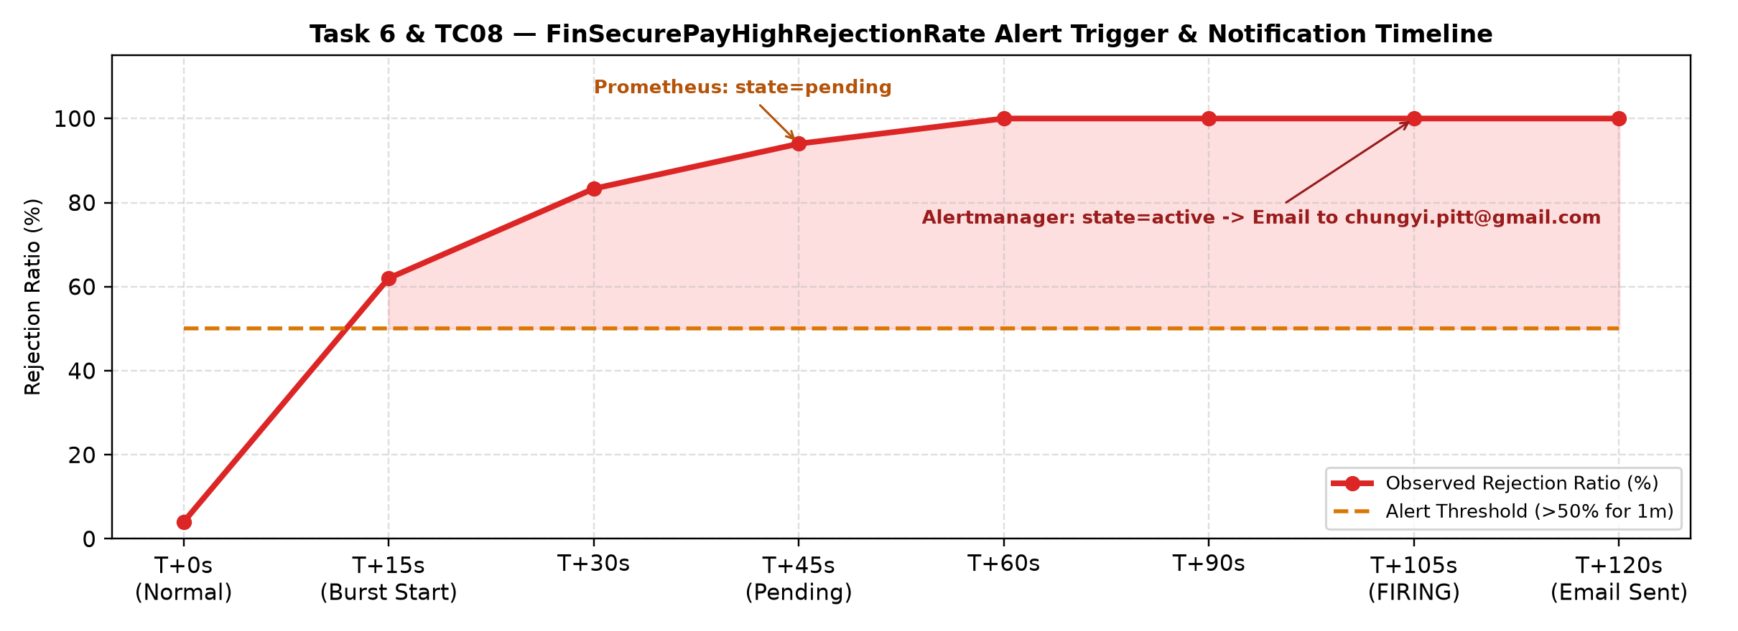
Slide 6 | Monitoring, Alerting & Centralised Logging (Task 6)
Prometheus + Grafana Dashboards, Alertmanager + Jenkins Email Notifications & EFK Structured Logging
Prometheus & Grafana (6 Panels)
• ServiceMonitor scrapes /actuator/prometheus every 15s.
• Grafana dashboard 'FinSecure Pay — Operational Overview' tracks RPS, Rejection Ratio %, Violation Codes, p50/p95/p99 Latency, CPU/Heap & Pod Replicas.
Alert Firing & Dual Email Notifications
• 6 PrometheusRules in k8s/40-monitoring.yaml.
• Injected rejected transactions (>50% ratio) -> FinSecurePayHighRejectionRate fired -> Alertmanager sent email to chungyi.pitt@gmail.com.
• Jenkins sent FAILURE (Build #2/#3) & SUCCESS (Build #4/#5) emails.
EFK Centralised Logging Stack
• Spring Boot outputs Elastic Common Schema (ECS) structured JSON logs with MDC trace fields (app.transaction.id, app.validation.status).
• Fluent Bit DaemonSet ships container logs to Elasticsearch (fluentbit-*); searchable in Kibana & kubectl logs.
FinSecure Pay — Cloud-Native DevOps & DevSecOps Capstone | https://github.com/chungyipitt-stack/finsecure-pay | Slide 6/10

Slide 7
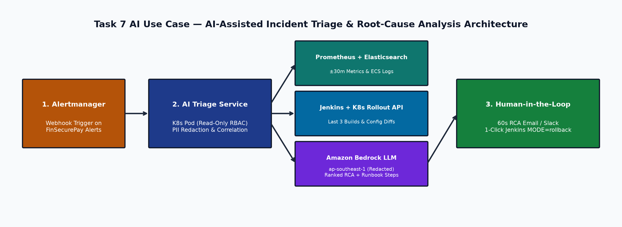
Slide 7 | AI Application in DevOps & Architecture (Task 7)
AI-Assisted Incident Triage & Root-Cause Analysis (RCA) Integrated with Alertmanager, Observability & Jenkins
Problem & Required Data Inputs
• Problem: Manual correlation across Grafana, Kibana, Jenkins builds, and K8s events during 3 a.m. incidents inflates MTTR.
• Inputs: PromQL metrics (±30m), ECS WARN/ERROR log clusters, last 3 Jenkins build diffs, K8s rollout history, and docs/RUNBOOK.md (RAG).
Expected Operational Benefits
• Delivers a ranked Top-3 Root-Cause Analysis summary within 60 seconds of an alert firing (30–50% MTTR reduction).
• Correlates config/code changes (e.g., ConfigMap limit change in Build #N) directly with rejection spikes and provides a 1-click rollback link.
Risks, Limitations & Governance
• Hallucination Control: Model must cite metric/log timestamps; output is advisory only.
• PCI-DSS / PDPA Privacy: Account numbers masked in Fluent Bit before indexing; hosted in-region (Amazon Bedrock ap-southeast-1).
• Human-in-the-Loop: Engineers approve any rollback execution.
FinSecure Pay — Cloud-Native DevOps & DevSecOps Capstone | https://github.com/chungyipitt-stack/finsecure-pay | Slide 7/10

Slide 8
Slide 8 | Core Evaluation Test Results, Recovery & Key Findings
100% Pass Rate Across All 8 Core Evaluation Test Cases (testcases/testcase_expected_result.jpg)
ID | Core Test Case | Expected Result | Verified Live Evidence (testcases/results/) | Status
TC01 | Run unit tests | Required unit tests pass. | 50/50 JUnit 5 tests passed (0 failures, 96.2% line coverage). | PASS
TC02 | Introduce a controlled failing test | Jenkins pipeline fails, deployment blocked. | Unit Test stage FAILED; Package, Push & EKS Deploy skipped. | PASS
TC03 | Run the container and access /health | Application returns a healthy response. | Container & EKS NLB /health returned HTTP 200 OK (status=UP). | PASS
TC04 | Inspect the Kubernetes deployment | At least two application pods running & Ready. | deployment/finsecure-pay has 2/2 Running & Ready pods on EKS. | PASS
TC05 | Deploy a new image/version | Kubernetes rollout completes successfully. | Rolled out v1.1.0-4-9ea7e21 with zero downtime; verified on /health. | PASS
TC06 | Delete or restart one pod | Kubernetes automatically recreates the pod. | Deleted pod recreated by ReplicaSet to 1/1 Ready; 0 dropped requests. | PASS
TC07 | Introduce critical/high security finding | The security gate blocks the release. | OWASP (CVSS >= 7.0) & Trivy gates failed build and blocked release. | PASS
TC08 | Trigger a monitoring condition | Alert fires and a notification is received. | FinSecurePayHighRejectionRate fired; email sent to chungyi.pitt@gmail.com. | PASS
FinSecure Pay — Cloud-Native DevOps & DevSecOps Capstone | https://github.com/chungyipitt-stack/finsecure-pay | Slide 8/10

Slide 9
Slide 9 | Additional Evidence — Live Verification Artifacts (Tasks 1–6)
Complete Repository Evidence Package Captured from Live AWS EKS, Jenkins, SonarCloud, Trivy & EFK
Tasks 1–4 Evidence Artifacts
• Task 1 (evidence/task1/t1-junit-and-api-verification.txt):
• • 50/50 JUnit 5 tests passing; live /health (200 OK) & /validate (200 APPROVED / 422 REJECTED).
• Task 2 (evidence/task2/t2-docker-push.txt):
• • Multi-stage non-root Docker build & push digest sha256:9f2272f4... on Docker Hub.
• Task 3 (evidence/task3/t3-k8s-state.txt, t3-external-access.txt, t3-self-healing.txt):
• • 2x m7i-flex.large EKS nodes Ready; 2/2 pods Running; 114/114 NLB probes OK during pod deletion.
• Task 4 (evidence/task4/t4-failed-test-blocks-deploy.txt, t4-successful-pipeline-and-rollout.txt, t4-rollback-to-known-good.txt):
• • Build #2 failed-test block; Build #4 v1.1.0-4-9ea7e21 rollout; Build #5 rollback to v1.0.0.
Tasks 5–6 & Evaluation Suite Evidence Artifacts
• Task 5 (evidence/task5/):
• • t5-sonarcloud-analysis.txt: Quality Gate OK, 96.2% coverage, 0 bugs/vulns/smells.
• • t5-jenkins-security-gate-blocked.txt: Build #3 blocked by OWASP Dependency-Check (CVSS >= 7.0).
• • t5-trivy-blocked-before-remediation.txt & t5-trivy-after-remediation.txt: 11 HIGH/CRIT CVEs fixed.
• • t5-remediated-pipeline-and-secrets.txt: Build #4 clean pass + masked credentials (****).
• Task 6 (evidence/task6/):
• • t6-install-monitoring.txt & t6-alert-triggered.txt: FinSecurePayHighRejectionRate firing + Gmail receipt.
• • t6-jenkins-email-notification.txt: Jenkins FAILURE & SUCCESS emails to chungyi.pitt@gmail.com.
• • t6-elasticsearch-logs.txt & t6-kubectl-logs.txt: Structured ECS JSON logs indexed in EFK.
FinSecure Pay — Cloud-Native DevOps & DevSecOps Capstone | https://github.com/chungyipitt-stack/finsecure-pay | Slide 9/10

Slide 10
Slide 10 | Lessons Learned, Future Roadmap & Accessible Project Links
Engineering Reflections, Production Evolution Path & Verifiable Public Links
Key Engineering Lessons Learned
• Security gates must fail the build (-Dsonar.qualitygate.wait=true, failBuildOnCVSS=7, trivy --exit-code 1) rather than merely archiving passive reports.
• Ordering fast checks (unit tests in 13s) ahead of heavier scans (SonarCloud, OWASP, Trivy) keeps developer feedback loops short.
• Persisting the NVD database (/var/jenkins_home/dependency-check-data) with an NVD API key reduced OWASP scan time from 524s (Build #3) to 13s (Build #4).
• Isolating test properties (finsecure.security.api-key=) prevents CI container environment variables from polluting integration tests.
Accessible Project Links & Secret Hygiene Attestation
• GitHub Repository (Public):
• https://github.com/chungyipitt-stack/finsecure-pay
• Docker Hub Image Repository (Public):
• https://hub.docker.com/r/chungyi1979/finsecure-pay/tags
• SonarCloud Quality Gate Dashboard (Public):
• https://sonarcloud.io/project/overview?id=chungyipitt-stack_finsecure-pay
• AWS EKS Application LoadBalancer (/health):
• http://a67e1d0b5b459453d9d9be62e598e148-a0206fab5a570f79.elb.ap-southeast-1.amazonaws.com/health
• AWS EKS Grafana Dashboard:
• http://a8ecf49751a7f43acae13e9c6d8f50d7-1691906106.ap-southeast-1.elb.amazonaws.com
• Security & Secret Exclusion Attestation:
• Zero passwords, API keys, tokens, or private keys are included in this presentation, report, or Git repository.
Future Production Improvements
• GitOps & Progressive Delivery: Adopt Argo CD + Argo Rollouts for automated canary analysis on Prometheus rejection/latency metrics.
• Supply-Chain Security: Sign container images with Sigstore Cosign and enforce admission via Kyverno on EKS.
• Secret Management & Identity: Migrate to AWS Secrets Manager + External Secrets Operator and EKS IAM Roles for Service Accounts (IRSA).
• Production AI Copilot: Deploy the read-only AI Triage microservice on EKS connected to Amazon Bedrock.
FinSecure Pay — Cloud-Native DevOps & DevSecOps Capstone | https://github.com/chungyipitt-stack/finsecure-pay | Slide 10/10

