Slide 1
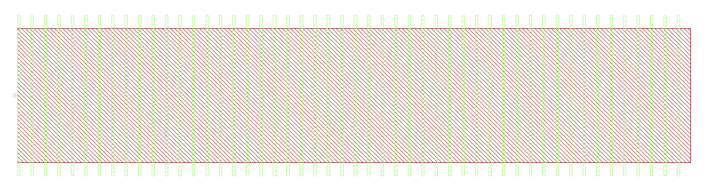


Component Layout
Please indicate all ports and their names
width
o0
period
length
$$period×duty_cycle$$

