Slide 1
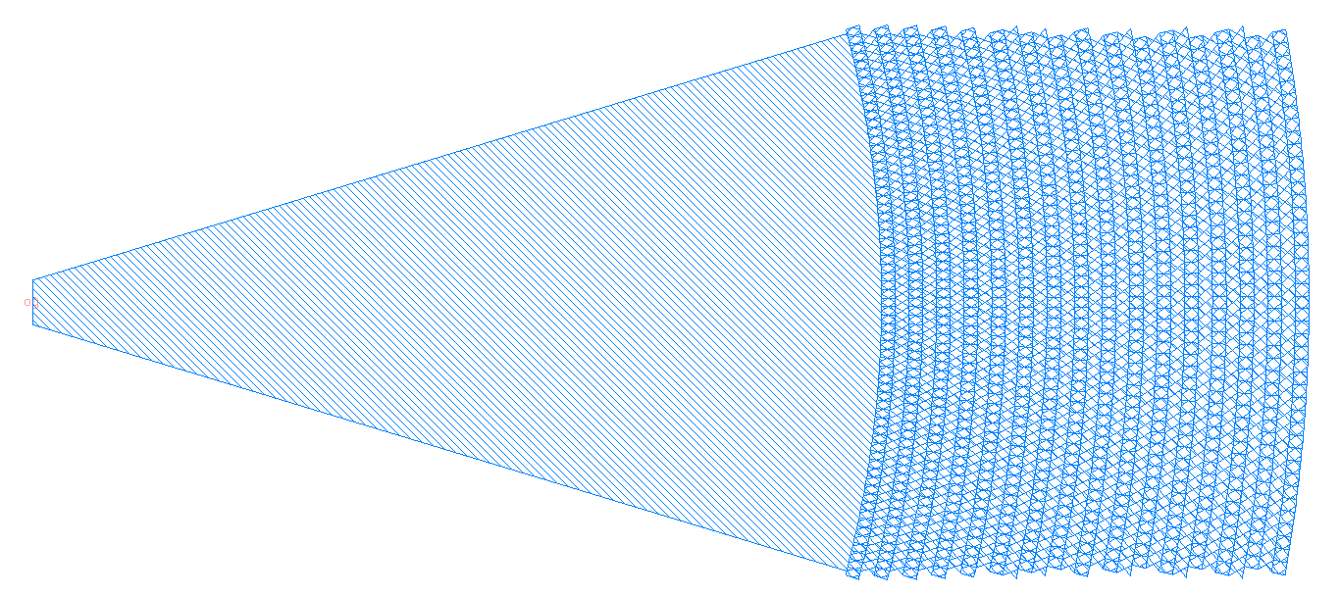

Component Layout
Please indicate all ports and their names
And also parameters
radius
L_grating
xperiod
W_wg
O0
yperiod
W_grating

