Slide 1
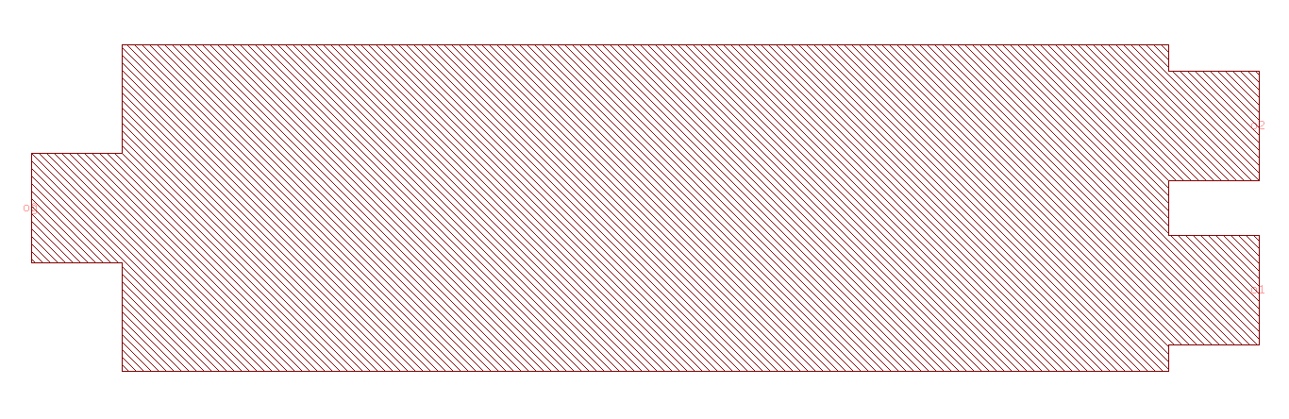
Component Layout
Please indicate all ports and their names
o2
o0
o1

