Slide 1
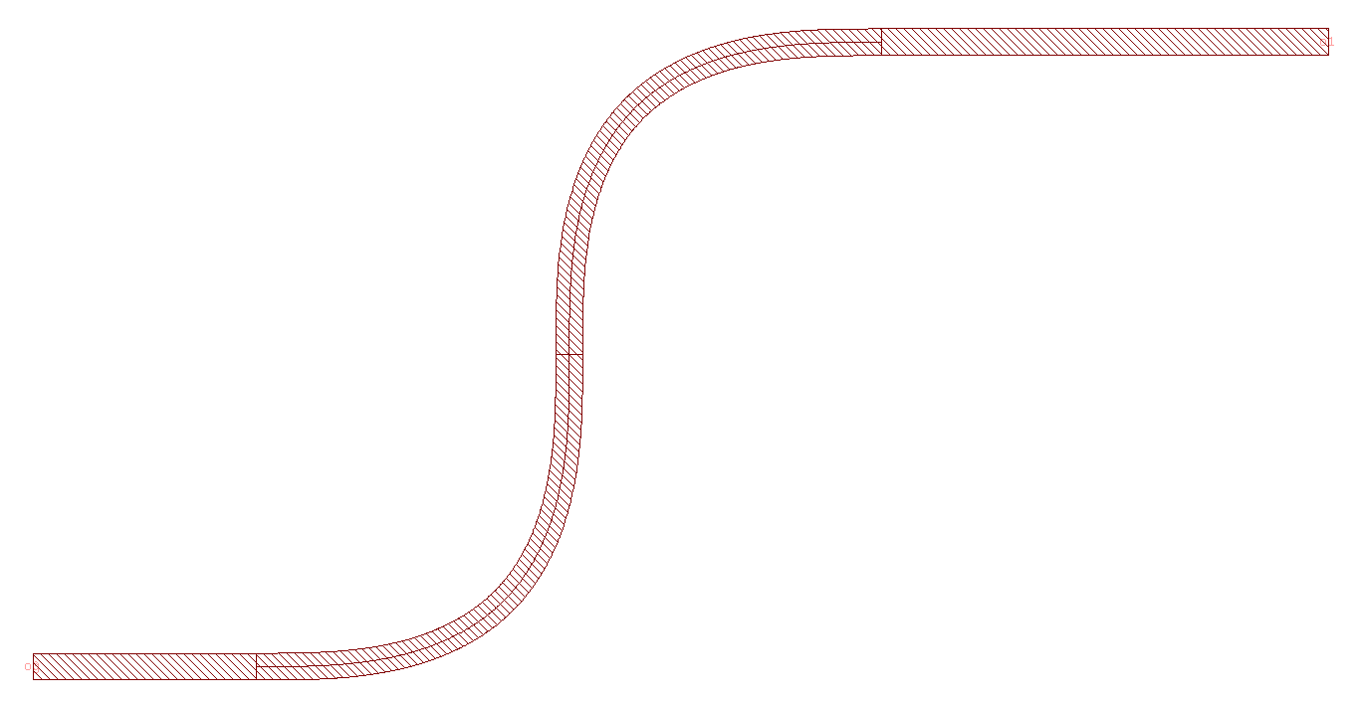
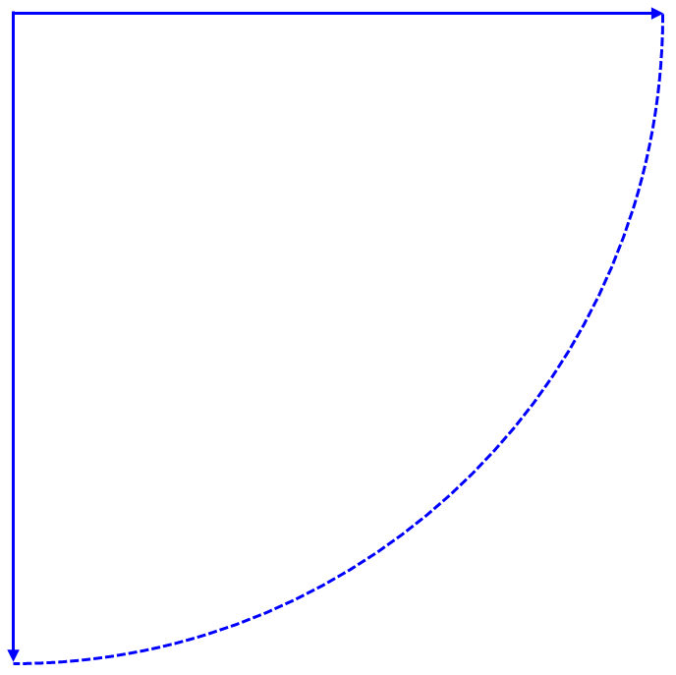
Component Layout
Please indicate all ports and their names
20
o1
path = [10, 'l', 'r', 20]
‘r’
bend_radius
10
‘l’
wg_width
o0

