Slide 1
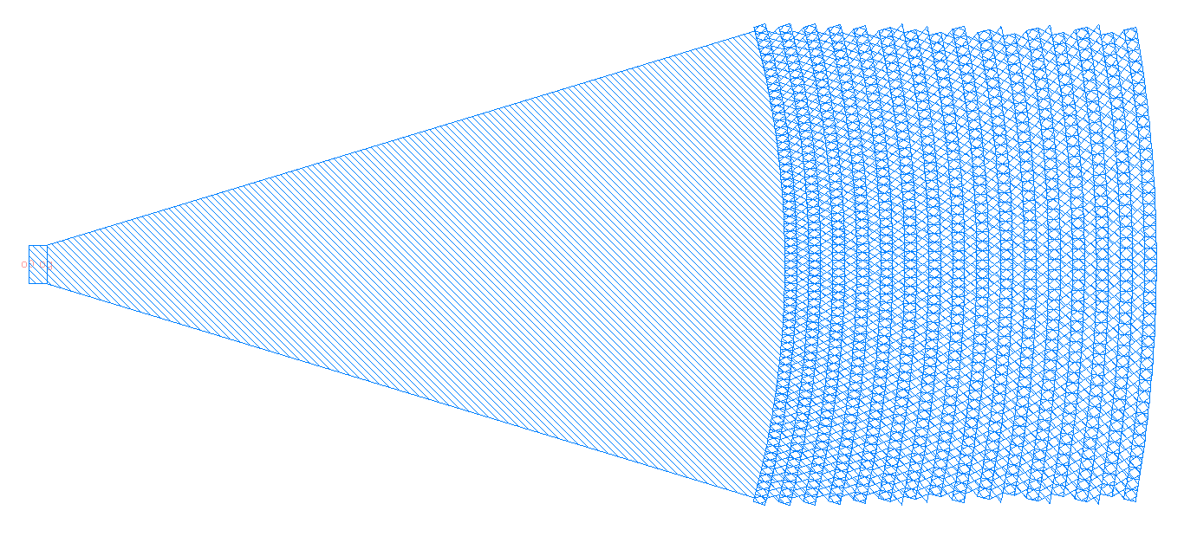
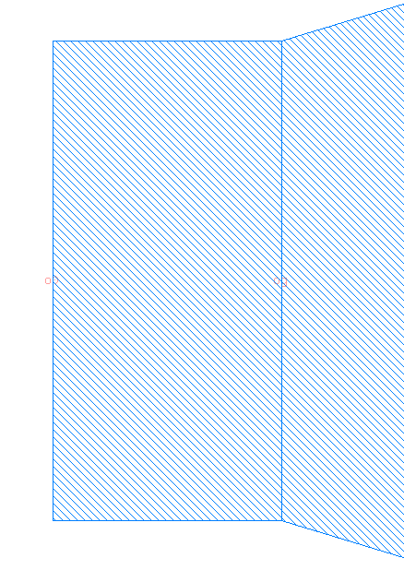

Component Layout
Please indicate all ports and their names
And also parameters
radius
L_grating
xperiod
W_wg
o0
og
yperiod
W_grating

