Slide 1
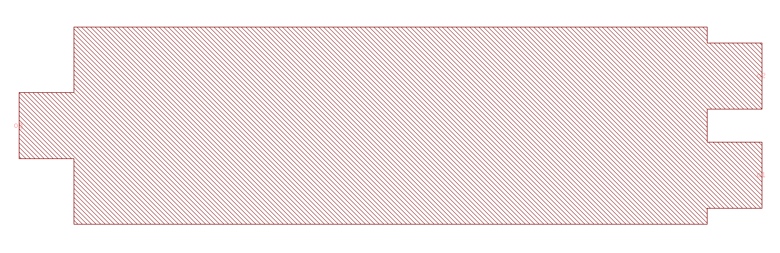
Component Layout
Please indicate all ports and their names
o2
og, o0
o1

