Slide 1
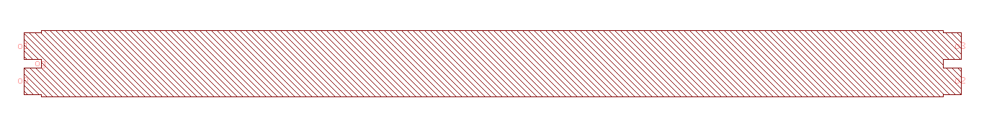
Component Layout
Please indicate all ports and their names
o1
o3
og
o0
o2

