Slide 1
Literature Review -
End-to-end Learning and Reinforcement Learning in Obstacle Avoidance

Slide 2
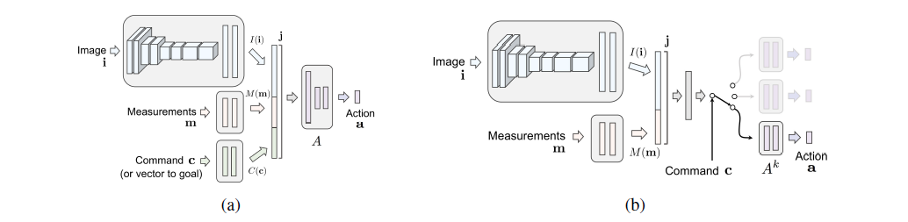
End-to-end learning with image input
End-to-End Driving via Conditional Imitation Learning (2018): At training time, the model is given not only the perceptual input and the control signal, but also a representation of the expert’s intention.
Link: https://arxiv.org/abs/1710.02410
Notes:
A vehicle trained end-to-end to imitate an expert cannot be guided to take a specific turn at an upcoming intersection.

Slide 3
End-to-end learning with image input
Off-Road Obstacle Avoidance through End-to-End Learning (2005): using two cameras as input of the neural network.
End-to-End Deep Learning for Autonomous Navigation of Mobile Robot (2018): regular methods of using single image. Nothing original.
Vision-Based Mobile Robot Navigation through Deep Convolutional Neural Networks and End-to-End Learning (2017): Nothing original.
CNN-Based Vision Model for Obstacle Avoidance of Mobile Robot (2017): Nothing original.

Slide 4
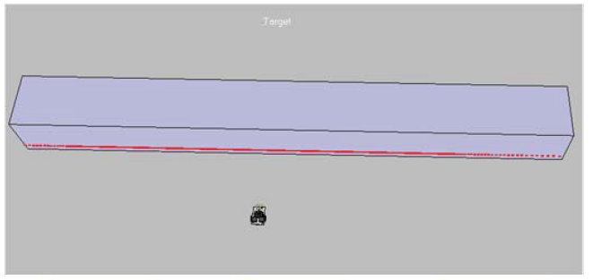
End-to-end learning with laser scan input
A LIDAR based end to end controller for robot navigation using deep neural network (2017): A sliding window of past information is incorporated to add the memory to controller, so that the hesitation is reduced when ambiguity occurs.
Link: https://ieeexplore.ieee.org/document/8278417/

Slide 5
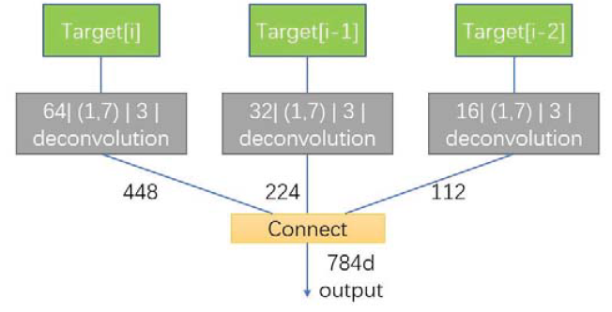
End-to-end learning with laser scan input
The target information is a combination of the last three frames of target information. Then they would be inserted into fully-connected layers to output the control commands.

Slide 6
End-to-end learning with laser scan and images input
LIDAR-Video Driving Dataset: Learning Driving Policies Effectively (2018): a dataset which is the first policy learning benchmark composed of driving videos, LIDAR data and corresponding driving behaviors.
DNN + LSTM. Long short-term memory (LSTM) is a well-improved recurrent neural network by introducing memory gates.
Depth representation: Point Clouds Mapping: LIDAR points are divided into grids on XOZ plane and we could get the nearest points of Y coordinate in each grid. PointNet: It directly take disorder pointes as the input of neural networks and finally output the representation features.
Vehicle speed and steering angle prediction models are trained individually.

Slide 7
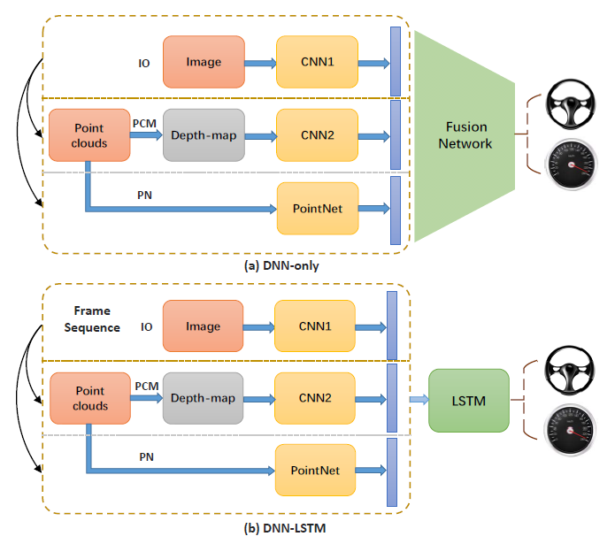
Link: http://openaccess.thecvf.com/content_cvpr_2018/html/Chen_LiDAR-Video_Driving_Dataset_CVPR_2018_paper.html

Slide 8
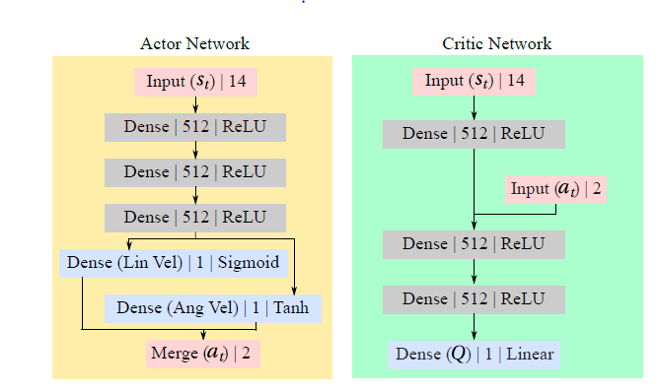
End-to-end reinforcement learning with laser scan input
Virtual-to-real Deep Reinforcement Learning: Continuous Control of Mobile Robots for Mapless Navigation (2017): taking LIDAR data and target position as input and steering commands as output. Using asynchronous DDPG method.
Notes:
The original DQN could only be used in tasks with a discrete action space. To extend it to continuous control, deep deterministic policy gradients is proposed. Asynchronous deep=RL with multiple sample collection threads working in parallel would improve the training efficiency. The increasing of Q-value of ADDPG is much faster.

Slide 9
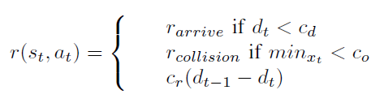
End-to-end reinforcement learning with laser scan input
Reward function definition
Link: https://ieeexplore.ieee.org/document/8202134/
Notes:
Otherwise, the reward is the difference in the distance from the target compared with last time step, multiplied by a hyper-parameter.

Slide 10
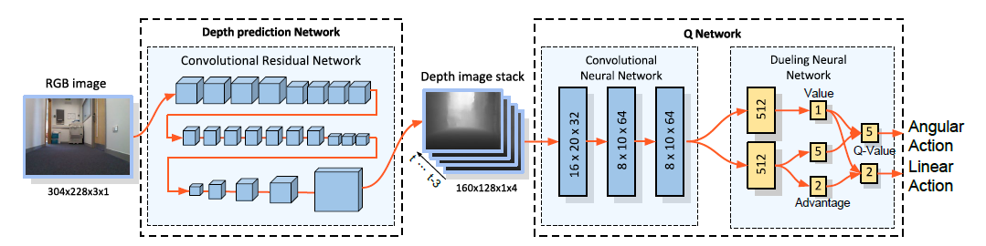
Reinforcement learning with image input
Towards Monocular Vision based Obstacle Avoidance through Deep Reinforcement Learning (2017): a dueling architecture based deep double-Q network is proposed, using only monocular RGB vision.
Link: https://arxiv.org/abs/1706.09829
Notes:
In the dueling network, two streams of fully connected layers are built to compute the value and advantage functions separately, which are finally combined together for computing Q-values.

Slide 11
Reinforcement learning with image/laser scan input
Uncertainty-Aware Reinforcement Learning for Collision Avoidance (2017): presenting an uncertainty-aware model-based learning algorithm that estimates the probability of collision together with a statistical estimate of uncertainty.
The collision prediction model is a fully connected neural network (policy gradient method).
Inputs are current state, the sensor observation, and a sequence of controls.
Outputs are the probability of collision, the uncertainty which is the variance, and a collision cost which is used in MPC.
In order to obtain accurate uncertainty, they use two techniques: bootstrapping and dropout.
Notes:
This learning method would proceed cautiously, experiencing only low-speed collisions until it gains confidence.

Slide 12
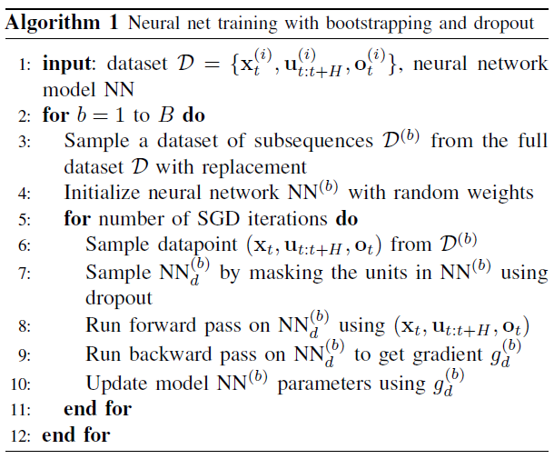
Reinforcement learning with image/laser scan input

Slide 13
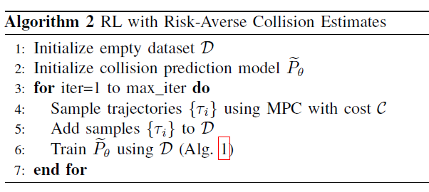
Reinforcement learning with image/laser scan input
Link: https://arxiv.org/abs/1702.01182
Notes:
Each iteration of the algorithm, the cost function C is formed using the current uncertainty-aware collision prediction model. The model predictive controller then samples trajectories using cost C. These sample trajectories are aggregated into a dataset containing all previous sampled trajectories. Then the collision prediction model is trained on the dataset according to Alg.1 and the next iteration begins.

Slide 14
Reinforcement learning
Motion Planning Among Dynamic, Decision-Making Agents with Deep Reinforcement Learning (2018): an algorithm that learns collision avoidance among a variety of types of dynamics agents without assuming they follow any particular behavior rules. It is a kind of modified actor-critic method.
Neural networks based reinforcement learning for mobile robots obstacle avoidance (2016): providing mobile robots a collision-free trajectory within an uncertain workspace which contains both stationary and moving entities. It is a modified Q-Learning approach.

Slide 15
Reinforcement learning
End-to-End Race Driving with Deep Reinforcement Learning (2018): including hand brake command in the learning algorithm to enforce drifting. An Asynchronous Actor-Critic framework is used. RGB Image input.
Avoiding Moving Obstacles with Stochastic Hybrid Dynamics using PEARL: PrEference Appraisal Reinforcement Learning (2016): PEARL projects the high-dimensional continuous robot state space to a low dimensional preference feature space resulting in efficient and adaptable planning.
Notes:
They trained the agent with 4 static obstacles, while the trained agent avoids up to 900 moving obstacles.

