Slide 1
Random Forest
in Adaptive Business Intelligent

Slide 2
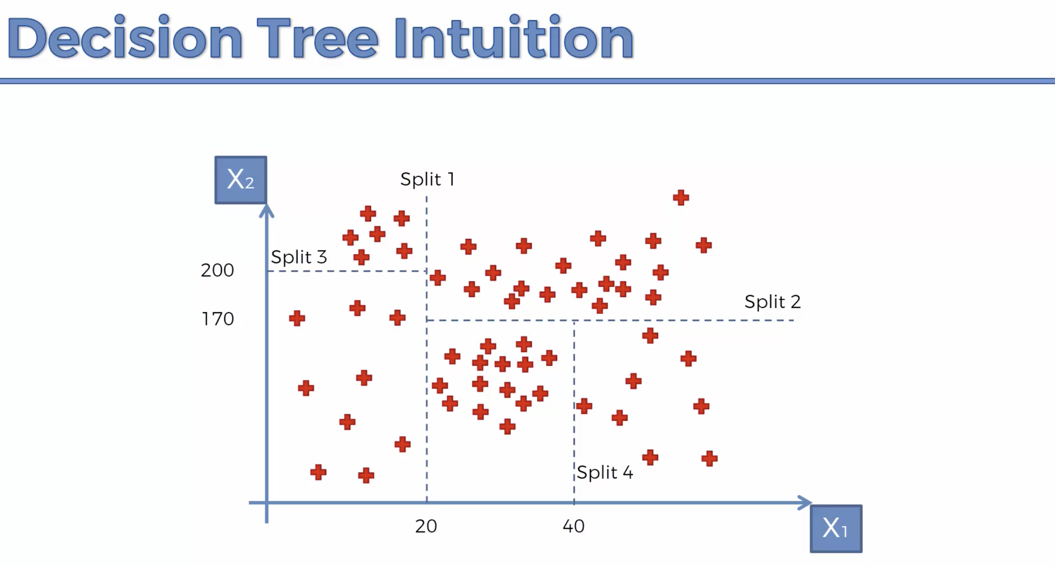

Slide 3
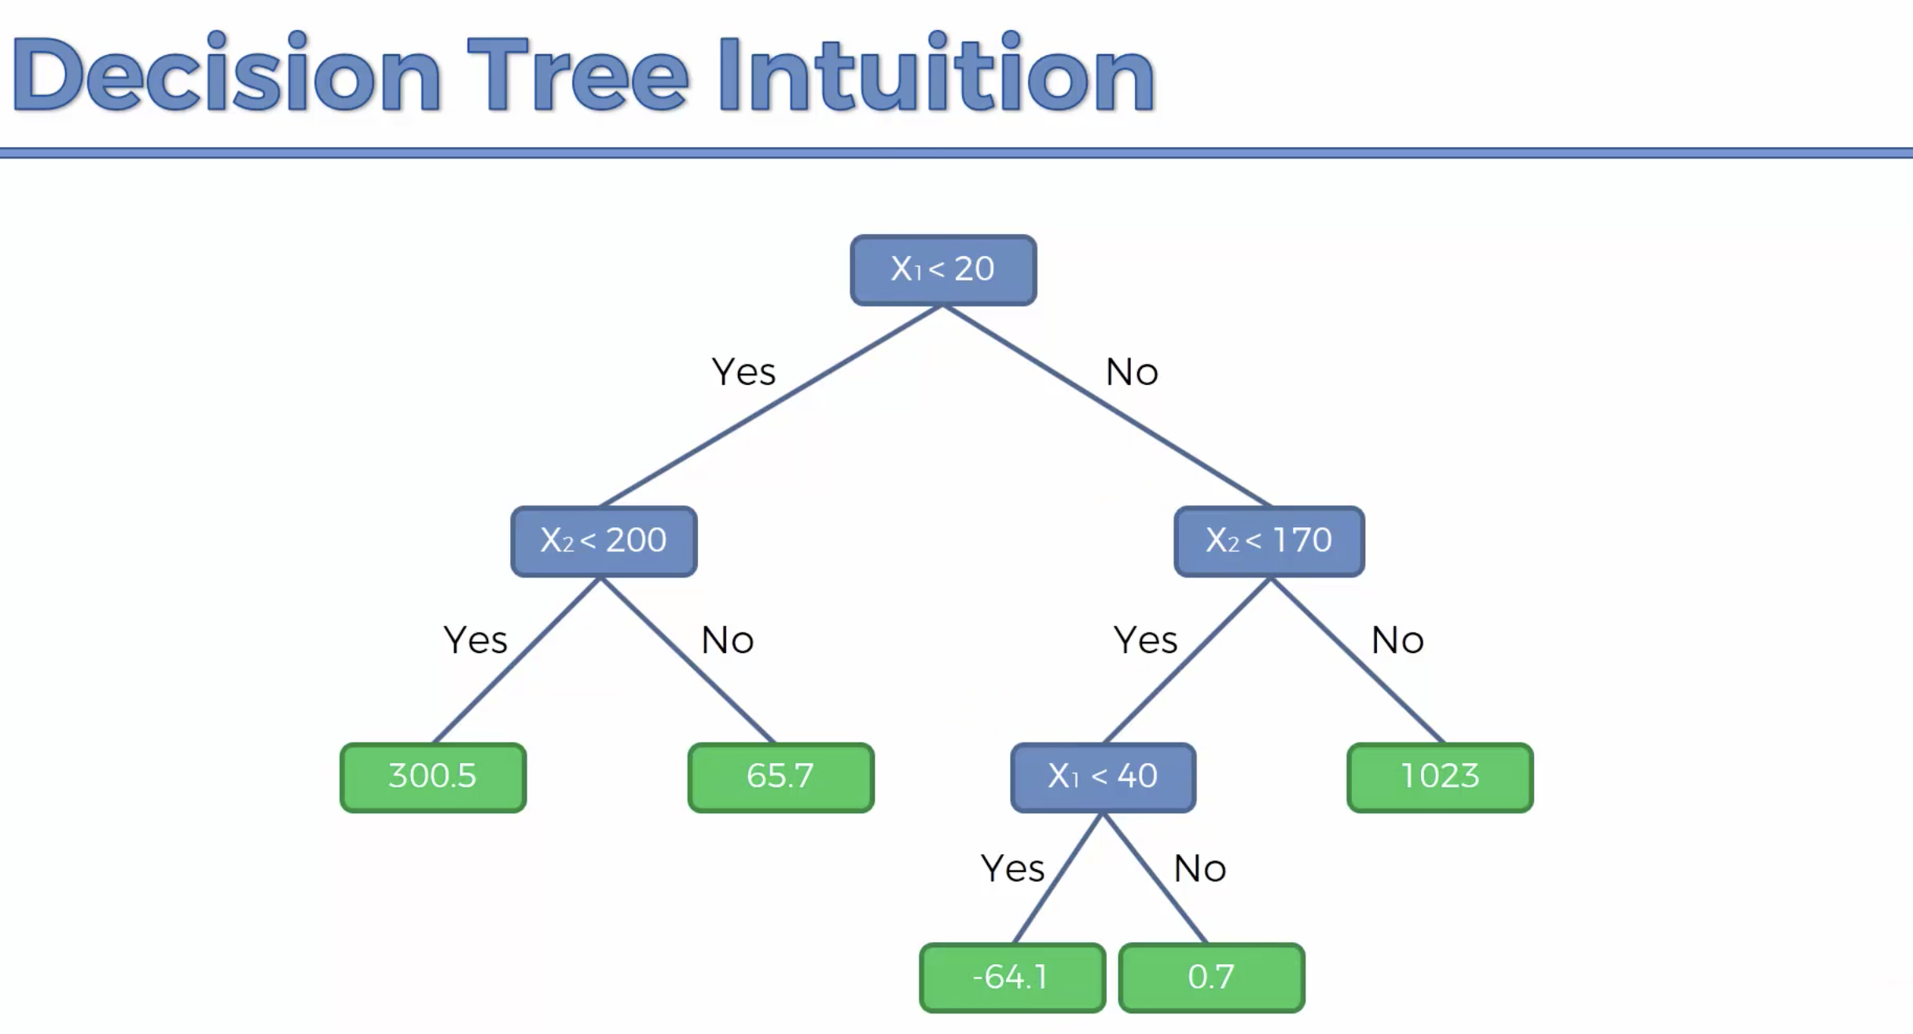

Slide 4
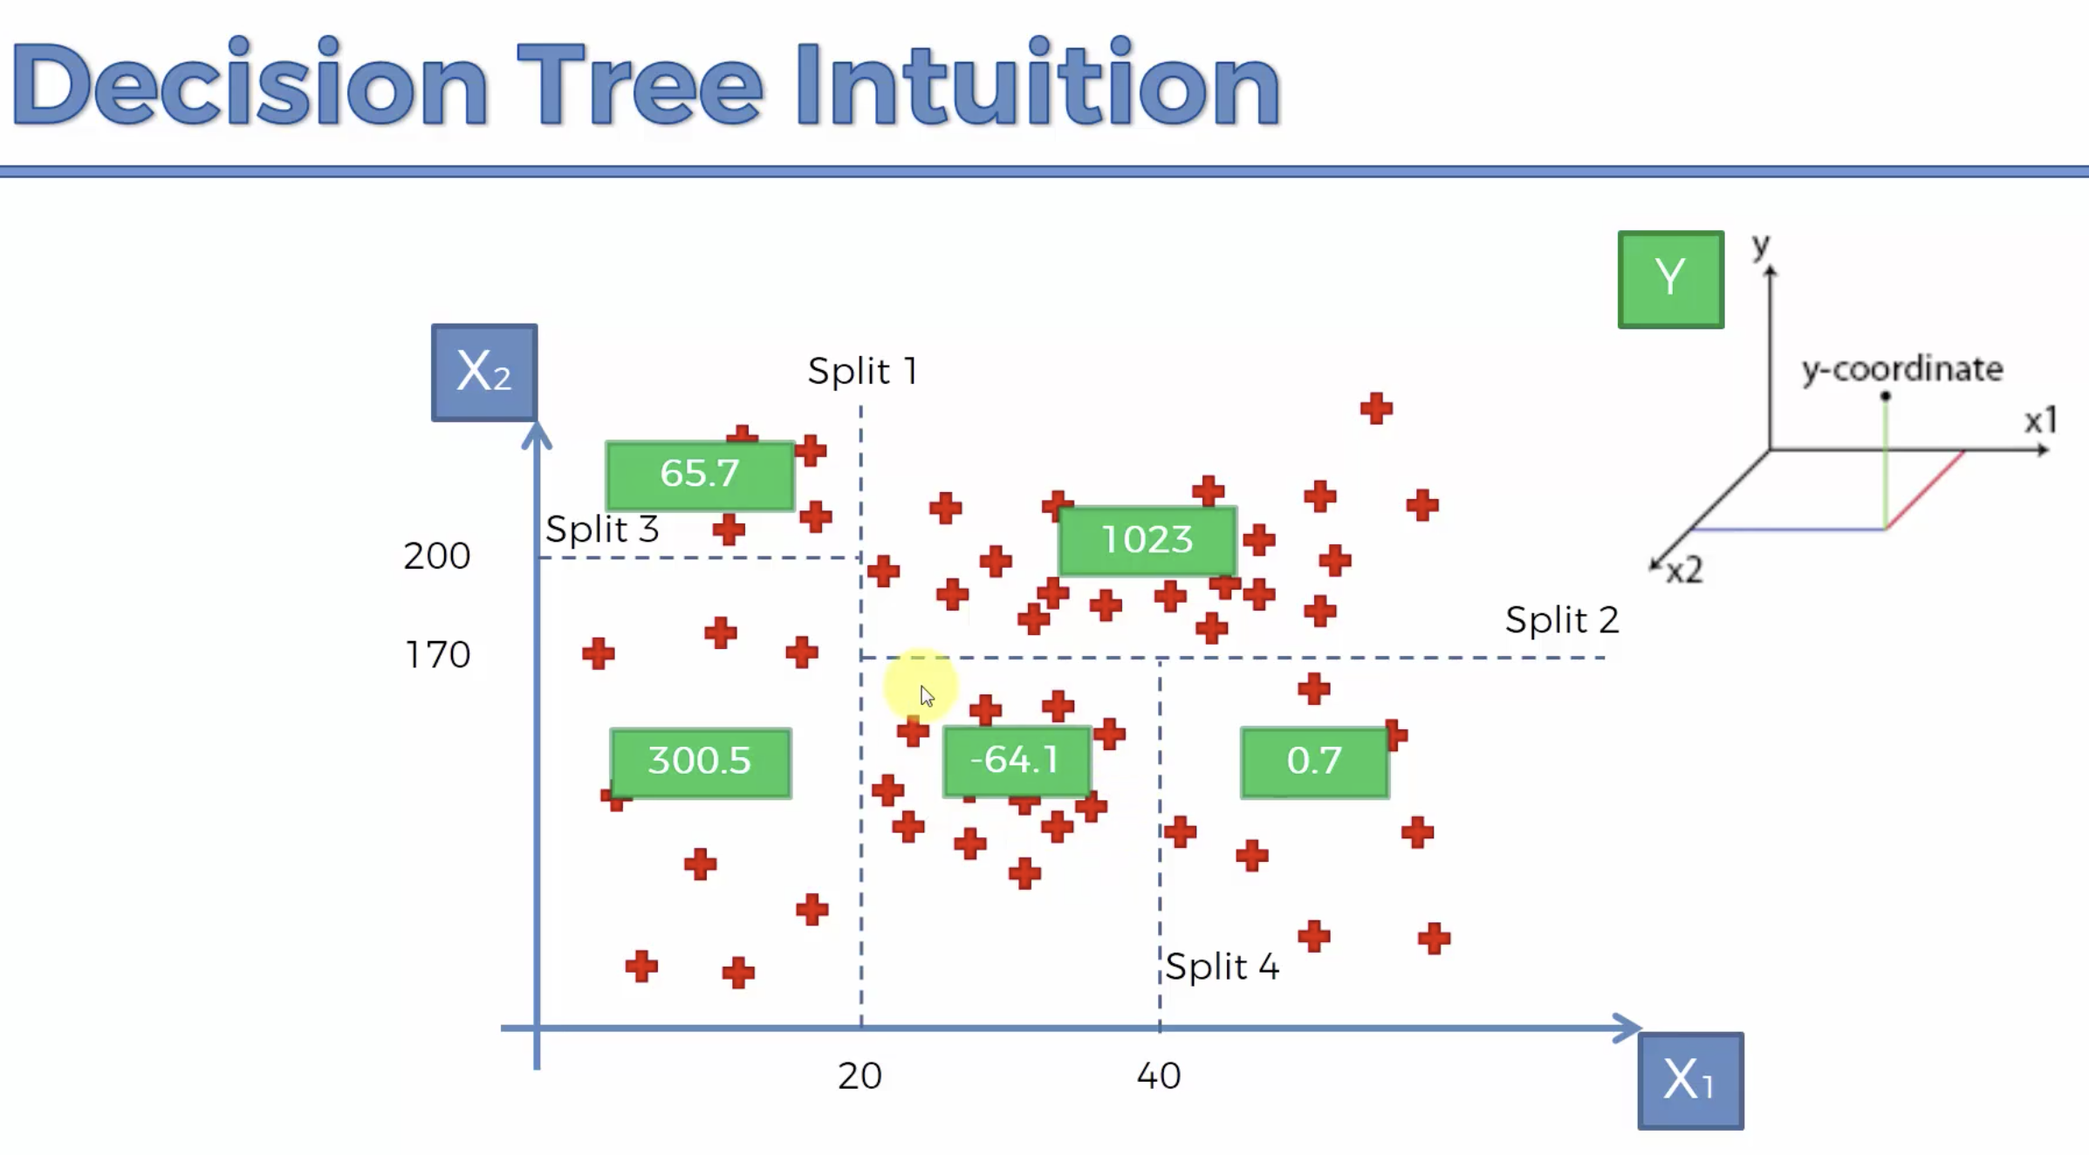

Slide 5
