Slide 1
BIS3208 SEMINAR SERIES Oral and Poster Presentation
Date: 17th November 2017 (Friday)
Time: 9am – 1pm, The Gallery, Level 1, NUB

Slide 2
Scientific Poster Design

Slide 3
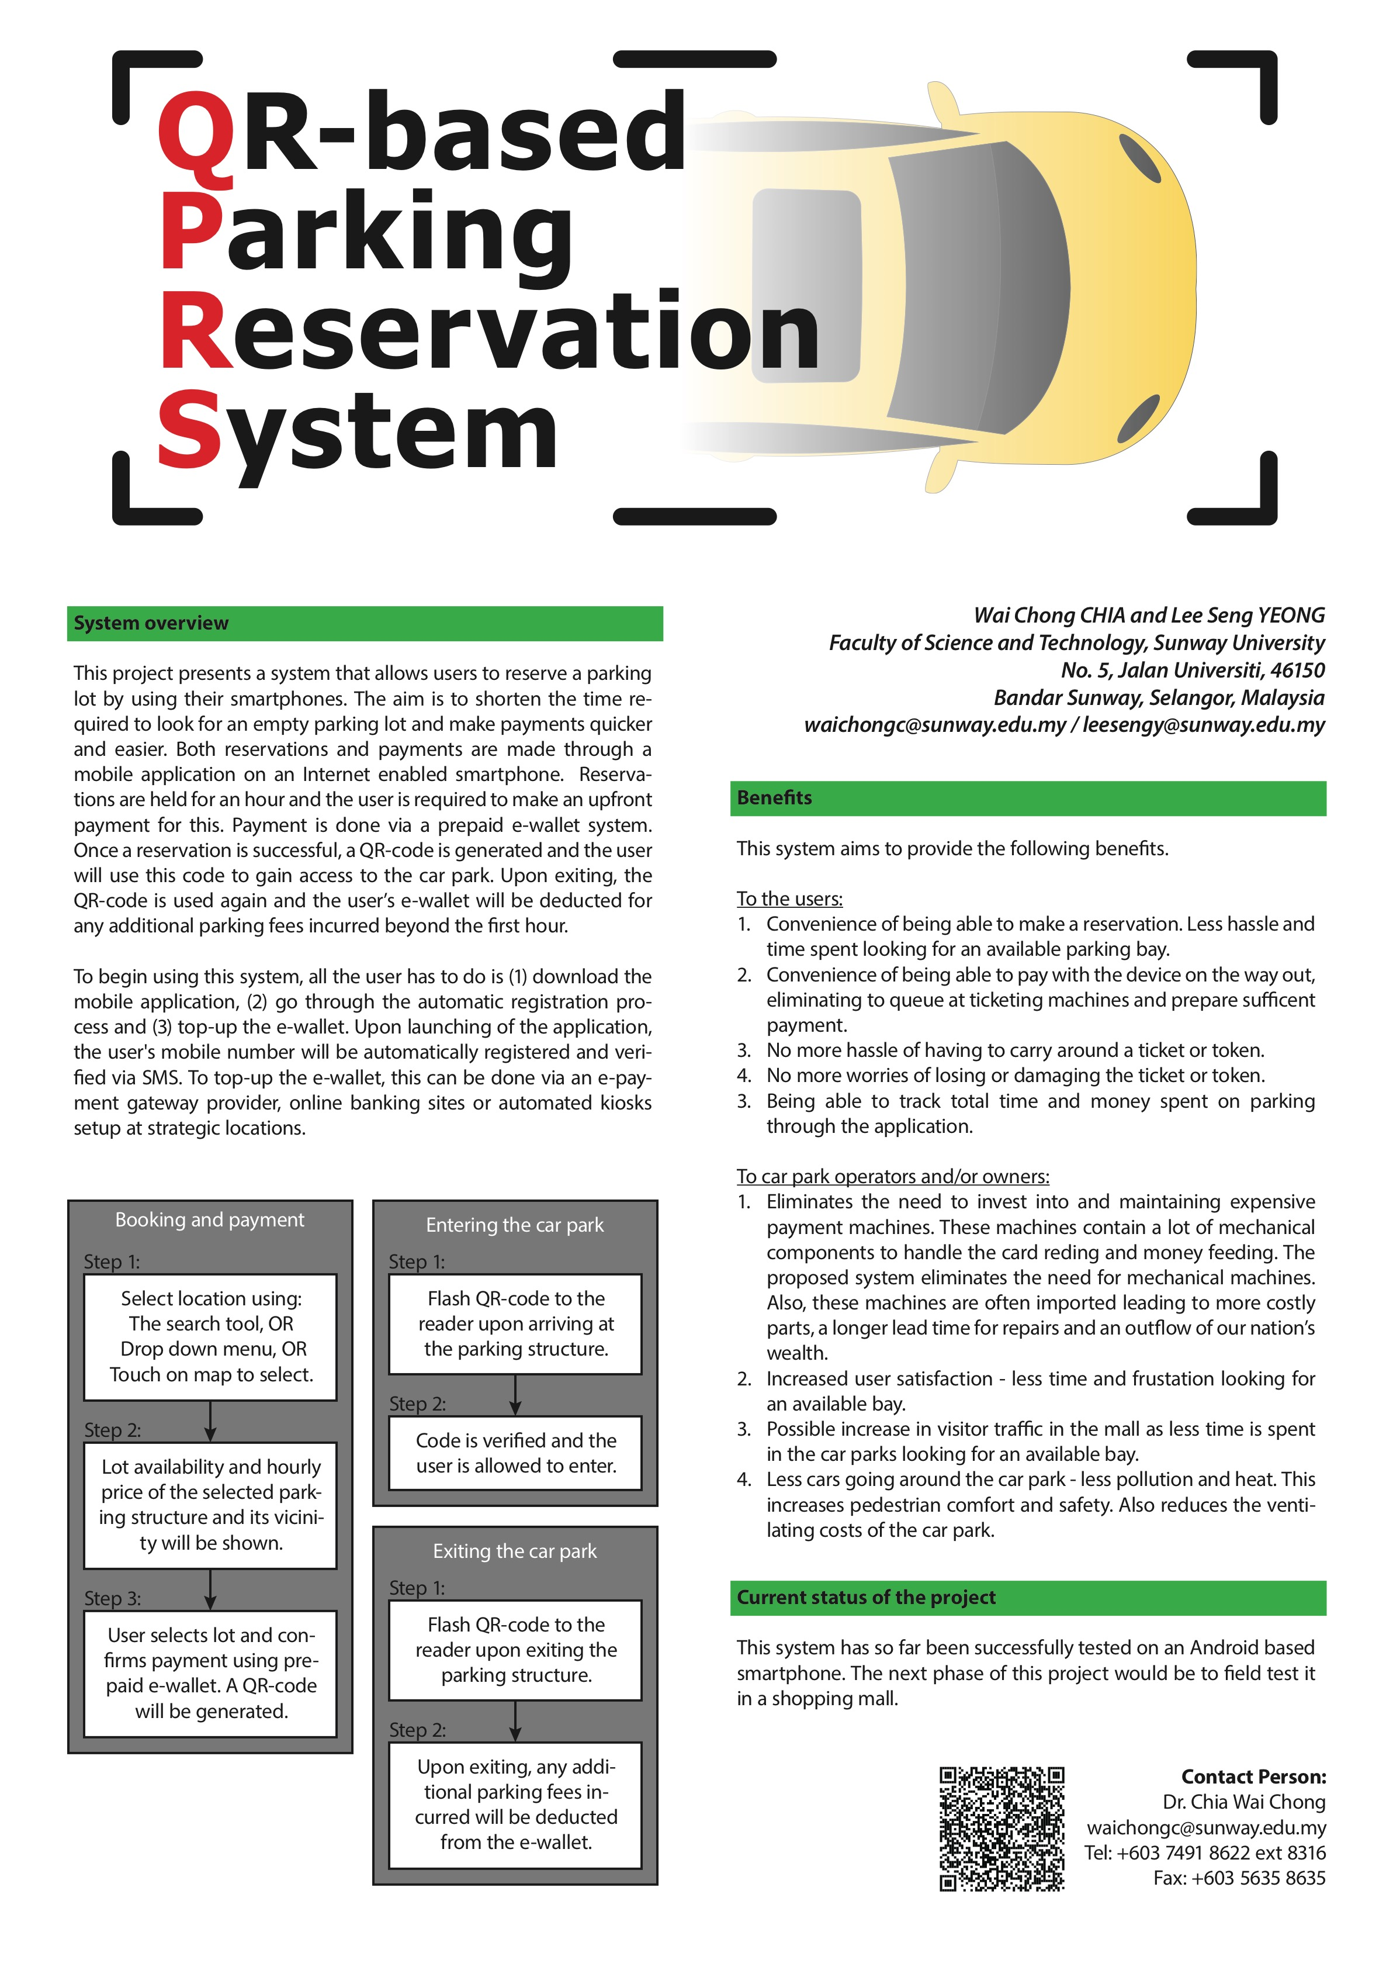
Abstract
Ali, Ah Beng, Ah Huat, Ah Sam

Slide 4
What’s an Abstract?
A very concise summary of your work.
Usually the last item that you write, but it really depends.
Get your abstract correct before you start to design your poster.

Slide 5
What are the items that I should include?
Motivation: Why do we care?
Problem Statement: What problem you are trying to solve?
Method: How did you solve the problem?
Results: What is the outcome?
Conclusions: How does your work add to the existing ones?

Slide 6
1) Things to find out?
Size does matter!
A4
A2
A3
A0
A1

Slide 7
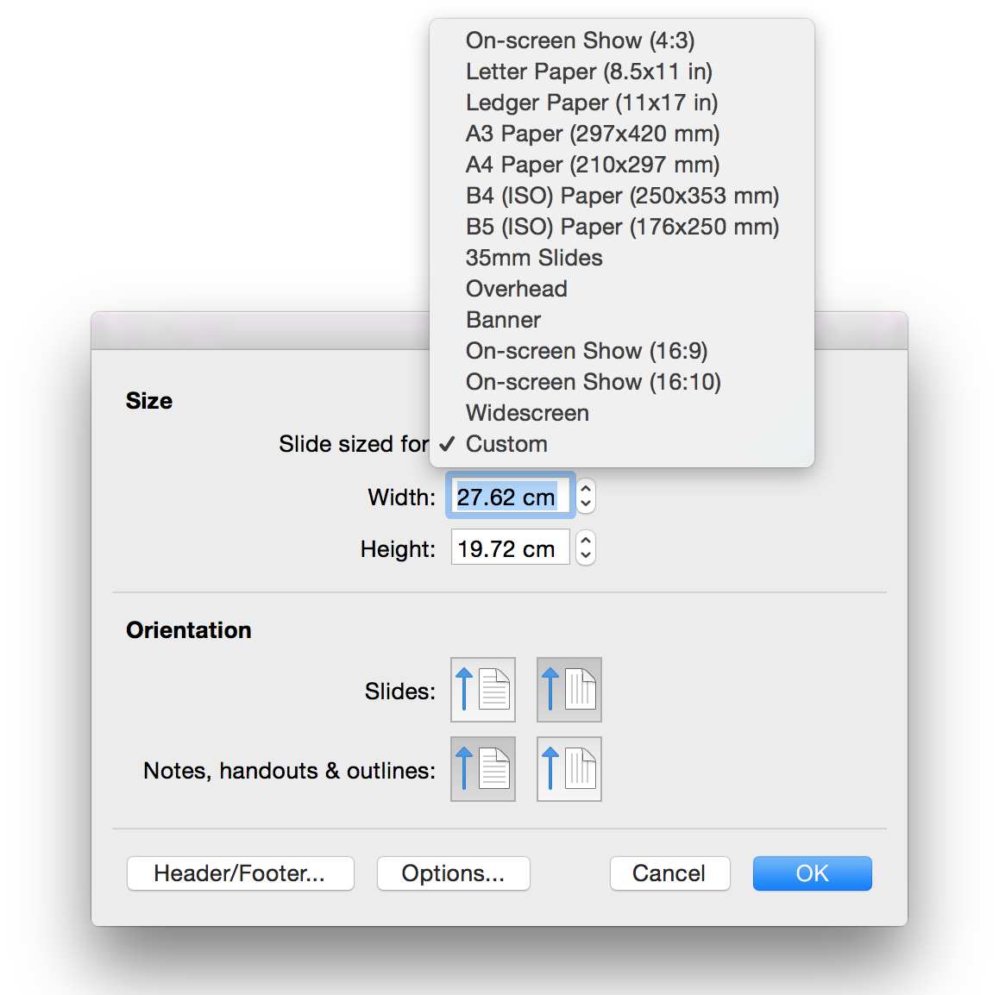
1) Things to find out?
PowerPoint – Page Setup
Adobe Illustrator
Adobe InDesign
LaTeX

Slide 8
1) Things to find out?
Your target audience!
Competitor?
People in your area?
People outside your area?

Slide 9


2) Layout?
101 Ways to Sleep Better
In Class
101 Ways to Sleep Better
In Class
V.S.

Slide 10
2) Layout?
101 Ways to Sleep Better
In Class
101 Ways to Sleep Better
In Class
V.S.

Slide 11
2) Layout?
101 Ways to Sleep Better
In Class
101 Ways to Sleep Better
In Class

Slide 12
3) Font Type and Font Size?
101 Ways to Sleep Better
Author 1, Author 2, Author 3
Title
Bold, NOT CAPS
Author
Names and Affiliation

Slide 13
3) Font Type and Font Size?
Left-Aligned? or Justified?
I am just writing a very long sentence with a load of words to demonstrate the difference between left-aligned and justified. If you are using software like Microsoft PowerPoint , it is very hard to fine-tune this. This is such a painful process for people with Obsessive Compulsive Disorder (OCD).
I am just writing a very long sentence with a load of words to demonstrate the difference between left-aligned and justified. If you are using software like Microsoft PowerPoint, it is very hard to fine-tune this. This is such a painful process for people with Obsessive Compulsive Disorder (OCD).

Slide 14
3) Font Type and Font Size?
Font Type!
Serif (for Main Text) | San-Serif (for Title)
Times New Roman | Arial Verdana

Slide 15

3) Font Type and Font Size?
Size does matter!

Slide 16
4) Figure?
“A picture is worth a thousand words.”

Slide 17
4) Figure?
Picture resolution does matter.
150 – 300 DPI
Save pictures as PNG or TIF instead of JPEG.

Slide 18
4) Figure?
Graphs

Slide 19

4) Figure?
I will try my best not to have a background picture.

Slide 20
Overall
Your poster should be short and precise (around 500 words).
Describe the few major points.
Trigger the readers to continue reading.
Poster templates are available on eLearn.

Slide 21
Next Week’s Schedule
Face-to-face tutorial classes are ON
Tutorial 5: Kick-start the design of your posters.
Event 5: Guest Speaker – Mr. Jaden Teo from Quandatics (M) Sdn. Bhd.
Date: 27th October 2017 (Friday)
Time: 10am – 11am
Venue: Auditorium 2
The last lecture class (Lecture 6: Portfolio Write-Up) will be rescheduled to 3rd November 2017, 10am – 11am.

