Slide 1
Improving Rental Price in the United States
BUAN6357
Professor: Sourav Chatterjee, PhD
Student: Chun-Li Hou

Slide 2
Introduction
Background, Question, Problem, Need
The client is the management in rental industry.
More of Americans than the other countries people are willing to rent for living but not buy for living. Statistically speaking, it is more than 65% of Americans under 35 years old who decide to rent for living.
The management of rental industry is curious to know if there is anyway to maximize profits.
Our goal for this project is to analyze the data about website crawling from rental websites from the year 2019 to produce recommendation to help improving the pricing of various properties.
We will firstly use different machine learning regression models to decide the best algorithm. Then, we will establish causality by interpreting the estimate coefficients.

Slide 3





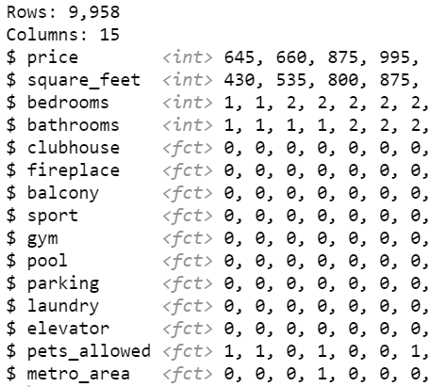







Data
Source, Dataset, Collection, Dimension, Feature Selection
Source: machines learning repository at UCI
Dataset: apartment for rent classified dataset (Fredrick Nilsson)
Collection: crawling from rental websites
Dimension: 9,958 rows and 15 columns
Feature Selection:

Slide 4
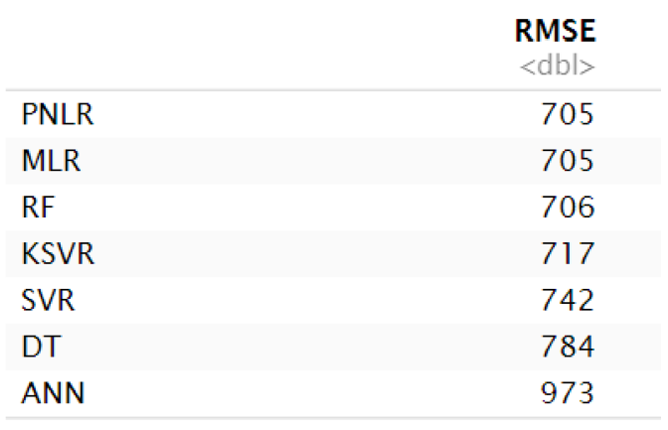
Machine Learning Algorithm
Regression model
PNLR: Polynomial Non Linear Regression
MLR: Multiple Linear Regression
RF: Random Forest Regression
KSVR: Kernel Support Vector Regression
SVR: Support Vector Regression
DT: Decision Tree Regression
ANN: Artificial Neural Network Regression
Notes:
先使用PNLR來當作最優秀的模型，但是後面會因為要兼顧假設，所以會去除掉一些項目，所以會變成是MLR，但是其實兩者的表現程度是一樣的

Slide 5
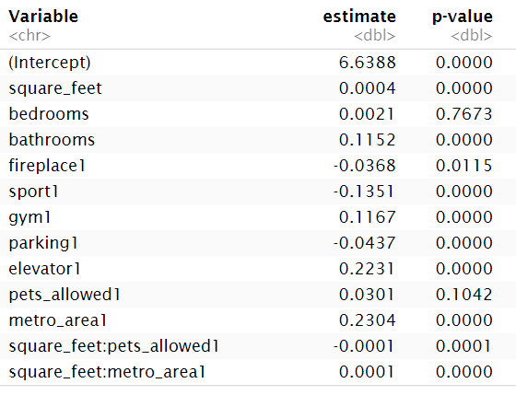
Log-Linear Regression Model
Regression model
log(price) = 6.6388 + 0.0004*square_feet + 0.0021*bedrooms + 0.1152*bathrooms - 0.0368*fireplace - 0.1351*sport + 0.1167*gym - 0.0437*parking + 0.2231*elevator + 0.0301*pets_allowed + 0.2304*metro_area - 0.0001*square_feet:pets_allowed + 0.0001*square_feet:metro_area
Multiple R-squared: 0.332; Adjusted R-squared: 0.331
Bedrooms, Fireplace, Pets_allowed are not statistically different from zero.
Besides that, other coefficients are statistically from zero.
All assumptions are satisfied.
Notes:
可以提到說PLNR和MLP是一樣，後面因為多次項違反col issue所以去除，所以看起來像是MLR

Slide 6
Business Question 1
As considering exercise facility, which exercise facility does increase the price more?
Having the outdoor sport facility, such as basketball field or tennis court, the price decreases by 13.51%.
Having the indoor sport facility, such as gym or fitness center, the price increases by 11.67%.
Thus, indoor exercise facility is more profitable.
Notes:
買屋的人是位老年人，他可能就會覺得底層出去有花園，不僅出門方便且踏實；而家庭主婦可能會覺得中間樓層比較好，至於年輕人就會比較喜歡高樓層的房子

Slide 7
Business Question 2
What apartment attribute affected the price is the most interesting?
The top highest coefficient is metro_area, which means whether the apartment location in a metro area or not. This is not interesting due to a common knowledge.
The second highest coefficient is elevator, which means whether the apartment have elevator or not. This is interesting due to some insights.
As for the apartment having the elevator, the price increases by 22.31%.
Although living in which floors has its pros and cons, having an elevator still significantly positive affect the price.

Slide 8
Business Question 3
How much should the new releasing apartment set the price for some requirements?
Example apartment:
808 square feet apartment in Richardson TX
1 bedroom, 1 bathroom
With gym, parking, and pet allowed
$1340 (actual)
https://www.sublet.com/property/2284864#
log(price) = 6.6388 + 0.0004*808 + 0.0021*1 + 0.1152*1 - 0.0368*0 - 0.1351*0 + 0.1167*1 - 0.0437*1 + 0.2231*0 + 0.0301*1 + 0.2304*0 - 0.0001*808*1 + 0.0001*808*0
Price = $1225 (predict)

Slide 9
Thank You

