Slide 1

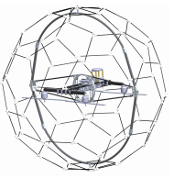
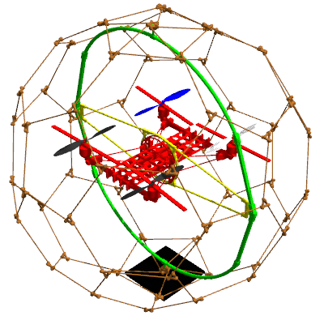
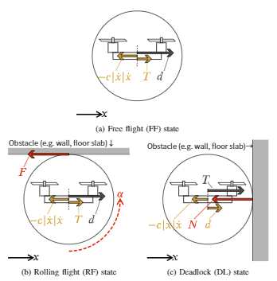
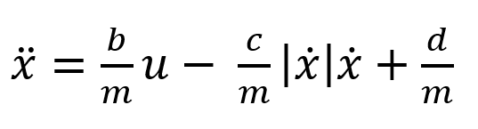
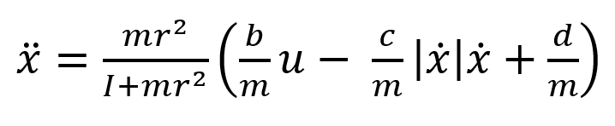
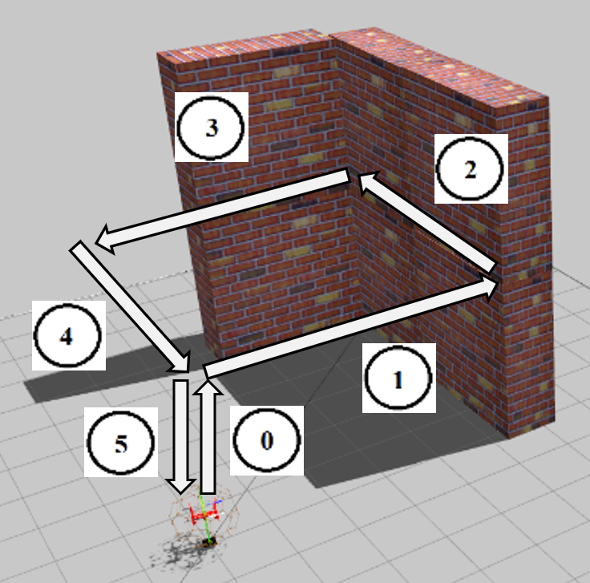
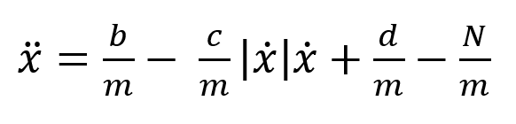
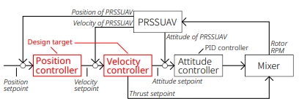
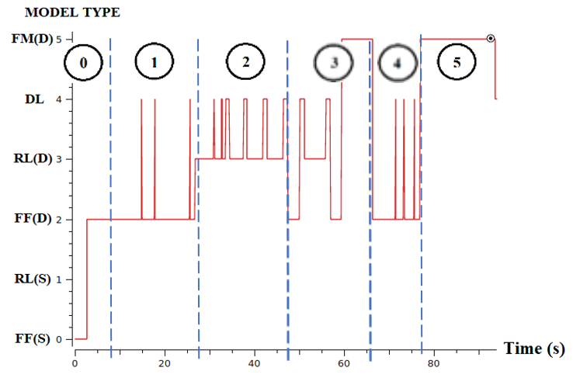

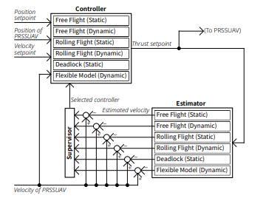

Multiple Model Adaptive Control for Passive Rotating Spherical Shell UAV
Graduate School of Information Science,
Applied Information Science
Human-Robot Informatics-Tadokoro Lab,
Pongsakorn Songsuroj C0IM4022
4040
1. RESEARCH BACKGROUND
x
① Specification
Internal structure is similar to conventional UAV
Use Quadrotor H as a main airframe
3 Rotatable Axis provide 3 degrees of freedom
② Advantages
Fully protected by outer spherical shell
Rollable by 3-DOF
Rough landing support
Able to install camera for inspection purpose
③ Limitation
Complex structure
Need specific control methods due to various movement stages
Passive Rotating Spherical Shell UAV
(PRSSUAV)
2. METHODOLOGY
3. SIMULATION
x
x
2.1 Math's Modelling
Free Flight (FF)
The model and world environment were built on Gazebo simulation with PX4 software in the loop as the firmware for PRSSUAV. The specification of simulated model is displayed below.
3 flight states can be separated according to different flying tasks.
The state when PRSSUAV flies similarly to an ordinary UAV.
Table 1. Specifications of PRSSUAV
Rolling Flight (RF)
Properties | Value
Radius of shell | 1 m.
Weight | 3.15 kg.
Propeller radius | 0.125 m.
The state when PRSSUAV contacts and rotates along surface.
PRSSUAV Model in simulation
Deadlock (DF)
In simulated environment, applying square waypoint to PRSSUAV to let it move from origin to different positions and finally return to origin.
0th waypoint – Takeoff
1st waypoint – No obstacles
2nd waypoint – Obstacles
3rd waypoint – Obstacles
4th waypoint – No obstacles
5th waypoint - Landing
The state when PRSSUAV gets stuck or it holds at given position.
x
2.2 Controller Design
Position controller and velocity controller are only two modules involved in PRSSUAV controlling methods.
Reference velocity and desired thrusts in different states can be acquired as follows.
Tested Environment with Wall Obstacle
4. RESULT
Control Diagram of Multicopter
Model Selection
0th wp – Free flight (D)
1st wp – Free flight (D)
2nd wp – Rolling flight (D) & Deadlock
3rd (1) wp – Rolling flight (D) & Deadlock
3rd (2) wp – Flexible model
4th wp – Free flight (D)
5th wp – Flexible Model
Free Flight (FF)
Rolling Flight (RF)
Deadlock (DF)
5. CONCLUSION
Multiple model adaptive controller selects the state model which has the lowest performance index ( ) for every iteration.
Overall, the model can switch to different dynamic models based on movement states.
At 1st waypoint and 4th waypoint, MMAC spontaneously switched to Deadlock model although PRSSUAV was in Free flight state due to some noises in state estimation.
2nd waypoint periodically switched between Rolling flight and Deadlock models due to obstacles.
Other switching algorithm can be applied to remove noise and improve switching smoothness.

