Slide 1
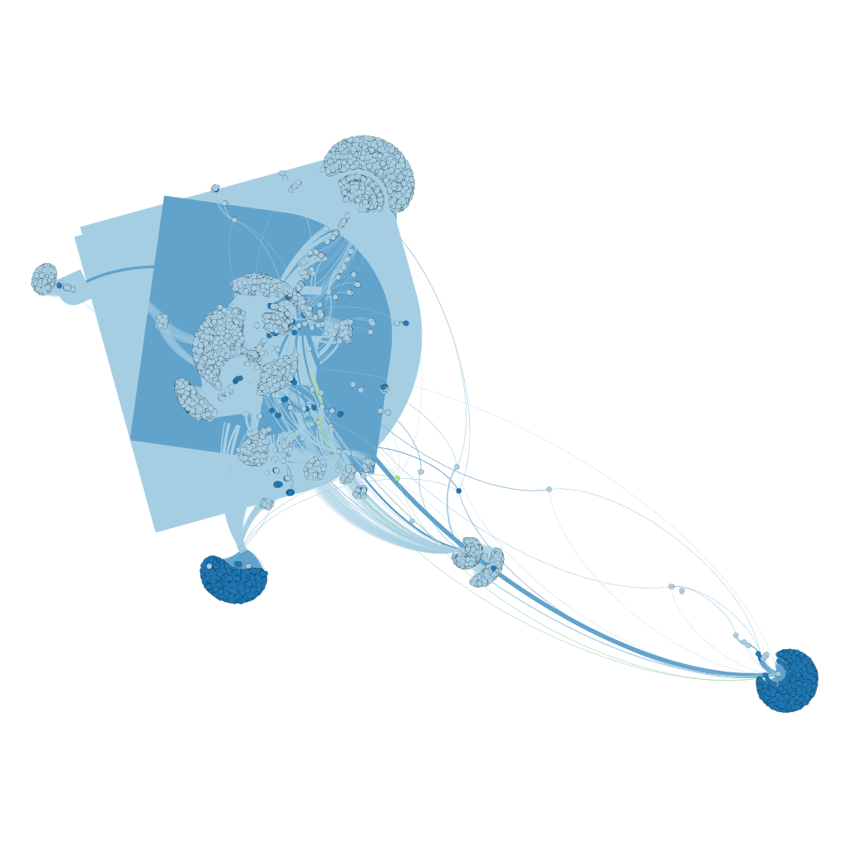
GEXFpy
@chunqishi

