Slide 1
Web Services for Effective NLP Application Development and Evaluation Using and Contributing to The Language Application Grid
Nancy Ide, Keith Suderman
Vassar College
James Pustejovsky, Chunqi Shi, Marc Verhagen
Brandeis University
Eric Nyberg, Di Wang
Carnegie-Mellon University
Christopher Cieri, Denise DiPersio, Jonathan Wright
Linguistic Data Consortium

Slide 2
Today’s Outline
Part I. Introduction
The LAPPS Grid
Nancy Ide, Chris Cieri
Project overview
Architecture
Core nodes and distributed services
The composer platform
Licensing
Available services
Overview of LAPPS web service technology
Nancy Ide
How LAPPS web services work: communication
Protocols and wrappers
Data interchange: JSON and JSON-LD for syntactic interoperability
Data interchange: issues and options for semantic interoperability (LAPPS Web Service Exchange Vocabulary)

Slide 3
Part II. Using the LAPPS Grid: Hands-on exercise
Di Wang, Keith Suderman
Using the composer
Selecting a data source
Creating a processing pipeline: Sample task: Co-reference annotation
Deploying the pipeline
Evaluating performance: Using the Open Advancement Evaluation Environment
Iterative improvement
Modifying the pipeline on the basis of OA analysis
Assessing results
-- Coffee Break --
Part III. Contributing to the LAPPS Grid: Hands-on exercise
Wrapping tools as web services
Chunqi Shi, Marc Verhagen
Mapping input and output to the exchange vocabulary
Keith Suderman
Registering services in the LAPPS Grid
Chunqi Shi, Marc Verhagen

Slide 4
The LAPPS Grid Project
Collaborative effort among US partners
Brandeis University
Vassar College
Carnegie-Mellon University
Linguistic Data Consortium (University of Pennsylvania)
Funded by the US National Science Foundation
Builds on
foundation laid in several projects: US/NSF SILT, Japanese Language Grid, EU PANACEA, CELI LinguaGrid…
momentum toward a comprehensive network of web services and resources within the NLP community

Slide 5
Goals
Design, develop, and promote a Language Application Grid based on Service Grid Software
Support development and deployment of integrated natural language applications
Enable federation of grids and services
Provide an open advancement (OA) framework for component- and application-based evaluation
Provide access to language resources for members of the NLP community as well as researchers in a wide range of social science and humanities disciplines
Enable easy navigation through licensing issues
Actively promote adoption, use, and community involvement with the LAPPS Grid

Slide 6
Functionality
Provides access to
basic NLP processing tools
language resources such as mono- and multi-lingual corpora and lexicons
Enables pipelining tools to create custom NLP applications and composite services (e.g., question answering, machine translation)
Ultimately a community-based project
Services contributed by members of the community
Existing service repositories and grids federated to enable universal access

Slide 7
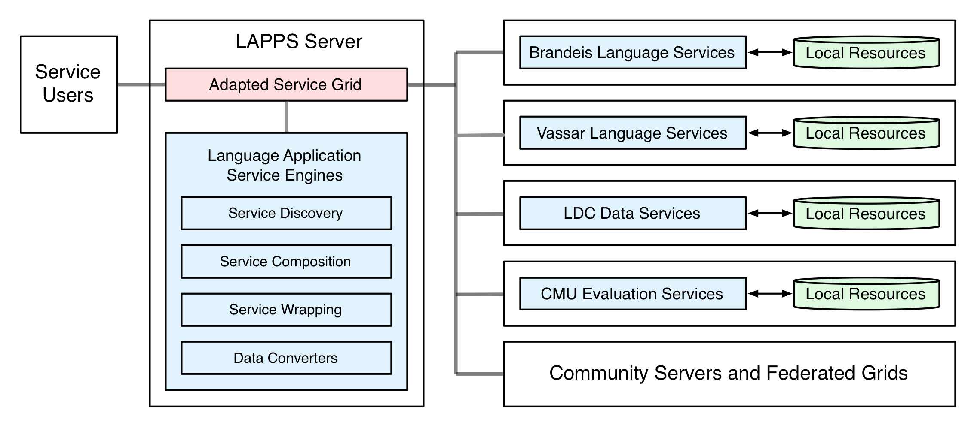
LAPPS Grid Architecture
workflow repository for composite linguistic services
workflow engine to enable users to develop composite (pipelined) services
modules for discovery, wrapping and conversion
House repositories of known atomic linguistic services, provide service discovery functionality to users and applications
Services for automatic instrumentation and performance measurement, error analysis
Data delivery for LDC holdings
Ultimately:
a world-wide network of grids and services
Federation with Language Grid and 3 Asian partners
Future federation with European Service platforms

Slide 8
Interoperability among Services
Each service in the LAPPS Grid publishes metadata describing what it requires for input and what it produces as output
Processes constructing a service pipeline query each service to determine compatibility
Use JSON-based serialization for Linked Data (JSON-LD) to represent linguistically annotated data for web service exchange
lightweight, text-based, language-independent data interchange format
small set of formatting rules for portable representation of structured data
based on the W3C Resource Definition Framework (RDF)
trivially maps to and from other graph-based formats such as ISO LAF/GrAF, UIMA CAS
enables services to reference categories and definitions in web-based repositories and ontologies or any concept defined at a given URI

Slide 9
LAPPS Exchange Vocabulary
No accepted standard for module description or input/output interchange in the language application domain currently exists
LAPPS Web Service Exchange Vocabulary (WS-EV)
specifies a terminology for a core of linguistic objects and features exchanged among NLP tools that consume and produce linguistically annotated data
addresses a need within the community to identify a standard terminology and indicate the relations among them
Repositories such as ISOCat etc. focus on data categories, do not always define items such as “token”, provide multiple definitions for the same concept, do not specify relations among terms, etc.

Slide 10
LAPPS WS-EV Repository
http://vocab.lappsgrid.org
Shallow hierarchy of elements
Inheritance

Slide 11
JSON-LD and WS-EV
References in JSON-LD representation point to URIs providing definitions for specific linguistic categories in the WS-EV
Also point to documentation for processing software and rules for processes such as tokenization, entity recognition, etc.
Often left unspecified in annotated resources
Not required for web service exchange in the LAPPS Grid
BUT inclusion of such references can contribute to better replication and evaluation of results in the field
Promote best practice!

Slide 12
User definition of objects and features
Many web services will require definition of objects and properties not included in the WS-EVR or elsewhere
Options
Provide a URI where a new term or other documentation is defined
Add a definition to the WS-EVR
Service providers use the name space automatically assigned to them at the time of registration
Avoids name clashes
Makes a distinction between general categories used across services and more idiosyncratic categories

Slide 13
LAPPS Web Composer
Web user interface
Currently supports
Registration of tools and resources, making them accessible through the LAPPS Grid
Browsing available resources and services
Searching available atomic web services to identify components of interest
Also helps LAPPS users to rapidly compose a service workflow, run experiments, and display results

Slide 14
Composer
Select a data source service or upload text in ad-hoc document field
^{Drag} service names from the available services tab, drop into selected services tab
User configures which steps generate the gold and predicted annotations

Slide 15
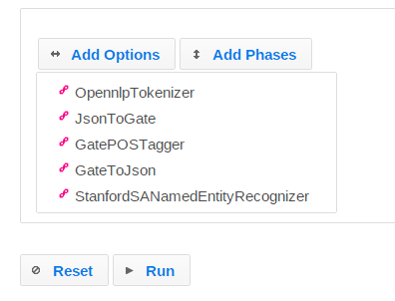
Mapping to and from JSON-LD
Where necessary, the encapsulating service provides a mapping to/from input and output JSON-LD realizations to be used internally by the tool

Slide 16
Open Advancement in a Nutshell
Evaluate multiple possible solutions to a given problem
Determine the optimal solution available using given components, resources, and evaluation data
Output of the optimal solution subjected to error analysis
Identify the most frequent errors with the highest impact
Consider possible enhancements
Aim to achieve the largest possible reduction in error rate by addressing the most frequent error types
Evaluate performance of new configurations
Determine if a significant improvement has been achieved in comparison with prior baselines

Slide 17
Licensing: Web Service Complexities
New ecosystem, licensing has not caught up
no bright line between derivative and transformative works
Multiple configurations of web services
Distributed: no provider or user controls whole ecosystem
Multiple types of stakeholder, in the grid case
grid operator
software service provider
data service provider
user
Approaches
control providers and/or
control users
laissez faire

Slide 18
Licensing: Web Service Complexities
Licensing types differ
software licenses: typically constrain use of software and derived works, typically considered other software
no software licenses surveyed attempt to constrain their output
data licenses: typically constrain use of data and derived works, typically considered other data (which is output)
No calculus of licensing constraints
1 LR constraints against commercial use; 1 LR allows it. What is the impact on a product that uses both?
Nevertheless, motivations to correctly handle IP
protection for contributors
peace of mind for users
legal requirement, contractual obligation

Slide 19
Current State of the Project
Prototype of eventual LAPPS functionality
Composer
Basic functionality
register/delete LAPPS data sources and web services, choose a registered data source as the input document, edit ad-hoc text documents to serve as input, browse/filter/select available services
Initial prototype of open advancement for LAPPS
supports drag/drop/re-order/group atomic services to create service pipelines, run services in parallel for "options" group, run services sequentially for "phases" group (the main pipeline is under "phases" group by default)
Evaluation function
click intermediate steps in the trace tree to view JSON output for that step, specify annotation type, gold standard producer (annotator name), and prediction producer to evaluate, generate an evaluation report containing metrics such as precision, recall, f1 measures, and an annotation difference table that aligns gold and predicted annotations with highlighted rows when they do not match

Slide 20
Current State of the Project
Available Data Sources
MASC (plain text, GrAF, JSON-LD)
Gigaword (XML)
Available Services
Composer
Evaluation
GATE Tools:
Tokenizer
Sentence Splitter
POS Tagger
Gazetteer
Orthomatcher
NP Chunker
VP Chunker
Coreferencer
Named Entity Recognizer
Stanford Tools:
Tokenizer
Sentence Splitter
POS Tagger
Named Entity Recognizer
OpenNLP Tools:
Tokenizer
Sentence Splitter
POS Tagger
Named Entity Recognizer

Slide 21
Overview of LAPPS Web Service Technology

Slide 22
Web Services Terminology
Protocols such as SOAP allow servers and clients to communicate
SOAP: Originally stood for "Simple Object Access Protocol”
SOAP uses WSDL to describe the services available
WSDL: Web Services Description Language
Describes services in terms of their
Methods
Parameters
Return Values
REST is an “architectural style” that allows servers and clients to communicate
REST: Representational State Transfer
Provides base URI, media type
Uses standard HTTP methods (get, put, post, delete…)

Slide 23
Web Services in LAPPS
LAPPS SOAP services provide two APIs
org.lappsgrid.api.DataSource
Provides data to other services
org.lappsgrid.api.WebService
Annotate, transform, or otherwise manipulate data from a datasource or another web service

Slide 24
Web Service Communication in LAPPS
All LAPPS services exchange org.lappsgrid.api.Data objects
Data objects consist of
a discriminator (type) : tells how to interpret the payload
a payload (typically a utf-8 string)
LAPPS uses JSON-LD as its standard format for the payload
Converters to and from JSON-LD for services that deliver in other formats
Some LAPPS services are wrapped to produce and consume JSON-LD

Slide 25
Logical flow
(client-server communication not represented)
Data
source
UIMA
service
UIMA CAS
UIMA
service
GATE
service
GATE
service
GATE XML
OpenNLP
service
OpenNLP
service
Stanford NLP
service
Stanford NLP
service
LAPPS services for OpenNLP and Stanford NLP tools are wrapped to produce and consume JSON-LD
JSON-LD output
Converter to JSON-LD
Converter from JSON-LD

Slide 26
Interoperability
Basic interoperability handled by SOAP/WSDL
Syntactic interoperability among NLP tools handled by JSON-LD
Semantic interoperability among NLP tools handled with the LAPPS Exchange Vocabulary

Slide 27
JSON-LD and the LAPPS Exchange Vocabulary
"@context" : "http://vocab.lappsgrid.org/",
"metadata" : { },
"text" : {
"@value" : “Some of the strongest critics of our welfare system …
"steps" : [ {
"metadata" : {
"contains" : {
"Token" : {
"producer" : "org.anc.lapps.stanford.SATokenizer:1.4.0",
"type" : "stanford"
}
}
},
"annotations" : [ {
"@type" : "Token",
"id" : "tok0",
"start" : 18,
"end" : 22,
"features" : {
”string" : "Some"
}
},
Provides the base URI for the LAPPS Exchange Vocabulary
Metadata for the annotations
Token defined at http://vocab.lappsgrid.org/Token
Features for Token defined at http://vocab.lappsgrid.org/Token

