Slide 1
Web Services for Effective NLP Application Development and Evaluation Using and Contributing to The Language Application Grid
Nancy Ide, Keith Suderman
Vassar College
James Pustejovsky, Chunqi Shi, Marc Verhagen
Brandeis University
Eric Nyberg, Di Wang
Carnegie-Mellon University
Christopher Cieri, Denise DiPersio, Jonathan Wright
Linguistic Data Consortium

Slide 2
Today’s Outline
Part I. Introduction
The LAPPS Grid
Nancy Ide, James Pustejovsky, Chris Cieri, Denise DiPersio
Project overview
Architecture
Core nodes and distributed services
The composer platform
Licensing
Available services
Data sources
NLP components
Open Advancement evaluation services
Overview of LAPPS web service technology
Nancy Ide
How LAPPS web services work: communication
Protocols and wrappers
Data interchange: JSON and JSON-LD for syntactic interoperability
Data interchange: issues and options for semantic interoperability (LAPPS Web Service Exchange Vocabulary)
Advantages of web services for NLP applications

Slide 3
Part II. Contributing to the LAPPS Grid: Hands-on exercise
Wrapping tools as web services
Chunqi Shi, Marc Verhagen
Mapping input and output to the exchange vocabulary
Keith Suderman, Nancy Ide
Registering services in the LAPPS Grid
Chunqi Shi, Marc Verhagen
-- Coffee Break --
Part III. Using the LAPPS Grid: Hands-on exercise
Di Wang, Keith Suderman
Using the composer
Selecting a data source
Creating a processing pipeline: Sample task: Co-reference annotation
Deploying the pipeline
Evaluating performance: Using the Open Advancement Evaluation Environment
Iterative improvement
Modifying the pipeline on the basis of OA analysis
Assessing results

Slide 4
The LAPPS Grid Project
Collaborative effort among US partners
Brandeis University
Vassar College
Carnegie-Mellon University
Linguistic Data Consortium (University of Pennsylvania)
Funded by the US National Science Foundation
Builds on
foundation laid in several projects: SILT (Ide et al., 2009), The Language Grid, PANACEA, LinguaGrid…
momentum toward a comprehensive network of web services and resources within the NLP community

Slide 5
Goals
Design, develop, and promote a Language Application Grid based on Service Grid Software
Support development and deployment of integrated natural language applications
Enable federation of grids and services
Provide an open advancement (OA) framework for component- and application-based evaluation
Provide access to language resources for members of the NLP community as well as researchers in a wide range of social science and humanities disciplines
Enable easy navigation through licensing issues
Actively promote adoption, use, and community involvement with the LAPPS Grid

Slide 6
Functionality
Provides access to
basic NLP processing tools
language resources such as mono- and multi-lingual corpora and lexicons
Enables pipelining tools to create custom NLP applications and composite services (e.g., question answering, machine translation)
Ultimately a community-based project
Services contributed by members of the community
Existing service repositories and grids federated to enable universal access

Slide 7
Overall Architecture
Based on the Open Service Grid Initiative’s Service Grid Server Software
Developed by the National Institute of Information and Communications Technology (NICT) in Japan
Used to implement Kyoto University’s Language Grid

Slide 8
Extension of Service Grid Software
Enhances capabilities for composition of tool and resource chains
Provides sophisticated evaluation services
Implements a dynamic licensing system for handling license agreements on the fly
Provides the option to run services locally, with high-security technology to protect sensitive information
Improves data delivery services
Enables access to grids other than those based on the Service Grid technology
Provides user-friendly, transparent facilities for wrapping user-provided services

Slide 9
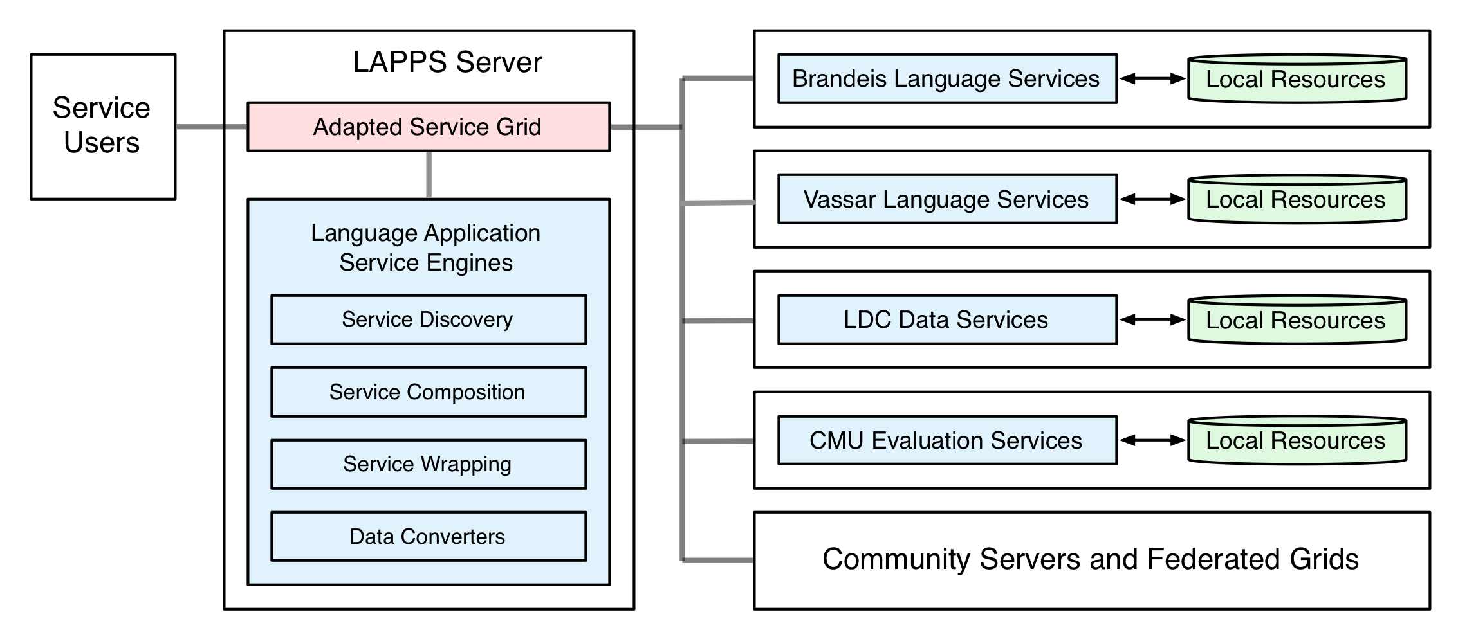
LAPPS Grid Architecture
workflow repository for composite linguistic services
workflow engine to enable users to develop composite (pipelined) services
modules for discovery, wrapping and conversion
House repositories of known atomic linguistic services, provide service discovery functionality to users and applications
Services for automatic instrumentation and performance measurement, error analysis
Data delivery for LDC holdings
Ultimately:
a world-wide network of grids and services
Federation with Language Grid and 3 Asian partners
Future federation with European Service platforms

Slide 10
Interoperability among Services
Each service in the LAPPS Grid publishes metadata describing what it requires for input and what it produces as output
Processes constructing a service pipeline query each service to determine compatibility
Use JSON-based serialization for Linked Data (JSON-LD) to represent linguistically annotated data for web service exchange.
lightweight, text-based, language-independent data interchange format
small set of formatting rules for portable representation of structured data
based on the W3C Resource Definition Framework (RDF)
trivially mappable to and from other graph-based formats such as ISO LAF/GrAF , UIMA CAS
enables services to reference categories and definitions in web-based repositories and ontologies or any concept defined at a given URI
LAPPS data converters map from commonly used formats to JSON-LD
Converters automatically invoked as needed to meet the I/O requirements of pipelined services

Slide 11
LAPPS/ISO Exchange Vocabulary
No accepted standard for module description or input/output interchange in the language application domain currently exists
LAPPS/ISO Web Service Exchange Vocabulary (WS-EV)
specifies a terminology for a core of linguistic objects and features exchanged among NLP tools that consume and produce linguistically annotated data
addresses a need within the community to identify a standard terminology and indicate the relations among them
Repositories such as ISOCat etc. focus on data categories, do not define items such as Token, provide multiple definitions for the same concept, do not specify relations among terms, etc.

Slide 12
LAPPS WS-EV Repository
http://vocab.lappsgrid.org
Shallow hierarchy of elements
Inheritance

Slide 13
JSON-LD and WS-EV
References in JSON-LD representation point to URIs providing definitions for specific linguistic categories in the WS-EV
Also point to documentation for processing software and rules for processes such as tokenization, entity recognition, etc.
Often left unspecified in annotated resources
Not required for web service exchange in the LAPPS Grid
BUT inclusion of such references can contribute to better replication and evaluation of results in the field
Promote best practice!

Slide 14
User definition of objects and features
Many web services will require definition of objects and properties not included in the WS-EVR or elsewhere
Options
Provide a URI where a new term or other documentation is defined
Add a definition to the WS-EVR
Service providers use the name space automatically assigned to them at the time of registration
Avoids name clashes
Makes a distinction between general categories used across services and more idiosyncratic categories

Slide 15
LAPPS Web Composer
Web user interface
Currently supports
Registration of tools and resources, making them accessible through the LAPPS Grid
Browsing available resources and services
Searching available atomic web services to identify components of interest
Also helps LAPPS users to rapidly compose a service workflow, run experiments, and display results

Slide 16
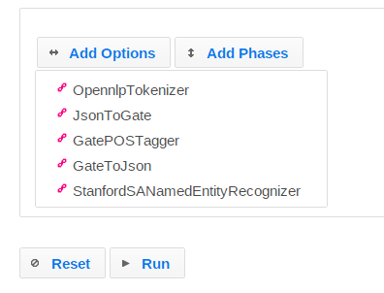
Mapping to and from JSON-LD
Where necessary, the encapsulating service provides a mapping to/from input and output JSON-LD realizations to be used internally by the tool

Slide 17
Open Advancement
CMU is providing the tooling and infrastructure for two major services
Based on the existing OAQA framework developed at CMU
Implement state-of-the-art Open Advancement techniques
Provides an unprecedented tool for NLP development
Could take the field to a new level of productivity
OA approach has been successful in enabling rapid identification of
frequent error categories within modules and documents
which module(s) and error type(s) have the greatest impact on overall performance
Used in the development of IBM’s Watson to achieve steady performance gains over the four years of its development

Slide 18
Open Advancement in a Nutshell
Evaluate multiple possible solutions to a given problem
Determine the optimal solution available using given components, resources, and evaluation data
Output of the optimal solution subjected to error analysis
Identify the most frequent errors with the highest impact
Consider possible enhancements
Aim to achieve the largest possible reduction in error rate by addressing the most frequent error types
Evaluate performance of new configurations
Determine if a significant improvement has been achieved in comparison with prior baselines

Slide 19
Resource Access

Slide 20
Current State of the Project
Composer
Basic functionality
register/delete LAPPS data sources and web services
choose a registered data source as the input document
edit ad-hoc text documents to serve as input
browse/filter/select available services
Initial prototype of open advancement for LAPPS supports:
drag/drop/re-order/group atomic services to create service pipelines
run services in parallel for "options" group
run services sequentially for "phases" group (the main pipeline is under "phases" group by default)
Built-in evaluation function
click intermediate steps in the trace tree to view JSON output for that step
specify annotation type, gold standard producer (annotator name), and prediction producer to evaluate
generate an evaluation report containing metrics such as precision, recall, f1 measures, and an annotation difference table that aligns gold and predicted annotations with highlighted rows when they do not match

Slide 21
Current State of the Project
Available services
Data Sources
MASC DataSource
Gigaword DataSource

Slide 22
Overview of LAPPS Web Service Technology

Slide 23
Web Services Terminology
Protocols such as SOAP allow servers and clients to communicate
SOAP: Originally stood for "Simple Object Access Protocol”
SOAP uses WSDL to describe the services available
WSDL: Web Services Description Language
Describes services in terms of their
Methods
Parameters
Return Values
REST is an “architectural style” that allows servers and clients to communicate
REST: Representational State Transfer
Provides base URI, media type
Uses standard HTTP methods (get, put, post, delete…)

Slide 24
Web Services in LAPPS
LAPPS SOAP services provide two APIs
org.lappsgrid.api.DataSource
Provides data to other services
org.lappsgrid.api.WebService
Annotate, transform, or otherwise manipulate data from a datasource or another web service

Slide 25
Web Service Communication in LAPPS
All LAPPS services exchange org.lappsgrid.api.Data objects
Data objects consist of
a discriminator (type) : tells how to interpret the payload
a payload (typically a utf-8 string)
LAPPS uses JSON-LD as its standard format for the payload
Converters to and from JSON-LD for services that deliver in other formats
Some LAPPS services are wrapped to produce and consume JSON-LD

Slide 26
Data
source
UIMA
service
UIMA CAS
UIMA
service
GATE
service
GATE
service
GATE XML
OpenNLP
service
OpenNLP
service
Stanford NLP
service
Stanford NLP
service
LAPPS services for OpenNLP and Stanford NLP tools are wrapped to produce and consume JSON-LD
JSON-LD output
Converter to JSON-LD
Converter from JSON-LD

Slide 27
Interoperability
Basic interoperability handled by SOAP/WSDL
Syntactic interoperability among NLP tools handled by JSON-LD
Semantic interoperability among NLP tools handled with the LAPPS Exchange Vocabulary

Slide 28
JSON-LD and the LAPPS Exchange Vocabulary
"@context" : "http://vocab.lappsgrid.org/",
"metadata" : { },
"text" : {
"@value" : “Some of the strongest critics of our welfare system …
"steps" : [ {
"metadata" : {
"contains" : {
"Token" : {
"producer" : "org.anc.lapps.stanford.SATokenizer:1.4.0",
"type" : "stanford"
}
}
},
"annotations" : [ {
"@type" : "Token",
"id" : "tok0",
"start" : 18,
"end" : 22,
"features" : {
”string" : "Some"
}
},
Provides the base URI for the LAPPS Exchange Vocabulary
Metadata for the annotations
Token defined at http://vocab.lappsgrid.org/Token
Features for Token defined at http://vocab.lappsgrid.org/Token

