Slide 1
Overview of Web Service Technology
Lapps Grid Group
May 26, 2014

Slide 2
Outline
Introduction
Web Service Model
Web Service Techniques
Service Oriented Architecture
Conclusion

Slide 3
Introduction
Motivation
Previous distributed computing solutions (CORBA, Java RMI) imply tight coupling between various components in a system.
High level of coordination and shared context among business systems from different organizations needed.
Service computing: systems composed by loosely coupled, dynamically flexible bound elements (distributed pieces of software-called services).

Slide 4
What is Web Service
Concept
A Web service is any piece of software that makes itself available over the internet and uses a standardized XML messaging system.
A Web service is a software system designed to support interoperable machine-to-machine interaction over a network (W3C).
Web Services are self-contained, modular, distributed, dynamic applications that can be described, published, located, or invoked over the network to create products, processes, and supply chains (IBM).
A Web service is a collection of open protocols and standards used for exchanging data between applications or systems (tutorials point).

Slide 5
Application Infrastructure Architecture Evolvement
Client-Server Architecture: composed by multiple fat clients where each of them needed to connect to a central server.
Distributed Internet Architecture: multi-tier client-server applications divide the monolithic client executable into components designed to different degrees of compliance with object orientation
Web Services Architecture: transformation from object-oriented systems toward systems of services can be observed, which contain behavior and messages
Service-Oriented Architecture (SOA): more complex composed services representing greater added value that applications become more flexible due to their ability to interact with any implementation of a contract

Slide 6

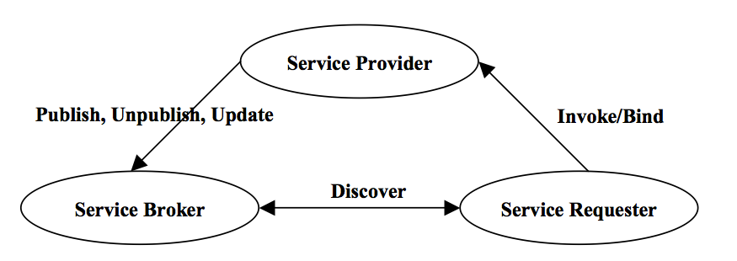
Web Service Model
Basic Activities
Creation
Description
Publishing
Discovery
Invocation
Un-publishing

Slide 7
Artifacts, Roles and Operations
Artifacts
Services: implementation of an interface described by service description.
Service Descriptions: including data types, operations, binding informations, and network location
Roles
Service Provider: owner of the services
Service Requestor: business (user / program) that requires certain functions be satisfied.
Service Broker/Registry: where provider publish service description (optional)
Operations
Publish ( to be accessible and a service description needed)
Discovery/Find (according to service description, interface description, location description)
Invoke/Bind (runtime biding and invoke)

Slide 8
Web Service Techniques
The web services description language (WSDL)
WSDL plays a role analogous to Interface Definition Language (IDL) used in distributed programming
The simple object access protocol (SOAP)
SOAP is a standard for sending messages and making remote procedure calls over the Internet. It is independent of the programming language, object model, operating system and platform.
Universal description, discovery, integration (UDDI)
UDDI defines a common means to publish information (type of service, locate information) about businesses and services.

Slide 9
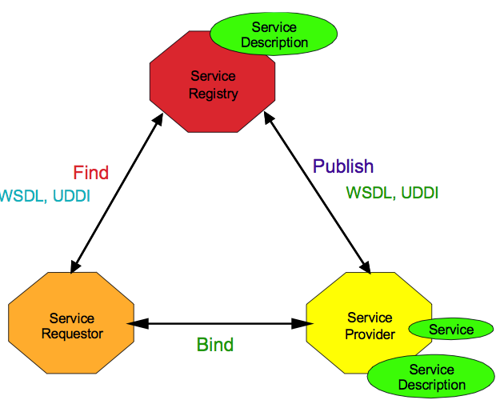
How SOAP, WSDL and UDDI are Related?
SOAP

Slide 10
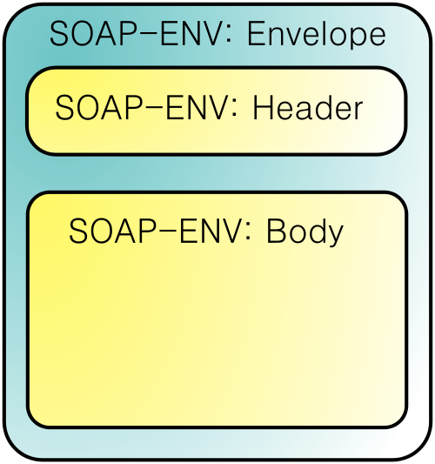
SOAP
SOAP was designed as an object-access protocol in 1998 by Dave Winer, Don Box, Bob Atkinson, and Mohsen Al-Ghosein for Microsoft
SOAP is the successor of XML-RPC, though it borrows its transport and interaction neutrality and the envelope/header/body from elsewhere
SOAP becomes the underlying layer of a more complex set of Web Services, based on Web Services Description Language (WSDL) and Universal Description Discovery and Integration (UDDI)

Slide 11
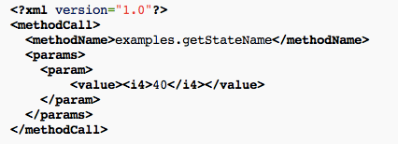
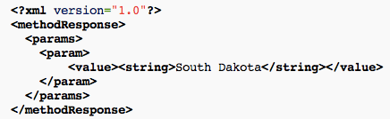
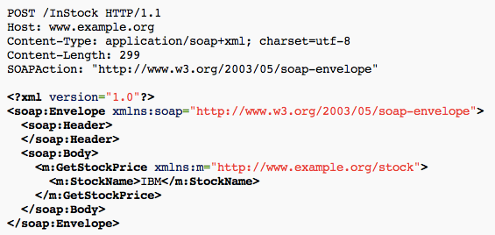
XML-RPC Request
XML-RPC Response
SOAP

Slide 12
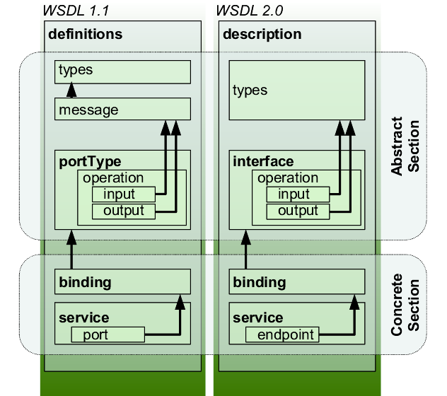
WSDL
types:“a container for data type definitions using some type system (such as XSD)”.
portType/interface: “an abstract set of operations supported by one or more endpoints”.
binding: “a concrete protocol and data format specification for a particular port type”.
port/endpoint: “a single endpoint defined as a combination of a binding and a network address”.

Slide 13
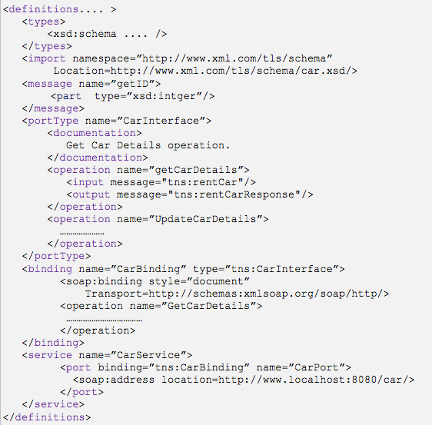


Type
Message
WSDL 1.1 elements
Service
Interface
Definition
PortType
Binding
Service
Service
Implementation
Definition
Port

Slide 14
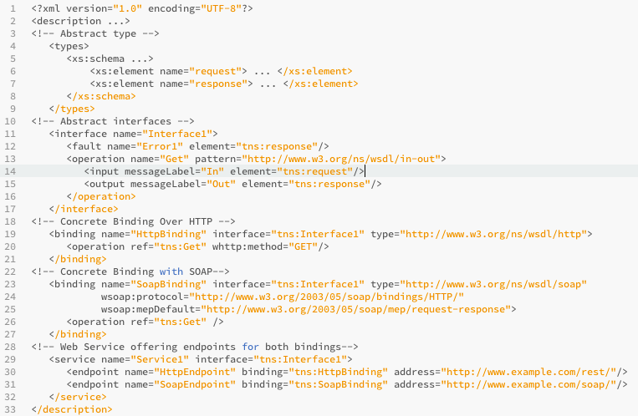
Types
WSDL 2.0 elements
Interface
Binding
Service
Endpoint

Slide 15
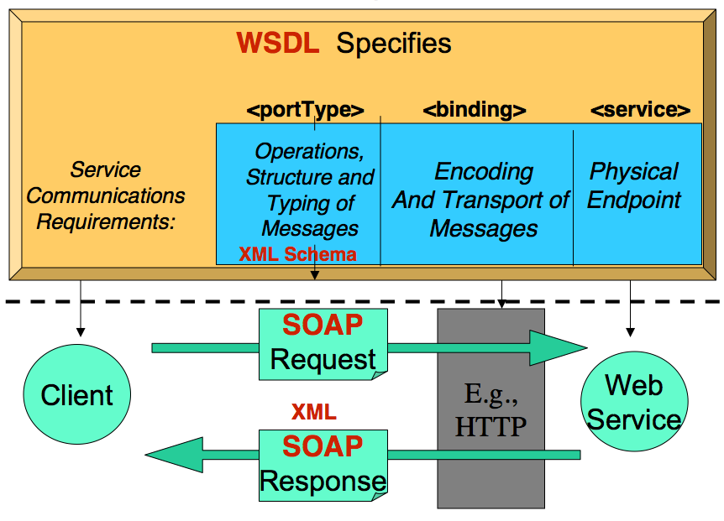
WSDL to SOAP Mapping

Slide 16
UDDI
Business information: information that is contained in a businessEntity structure.
Service information: information that describes a group of Web services. It is contained in a businessService structure.
Binding information: information represented by the bindingTemplate structure.
Information describing the specifications for services: metadata about the various specifications implemented by a given Web service represented by the tModel.

Slide 17
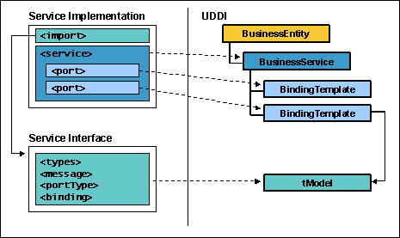
WSDL to UDDI Mapping

Slide 18
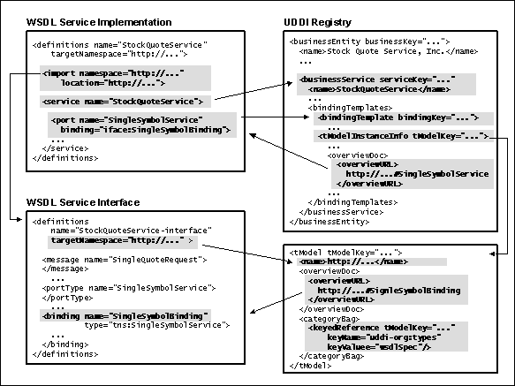

Slide 19
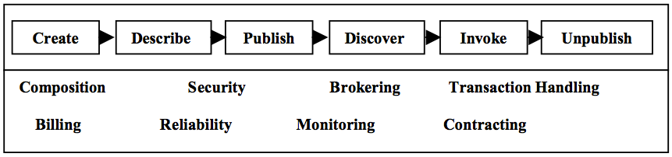
Service Oriented Architecture
Definition:
Service-oriented architecture (SOA) is a software design and software architecture design pattern based on discrete pieces of software providing application functionality as services to other applications
Characteristics
Interoperable, Loosely Coupled, Reusable, Scalable
Value-Added Layer

Slide 20
Web Service and SOA
EAI
Technology Realization
Messaging
EDI / B2B
Web Site/Portal
Distributed Computing
Policies
Frameworks
Standard Protocols
Practices
Universal Support
Existing Assets
Low Cost
Best Practice Approach
Web Service
SOA

Slide 21
Key Components of SOA
SOA
Business Services
Service Repository
Enterprise Service Bus
Governance
Front-End
Contract
Implementation
Interface
Data
Business Logic

Slide 22
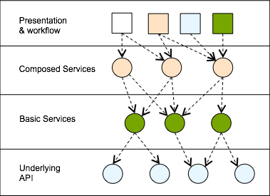
Layers of SOA
Flexible composition.
Reuse.
Functional standardization in lower levels
Customization in higher layers
Separation of concerns.
Policies may vary by layer

Slide 23
Challenges of SOA
Transaction management is complex in interactions between logically separate system
Finding the right services and right interfaces
Organizing the services – registry & repository
Optimization
Performance - XML brings robustness not speed
Security challenges - loosely coupled environment

Slide 24
Conclusion
Web Service
Available, interoperable, self-contained, modular, distributed, dynamic, of open protocols and standards
Web Service Techniques
SOAP, WSDL, UDDI
Service Oriented Architecture
Greater added value that applications become more flexible
Interoperable, loosely coupled, reusable, scalable

Slide 25
Reference
Wikipedia: http://en.wikipedia.org/wiki/Web_Services_Description_Language
Wikipedia: http://en.wikipedia.org/wiki/SOAP_(protocol)
Wikipedia: http://en.wikipedia.org/wiki/Web_service
Wikipedia: http://en.wikipedia.org/wiki/XML-RPC
Wikipedia: http://en.wikipedia.org/wiki/Service-oriented_architecture
Web Services Conceptual Architecture (WSCA 1.0) May 2001. By Heather Kreger IBM Software Group.
Web Services Technologies : State of the Art. Albreshne, Abdaldhem; Fuhrer, Patrik; Pasquier, Jacques. September 2009.
Web Services Technologies XML and SOAP WSDL and UDDI Version 16, Object Management Group, http://www.omg.org/news/meetings/workshops/MDA-SOA-WS_Manual/00-T1_Newcomer/CH2-WSTechnologies_V16-Standard.pdf
Understanding WSDL in a UDDI registry, http://www.ibm.com/developerworks/library/ws-wsdl/
Service Oriented Architecture: Right on Track, TechNet & MSDN, Microsoft. http://download.microsoft.com/download/e/9/d/e9d163db-5c96-46bc-9263-aac62fc38831/Service%20Oriented%20Architecture.pdf

