Slide 1
Contributing to the Lapps Grid
Lapps Service Wrapping Screenshots
Lapps Grid Group
May 26, 2014

Slide 2
Outline
From Software to Web Service
From NLP Tool to Lapps Service
Java Example
Python Example

Slide 3
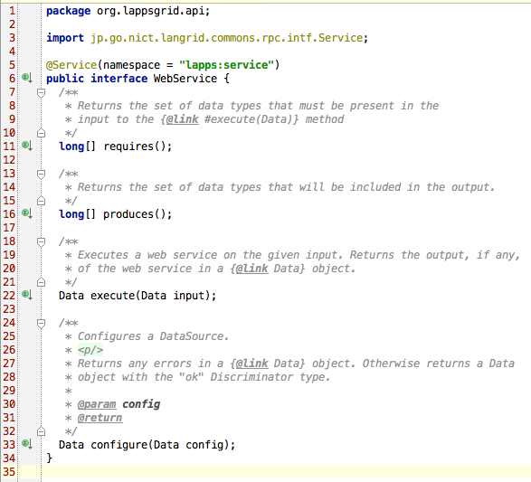
Consistent Interface (Java)

Slide 4
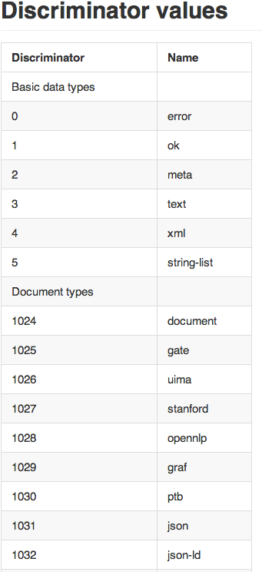
Discriminator
long [] requires()
long [] produces()

Slide 5
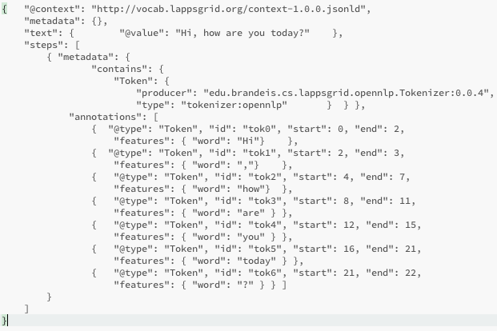
JSON

Slide 6
Service Wrapping Tutorial
Web Service: “Hello World!”
“Hello World” Program (Java) —> WSDL
Lapps Service: “Stanford Tagger”
Stanford Tagger (Java) + Lapps API —> WSDL
Lapps Service: “NLTK Tagger”
NLTK Tagger (Python) + Lapps API —>WSDL

Slide 7
Web Service Wrapping

Slide 8
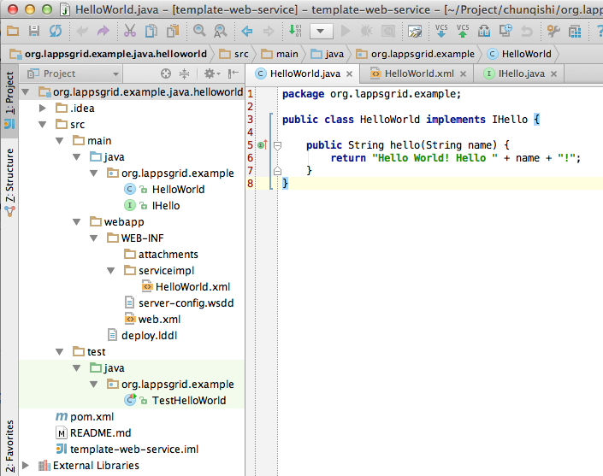
Hello World (Java)
https://github.com/chunqishi/org.lappsgrid.example.java.helloworld

Slide 9
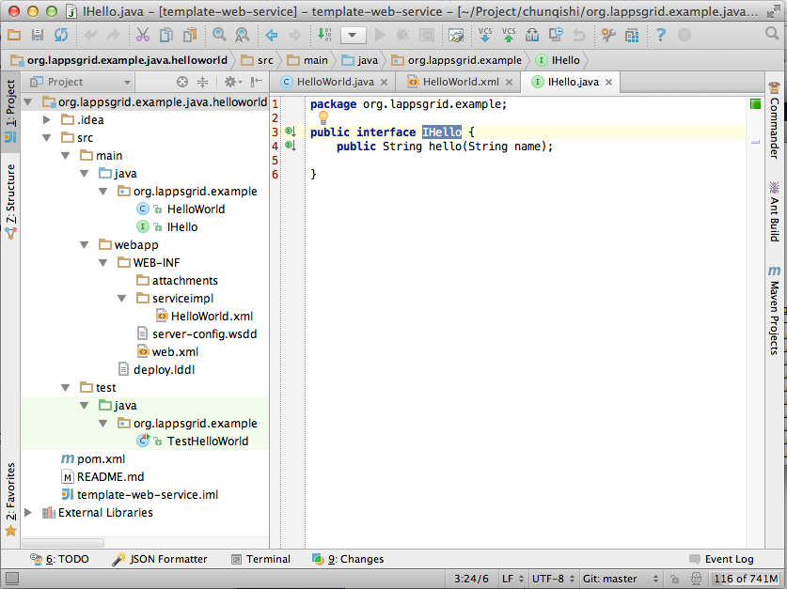
Interface Design

Slide 10
Developing Template
Developing Template
Maven for Dependency Library Management
Github Repository
https://github.com/chunqishi/org.lappsgrid.example.java.helloworld
Local Test
Maven Compile/Package & Jetty Server based Testing
Command: mvn clean package jetty:run

Slide 11
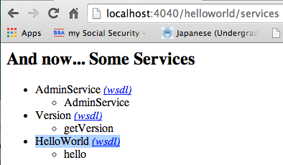
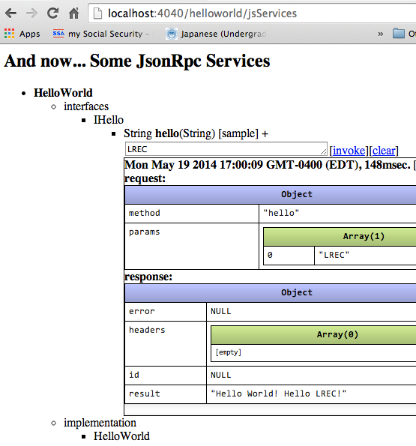
Web Service WSDL

Slide 12
Lapps Service Wrapping (Java)

Slide 13
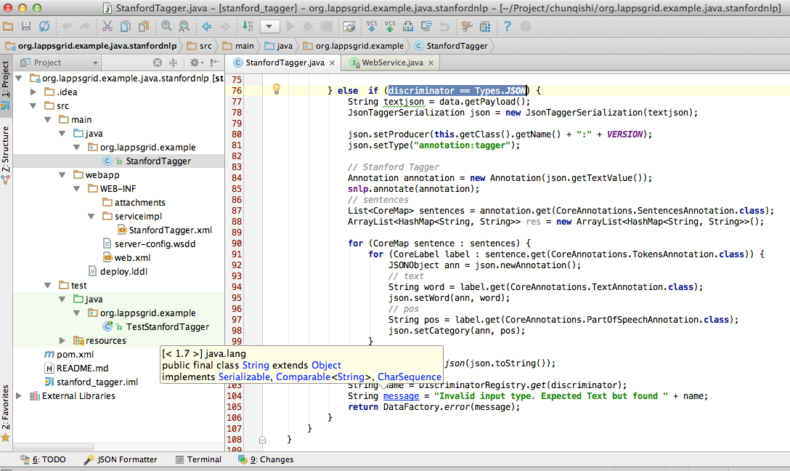
Developing Template
https://github.com/chunqishi/org.lappsgrid.example.java.stanfordnlp

Slide 14
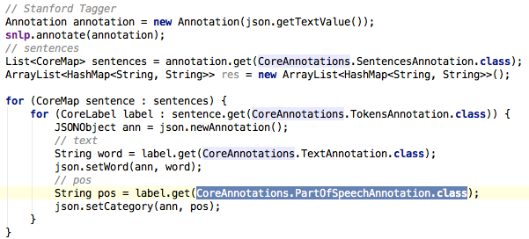
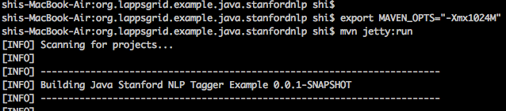
Stanford Tagger Wrapping
Java Wrapping
Jetty Running

Slide 15
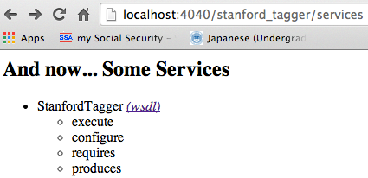
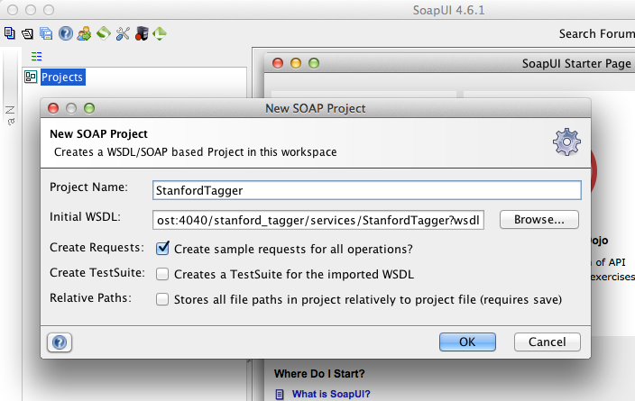
Stanford Tagger Testing
Local Service
SoapUI Testing

Slide 16
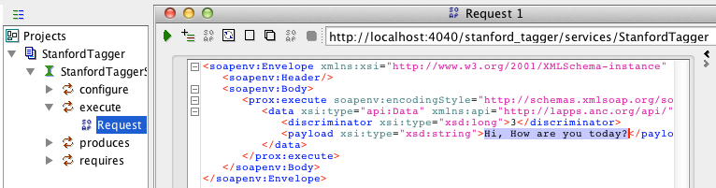
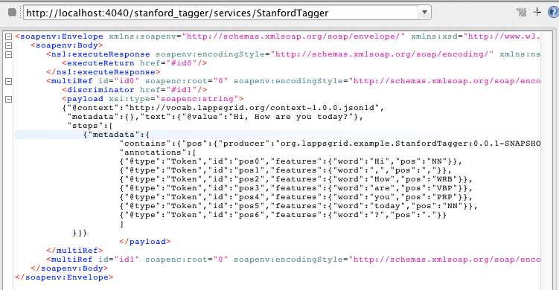
Stanford Tagger Testing Result
Request
Response

Slide 17
Lapps Service Wrapping (Python)

Slide 18
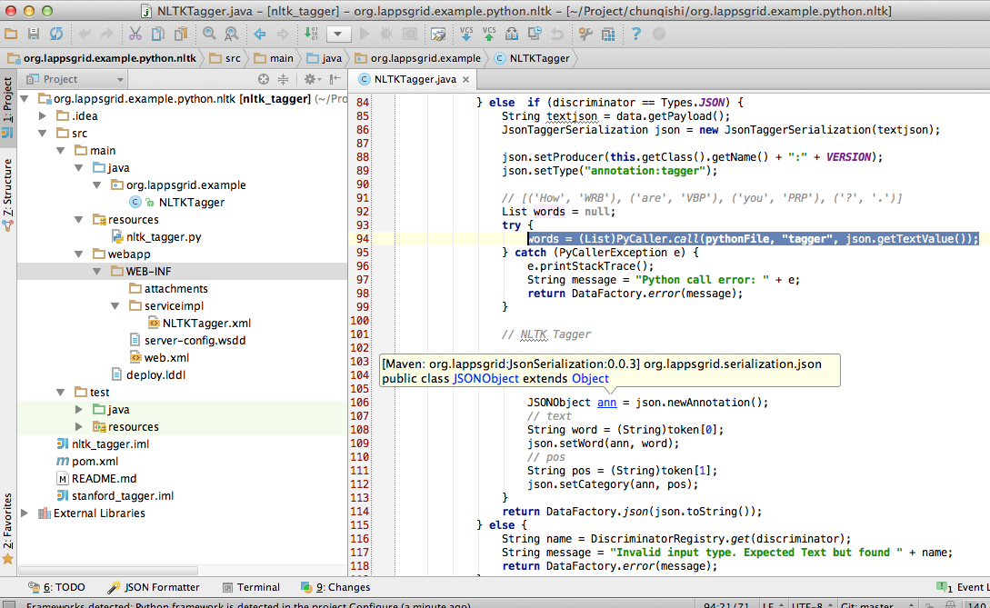

Developing Template

Slide 19
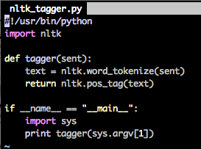
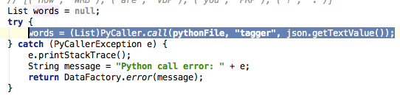
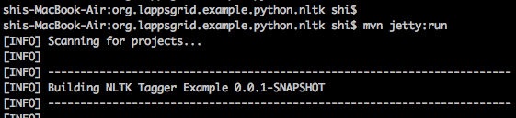
NLTK Python
Python Program
Python Result
Java Wrapping
Jetty Running

Slide 20
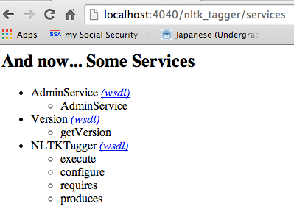
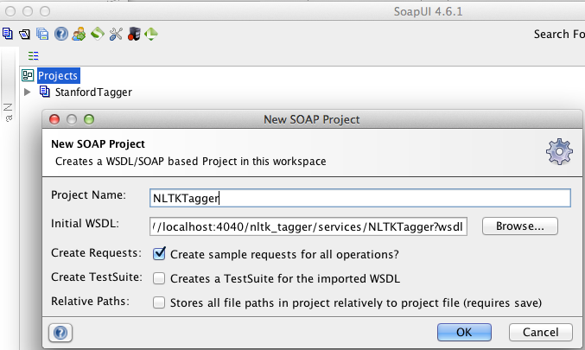
NLTK Tagger Testing
Local Service
SoapUI Testing

Slide 21
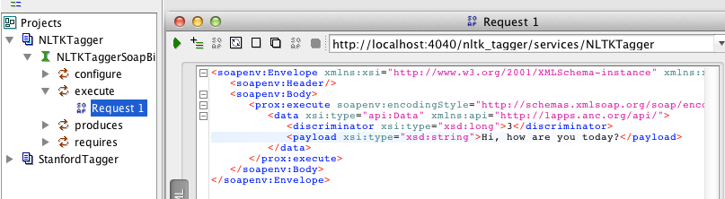
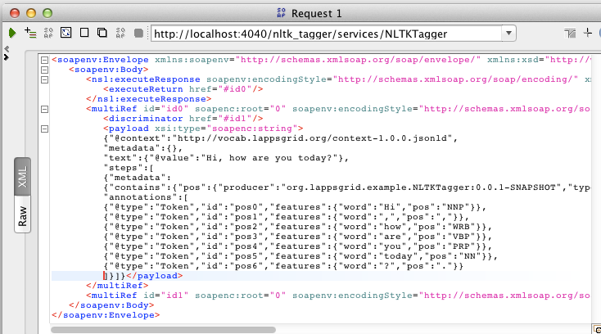
NLTK Tagger Testing Result
Request
Response

Slide 22
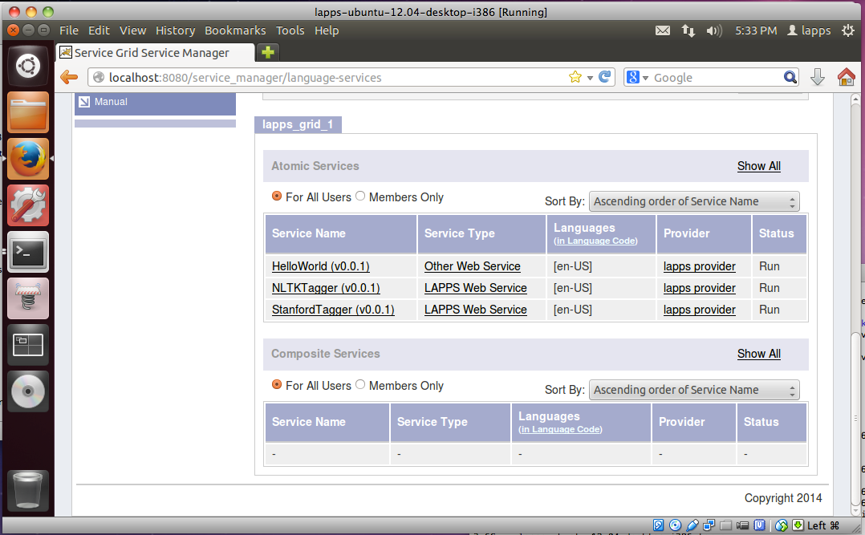
Service Register
Service Manager

Slide 23
Reference
API Docs: http://www.anc.org/projects/lapps/api/project-info.html
Service Templates:
https://github.com/chunqishi/org.lappsgrid.example.java.helloworld
https://github.com/chunqishi/org.lappsgrid.example.java.stanfordnlp
https://github.com/chunqishi/org.lappsgrid.example.python.nltk
Service Managers:
http://eldrad.cs-i.brandeis.edu/service_manager/language-services
http://grid.anc.org:8080/service_manager/language-services
VirtualBox Image:
http://eldrad.cs-i.brandeis.edu/download/lapps-ubuntu-12.04-desktop-i386.tar.gz

