Slide 1

Introduction to Hadoop
Chunren Lai

Slide 2
Agenda
1. Overview
2. Big Data Challenges
3. Introduction to Hadoop
4. Hadoop Ecosystems (HDFS, MapReduce, YARN)
5. Big Data Processing with MapReduce
6. DEMO
7. Summary
8. References

Slide 3
1.Overview
Quick overview of what this meeting is all about:
Agenda
What to expect

Slide 4
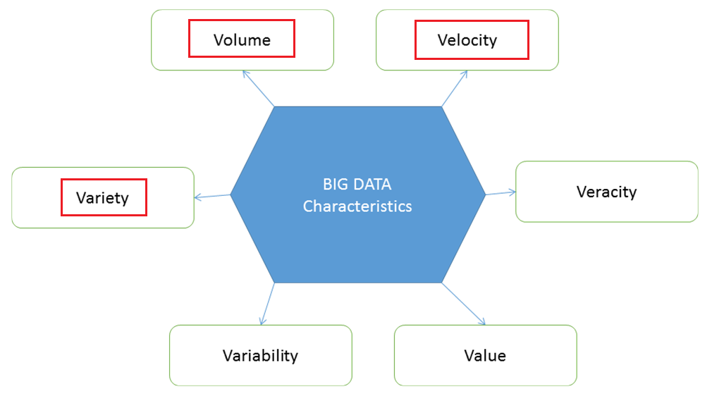
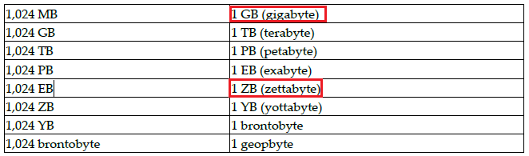
2. Big Data Challenges
Characteristics of big data.
In 2001, Doug Laney first presented the “Three Vs of Big data” – Volume, Velocity, and Variety
Now these three Vs become the Six Vs of Big Data.
Volume:
Facebook: 600TB of data daily.
Last two years, the data generated is equal to 90% of the data ever created.
World data is doubling every 1.2 years.
Estimated: 40 zettabyte of data will be created by 2020.
(Data and Image Reference: Ref03)

Slide 5
2. Big Data Challenges
Velocity:
Velocity is the rate at which the data is being generated, or how fast the data is coming in.
120 hours of videos are being uploaded to YouTube every minute. Millions of weather sensors. 100 sensors per car.
200 Million emails are sent every minute.
Variety:
Structured or unstructured data.
documents, emails, social media text messages, videos, still images, audio, graphs.
machine-generated data from sensors, devices, RFID tags, machine logs, and cell phone GPS signals, and more.
(Data and Image Reference: Ref03)

Slide 6

2. Big Data Challenges
Veracity:
This vector deals with the uncertainty of data, e.g., poor data quality, noise in data. Velocity and variety are dependent on clean data, while Veracity is derived from the uncertainty of data.
Some streaming data with noise, and some data such as events data is generated by machines and sensors.
Limitation of Early Large-Scale Computing:
Traditional computation was processor-bound
Data volume relatively small
Complicated computation performed on that data
Advances in computer technology centered around improving the power of a single machine
Power consumption limits the speed increase we get from transistor density.
Variability:
This derives from the lack of consistency of fixed patterns in data.
Cake shop, many different flavors. If you take the same flavor every day, but you find it different in taste every time, this is variability
For data, if the meaning and understanding of data keeps on changing.
Value:
Most important: Data value.
Cost: store the data
Whether it is worth storing the data and investing in infrastructure, either on premises or in the cloud.
(Data and Image Reference: Ref03)
(Data and Image Reference: Ref07)

Slide 7
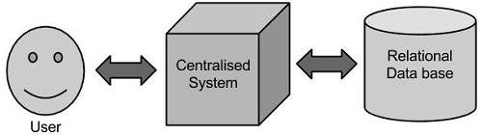
2. Big Data Challenges
Limitation of Early Large-Scale Computing:
Traditional computation was processor-bound
Traditional approaches to data storage
Database servers or data warehouses.
(Image Reference: Ref05)
Other challenges
Searching, Sharing, Transfer, Analysis, Presentation.
(Image Reference: Ref03)

Slide 8

2. Big Data Challenges
Distributed Systems:
Allow to use multiple machines for a single task
Distributed Systems: Problems
Complex to synchronize data exchange
Manage a finite bandwidth
Control computation timing
Errors of data files or exchange
Requirements for Hadoop
Fault tolerant - Reliable
Scalable distributed systems

Slide 9










3. Introduction to hadoop
Hadoop:
The Apache™ Hadoop® project develops open-source software for reliable, scalable, distributed computing.
The Apache Hadoop software library is a framework that allows for the distributed processing of large data sets across clusters of computers using simple programming models. It is designed to scale up from single servers to thousands of machines, each offering local computation and storage. Rather than rely on hardware to deliver high-availability, the library itself is designed to detect and handle failures at the application layer, so delivering a highly-available service on top of a cluster of computers, each of which may be prone to failures. [Ref01]
Hadoop History:
Created by Doug Cutting and Mike Carafella in 2005. Cutting named the program after his son’s toy elephant.
Use: Data-intensive text processing, Assembly of large genomes, graph mining, machine learning and data mining, large scale social network analysis
Organizations:

Slide 10
4. Hadoop Ecosystems
(Image Reference: Ref03)

Slide 11
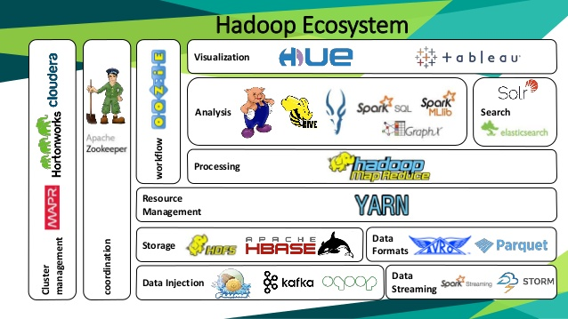
4. Hadoop Ecosystems
Apache Flume: a framework that helps move a large amount of streaming data from one place to another.
Apache Kafka: real-time feed handling system that can receive data from multiple sources called Producers and that can provide data to multiple destinations called Consumers in a sequential manner.
Apache HBase: to manage the NoSQL data store (column-oriented data model, for reliability, fault tolerant etc.)
Apache Spark: Spark Core, Spark SQL, Mlib, Spark Streaming, GraphX
Tableau: Visualization tool
HUE: Visualization tool
(Image Reference: Ref09)

Slide 12
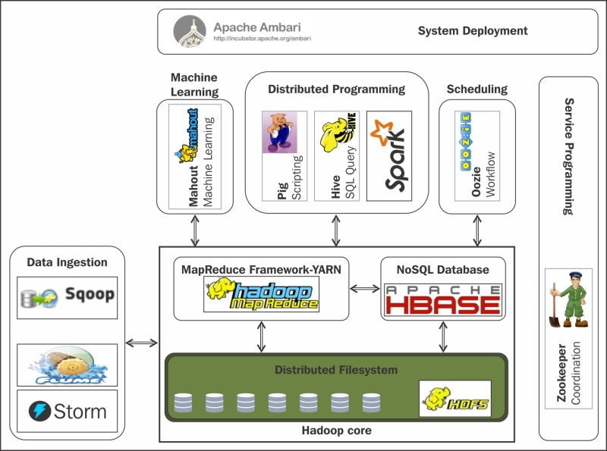
4. Hadoop Ecosystems
Apache Zookeeper: that provides a centralized infrastructure and services that enable synchronization across a cluster.
Apache Sqoop: It efficiently transfers bulk data between Apache Hadoop and structured datastores such as relational databases. Sqoop helps offload certain tasks (such as ETL processing) from the EDW to Hadoop for efficient execution at a much lower cost. [Ref11]
Apache Pig: Apache Pig is a platform for analyzing large data sets that consists of a high-level language for expressing data analysis programs, coupled with infrastructure for evaluating these programs. The salient property of Pig programs is that their structure is amenable to substantial parallelization, which in turns enables them to handle very large data sets. [Ref12]
(Image Reference: Ref08)

Slide 13
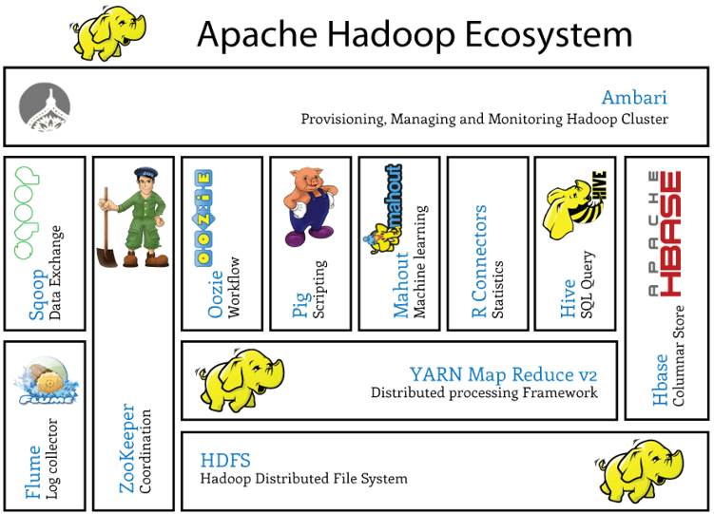
4. Hadoop Ecosystems
(Image Reference: Ref10)

Slide 14
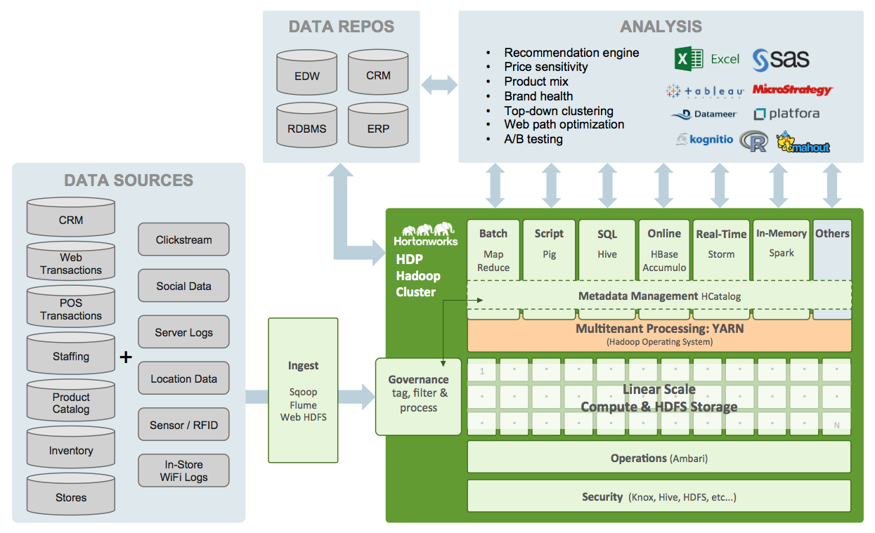
4. Hadoop Ecosystems
(Image Reference: ?)

Slide 15
4. Hadoop Ecosystems - HDFS
HDFS – Hadoop Distributed File System, is a file system that is specially designed for distributed systems that need to process large datasets with high availability.
(Image Reference: Ref03)

Slide 16
4. Hadoop Ecosystems - YARN
YARN – “Yet Another Resource Negotiator”. Job Tracker model – performance bottle neck, and all DataNode are considered the same resource capacity.
YARN (from Hadoop v2):
Resource Manager: JobId, backup RM
Node Manager:
Container: a slot representation of CPU and memory
Application Master: to retrieve metadata required to execute the job; then create the Map task per input split.
(Image Reference: Ref03)

Slide 17
4. Hadoop Ecosystems - MapReduce
MapReduce – two parts: Map and Reduce. Map: to get info from data store, apply the required algorithm, generate result (key-value pairs format). Reduce: to summarize the info
(Image Reference: Ref02)

Slide 18
4. Hadoop Ecosystems - Setup
Steps to set up the Hadoop [Ref01, Ref02]
Install Linux machine
Install Java 8 +
Install Hadoop 3.0.3
Set up the NameNode
Start HDFS
Set up YARN

Slide 19
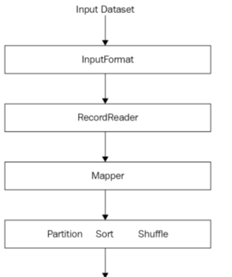
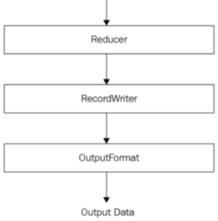
5. Big Data Processing with MapReduce
Programming Component of
MapReduce:
(Image Reference: Ref02)

Slide 20
5. Big Data Processing with MapReduce
Input Dataset: in the input data file such as csv files, to move into the HDFS
Record Reader: it divides the input into appropriately sized splits (e.g., 64MB or 128MB), and translate the splits into records (as a key/value pair)
Map: takes key/value pairs, processes them and generates zero or more output key/value pairs (intermediate output of the mapper)
Combiner: an optional localized reducer, can group data in the map phase.
Partitioner: takes the intermediate key/value pairs from the mapper (or combiner), and splits them up into shards, one shard per reducer.

Slide 21
5. Big Data Processing with MapReduce
Shuffle and sort: Shuffle to ensure same keys ends up at the same reducer, then sorted by key
Reduce: takes the grouped data as input and runs a reduce function once per key grouping. Data can be aggregated, filtered, and combined in a number of ways.

Slide 22
5. Big Data Processing with MapReduce
MapReduce Patterns
Aggregation Patterns: e.g., Record count, Max/Min/count, Average/Median/Standard deviation.
Filtering Patterns: e.g., filtering, bloom filtering, top 10, distinct
Join Patterns: e.g., inner join, left anti join, left outer join, right outer join, full outer join, left semi join, cross join

Slide 23
6. DEMO
todo.

Slide 24
7. Summarize
Big data challenges: six Vs – Volume, Velocity, Variety, Veracity, Variability, Value.
Hadoop ecosystems – HDFS and MapReduce.
Big data processing with MapReduce.
Scientific computing and big data analysis with Hadoop and Python
DEMO shows how to set the Map and Reduce jobs.

Slide 25
8. References
Ref01: Apache Hadoop: https://hadoop.apache.org/
Ref02: “Big Data Analytics with Hadoop 3”, Sridhar Alla, ISBN 978-1-78862-884-6, Packt Publishing, May 2018
Ref03: “Big Data Architect’s Handbook”, Syed Muhammad Fahad Akhtar, ISBN 978-1-78883-582-4, Packt Publishing, June 2018.
Ref04: “The building blocks of Hadoop – HDFS, MapReduce, and YARN”, Janani Ravi, pluralsight
Ref05: “Hadoop – Big Data Overview”, https://www.tutorialspoint.com/hadoop/hadoop_big_data_overview.htm
Ref06: “Hadoop, a distributed framework for Big Data”, Nalini Venkatasubramanian, https://www.ics.uci.edu/~cs237/lectures/cloudvirtualization/Hadoop.pptx
Ref07: “What is Hadoop”, Daniel Leblanc, http://web.cecs.pdx.edu/~dleblanc/hadoop/hadoop.pptm
Ref08: “Hadoop Essentials”, https://www.packtpub.com/mapt/book/big_data_and_business_intelligence/9781784396688/2/ch02lvl1sec23/the-hadoop-ecosystem
Ref09: “Hadoop Ecosystem”, Lior Sidi, https://www.slideshare.net/LiorSidi/hadoop-ecosystem-65935516
Ref10: “Learn Hadoop with me”, https://www.facebook.com/hadoopers
Ref11: “Apache Sqoop”, https://hortonworks.com/apache/sqoop/
Ref12: “Apache Pig”, https://pig.apache.org/
Ref13: “Hadoop: The definite guide” 4th Edition, Tom White, ISBN 978-1-491-90163, O’Reailly, April 2015

Slide 26
9. Questions ?

