Slide 1
Microservices architecture and Azure Service Fabric
Charles Lai
Dec. 13, 2017

Slide 2
Outline of Microservices and Azure Service Fabric
1. Introduction to Microservices
2. Benefits of Microservices
3. Microservices Design Principles
4. Azure Service Fabric
5. Demo of Service Fabric Application
6. References

Slide 3
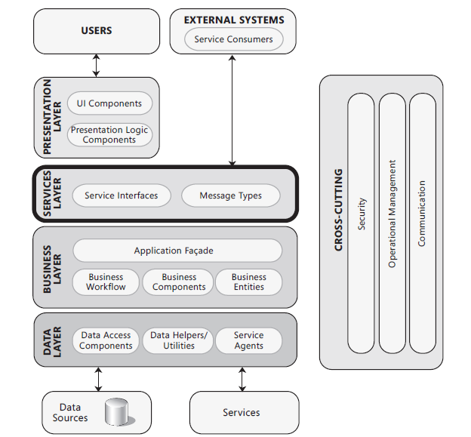
1. Introduction to Microservices
The Monolithic Architecture
(Layer architecture – [Ref03])

Slide 4
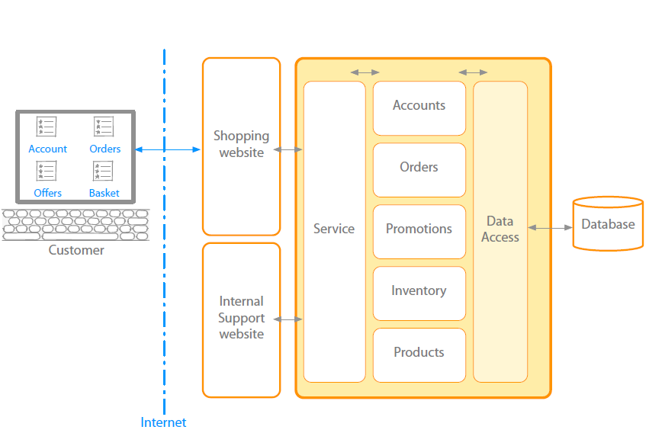
1. Introduction to Microservices
(2) Characteristics of the Monolithic Architecture [Ref05]
Characteristics of Monolithic:
App: Typical enterprise application
Large codebase: longer development time
Coupling: High levels of coupling between
modules and services
Deployment: inaccessible features
Failure: could affect whole system
Scaling: requires duplication of the whole
Change: minor change could result in
complete rebuild and
redeployment

Slide 5
1. Introduction to Microservices
(3) Why need Microservices?
Change: Need to respond to change quickly, shorter time to Market
Reliability: need for reliability
Coupling: need for loose coupling between modules and services for ease of maintenance
Deployment: need for no or shorter downtime deployment
Host: on-demand hosting technology, cloud technology
Scaling: need good scaling

Slide 6
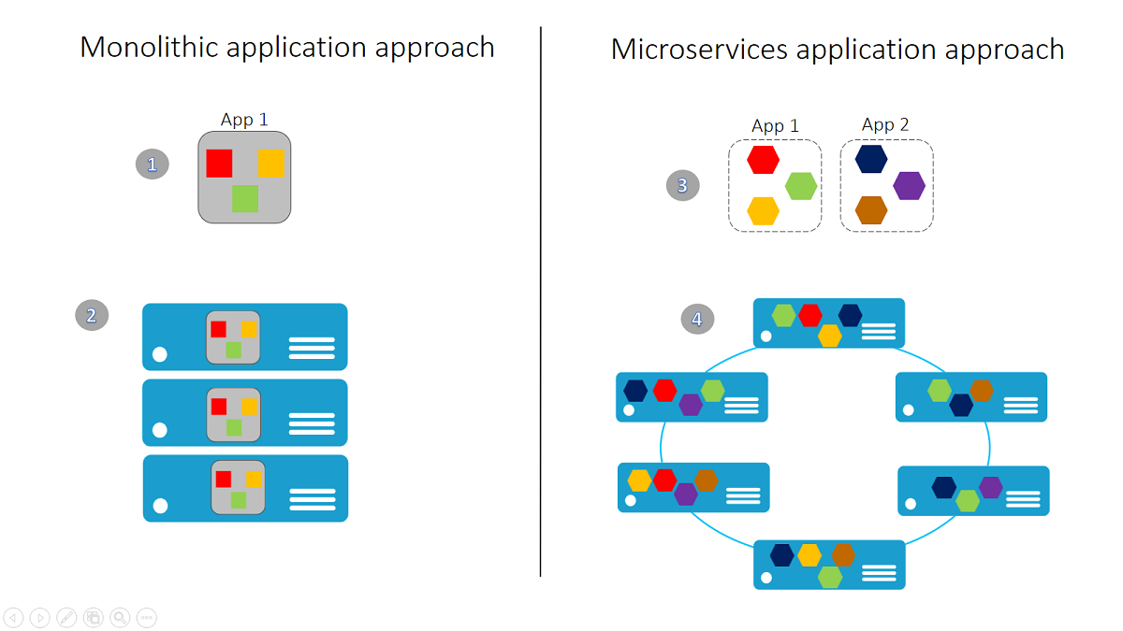
1. Introduction to Microservices
(4) The Monolithic Architecture vs Microservices Architecture [Ref03]

Slide 7
1. Introduction to Microservices
(4) The Monolithic Architecture vs Microservices Architecture [Ref03]
Monolithic Architecture:
1) A monolithic app contains domain-specific functionality and is normally divided by functional layers, such as web, business, and data. 2) You scale a monolithic app by cloning it on multiple servers/virtual machines/containers.
Microservices Architecture
3) A microservice application separates functionality into separate smaller services. 4) The microservices approach scales out by deploying each service independently, creating instances of these services across servers/virtual machines/containers.
https://channel9.msdn.com/Blogs/Azure/Azure-Service-Fabric?ocid=player

Slide 8
2. Benefits of Microservices
(1) Benefits of Microservices
Shorter deployments times – reliable and faster deployments
Enables frequent updates – decouple the changeable parts
Security
Increase uptime – fast issue resolution
Highly scalable and better performance
Better ownership and knowledge
Enable distributed teams

Slide 9
3. Microservices Design Principles
High Cohesion: Single focus, single responsibility (e.g., StudentSvc, ParentSvc, EmailSvc)
(2) Autonomous: loose coupling (e.g., independently changeable and deployable)
(3) Business Domain Centric: service represents business function (e.g., Accounts Department,
Order department, and Stock Department)
(4) Resilience: failure tolerance, degrade functionality
(5) Observable: System health (status, logs, errors), centralized monitoring and logging

Slide 10
4. Azure Service Fabric (Video ads)
Mouse move over or click to play the movie

Slide 11
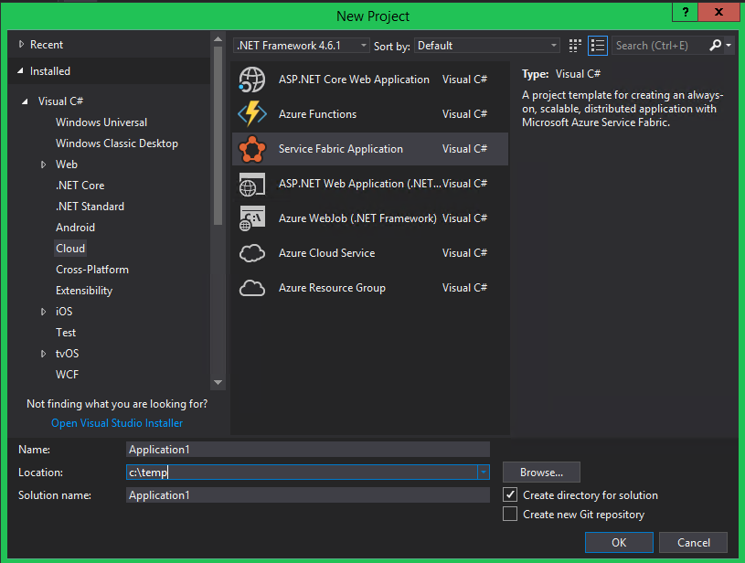
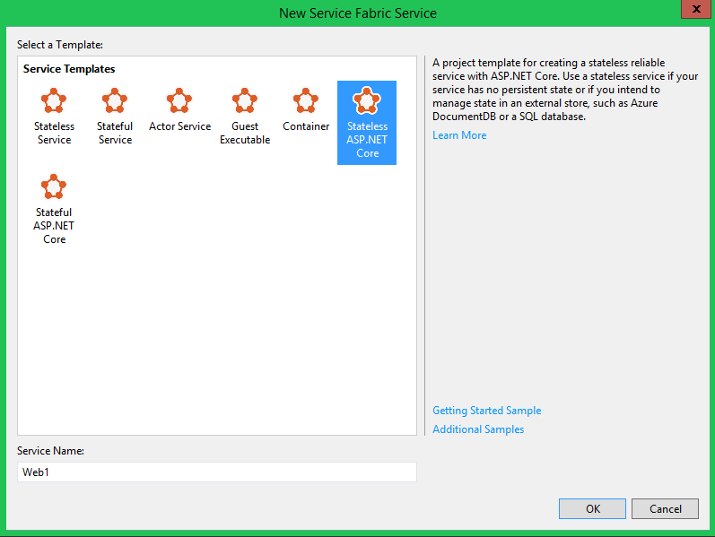
4. Azure Service Fabric
(1) Development for the Service Fabric applications
OS: Windows 7+; VS 2017; Microsoft Azure Service Fabric SDK

Slide 12
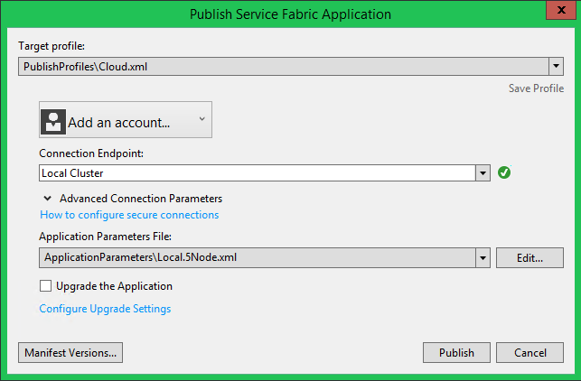
4. Azure Service Fabric
(2) Deployment by Visual Studio 2017
(2) Deployment by PowerShell
PS C:\>Connect-ServiceFabricCluster
PS C:\>$path = 'C:\deploy\pkg\Debug'
PS C:\>Copy-ServiceFabricApplicationPackage
-ApplicationPackagePath $path
PS C:\>Register-ServiceFabricApplicationType MyApplicationV1
PS C:\>Get-ServiceFabricApplicationType
PS C:\>Remove-ServiceFabricApplicationPackage
-ApplicationPackagePathInImageStore MyApplicationV1
PS C:\>New-ServiceFabricApplication fabric:/MyApp
MyApplicationType 1.0.0
PS C:\>Start-ServiceFabricApplicationUpgrade
-ApplicationName fabric:/myApplication
-ApplicationTypeVersion 2.0.0.0 –{other switch}

Slide 13
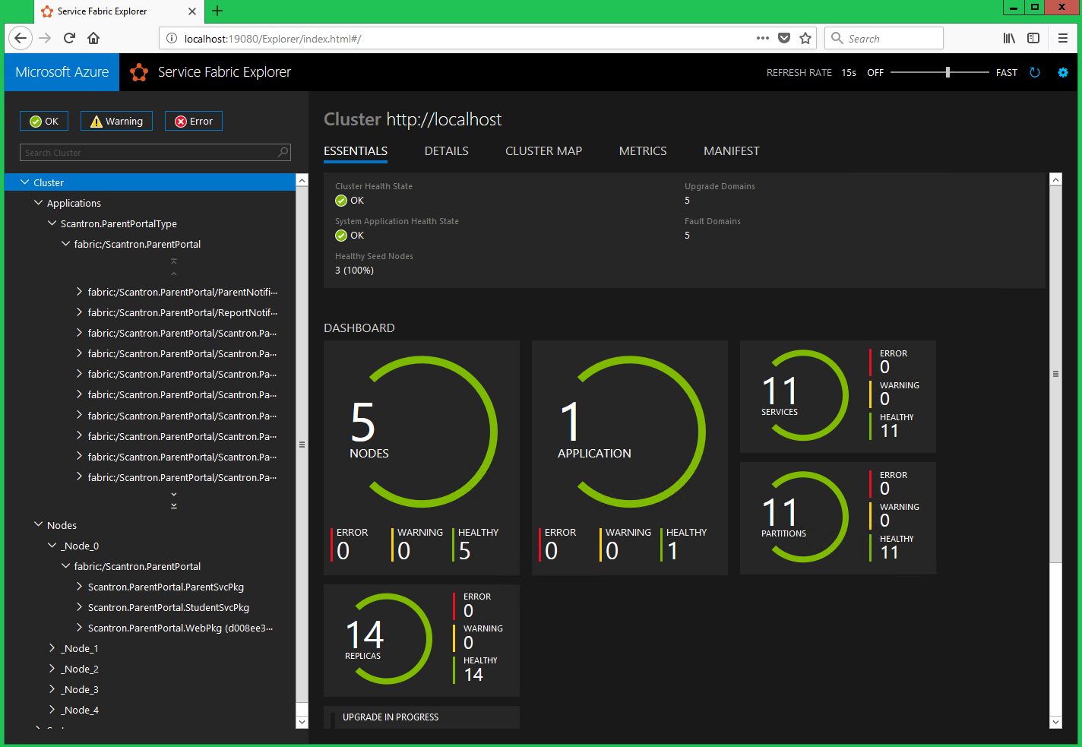
5. Demo of Azure Service Fabric
(1) Service Fabric Explorer:
Local DEV: http://localhost:19080/Explorer/index.html#/
POC: http://eag-pp-poc1.corp.scantron.com:19080/Explorer/index.html#/node/eag-pp-poc1

Slide 14
6. References
Ref 01: | Bob Familiar, “Microservices, IoT, and Azure Leveraging DevOps and Microservice Architecture to Deliver SaaS Solutions”, 2015, Apress, ISBN: 978-1-4842-1276-9
Ref 02: | Why a microservices approach to building applications?, https://docs.microsoft.com/en-us/azure/service-fabric/service-fabric-overview-microservices
Ref 03: | Microsoft, “Microsoft Application Architecture Guide (2nd Edition)”, 2009, ISBN: 9780735627109
Ref 04: | Dam Newman, “Building Microservices Designing Fine-Grained Systems”, 2015, O’Reilly, ISBN:978-1-491-95035-7
Ref 05: | Rag Dhiman, “Microservices Architecture”, Pluralsight, https://app.pluralsight.com/library/courses/microservices-architecture/table-of-contents

