Slide 1
智慧型管理決策系統
Decision Tree

Slide 2
K-fold cross-validation
In k-fold cross-validation, the original sample is randomly partitioned into k equal sized subsamples. Of the k subsamples, a single subsample is retained as the validation data for testing the model, and the remaining k − 1 subsamples are used as training data. The cross-validation process is then repeated k times (the folds), with each of the k subsamples used exactly once as the validation data. The k results from the folds can then be averaged to produce a single estimation. The advantage of this method over repeated random sub-sampling (see below) is that all observations are used for both training and validation, and each observation is used for validation exactly once. 10-fold cross-validation is commonly used, but in general k remains an unfixed parameter.
For example, setting k = 2 results in 2-fold cross-validation. In 2-fold cross-validation, we randomly shuffle the dataset into two sets d0 and d1, so that both sets are equal size (this is usually implemented by shuffling the data array and then splitting it in two). We then train on d0 and test on d1, followed by training on d1 and testing on d0.
When k = n (the number of observations), the k-fold cross-validation is exactly the leave-one-out cross-validation.
In stratified k-fold cross-validation, the folds are selected so that the mean response value is approximately equal in all the folds. In the case of a dichotomous classification, this means that each fold contains roughly the same proportions of the two types of class labels.

Slide 3
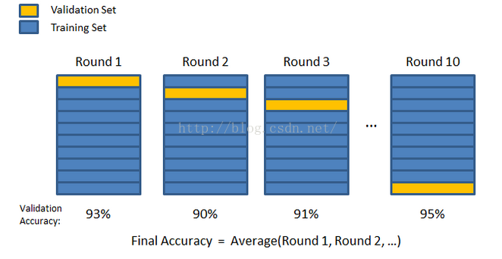
K-fold cross-validation

Slide 4
Leave-one-out cross-validation
Leave-one-out cross-validation (LOOCV) is a particular case of leave-p-out cross-validation with p = 1. The process looks similar to jackknife, however with cross-validation you compute a statistic on the left-out sample(s), while with jackknifing you compute a statistic from the kept samples only.

Slide 5
HW3
請用下列程式讀取iris資料庫
iris.data紀錄著150朵鳶尾花萼片及花瓣的長及寬(共4個數值)
Iris.target紀錄著3種不同的花
請完成下列程式
計算k-fold cross validation，分成10群，每次取出1群測試，其他9群建模，重覆10次計算錯誤率
每次建模建構三棵ID3決策樹，分別針對target為(0,1)、(0,2)、(1,2)各建一棵
測試時採用多數決，如果三種各一票的話，則歸類為0
from sklearn import datasets
iris = datasets.load_iris()

