Slide 1
雲端運算期中報告
0524829
蔡博鈞

Slide 2
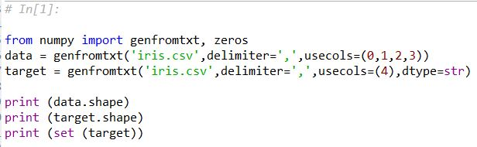
(150, 4)
(150,)
{'setosa', 'versicolor', 'virginica'}

Slide 3
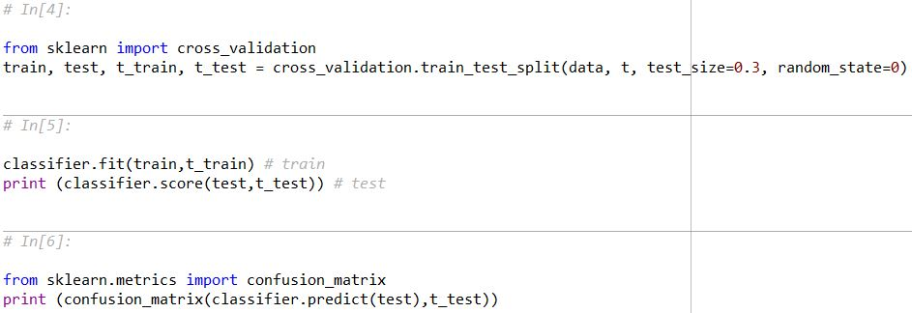
0.977777777778
[[16 0 0]
[ 0 17 0]
[ 0 1 11]]

Slide 4

precision recall f1-score support
setosa 1.00 1.00 1.00 16
versicolor 0.94 1.00 0.97 17
virginica 1.00 0.92 0.96 12
avg / total 0.98 0.98 0.98 45

Slide 5
precision recall f1-score support
setosa 1.00 1.00 1.00 11
versicolor 0.92 1.00 0.96 12
virginica 1.00 0.86 0.92 7
avg / total 0.97 0.97 0.97 30

Slide 6
precision recall f1-score support
setosa 1.00 1.00 1.00 16
versicolor 0.96 0.92 0.94 24
virginica 0.90 0.95 0.93 20
avg / total 0.95 0.95 0.95 60

