Slide 1

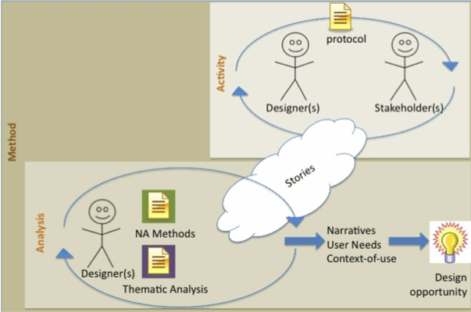
  Using Storytelling to Inform Design: Narrative Analysis of ER Stories
Students: Erin Folly, Saba Sadeq, Chun Wang, Alan Torrico-Lopez
Advisors: Kim Gausepohl and Dr. Woodrow Winchester III
Grado Department of Industrial & Systems Engineering
Human Factors Engineering and Ergonomics Center
Rationale
Process
The purpose of this undergraduate research project is to explore the use of narrative analysis methods during the concept phase of design. As a design method storytelling may be viewed as both data gathering and analysis activities (Figure 1).
Figure 1. Conceptual model of storytelling’s role during problem exploration.
First, designers use a protocol incorporating narrative inquiry techniques to elicit stakeholder stories. Designers use qualitative methods (i.e., narrative & thematic analysis) to analyze the collected stories. Outputs of the analysis include narratives, user needs, and a deeper understanding of the context-of-use, which help designers identify a design opportunity. This poster presents the narrative analysis process used to form ER nurses’ stories into narratives with a consistent structure. These narratives were used by ISE 3614 (i.e., Introduction to Human Factors) students to inspire design of products which address unmet ER nurses’ needs.
UTILIZING STRUCTURAL COMPONENTS TO TRANSFORM STORIES INTO CONCISE NARRATIVES
The narrative analysis process utilized in this study incorporates Labov & Waletzky’s (1967) structural approach, which provides a consistent structure across created narratives.
Table 1. Narrative structural components
INCORPORATING BEST PRACTICES FROM QUALITATIVE INQUIRY
The goal of the analysis process was to transform ER nurses’ stories into narratives that could be used by ISE 3614 design students to inspire the design of new products or process solutions. Best practices from qualitative research, such as an iterative approach and the use of multiple analysts, were used to encourage a rigorous analytic approach.
Table 2. Narrative analysis process steps
USING RECONCILIATION MEETINGS TO CREATE THE “BEST” NARRATIVE
To reduce bias each transcript was independently analyzed by 2 separate undergraduate researchers acting as data coders. Discrepancies in the created narratives were reconciled during a meeting between the coders and a separate judge.
Figure 2. Structural analysis process
Challenges:
- Habituals difficult to understand because interviewees did not answer the researcher’s question accordingly; having many different complicating actions that were not related to each other ; terminology being used was difficult to relate to.
Suggested Process improvements:
- Further detailed categories could be added as narrative components. e.g. An “Extra thought” section could be split out of “Evaluation” to differentiate useful but less related reflections from the major narrative. This is to allow maximum retaining of original thoughts.
- Researcher’s remarks, if containing helpful information, should be included in narratives. Any additional useful information outside demarcations of a narrative should be included.
- Sentences in the rearranged narratives could come not in order of time or line number sequence to allow better flow of story. Information not occurring in the same sentence but complementing understanding should be allowed in parentheses as a supplement of the original sentence.
Component | Operational Definition
ABSTRACT | Summative statement
ORIENTATION | Contextual information (i.e., character & setting description, background info)
COMPLICATING ACTION | The “Plot” Temporal sequence of events Conflict
RESOLUTION | Result
EVALUATION | Opinion & reflection of events
Transcript
(stories)
Narratives
Coder explains structural analysis
Coder agreement
Yes/No
No
Narrative structure edited
Judge agreement
Yes
Narrative structure unedited
Reflections
STEPS
1 | Individually read participant’s response within the transcript (i.e., the ER nurses’ story relating to an Institute of Medicine (IOM) quality aim.
2 | Individually categorize statements into narrative structural components
3 | Reconcile results as a group to create one agreed upon narrative
 | *Repeat steps 1-3 for all stories within transcript
LUCID: Laboratory for User Centric Innovations in Design

