Slide 1
Graph Based Cardinality Estimation from Query Constraints
Group Member: Chun Wang, Wanning He, Changwen Xu

Slide 2
﻿ Cardinality Estimation Problem
﻿Cardinality estimation is a sub-problem of database query optimization
﻿Given a database schema and a collection of query and their cardinality constraints C₁, . . . , C_{m}
Generate a database instance conforming to the schema that satisfies all the constraints.
Given future input queries and return their estimated cardinality.

Slide 3
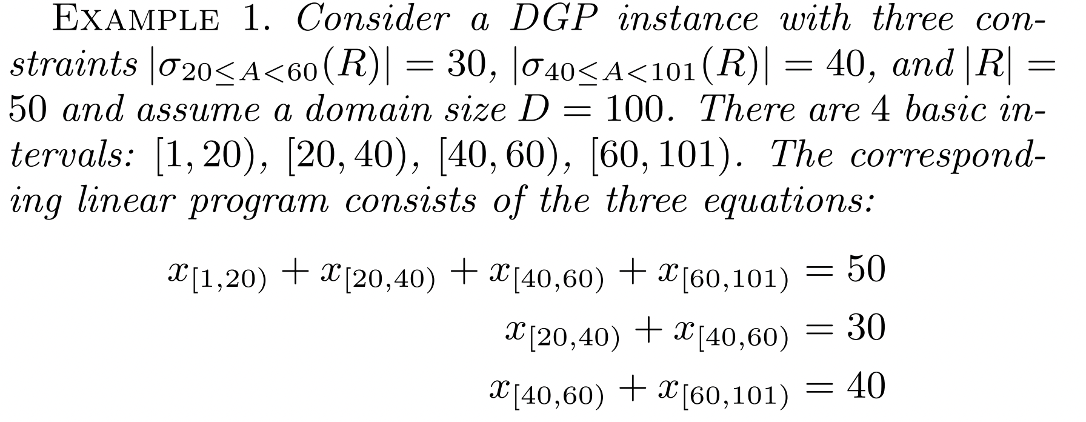
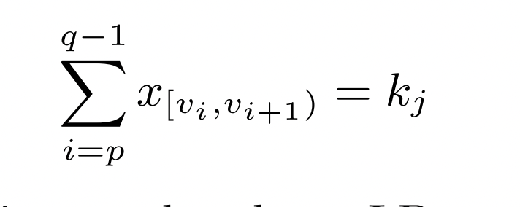
Cardinality Constraints
﻿Single Table, Single Attribute (﻿﻿Intervalization)
X_{[vi,vi+1)} ﻿represents the number of tuples t ∈ Dom(A) in R(A) that belong to the interval [v_{i}, v_{i+1}) ﻿.

Slide 4
Existing Works
﻿ ﻿ Symbolic-CSP-based
﻿It starts with a symbolic database. It then translates the input AQPs to constraints over the symbols in the database, and invokes a black-box constraint satisfaction program (CSP) to identify values for symbols that satisfy all the constraints.
Limitation: ﻿
Not guaranteed to produce a single database instance.
﻿The times invoking a CSP grows with the size of the generated database.
Related work: QAGen [﻿SIGMOD, 2007]、﻿MyBenchmark [VLDB 2010]

Slide 5
Existing Works
ILP-CSP-based
﻿Modeling the CCs as a system of linear equations and solve it using an Integer Linear Problem solver.
Limitation
﻿The number of variables created can be exponential in the number of attributes.
﻿ Related work:
﻿Data Generation using Declarative Constraints [Sigmod 2011]
﻿Synthesizing Linked Data Under Cardinality and Integrity Constraints [Sigmod 2021]

Slide 6
Motivation
Symbolic-CSP-based methods use greedy algorithm to identify values for symbols that satisfy all the constraints. They us can not effectively generate database satisfying lots of constraints (for workload with large amount of queries).
﻿The number of variables created by ILP-based methods can be exponential in the number of attributes.
Therefore, we try to learn the joint distribution of origin database from the workload by Graph Neural Network according to the cardinality of queries in workload.

Slide 7
Machine learning Based Data Generation
PDF: Probability density function based
Symbolic- and ILP- CSP based method
CDF: Cumulative distribution function based
Ours graph method

Slide 8
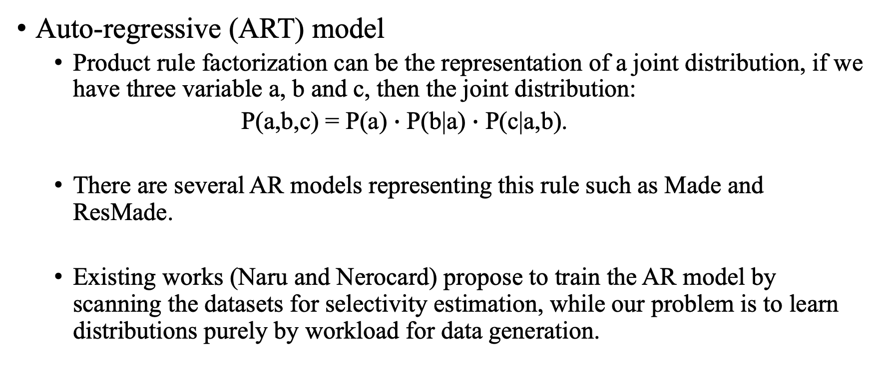
PDF based
Auto-regressive (ART) model
Product rule factorization can be the representation of a joint distribution, if we have three variable a, b and c, then the joint distribution:
P(a,b,c) = P(a) $∙$ P(b|a) $∙$ P(c|a,b).
There are several AR models representing this rule such as Made and ResMade.
Existing works (Naru and Nerocard) propose to train the AR model by scanning the datasets for selectivity estimation, while our problem is to learn distributions purely by workload for data generation.

Slide 9
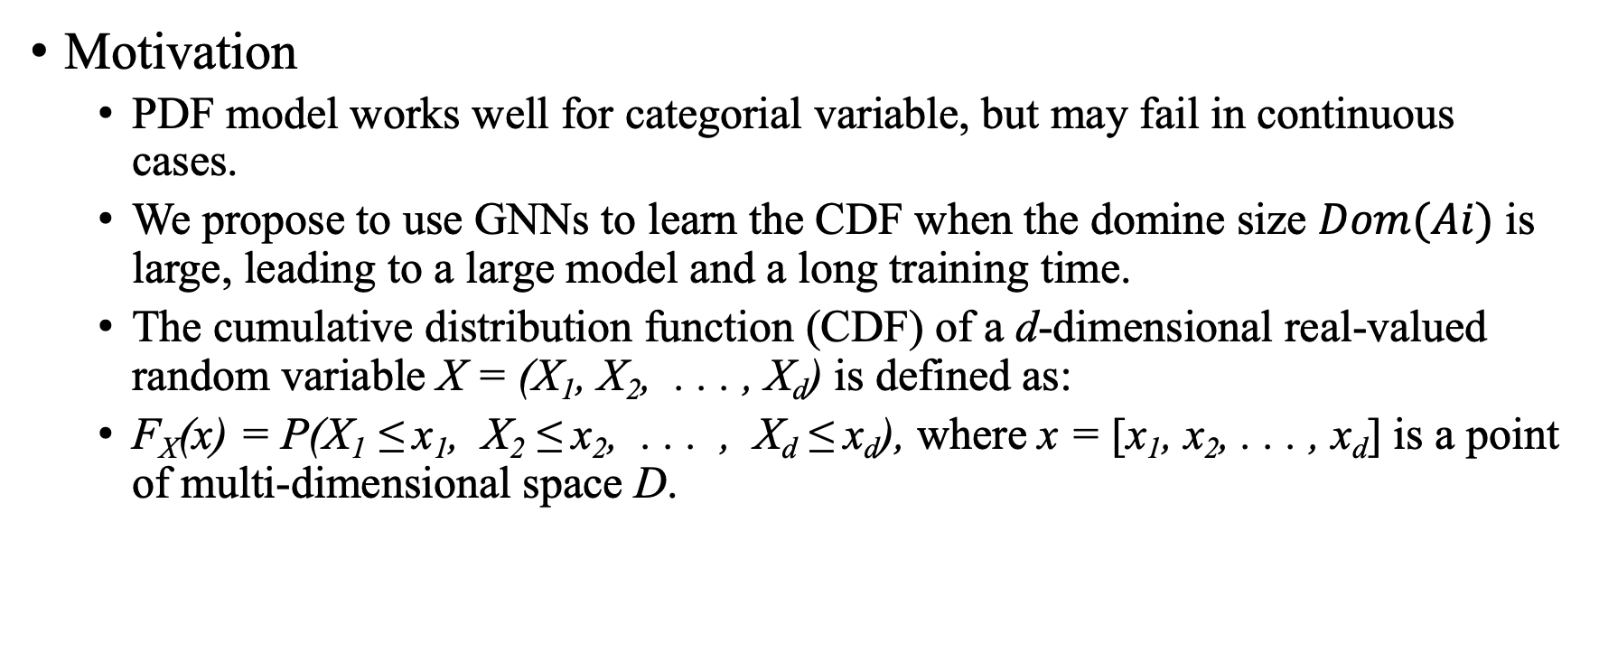
CDF-based
Motivation
PDF model works well for categorial variable, but may fail in continuous cases.
We propose to use GNNs to learn the CDF when the domine size $Dom(Ai)$ is large, leading to a large model and a long training time.
The cumulative distribution function (CDF) of a d-dimensional real-valued random variable X = (X₁, X₂, . . . , X_{d}) is defined as:
F_{X}(x) = P(X₁ ≤ x₁, X₂ ≤ x₂, . . . , X_{d} ≤ x_{d}), where x = [x₁, x₂, . . . , x_{d}] is a point of multi-dimensional space D.

Slide 10
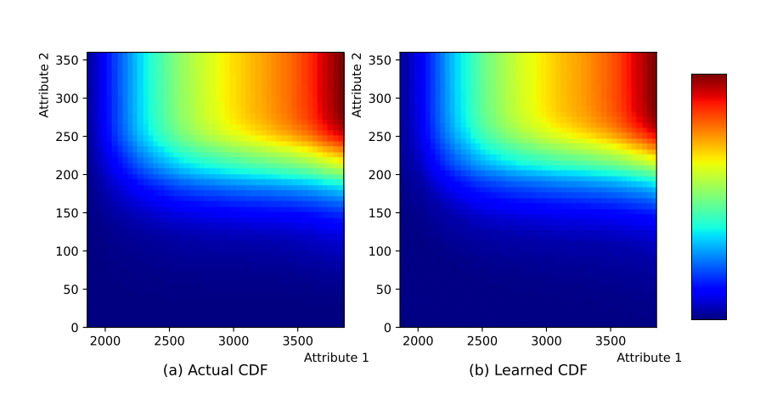
The CDF could be learned ﻿in a query-based fashion.
An observation:
﻿The actual joint CDF is monotonically increasing with each attribute
Thus we may use this to design our GNN architecture.

Slide 11
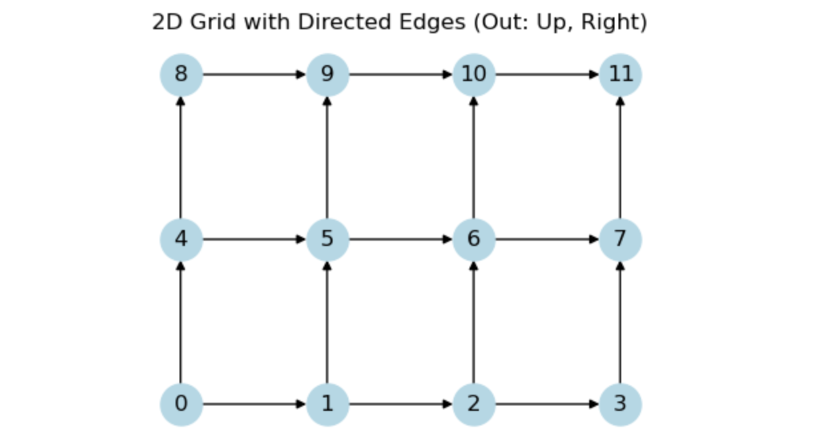
Workflow of Graph based methods
How to connect and update the graph node?
Each node (xi, yi) represent F(xi, yi) = P(X<=xi, Y<=yi)
Each node is encoded by index, we use index to take corresponding nodes out of a 1D-array instead of maintain a multi-dimension array.
We implement the node in monotonical order and design a directed graph.
Each node takes max value (activation) of all its successors.

Slide 12
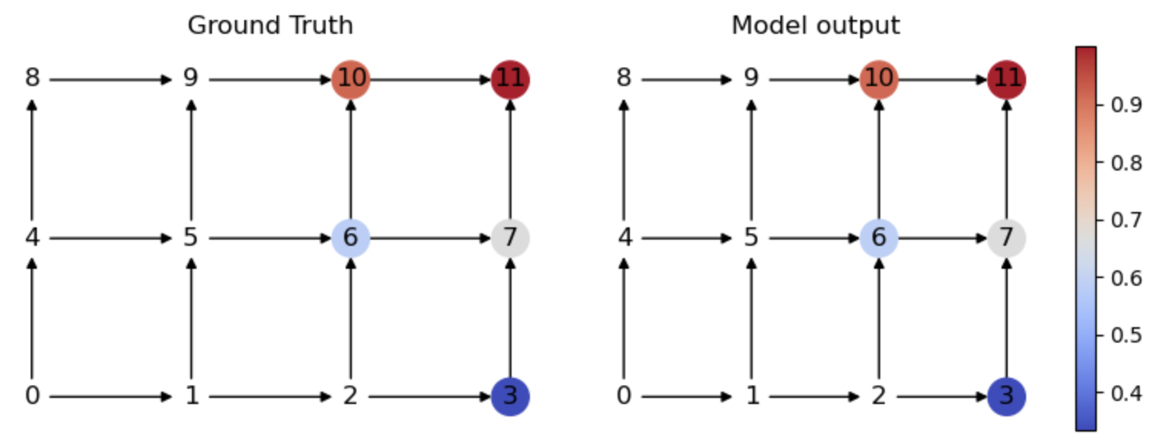
Workflow of Graph based methods
How to define the training error without the true data as input?
We use the RMSE between true selectivity and predicted selectivity of selected nodes as the training loss.
Cross entropy loss or neg-log likelihood is also promising if we treat CDF as a PDF.

Slide 13
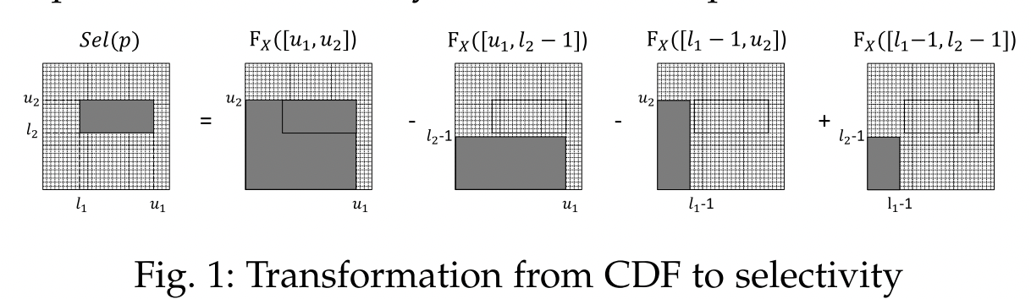
Challenges
CDF to common query selectivity constraint
A common query can be represented by the 2-input range [li, ui] and the selectivity ki .
We need one step calculation to transform CDF to range selectivity
The cumulative probability of point x=[x1, x2, . . . , xd] is actually the selectivity of query with range of [0, x1] × [0, x2] × . . . × [0, xd]

Slide 14
Challenges
Large-scale Graph
How to evaluate and limit the size of the graph? As the dimension increases, the smallest connection structure (Markov blanket) of each node becomes larger. Do it as conditional probability? AR model?
Multiple tables
First learn the outer-join of n tables
Design an assignment matching algorithm to split each table.

