Slide 1

The AI code assistant revolution
Lightning Talk 2023
Lee Chun Wei

Slide 2
Artist: DALL-E
An oil painting of a fox sitting in a field
Notes:
Do you know that this beautiful picture is drawn by an artist?
What is the name of this artist?
It is none other than the world-renowned DALL-E!
Except DALL-E isn’t a real person. DALL-E is a generative artificial intelligence that can create artistic images when I give it a prompt.
In other words, DALL-E is non-human doing the work of human artists.
DALL-E is not the only generative AI out there. There are numerous others. The most notable one recently being ChatGPT.

Slide 3
Jobs for humans
Artists
Writers
Software Developers
Notes:
What does this mean for our jobs?
Artists…

Slide 4
Jobs for humans
Artists (Replaced by DALL-E)
Writers (Replaced by ChatGPT)
Software developers (Replaced by ChatGPT, GitHub Copilot, Tabnine)
Notes:
Taken over by so many other AI tools.
Are we all doomed? Well, of course not. AI can’t take over us actually. They just don’t perform the job as well as us!

Slide 5
Jobs for humans
Artists (Use DALL-E to gain inspiration for their work)
Writers (Use ChatGPT to help overcome writer’s block)
Software developers (Use GitHub Copilot, Tabnine to assist in writing code and documentations)
Notes:
Artists can gain inspiration from the art generated by DALL-E.
Let’s focus on the software developers, because I am sure that’s what most of you are here for.

Slide 6
Agenda
How can you use AI tools?
Why should you use them?
What are the pitfalls of AI?

Slide 7
Agenda
How can you use AI tools?
Why should you use them?
What are the pitfalls of AI?

Slide 8
Free to use tools
GitHub Copilot
Free for students, teachers, and maintainers of popular OSS projects
60-day free trial for others, followed by $10/month or $100/year for an individual
Notes:
There are 2 tools that I am going to share today. Firstly, you can use GitHub Copilot…

Slide 9
Free to use tools
Tabnine
Free plan for everyone
Pro plan with more powerful auto-complete features
Notes:
A very good alternative is Tabnine…
Both tools are easy to install into your existing code editors or IDEs.
And to get the code suggestions, you just have to type something and let the tool suggest and then press the tab key to accept.
If you use autocomplete in your editor, you will know how to use these tools.

Slide 10
Agenda
How can you use AI tools?
Why should you use them?
What are the pitfalls of AI?

Slide 11
AI generates code. Intelligently.
Auto-completion: auto-completes a symbol (variables, functions etc)
AI: auto-completes an entire block of code.
Notes:
AI tools generate code intelligently.
Let’s compare AI to the more common auto-completion tool, like intellisense.
For intellisense, it can auto-complete a symbol, or autocomplete a template for a for loop, for example.
However, AI can auto-complete a whole block of code or even an entire function. Let’s demo this.

Slide 12
Python auto-complete demo
Notes:
In this example, I write the bubble sort function in python using intellisense.
It works, though it might be a little slow. My coding speed isn’t fast.

Slide 13
Python with GitHub Copilot
Notes:
Now, we use github copilot.
Look at how fast the code is generated.
In fact, this bubble sort code works when I tested it out. It is truly amazing.

Slide 14
AI can write comments for you.
Notes:
Other than code, AI tools can also write comments and documentation.
In this C++ code snippet, I get Copilot to help me write a comment describing the method addOrder().

Slide 15
AI can write code in your style
Useful for an enterprise level
Tabnine Enterprise:
Integrates private repositories
Trains the model to provide better consistency in code suggestions
Notes:
AI can also do one thing that the typical code autocomplete tool cannot:
It can write code in your own style. This is useful for an enterprise level where code should have similar styles and patterns.
Tabnine Enterprise includes this feature.

Slide 16
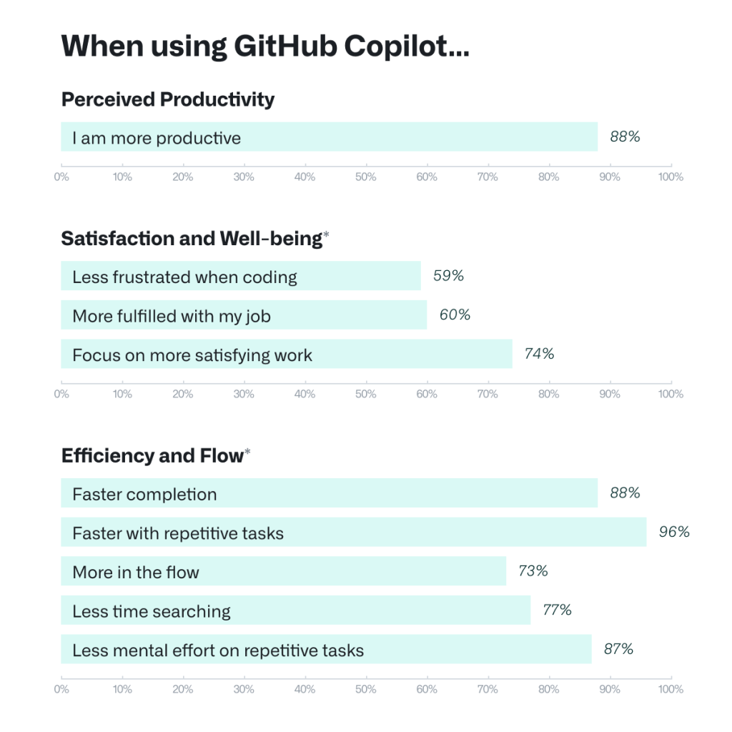
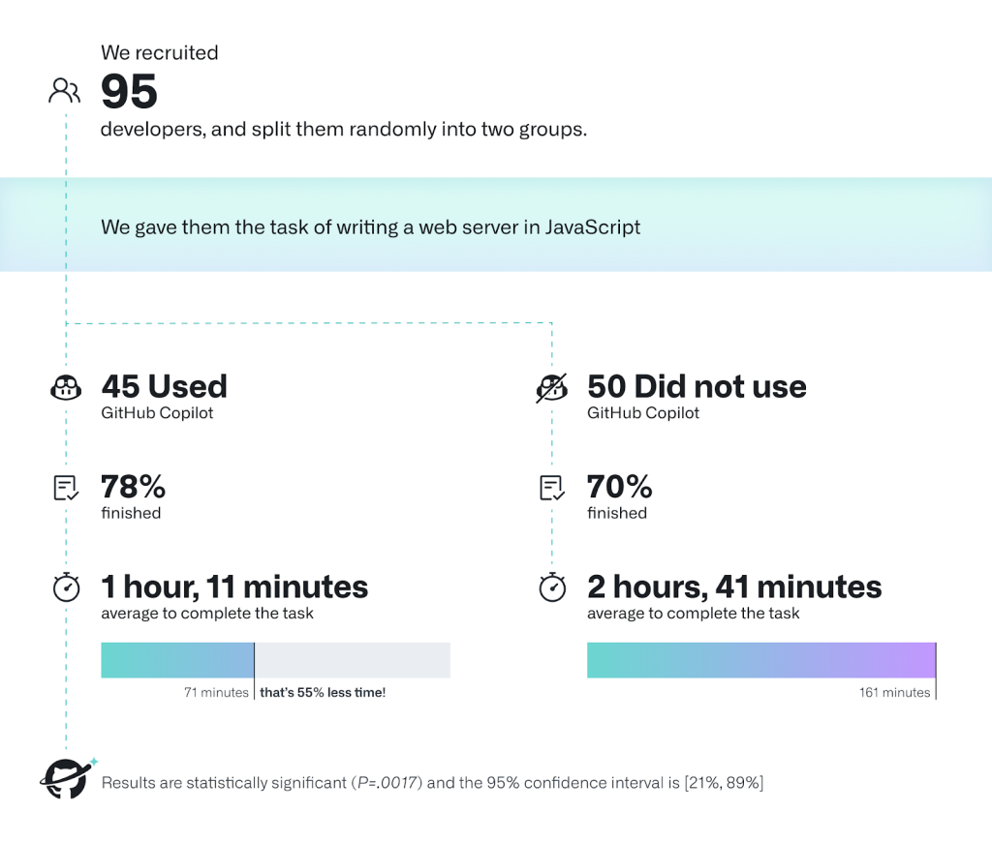
AI improves your productivity
Notes:
Overall, AI improves your productivity significantly.
Here is a survey conducted by Github on users who use Copilot…

Slide 17
AI improves your productivity
Notes:
Here is a study done by Github…
https://github.blog/2022-09-07-research-quantifying-github-copilots-impact-on-developer-productivity-and-happiness/

Slide 18
Agenda
How can you use AI tools?
Why should you use them?
What are the pitfalls of AI?
Notes:
However, using AI tools can sometimes be a double-edged sword.
What are some of the pitfalls of AI that you should be aware of?

Slide 19
Over-dependence on AI
AI could suggest solutions that appear correct but are not
Developer may overlook this and accept the generated code
Mitigation: Review all code written by the AI, just as you would in a code review for a PR.
Notes:
One of the drawbacks of using AI tools is that it is easy for one to become over-dependent on it.
Too much of it is not a good thing..

Slide 20
Legal Implications
AI is trained on existing code written by real programmers.
Generated code could be identical to some other code that should not be copied
Some licenses disallow this. Others require you to disclose the source
Notes:
Another downside of using AI tools is that there could be legal implications…

Slide 21
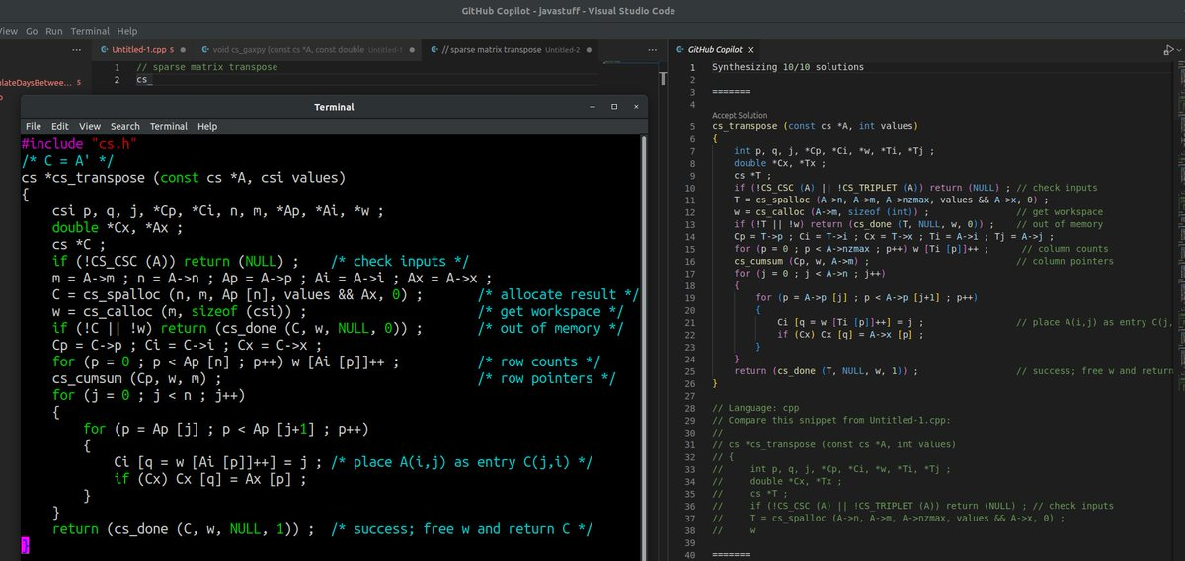
Legal Implications
Notes:
Example: Sparse matrix transpose code in c++.
Written by Prof Tim Davis, Prof of CS at Texas A&M Uni

Slide 22
Legal Implications
Notes:
Example: Sparse matrix transpose code in c++.
Written by Prof Tim Davis, Prof of CS at Texas A&M Uni

Slide 23
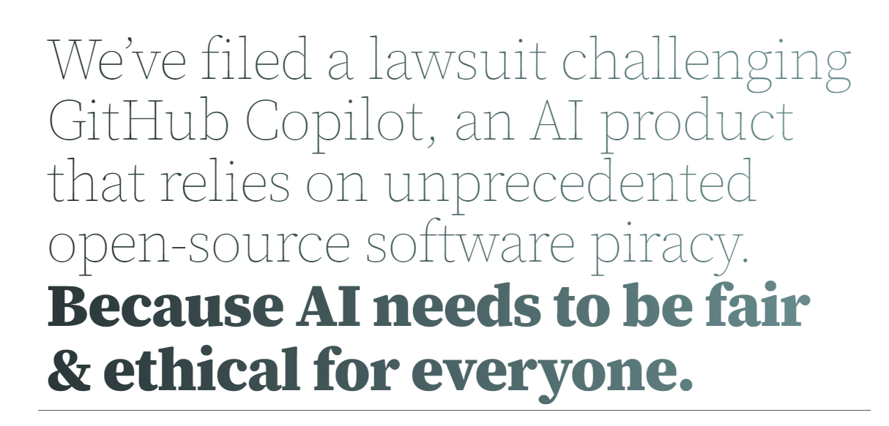
https://githubcopilotlitigation.com/
Notes:
In November last year, Matthew Butterick, a lawyer and a programmer from Los Angeles,
filed a class action lawsuit against OpenAI and Microsoft challenging the legality of GitHub Copilot.
He argues that Codex/Github Copilot relies too much on the open source code

Slide 24
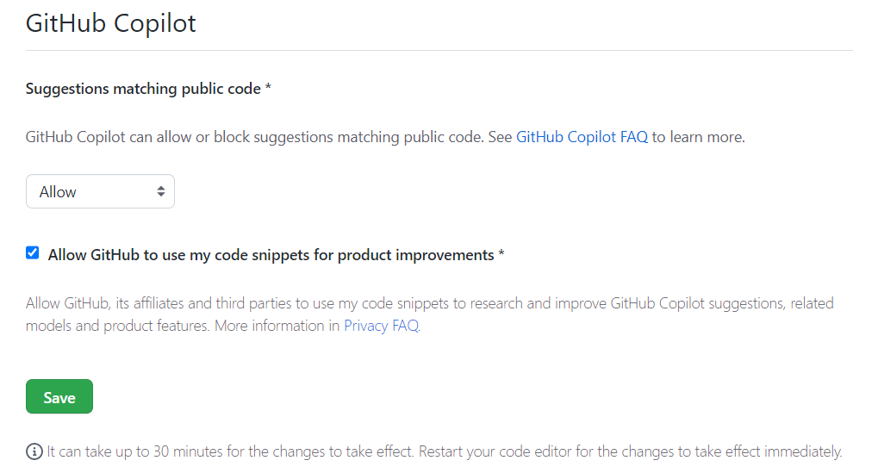

Slide 25
Legal Implications
AI is trained on existing code written by real programmers.
Generated code could be identical to some other code that should not be copied
Some licenses disallow this. Others require you to disclose the source
Mitigation: Read the terms and conditions and understand what data is used to train your AI tool

Slide 26
Summary
Examples of AI coding tools are GitHub Copilot and Tabnine
AI tools help improve your productivity
Beware of the pitfalls: over-reliance and legal problems
Notes:
I hope that all of you will utilize such AI tools wisely to speed up your development.

