Slide 1
Memory Management Virtual Memory Management
Lecture 11 (Live Version)

Slide 2
Overview
Virtual Memory:
Motivation
Basic Idea
Page Faults
Common application of Virtual Memory:
Demand Paging
Aspects of virtual memory management:
Page Table Structure
Page Replacement Algorithms
Frame Allocation

Slide 3
Virtual Memory: Motivation
Recall our assumptions:
Too restrictive:
What if the logical memory space of process is >> than physical memory?
What if the same program is executed on a computer with less physical memory?
1. Each process occupies a contiguous memory region
2. The physical memory is large enough to contain one or more processes with complete memory space

Slide 4
Virtual Memory: Basic Idea
Key observations:
Basic Idea:
Split the logical address space into small chunks:
Some chunks reside in physical memory
Other are stored on secondary storage
The most popular approach:
Extension of the paging scheme
Logical memory space split into fixed size page
Some pages may be in physical memory, others in secondary storage
1. Secondary Storage Capacity (HDD, SDD) >> Physical Memory Capacity
2. Some pages are accessed much more often than others.

Slide 5
Virtual Memory: Paging Illustration
Page 4
Page 0
Page 5
Page 1
Page 2
Page 3
Page 3
Page 0
Page 1
Page 4
Page 2
Page 5
Logical Memory Space
physical memory
Secondary Storage
(== Virtual Memory Space)
Extension of basic paging scheme, i.e., the "virtual" part

Slide 6
Extended Paging Scheme
Basic idea remains unchanged:
Use Page Table for Virtual (Logical) ➔ Physical address translation
New addition:
Two page types:
Memory resident (pages in physical memory)
Non-memory resident (pages in secondary storage)
Use a resident bit in the page-table entry
Indicates whether the page is resident in memory
CPU can only access memory resident pages:
Page Fault: When CPU tries to access non-memory resident page
OS need to bring a non-memory resident page into physical memory

Slide 7
Accessing Page X: General Steps
Check page table:
Is page X memory resident?
Yes: Access physical memory location. Done.
No: raise an exception!
Page Fault: OS takes control
Locate page X in secondary storage
Load page X into a physical memory
Update page table
Go to step 1 to re-execute the same instruction
This time with the page in memory
Hardware
OS

Slide 8
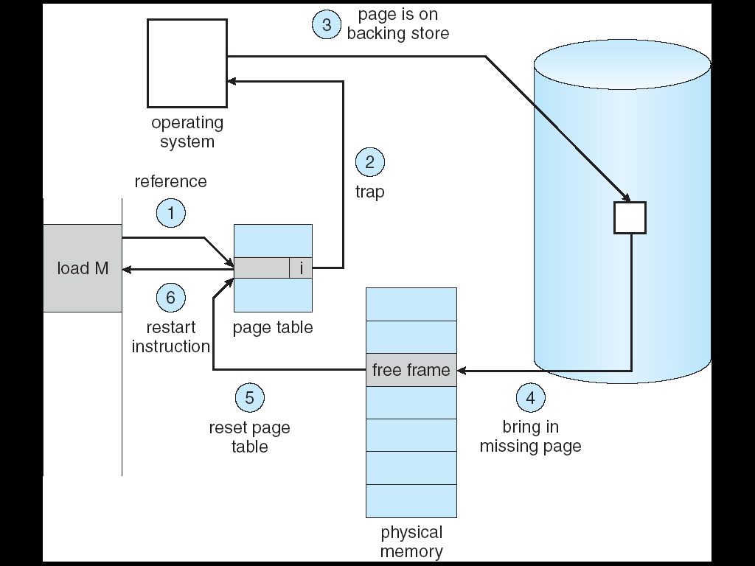
Virtual Memory Accessing: Illustration
The OS schedules page transfer as an I/O operation
Transfer usually done by a DMA controller, so the CPU is free
The process that faulted is in the BLOCKED state
Other processes may run

Slide 9
Page Fault: Illustration
frame 0
Page 3
swap 0
Page 4
Page 0
1
Page 5
1
Page 1
0
0
F4
T
2
2
Need Page 2
1
Page 2
1
S4
F
2
CPU
2
F5
T
3
3
Page 3
Page 3
3
3
S3
F
F0
T
Need Page 3
4
4
Page 0
4
Page 1
4
S0
F
CPU
Page 4
5
5
F1
T
5
Page 2
5
Page 5
page table
……
……
Virtual Memory Space
physical memory
Secondary Storage

Slide 10
The Hardware Involved
RAM
Disk
CPU chip (multiple cores)
frame 0
Page 3
swap 0
Page 4
MMU
1
Page 5
1
CPU core
TLB
0
0
F4
T
2
2
Need Page 2
1
1
S4
F
2
2
F5
T
3
3
3
3
S3
F
F0
T
Need Page 3
4
4
Page 0
4
Page 1
4
S0
F
5
5
F1
T
5
Page 2
5
page table
……
……
physical memory
Secondary Storage
BUS

Slide 11
Virtual Memory: What are the issues?
The elephant in the room:
Secondary Storage access time >> Physical memory access time
~5 orders of magnitude: milliseconds >> nanoseconds
If memory access results in page fault most of the time
To load non-resident pages into memory
The entire system can slow down significantly
Known as thrashing
How to ensure that thrashing doesn’t happen?
Related: How do we know that after a page is loaded into memory, it is likely to be useful for future accesses?
Archipelago

Slide 12
Recap: Locality Principles
Most programs exhibit these behaviors:
Most time are spent on a relatively small part of code
In any given time period, accesses are made to a relatively small part of data
Locality principles:
Temporal Locality:
Memory address used now is likely to be used again
Spatial Locality:
Memory addresses close to the address that is used now is likely to be used soon

Slide 13
Virtual Memory and Locality Principle
Both forms of locality help amortize the cost of loading the page:
Exploiting Temporal Locality:
Exploiting Spatial Locality:
After a page is loaded to physical memory, the requested memory location may be needed again
Later access to nearby locations will not cause page fault
A page contains many consecutive locations that are likely to be accessed in near future
However, there are always exceptions ☺
Programs that behave badly due to poor design or malicious intentions

Slide 14
The Memory Hierarchy
Skew in object popularity present across the memory hierarchy
compiler/programmer
CPU registers: < 1ns
$$$$$$ ~100 bytes
Managed by HW
(mostly invisible to software)
object popularity
(access frequency)
$$$$$ CPU caches: 1-10ns
L1: 64KB, L2: 512KB, L3: 16MB
main memory LD/ST access
Managed by OS w/ HW help
$$$$ DRAM: 15 - 40ns
10-100GB
bandwidth & cost per bit ($)
capacity & latency
number of objects
syscalls or persistent LD/ST
$$$ Flash, PCM (3D XPoint) 1-10us
100GB - 1TB
$$ Magnetic Disk (HDD): 1-10ms
10TB
system calls
managed manually or by robots
$ Magnetic tapes: minutes
1PB
usually involves
lab technicians
DNA molecules: hours
zettabytes (practically unlimited)

Slide 15
Virtual Memory: Summary
Mini Recap
Fully separates logical memory from physical memory
Amount of physical memory no longer restrict the size of logical memory address
More efficient use of physical memory
Page currently not needed can be on secondary storage
Allows more processes to reside in memory
Improve CPU utilization as more processes are able to run

Slide 16
IMPORTANT application
…. let's use VM to handle this

Slide 17
Motivation
When a new process is launched, should ALL text (instruction), data (global variables, etc.) pages be allocated in memory?
Considerations:
Large startup cost if there are large number of pages to allocate and initialize
But, how to pick which pages to load if we don’t load all?
Need to reduce the footprint of processes in physical memory so that more processes can use memory

Slide 18
Demand Paging
Simple idea:
Process start with no memory resident page
Only allocate a page when there is a page fault
Pros:
Fast startup time for new process
Small memory footprint
Cons:
Process may appear sluggish at the start due to multiple page faults
The page faults may have cascading effect on other processes (i.e., thrashing)

Slide 19
Demand Paging 1
P has 5 pages
frame 0
Page 3
swap 0
1
Page 1
1
0
0
F4
T
2
Page 4
2
1
1
F1
T
2
2
F5
T
3
3
3
3
F0
T
4
4
Page 0
4
4
F2
T
5
5
--
--
5
Page 2
5
page table
……
……
physical memory
Secondary Storage

Slide 20
Demand Paging2
P has 5 pages
frame 0
Page 3
swap 0
Page 0
1
1
Page 1
0
0
S0
F
F4
T
2
2
Page 2
1
1
S1
F
2
Need Page 3
2
S2
F
3
3
Page 3
Need Page 0
3
3
S3
F
F0
T
CPU
CPU
4
Page 0
Page 4
4
4
4
S4
F
5
5
--
--
5
page table
5
……
……
physical memory
Secondary Storage
Archipelago

Slide 21
More on Virtual Memory Management
Huge page table with large logical memory space
➔ How to structure the page table for efficiency?
Page Table Structures
Each process has limited number of resident memory pages
➔ Which page should be replaced when needed?
Page Replacement Algorithms
Limited physical memory frames
➔ How to distribute among the processes?
Frame Allocation Policies

Slide 22
Page Table Structure
Waste not, want not

Slide 23
Page Table Structure
Page table information is kept with the process information and takes up physical memory space
Modern computer systems provide huge logical memory space
4GiB(32bit) was the norm in the past, 8TiB or more is possible now
Huge logical memory space ➔ Huge number of pages
Each page has a page table entry ➔ Huge page table
Problems with huge page table
High overhead
Page-table allocation
Page table can occupy several frames
So what? Is there an issue?

Slide 24
Page Table Structure: Direct Paging
Direct Paging: keep all entries in a single table
With 2^{p} pages in logical memory space
p bits to specify one unique page
2^{p} page table entries (PTE) with:
physical frame number + additional information bits (valid, read only, etc)
Example from the mid 1980s:
Virtual Address: 32 bits, Page Size = 4KiB
P = 32 – 12 = 20
Size of PTE = 4 bytes
Page Table Size = 2²⁰ * 4 bytes = 4MiB (!)

Slide 25
Page Table Size – Today’s example (midrange laptop)
Page size: 4KB (12 bits for offset)
VA 64-bit → 16 ExaBytes of virtual address space
Physical memory 16GB → PA 34 bits
How many virtual pages? 2⁶⁴/2¹² = 2⁵²
2⁵² PTE entries
How many physical pages? 2³⁴/2¹² = 2²²
How many bits for physical page ID? 22 bits = 3B
In reality, PTE size = 8B (with other flags)
Page table size = 2⁵² * 8B = 2⁵⁵B per process!!!!!!!!!
physical memory size 2³⁴B!
fun fact: 2⁵⁵B is the approximate amount of DRAM in all of SG

Slide 26
Even worse: Page Tables must be contiguous in OS memory!
Even if they don’t fit in a frame!
OS must ensure that page-tables are laid out consecutively in its own memory
For efficient retrieval of the p^{th} entry (in one memory access)
This may be hard to achieve, and impossible especially with huge tables
How to solve this problem?
Physical Memory
CPU
P
D
F
D
P
Frame #
Frame N
P
Page
Table
Frame N+1

Slide 27
2-Level Paging: paging the page table
Observation:
Process may not use entire virtual memory space
➔ Full page table is a waste!
The basic Idea is to page the page table
Split the whole page table into regions
Only a few regions are used
As memory usage grows, new region can be allocated
Similar to splitting of logical memory space into pages ☺
Need a “directory” to keep track of the regions
Analogues to the relationship between page tables and data pages

Slide 28
2-Level Paging: Description
Split page table into smaller page tables
Each with a page table number
If the original page table has 2^{P} entries:
With 2^{M} smaller page tables, M bits is needed to uniquely identify one page table
Each smaller page table contains 2^{(P-M)} entries
To keep track of the smaller page tables
A single page directory is needed
Page directory contains 2^{M} indices to locate each of the smaller page table

Slide 29
2-level Paging
virtual address
page #
page dir #
page #
offset
page table
page directory
frame #
offset
Page Directory
Base Register
physical address
.
.
.
.
.
.
Notes:
Redraw and merge with previous example

Slide 30
2-Level Paging: Advantages
Using the same setting as the previous example:
Assume only 3 page tables is in use
Overhead = 1 page directory + 3 smaller page tables
1. Enables page table structures to grow beyond the size of a frame
The entire structure does not need to be contiguous in OS memory
2. We can have empty entries in the page directory
→ The corresponding page tables need not be allocated!
Virtual Address: 32bit
Page Size: 4KiB (2¹²)
PTE Size = 2 bytes
Page Tables
Overhead
= 3 x (2¹¹ x 2)
= 12KiB
2¹¹ entries
2¹¹ entries
Page Directory 2²⁰ / 2¹¹ = 2⁹ entries
Overhead
= 2⁹ x 2 = 1KiB
2¹¹ entries
Empty
Empty
Total Overhead
= 1KB + 12KB =13KiB

Slide 31
2-Level Paging: Problems
Requires two serialized memory accesses just to get the frame number
One access for the directory
One access for the page-table
… and only then can access data
Solution: TLB?
TLB hits eliminate page-table accesses
However, TLB misses experience longer page-table walks
Page-table walk: the traversal of page-tables in hardware
Additional hardware in modern processors: MMU caches
tiny cache in the MMU that caches frequent page directory entries
Purpose: to speed up the page-table walk upon a TLB miss
Acts like a TLB specifically designed for the directory entries, not PTEs

Slide 32
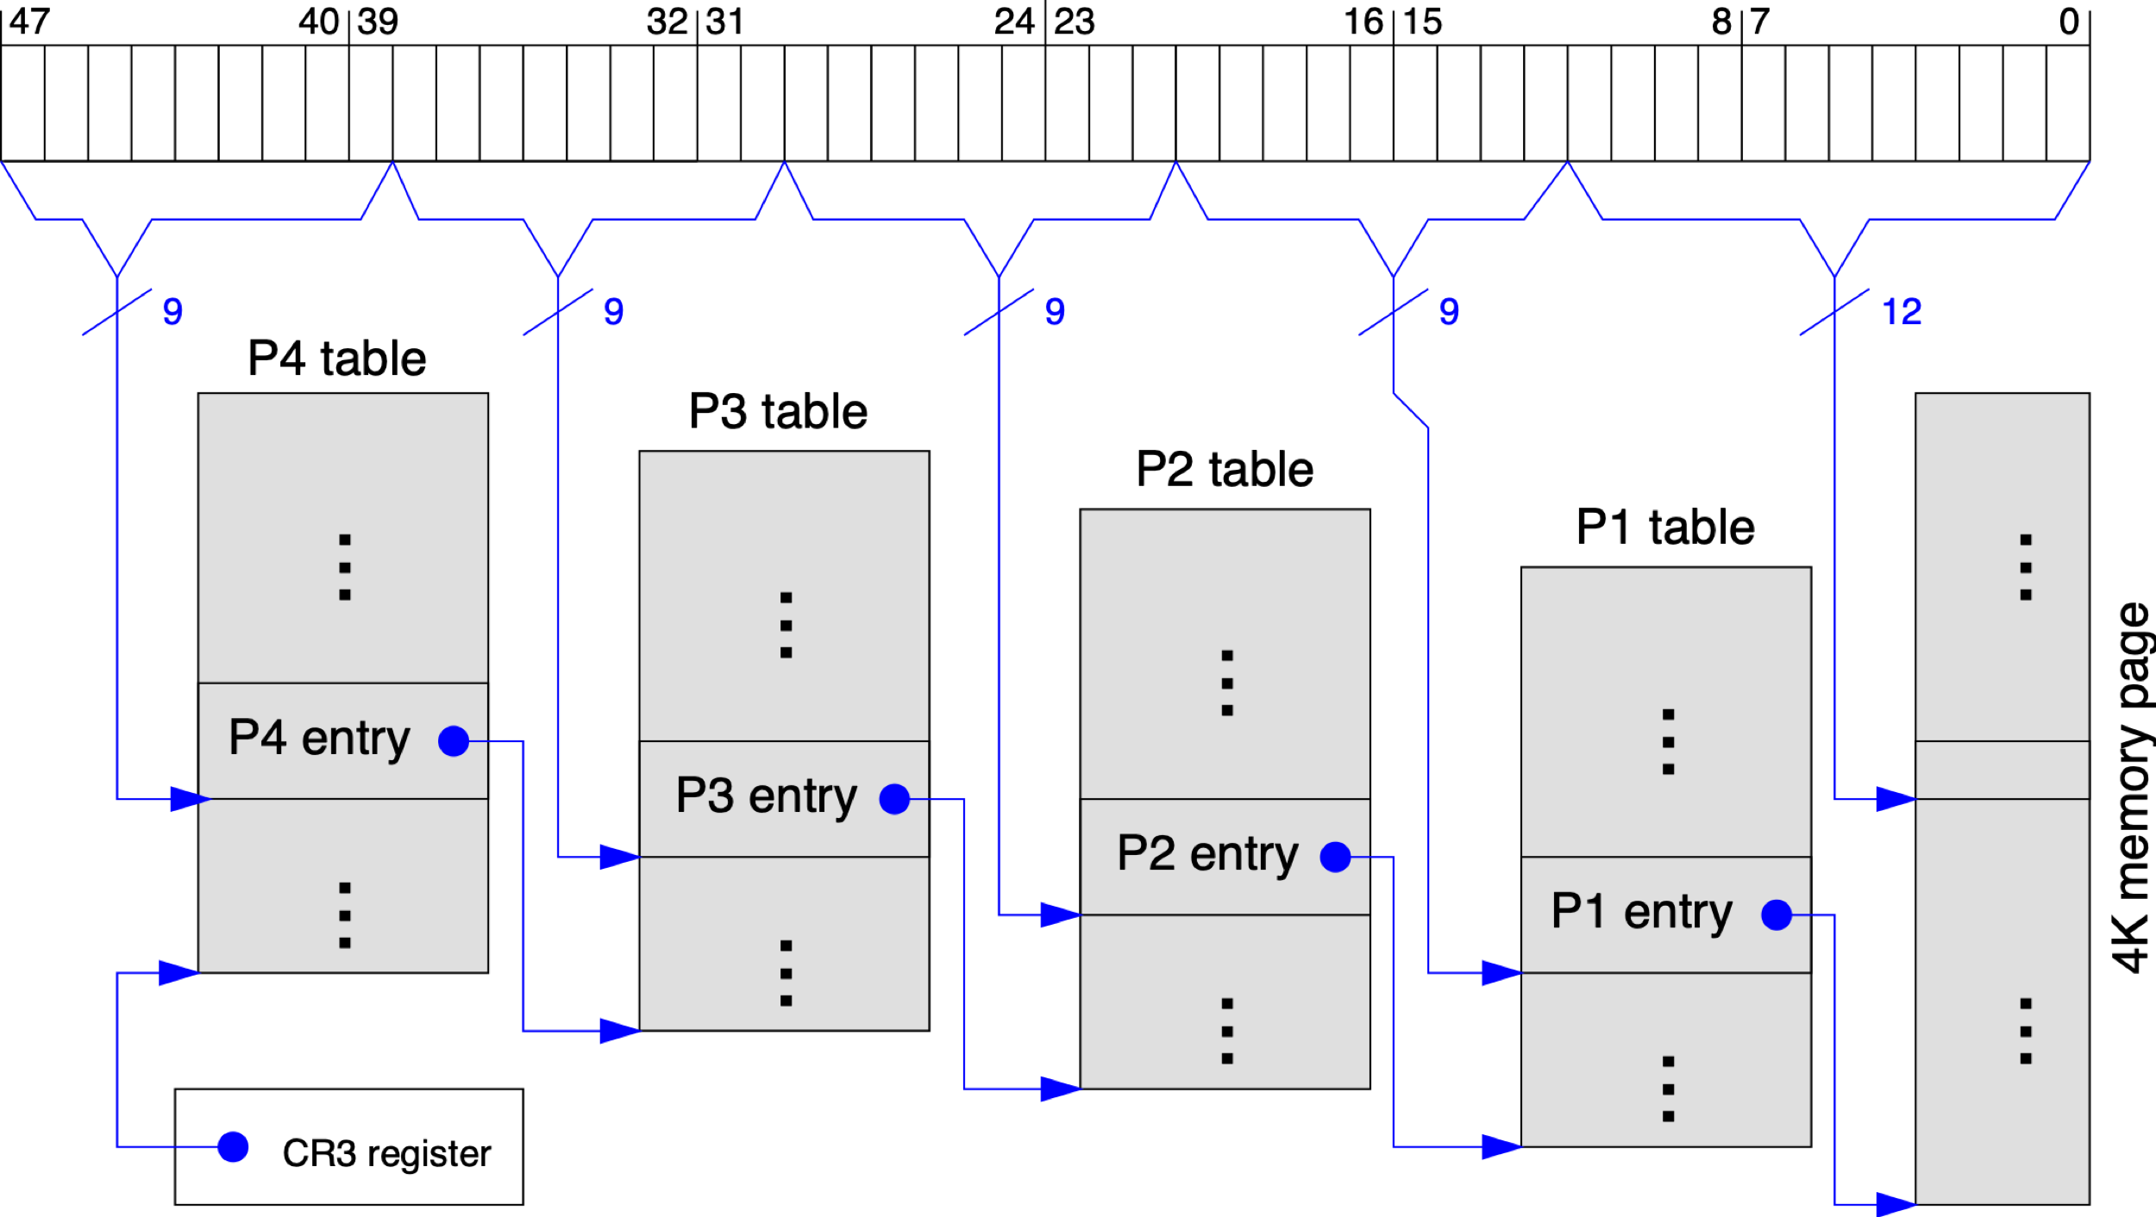
Hierarchical Page Table – Todays’ Midrange Laptop (Often in Exams)
virtual address (bits 48- 63 currently unused)
Radix-tree structure
A table in each level in the hierarchy is sized to fit in a frame
All tables are setup and wired by the OS in SW, but traversed by HW
The most complicated interface/contract between commercial HW and SW
data
part of the HW context of each process
An invalid entry in any level means that the entire subtree does not exist
Notes:
Top level (P4) has a single page pointed to by a register that is part of the process context. The page has 512 entries, 8B each.
Each entry points to a physical address of the page holding the next page table level (up to 512 (i.e., 2^9) P3-level pages). 9 bits of the virtual address point to the exact entry in the page table. The last level (P1) contains the actual PTEs.
Unused parts of the virtual address space are not stored. This dramatically reduces the page-table space requirements.

Slide 33
Inverted Page Table: Basic Idea
Page table is a per-process information
With M processes in memory, there are M independent page tables
Observation:
Only N physical memory frames can be occupied
Out of the M page tables, only N entries are valid!
Huge waste: N << Overhead of M page tables
Idea:
Keep a single mapping of physical frame to <pid, page#>
pid = process id , page# = logical page number in the corresponding the process
page# is not unique among processes
pid + page# can uniquely identify a memory page

Slide 34
Inverted Page Table: Basic Idea (cont)
In normal page table, the entries are ordered by page number
To lookup page X, simply access the Xth entry
In inverted page table, the entries are ordered by frame number
To lookup page X, need to search the whole table
Advantage:
Huge saving: One table for all processes
Disadvantage:
Slow translation
In practice Inverted tables are often used as an auxiliary structure
To answer questions like: who are all the sharers of physical frame X?

Slide 35
Inverted Table: Illustration
Physical Memory
Frame 0
CPU
i
D
Frame 1
PID
P
D
Frame 2
Frame 3
Frame 4
Frame 5
i=?
PID
P
Frame 6
Frame 7
Inverted Page Table
Notes:
P change to Pg

Slide 36
Page Replacement Algorithms
Who should I kick out next?

Slide 37
Page Replacement Algorithms
No free physical memory frame during a page fault:
➔ Need to evict (free) a memory page
When a page is evicted:
Clean page: not modified ➔ no need to write back
Dirty page: modified ➔ need to write back
Algorithms to find a suitable replacement page
Optimum (OPT)
FIFO
Least Recently Used
Second-Chance (Clock)
etc…

Slide 38
Modeling Memory References
In actual memory reference:
Logical Address = Page Number + Offset
However, to study the page replacement algorithm
Only page number is important
➔ To simplify discussion, memory references are often modeled as memory reference strings, i.e., a sequence of page numbers

Slide 39
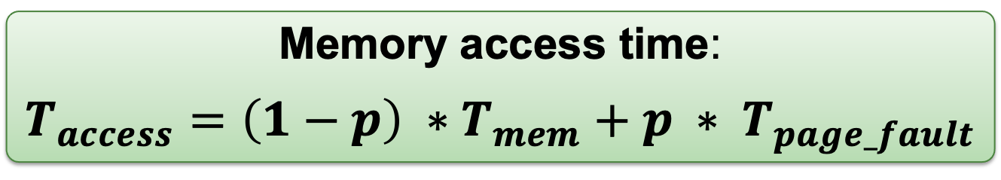
Page Replacement Algorithms: Evaluation
Memory access time:
$$T_{access}=\left(1−p\right) ∗T_{mem}+p ∗ T_{page_fault}$$
𝒑 = probability of page fault
T_{mem} = access time for memory resident page
T_{page_fault} = access time if page fault occurs
Since T_{page_fault} >> T_{mem}
Need to reduce p to keep T_{access} reasonable
Homework: try to find 𝒑 such that:
T_{mem} = 100ns, T_{page_fault} = 10ms, T_{access} = 120ns
Good algorithm should minimize the total number of page faults. And be fast!

Slide 40
Optimal Page Replacement (OPT)
General Idea:
Replace the page that will not be needed again for the longest period of time
Guarantees minimum number of page faults
try to prove at home
Unfortunately, not realizable:
Need future knowledge of memory references
Still useful:
As a base of comparison for other algorithms
The closer to OPT == better algorithm

Slide 41
OPT (6 Page Faults)
Time | Memory Reference | Frame |  |  | Next Use Time |  |  | Fault?
 |  | A | B | C
1 | 2 | 2 |  |  | 3 | ◎ | ◎ | Y
2 | 3 | 2 | 3 |  | 3 | 9 | ◎ | Y
3 | 2 | 2 | 3 |  | 6 | 9 | ◎
4 | 1 | 2 | 3 | 1 | 6 | 9 | ◎ | Y
5 | 5 | 2 | 3 | 5 | 6 | 9 | 8 | Y
6 | 2 | 2 | 3 | 5 | 10 | 9 | 8
7 | 4 | 4 | 3 | 5 | ◎ | 9 | 8 | Y
8 | 5 | 4 | 3 | 5 | ◎ | 9 | 11
9 | 3 | 4 | 3 | 5 | ◎ | ◎ | 11
10 | 2 | 2 | 3 | 5 | 12 | ◎ | 11 | Y
11 | 5 | 2 | 3 | 5 | ◎ | ◎ | 11
12 | 2 | 2 | 3 | 5 | ◎ | ◎ | ◎

Slide 42
FIFO Page Replacement Algorithm
General Idea:
Memory pages are evicted based on their loading time
Evict the oldest memory page
Implementation:
OS maintain a queue of resident page numbers
Remove the first page in queue if replacement is needed
Update the queue during page fault trap
Simple to implement
No hardware support needed

Slide 43
FIFO (9 Page Faults)
Time | Memory Reference | Frame |  |  | Loaded at Time |  |  | Fault?
 |  | A | B | C
1 | 2 | 2 |  |  | 1 |  |  | Y
2 | 3 | 2 | 3 |  | 1 | 2 |  | Y
3 | 2 | 2 | 3 |  | 1 | 2
4 | 1 | 2 | 3 | 1 | 1 | 2 | 4 | Y
5 | 5 | 5 | 3 | 1 | 5 | 2 | 4 | Y
6 | 2 | 5 | 2 | 1 | 5 | 6 | 4 | Y
7 | 4 | 5 | 2 | 4 | 5 | 6 | 7 | Y
8 | 5 | 5 | 2 | 4 | 5 | 6 | 7
9 | 3 | 3 | 2 | 4 | 9 | 6 | 7 | Y
10 | 2 | 3 | 2 | 4 | 9 | 6 | 7
11 | 5 | 3 | 5 | 4 | 9 | 11 | 7 | Y
12 | 2 | 3 | 5 | 2 | 9 | 11 | 12 | Y

Slide 44
FIFO: Problems
If the number of physical frame increases (e.g., more RAM)
The number of page faults should decrease
Intuitively…
FIFO violates this simple intuition!
For homework, use 3 / 4 frames to try: 1 2 3 4 1 2 5 1 2 3 4 5
Opposite behavior (↑ frames ➔ ↑ page faults)
Known as Belady's Anomaly
Reason: FIFO does not exploit temporal locality
Bad performance in practice

Slide 45
Least Recently Used (LRU)
General Idea: make use of temporal locality
Honor the notion of recency
Replace the page that has not been used in the longest time
the least recent one
Expect a page to be reused in a short time window
Have not used for some time ➔ most likely will not be used again
Notes:
Aims to approximate the OPT algorithm
Predicts future by mirroring the past
Gives good results in practice
Does not suffer from Belady's Anomaly

Slide 46
LRU (7 Page Faults)
Time | Memory Reference | Frame |  |  | Last Use Time |  |  | Fault?
 |  | A | B | C
1 | 2 | 2 |  |  | 1 |  |  | Y
2 | 3 | 2 | 3 |  | 1 | 2 |  | Y
3 | 2 | 2 | 3 |  | 3 | 2
4 | 1 | 2 | 3 | 1 | 3 | 2 | 4 | Y
5 | 5 | 2 | 5 | 1 | 3 | 5 | 4 | Y
6 | 2 | 2 | 5 | 1 | 6 | 5 | 4
7 | 4 | 2 | 5 | 4 | 6 | 5 | 7 | Y
8 | 5 | 2 | 5 | 4 | 6 | 8 | 7
9 | 3 | 3 | 5 | 4 | 9 | 8 | 7 | Y
10 | 2 | 3 | 5 | 2 | 9 | 8 | 10 | Y
11 | 5 | 3 | 5 | 2 | 9 | 11 | 10
12 | 2 | 3 | 5 | 2 | 9 | 11 | 12

Slide 47
LRU: Implementation Details
Implementing LRU is not easy:
Need to keep track of the "last access time" somehow
Need substantial hardware support
Approach A - Use a Counter:
A logical "time" counters, which is incremented for every memory reference
Page table entry has a "time-of-use" field
Store the time counter value whenever reference occurs
Replace the page with smallest "time-of-use"
Problems:
Need to search through all pages
"Time-of-use" is forever increasing (overflow possible!)

Slide 48
LRU: Implementation Details (cont)
Approach B - Use a "Stack":
Maintain a stack of page numbers
If page X is referenced
Remove from the stack (for existing entry)
Push on top of stack
Replace the page at the bottom of stack
No need to search through all entries
Problems:
Not a pure stack: Entries can be removed from any where in the stack
Hard to implement in hardware

Slide 49
Second-Chance Page Replacement (a.k.a. CLOCK)
General Idea:
Modified FIFO to give a second chance to pages that are accessed
Each PTE now maintains a reference bit:
1 = Accessed since the last reset, 0 = Not accessed
Algorithm:
The oldest FIFO page is selected
If reference bit == 0 ➔ Page is replaced. Done.
If reference bit == 1 ➔ Page is given a 2nd chance
Reference bit cleared to 0
Effectively resets the arrival time ➔ page taken as newly loaded
Next FIFO page is selected, go to Step 2
Degenerate into FIFO algorithm
When all pages has reference bit == 1
Adds some notion of recency and works well in practice.

Slide 50
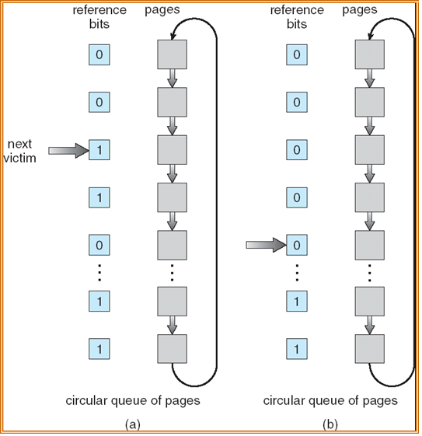

Second-Chance: Implementation Details
Maintain a circular list of all pages
And a pointer pointing to the next potential victim page
To find a victim:
Advance until the 1st page with '0' reference bit
That’s the victim
Clear any reference bits as pointer passes through

Slide 51
CLOCK( 6 Page Faults )
Time | Memory Reference | Frame (with Ref Bit) |  |  | Fault?
 |  | A | B | C
1 | 2 | ►2 (0) |  |  | Y
2 | 3 | ►2 (0) | 3 (0) |  | Y
3 | 2 | ►2 (1) | 3 (0)
4 | 1 | ►2 (1) | 3 (0) | 1 (0) | Y
5 | 5 | 2 (0) | 5 (0) | ►1 (0) | Y
6 | 2 | 2 (1) | 5 (0) | ►1 (0)
7 | 4 | ►2 (1) | 5 (0) | 4 (0) | Y
8 | 5 | ►2 (1) | 5 (1) | 4 (0)
9 | 3 | 2 (0) | 5 (0) | ►3 (0) | Y
10 | 2 | 2 (1) | 5 (0) | ►3 (0)
11 | 5 | 2 (1) | 5 (1) | ►3 (0)
12 | 2 | 2 (1) | 5 (1) | ►3 (0)

Slide 52
Frame Allocation
Which process should I favor?

Slide 53
Frame Allocation
Consider:
There are N physical memory frames
There are M processes competing for frames
Best way to distribute the N frames?
Some simple approaches:
Equal Allocation:
Each process get N / M frames
Proportional Allocation:
Processes are different in size (memory usage)
Let size_{p} = size of process p, size_{total} = total size of all processes
Each process get size_{p}/size_{total}*N frames

Slide 54
Frame Allocation and Page Replacement
The implicit assumption for page replacement algorithms so far:
Victim page are selected among pages of the process that causes page fault
Known as local replacement
If victim page can be chosen among all physical frames:
Process P can take a frame from Process Q by evicting Q's frame during replacement!
Known as global replacement

Slide 55
Local vs Global Replacement
Local Replacement:
Pros:
Number of frames allocated to a process remain constant ➔ Performance is stable between multiple runs
Cons:
If the frames allocated are not enough ➔ hinder the progress of a process
Global Replacement:
Pros:
Allow self-adjustment between processes
Process that needs more frame can get from others that need less
Cons:
Badly behaved processes can affect others
Number of frames allocated to a process can be different from run to run

Slide 56
Frame Allocation and Thrashing
Insufficient physical frame ➔ Thrashing
Heavy I/O to bring non-resident pages into RAM
Hard to find the right number of frames:
If global replacement is used:
A thrashing process "steals" page from other process
cause other process to thrash (Cascading Thrashing)
If local replacement is used:
Thrashing can be limited to one process
But that single process can use up the I/O bandwidth and degrade the performance of other processes

Slide 57
Finding the right number of frames…
Observation:
The set of pages referenced by a process is relatively constant in a period of time
Known as working set
However, as time passes, the set of pages can change
Different program phases require different data
Example:
When a function is executing, the references are likely on:
local variables, parameters, code in that function
these pages define the locality for the function
After the function terminates, the references will change to another set of pages

Slide 58
Working Set Model
When the working set is stable and well defined:
Page faults are rare
When transitioning to a new working set
Many page faults for the new set of pages
Working Set Model:
Defines Working Set Window Δ
An interval of time
W(t,Δ) = active pages in the interval at time t
Allocate enough frames for pages in W(t, Δ) to reduce possibility of page fault

Slide 59
Working Set Model: Illustration
Working Set Size
Pages
Transient region:
working set changing
in size
Stable region:
working set about the
same for a long time
Time
Accuracy of working set model is directly affected by the choice of Δ
Too small: May miss pages in the current working set
Too big: May contains pages from a different working set

Slide 60
Working Set Model: Illustration
Example memory reference strings
… | 2 | 6 | 5 | 7 | 1 | 1 | 2 | 7 | 5 | 6 | 3 | 4 | 4 | 4 | 3 | 5 | 3 | …
Δ
Δ
t1
t2
Assume
Δ = an interval of 5 memory references
W(t1,Δ)={1,2,5,6,7} (5 frames needed)
W(t2,Δ)={3,4} (2 frames needed)
Homework: Try using different Δ values

Slide 61
Summary
Covered virtual memory
Why it’s needed and how it works
Discussed different aspects of virtual memory management
Use different page table structure to reduce page table overhead
Use different page replacement algorithms to reduce page fault
How frame allocation affects page fault of a process

Slide 62
References
OS Concepts (Silberschatz)
Chapter 9 (all)
Modern Operating Systems (Tanenbaum)
Chapters 3.3, 3.4, 3.5
Three Easy Pieces
Chapters 19, 20, 21, 22, 23, 24

