Slide 1
Memory Management Memory Abstraction
Lecture 9 (Live Version)

Slide 2
Overview
Basics of Memory:
Hardware
Memory usage of a process
Role of OS
Memory abstractions:
Physical address
Logical address
Contiguous Memory Allocation:
Fixed Size Partitions
Variable Size Partitions

Slide 3
Memory Hardware
Physical memory storage:
Random Access Memory (RAM)
Access latency (approximately) constant regardless of the location (address)
Can be treated as a 1D array of AUs
AU = addressable unit = (historically) 1 byte
Each AU (byte) has a unique index
Known as physical address
A contiguous memory region:
A range of consecutive addresses
0
1
.
physical
addresses
.
n-1

Slide 4
The Memory Hierarchy 2022
compiler/programmer
CPU registers: < 1ns
$$$$$$ ~100 bytes
Managed by HW
(mostly invisible to software)
$$$$$ CPU caches: 1-10ns
L1: 64KB, L2: 512KB, L3: 16MB
main memory LD/ST access
Managed by OS w/ HW help
$$$$ DRAM: 15 - 40ns
10-100GB
bandwidth & cost per bit ($)
capacity & latency
syscalls or persistent LD/ST
$$$ Flash, PCM (3D XPoint) 1-10us
100GB - 1TB
$$ Magnetic Disk (HDD): 1-10ms
10TB
system calls
managed manually or by robots
$ Magnetic tapes: minutes
1PB
usually involves
lab technicians
DNA molecules: hours
zettabytes (practically unlimited)

Slide 5
Recap: Memory Usage of Process
Text
(for instructions)
Data
(for global variables)
The entire
memory space
Heap
(for dynamic allocation)
Stack
(for function invocations)

Slide 6
Calculations of Memory Addresses
int i = 0;
void inc()
{
i = i + 20;
}
int main()
{
inc();
...
...
}
...
0
...
i
inc()
...
lw $1, [4096]
addi $1, $1, 20
sw $1, [4096]
...
Compile
by Compiler
main()
...
...
call inc
...
Source Code
Executable file on the disk
(.exe, a.out, …)
Executable typically contains compiled code (text region) and global data

Slide 7
Actual Execution
Free Memory
...
lw $1, [4096]
addi $1, $1, 20
sw $1, [4096]
...
...
0
...
inc()
i
code
...
...
call inc
...
...
lw $1, [4096]
addi $1, $1, 20
sw $1, [4096]
...
main()
inc()
Load and Run
by Operating System
...
0
...
i
data
...
...
call inc
...
main()
...free memory...
inc() stack frame
Executable
stack
main() stack frame
Main Memory

Slide 8
Memory Usage: Summary
Generally, two types of data in a process:
Transient Data
Valid only for a limited duration, e.g., during a function call
e.g., function parameters, local variables
Persistent Data
Valid for the duration of the program or until explicitly deallocated
e.g., global variables, dynamically allocated memory
Both types of data sections can grow / shrink during execution

Slide 9
Operating System: Managing Memory
OS handles the following memory related tasks:
Allocate memory space to new process
Manage memory space of a process
Protect memory space of a process from other processes
Provides memory related system calls to processes
Manages memory space for internal OS use

Slide 10
Key Topics
Memory Abstraction
Use of secondary storage as an extended memory region
Virtual Memory Management
Allocating and managing memory in disjoint areas
Disjoint Memory Allocation
Allocating and managing continuous chunks of memory
Contiguous Memory Allocation
Presenting a logical interface for memory accesses

Slide 11
Memory Abstraction
You have to be logical!

Slide 12
Without Memory Abstraction
Suppose a process directly uses physical address:
i.e. ,no memory abstraction
Assuming a program that only has the above line of code:
How to access the memory location in a process?
Can multiple processes share the physical memory correctly?
Can the address space of a process be protected easily?
i=i+20;

Slide 13
Without Memory Abstraction: Pros
0
...
lw $1, [4096]
addi $1, $1, 20
sw $1, [4096]
...
Process A
...
0
...
4096
Memory access is straightforward
Address in program == Physical Address
No conversion/mapping is required
Address fixed at compilation time
physical address
Main Memory

Slide 14
Without Memory Abstraction: Cons
0
...
lw $1, [4096]
addi $1, $1, 20
sw $1, [4096]
...
Process A
Hard to protect memory space!
Two processes are occupying the same physical locations
→ Conflict: Both processes assume memory starts at 0!
...
0
...
4096
physical address
......
8000
...
lw $1, [4096]
addi $1, $1, 20
sw $1, [4096]
...
Process B
...
0
...
12096
Main Memory

Slide 15
Fix Attempt: Address Relocation
Recalculate the memory references during loading:
Problems:
Slow loading time
Not easy to distinguish memory reference from normal integer constant
8000
...
lw $1, [4096]
addi $1, $1, 20
sw $1, [4096]
...
...
0
...
Process B
12096

Slide 16
Fix Attempt 2: Base + Limit Registers
Use a special register as the base of all memory references:
Known as Base Register
During compilation time, all memory references are compiled as an offset from this register
At loading time, the base register is initialized to the starting address of the process memory space
Add another special register to indicate the range of the memory space of current process:
Known as Limit Register
Every memory access is checked against the limit to protect memory space integrity

Slide 17
Base + Limit Register: Illustration
...
0
...
...
0
...
Base Register
i
0
...
lw $1, [B+4096]
addi $1, $1, 20
sw $1, [B+4096]
...
Process A
i
......
XXX
Base
...
lw $1, [4096]
addi $1, $1, 20
sw $1, [4096]
...
...
lw $1, [B+4096]
addi $1, $1, 20
sw $1, [B+4096]
...
Limit Register
0
inc()
inc()
...
0
...
XXX
4096
Limit
5000
...
...
call inc
...
...
...
call inc
...
main()
main()
Process B
8000
...
lw $1, [B+4096]
addi $1, $1, 20
sw $1, [B+4096]
...
Executable
Base
Executable
8000
Load and Run
...
0
...
12096
Limit
13000
physical address
Main Memory

Slide 18
Base + Limit: Summary
Problems:
To access address Adr:
Actual = Base + Adr
Check Actual < Limit for validity
➔ every memory access incurs an addition and a comparison
The idea is very useful:
Later generalized to segmentation mechanism
Provides a crude memory abstraction:
Address 4096 in Process A and B are no longer the same physical location!

Slide 19
Memory Abstraction: Logical Address
Embedding actual physical address in program is a bad idea
➔Give birth to the idea of logical address:
Logical address == how the process view its memory space
Logical address != Physical address in general
A mapping between logical address and physical address is needed
Each process has a self-contained, independent logical memory space

Slide 20
Illustration: Logical Addresses
Physical address
Logical address
Process A
Process B
lw
lw $1, [4096]
addi $1, $1, 20
sw $1, [4096]
...
......
Mapping
...
0
...
Process B
lw $1, [4096]
addi $1, $1, 20
sw $1, [4096]
...
Process A
lw
...
0
...
This mechanism achieves:
Logical vs. physical address separation
Relocatable programs

Slide 21
Overview of the upcoming lectures
Process fits in memory as a contiguous piece (week 8)
Process fits in memory but split
into disjoint chunks (week 9)
Process doesn’t fit
(and split into chunks)
(week 10)
Process A
Process C
Virtual memory
Process C
Process B
Process A
Process B
slots of fixed size and variable size
chunks are fixed or variable size

Slide 22
Contiguous Memory Management
Chunk of continuous addresses

Slide 23
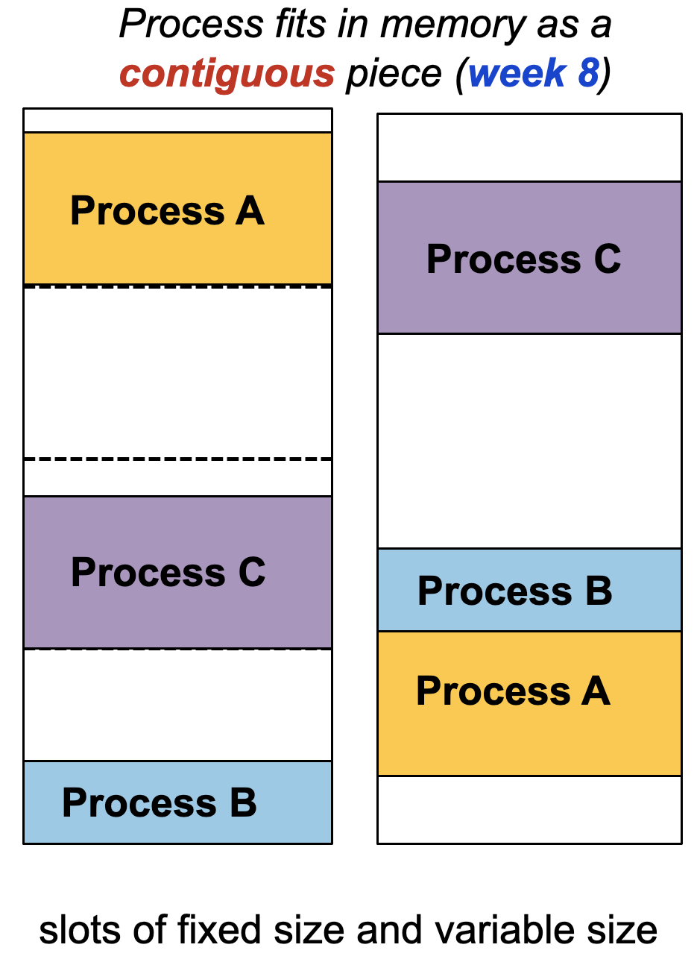
Contiguous Memory Management: Assumptions
Process must be in memory, as one piece, during whole execution
1. Each process occupies a contiguous memory region
2. The physical memory is large enough to contain one or more processes with complete memory space
Note: These assumptions will be removed in later topics

Slide 24
Multitasking, Context Switching & Swapping
To support multitasking:
Allow multiple processes in the physical memory at the same time
So that we can switch from one process to another
When the physical memory is full:
Free up memory by:
Removing terminated process
Swapping blocked process to secondary storage
Notes:
Operations to support

Slide 25
Memory Partitioning
Memory Partition:
A contiguous memory region allocated to a single process
Two allocation schemes:
Fixed-Size Partitions
Physical memory is split into fixed number of partitions of equal size
A process will occupy one of the partitions
Variable-Size Partitions
Partition is created based on the actual size of process
OS keep track of the occupied and free memory regions
Perform splitting and merging when necessary

Slide 26
Fixed Partitioning: Illustration
Free Memory
Partition 4
Partition 3
Partition 2
Process B
Partition 1
Partition 1
Process A
OS

Slide 27
Fixed Partitioning: Summary
If a process does not occupy the whole partition:
Any leftover space is wasted!
Known as internal fragmentation
Pros:
Easy to manage
Fast to allocate
Every free partition is the same ➔ No need to choose
Cons:
Partition size need be large enough to contain the largest of the processes
Smaller process will waste memory space ➔ internal fragmentation

Slide 28
Dynamic Partitioning: Illustration
Free Memory
Free Memory
Free Memory
Process C
free
“holes”
Process B
Process A
Free Memory
Free Memory
Process D
OS

Slide 29
Dynamic Partitioning: Summary
Free memory space is known as hole
With process creation/termination/swapping:
➔ tend to have a large number of holes
Known as external fragmentation
Merging of neighboring holes is possible
Pros:
Flexible and removes internal fragmentation
Cons:
Need to maintain more information in OS
Takes more time to locate appropriate region

Slide 30
Dynamic Partitioning: Allocation Algorithms
Assuming the OS maintain a list of partitions and holes
Algorithm to locate partition of size N:
Search for hole with size M > N. Several variants:
First-Fit:
Take the first hole that is large enough
Best-Fit:
Find the smallest hole that is large enough
Worst-Fit:
Find the largest hole
Split the hole into N and M-N
N will be the new partition
M-N will be the left over space ➔ a new hole
A
B
C
D
3
8
7
11
Archipelago

Slide 31
Reducing External Fragmentation: Merging and Compaction
When an occupied partition is freed:
Merge with adjacent hole if possible
Compaction can also be used:
Move the occupied partitions around to create bigger, consolidated holes
Cannot be invoked too frequently as it is very time consuming

Slide 32
Dynamic Partitioning in Action: Example
OS maintains a linked list for partition info
Assume First-Fit algorithm is used
4095
Free Memory
4095
Free Memory
T0
T1
Request: Process A (size 512)
start
length
768
F
Process A
T
256
256
3840
512
Status: True = occupied False= hole
F
768
3328
256
256
OS
OS

Slide 33
Dynamic Partitioning in Action: Example
T2
Request: Process B (size 1024)
4095
Free Memory
Free Memory
T3
Free: Process A
Free Memory
Request: Process C (size 640)
Process C
T4
Free Memory
Process B
T
256
512
F
768
3328
F
256
512
T
768
1024
768
F
1792
2304
Process A
T
1792
640
F
2432
1664
Free Memory
256
OS

Slide 34
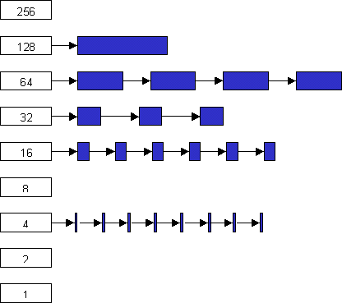
Multiple Free Lists
1. Separate list of free holes from list of occupied partitions
2. Keep multiple lists of different hole sizes
Take hole from a list that most closely matches request size
Partition size typically increases exponentially
Faster allocation
256B
128B
64B
32B
16B
8B
4B
2B
1B
Notes:
Usually the size of each is 1, 2, 4, 8, 16, ….

Slide 35
Dynamic Allocation Algorithm: Buddy System
Popular implementation of multiple free lists
Buddy memory allocation provides efficient:
Partition splitting
Locating good match for a free partition (hole)
Partition de-allocation and coalescing
Main idea:
Free block is split into half repeatedly to meet request size
The two halves forms a sibling blocks (buddy blocks)
When buddy blocks are both free
Can be merged to form larger block

Slide 36
Buddy Blocks Illustration
original memory size = 2^{k}
original memory size = 2^{k}
split in half
2^{k} / 2 = 2^{k-1}
2^{k-1}
Logical relationship between blocks
2^{k} / 2 = 2^{k-1}
split in half
2^{k-2}
2^{k-2}
2^{k-2}
split in half
2^{k-3}
2^{k-3}
Actual partitions in memory
2^{k-2}
2^{k-3}
2^{k-3}
2^{k-1}

Slide 37
Buddy System: Implementation
Keep an array A[0…K], where 2^{K} is the largest allocable block size
Each array element A[J] is a linked list which keep tracks of free block(s) of the size 2^{J}
Each free block is indicated just by the starting address
In actual implementation, there may be a smallest allocable block size as well
A block that is too small is not cost effective to manage
We will ignore this in the discussion

Slide 38
Buddy System: Allocation Algorithm
To allocate a block of size N:
Find the smallest S, such that 2^{S} >= N
Access A[S] for a free block
If free block exists:
Remove the block from free block list
Allocate the block
Else
Find the smallest R from S+1 to K, such that A[R] has a free block B
For (R-1 to S)
Repeatedly split B ➔ A[S...R-1] has a new free block
Goto Step 2

Slide 39
Buddy System: Deallocation Algorithm
To free a block B:
Check in A[S] , where 2^{S} == size of B
If the buddy C of B exists (also free)
Remove B and C from list
Merge B and C to get a larger block B’
Goto step 1, where B ⬅ B'
Else (buddy of B is not free yet)
Insert B to the list in A[S]

Slide 40
Buddy System: Where is my Buddy?
Observe that:
Block address A is in the format xxxx00..00₂
Splitting A into 2 blocks of half the size:
B = xxxx00..00₂ and C = xxxx1..00₂
Example:
A = 0 (000000₂), size = 32
After splitting:
B = 0 (000000₂), size = 16
C = 16 (010000₂), size = 16
So, two blocks B and C are buddy of size 2^{S}, if
The lowest S bits (bits 0 .. S-1) of B and C are identical
Bit S (i.e., S+1st bit) of B and C is different

Slide 41
Buddy System: Example
T1
2^{S}=128
S = 7
Request 100
Block P allocated at 0 size = 128
A[9]
0
A[8]
… … …
A[9]
0
A[8]
0
256
256
A[1]
A[7]
128
0
128
A[0]
… … …
A[0]
0
0
0
128
256
0
256
0
128
256
Free Memory = 512
Free Memory = 512
P
Free
Free
Free
Free
Free
Free
Free

Slide 42
Buddy System: Example (cont)
T2
Request 250
Block Q allocated at 256 size = 128
T3
Free Block P
2^{S}=256
S = 8
Hi Buddy!
A[9]
A[9]
A[8]
0
A[8]
256
A[7]
128
0
A[7]
128
… … …
… … …
Long time no see!
A[0]
A[0]
0
128
256
0
0
128
256
256
P
Free
Q
Free
Free
Free
Q
Q

Slide 43
Summary
Relationship between:
OS, Process and Memory
Why memory abstraction is needed
The advantages of using logical address
Assuming process must fit memory as a single piece:
Various memory sharing schemes are discussed

Slide 44
References
Modern Operating System (4th Edition)
Chapters 3.1, 3.2
Operating System Concepts (9th Edition)
Chapters 8.1, 8.2, 8.3
Three Easy Pieces
Chapters 12, 13, 14

