Slide 1
Memory Management Disjoint Memory Schemes
Lecture 10 (Live Version)

Slide 2

Memory Management Schedule
Process fits in memory as a contiguous piece (week 8)
Process fits in memory but split
into disjoint chunks (week 9)
Process doesn’t fit
(& split into chunks)
(week 10)
Process A
Process C
Virtual memory
Process C
Process B
Process A
Process B
slots of fixed size and variable size
chunks are fixed or variable size

Slide 3
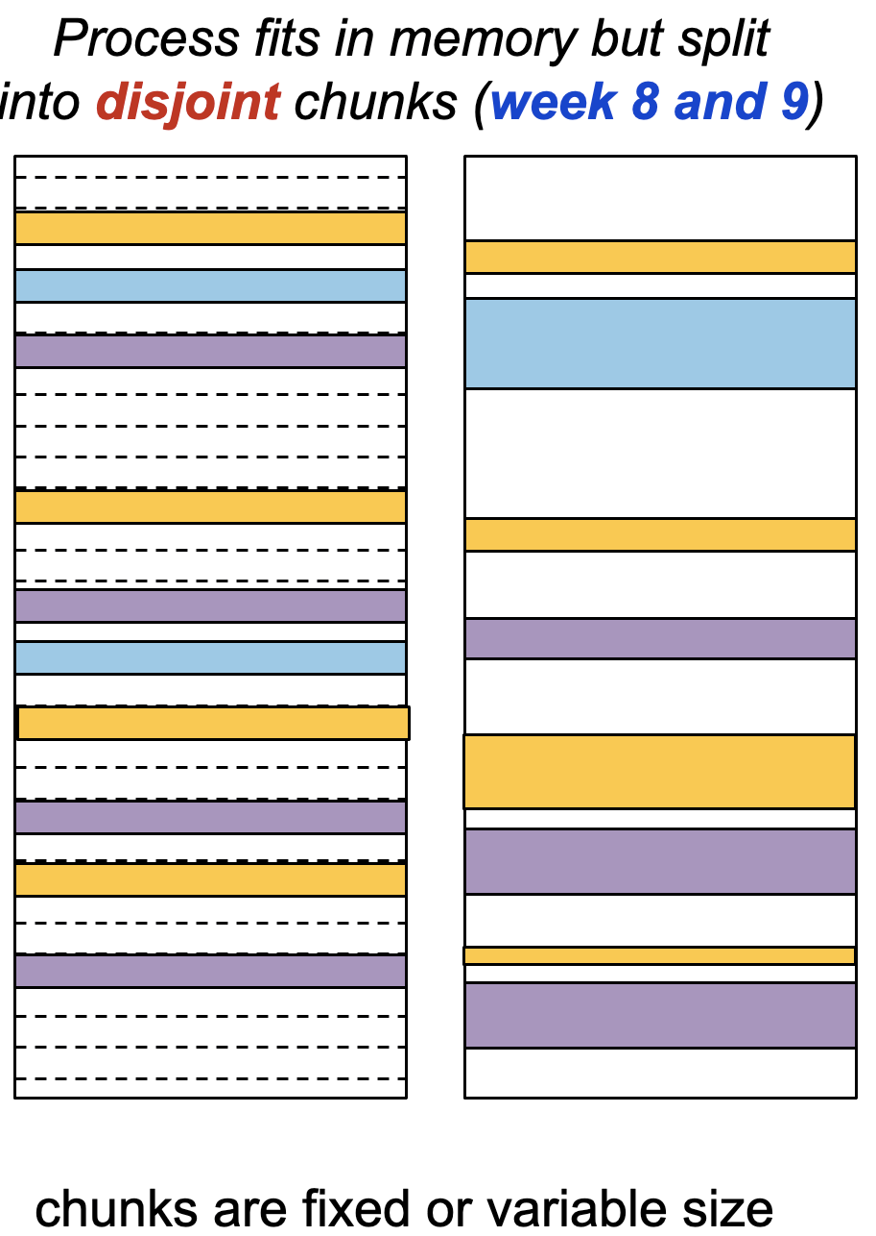

Overview
Paging Scheme
Basic Idea
Logical-to-Physical Address Translation
Hardware Support
Protection & Page Sharing
Segmentation Scheme
Motivation
Basic Idea
Logical-to-Physical Address Translation
Hardware Support
Segmentation with Paging

Slide 4
Disjoined Memory Space with Paging
Previous lecture: memory management was discussed with two assumptions:
1. Each process occupies a single contiguous piece of memory
2. The physical memory is large enough to contain one or more processes with their entire memory spaces
Let us remove assumption(1) in this lecture:
Process memory space can now be split into disjoint physical memory ranges

Slide 5
Paging Scheme: Basic Idea
The physical memory is split into regions of fixed size
known as physical frames
Frame size decided by hardware (which hardware? Memory? CPU?)
The logical memory of a process is similarly split into regions of same size
known as logical page
At execution time, the pages of a process are loaded into any available memory frame
Logical memory space remain contiguous
Occupied physical memory region can be disjoint!

Slide 6

Page Table: Lookup Mechanism
In contiguous memory allocation, it is very simple to keep track of the usage of a process:
Minimally, starting address and size of process
Simple linked list storing mem. context information for all processes
Under paging scheme:
Logical page ←→ Physical page (frame) mapping is no longer straightforward
Need a lookup table to provide the translation
This structure is known as a Page Table

Slide 7
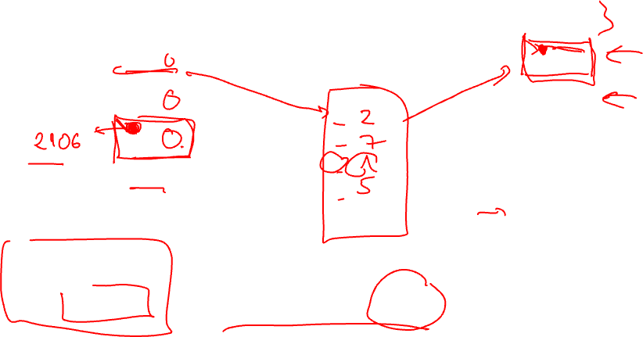
Paging: Illustration
frame 0
Page 0
1
Page 2
Page 1
2
Page 0
0
Page 2
3
1
Page 3
2
4
3
logical memory
5
Page 3
page table
6
Page Size = 1,000B
frame 7
Page 1
load r1, [2106]
physical memory

Slide 8
Paging: Illustration (printer friendly)
frame 0
1
Page 2
Page 0
2
Page 0
Page 1
0
2
1
7
3
Page 2
2
1
4
Page 3
3
5
page table
A mapping mechanism to convert page# to frame#
5
Page 3
logical memory
6
frame 7
Page 1
physical memory

Slide 9

Logical-to-Physical Address Translation
frame 0
Page 0
1
Page 2
Page 1
2
Page 0
0
2
Page 2
3
1
7
Page 3
2
1
4
3
5
logical memory
5
Page 3
page table
6
Physical Address
= Frame_number x sizeof(physical_frame) + offset
frame 7
Page 1
Offset: displacement from the beginning of the physical frame
physical memory

Slide 10
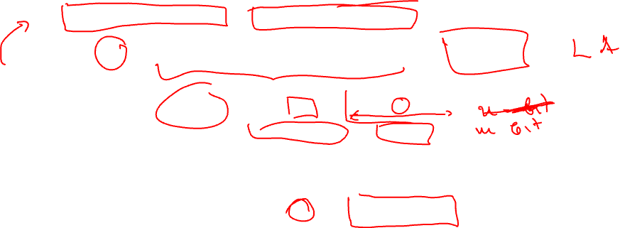
Address Translation: Essential Tricks
Two important design decisions to simplify address translation:
Keep frame size (page size) as a power-of-2
Physical frame size == Logical page size
PA = F x sizeof(physical_frame) + offset
Page Number
Offset
Logical Address
p
o
(m – n) bits
n bits
Translation mechanism
Physical Address
f
o
Frame Number
Offset

Slide 11
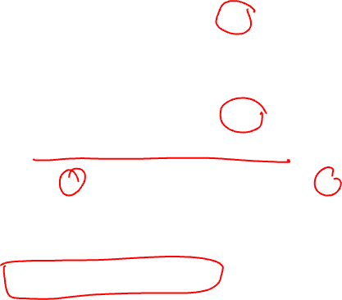
Address Translation: Formula
Given:
Page/Frame size of 2^{n}
m bits of logical address
Logical Address LA:
p = Most significant m-n bits of LA
o = Remaining n bits of LA
Use p to find frame number f
from mapping mechanism like page table
Physical Address PA:
PA = f*2^{n} + o

Slide 12
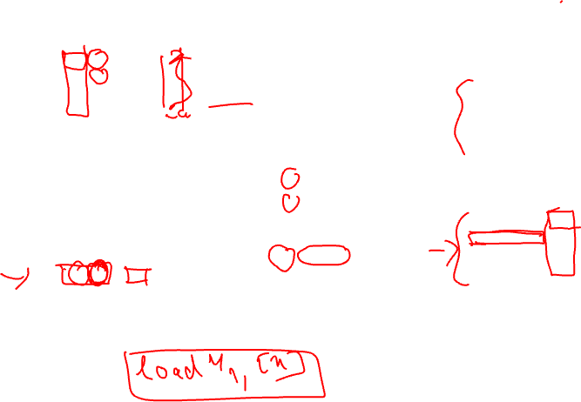
Example: 4 Logical Pages, 8 Physical Frames
m = 4 bits
...
00000
0000
0001
0010
0011
a
b
c
d
...
00100
page size = 4 bytes (n=2)
a
b
c
d
01000
01001
01010
01011
.
.
.
.
.
.
.
.
...
01100
00
0
010
1000
1001
1010
1011
i
j
k
l
...
10000
01
1
111
10
m
n
o
p
2
001
10100
10101
10110
10111
11
1100
1101
1110
1111
m
n
o
p
3
101
page table
page table
...
11000
logical address
logical memory
...
11100
physical memory
physical address

Slide 13
Paging: Observations
External fragmentation? Not possible
No left-over physical memory region
Every single free frame can be used
Internal fragmentation? Yes, but insignificant
Logical memory space may not be multiple of page size
Max one page per process is not fully utilized
Clean separation of logical and physical address space
Allows great flexibility
Simple address translation

Slide 14
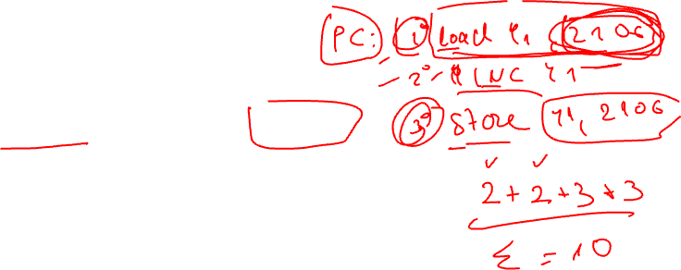
Implementing Paging Scheme
A pure-software solution:
OS stores page table information in PCB
Improved understanding: Memory context of a process includes the page table
(or pointers to it; today’s page tables are quite big)
Issues:
Requires two memory access for every memory reference
1st access is to read the indexed page table entry to get frame number
2nd access is to access the actual memory item
Archipelago

Slide 15

Paging Scheme: Hardware Support
Modern processors provide Translation Look-Aside Buffer (TLB)
Specialized on-chip component to support paging (how many?)
Speeds up address translation
TLB acts as a cache for the page table entries
Very small (tens of entries) and fast (<= 1 clock cycle)
Logical address translation with TLB:
Use page number to search TLB associatively
Entry found (TLB-Hit):
Frame number is retrieved to generate physical address
Entry not found (TLB-Miss):
Memory access to access the page table
Retrieved frame number is used to generate physical address and update TLB

Slide 16
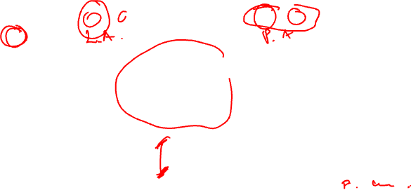
Translation Look-Aside Buffer
Physical Memory
CPU
P
O
F
O
Page#
Frame #
TLB
P
Frame #
Page Table

Slide 17
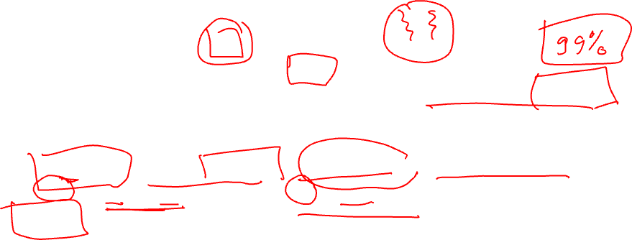
TLB: Impact on Memory Access Time
Suppose:
TLB access takes 1ns
Main memory access takes 50ns
What is the average memory access time if TLB hit ratio is 90%?
Average memory access time (AMAT):
= P(TLB hit) x latency(TLB hit) + P(TLB miss) x latency(TLB miss)
= 90% x (1ns + 50ns) + 10% x (1ns + 50ns + 50ns)
= 56ns
Notes: Latency of filling in TLB entry can be hidden by the hardware. Impact of caches ignored
Archipelago

Slide 18

TLB and Process Switching
Improved Understanding: TLB is part of the hardware context of a process? Yes? No?
When a context switch occurs:
TLB entries are flushed
So that new process will not get incorrect translation
Avoids correctness, security, and safety issues
Hence, when a process resume running:
Will encounter many TLB misses to fill the TLB
Physical Memory
CPU
P
D
F
D
Page#
Frame #
TLB
P
Frame #
Page Table
Archipelago

Slide 19
Paging Scheme: Protection
Paging can be easily extended to provide memory protection using:
Access-Right Bits
Valid Bit
Access Right Bits:
Each Page Table Entry has { writable, readable, executable } bits
E.g., page containing code should be executable and read only, page containing data should be readable and writable, etc.
Every memory access is checked against the access right bits in hardware

Slide 20

Paging Scheme: Protection (cont)
Observation:
The logical memory range is usually the same for all processes
However, not all process utilize the whole range
Some pages are out-of-range for a particular process
Valid bit:
Included in each page table entry
Indicates whether the page is valid to access by the process
OS will set the valid bits as memory is being allocated to the process
Every memory access is checked against this bit in hardware:
Out-of-range access will be caught by OS in this manner

Slide 21
Paging Scheme: Page sharing
Page table can allow several processes to share the same physical memory frame
Use the same physical frame number in the page table entries
Possible usage:
Shared code page:
Some code is being used by many processes, e.g., C standard library, system calls etc.
Implementing Copy-On-Write:
As discussed in "Process Abstraction", parent and child process can share a page until one tries to change a value in it

Slide 22
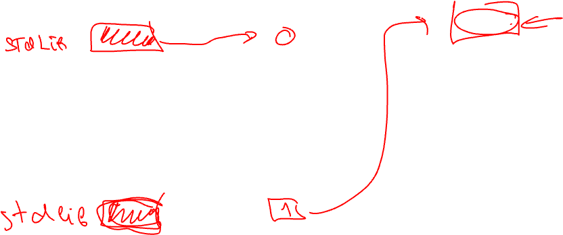
Paging Scheme: Page Sharing
Page 0
frame 0
Page 1
0
2
Page 1
1
7
1
Page 2
Page 2
2
1
2
Page 0
Page 3
3
5
Process P's
logical memory
Process P's
page table
3
Page 2
4
Page 0
Page 0
0
5
Page 3
Page 1
1
6
Page 3
Page 2
2
Page 3
3
frame 7
Page 1
Process Q's
logical memory
Process Q's
page table
physical memory

Slide 23
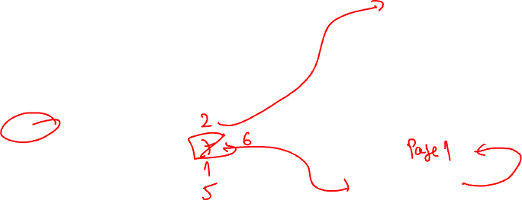
Paging Scheme: Copy-On-Write
Page 0
frame 0
Page 1
0
2
Page 1
1
7
1
Page 2
Page 2
2
1
2
Page 0
Page 3
3
5
Process P's
page table
Page 2
Process P's
logical memory
3
Page 2
4
Page 0
Page 0
5
Page 3
Page 1
0
1
6
Page 3
Page 2
2
Page 3
frame 7
Page 1
3
Process Q's
logical memory
physical memory
Process Q's
page table
Notes:
Page table can allow several processes to share the same physical memory frame
Use the same physical frame number in the page table entries
Possible usage:
Shared code page:
Some code are being used by many processes, e.g. C standard library, system calls etc
Implement Copy-On-Write:
As discussed in "Process Abstraction", parent and child process can share a page until one tries to update a value in it

Slide 24
Segmentation Scheme

Slide 25
Segmentation Scheme: Motivation
The memory space of a process is treated as a single entity so far
However, each process has a number of logical memory regions
Different regions have different usage, permissions, lifetime, scope, etc
Text
Logical
Memory
Space
Text
Data
Data
Heap
Heap
Stack
Stack

Slide 26
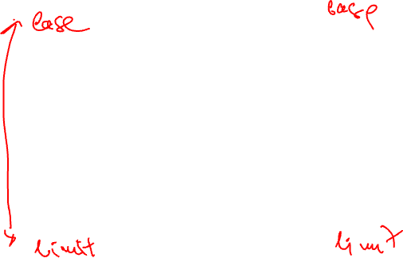
Segmentation Scheme: Motivation (cont)
Some regions may grow / shrink at execution time
Hard to achieve if the whole process is one piece
Gaps in-between should be provisioned for in advance
Hard to check whether a memory access in a region is in-range or not
Different usage permissions
across segments
Same usage and permissions within a segment

Slide 27

Segmentation Scheme: Basic Idea
Manage memory at the level of memory segments
Logical memory space of a process: a collection of segments
Mapped into contiguous physical partitions of the same size
Each memory segment:
Has a name
For ease of reference
Has a limit
Indicate the exact range of the segment
All memory references specified as:
Segment name + Offset
Heap Segment
+245
Item
Memory Access:
"Heap" + 245

Slide 28

Segmentation: Illustration
Global Data Segment
Stack Segment
Global Data Segment
User Code Segment
User Code Segment
Heap Segment
Heap Segment
Stack Segment
Logical Address Space
(Segments can be of different sizes)
Physical Memory
(Segments are disjoint in physical memory)

Slide 29
Segmentation: Logical Address Translation
Each segment mapped to a contiguous physical memory region
with a base address and a limit/size
The segment name usually represented as a single number
Known as segment id
Logical address <SegID, Offset>:
SegID is used to look up <Base, Limit> of the segment in a segment table
Physical Address PA = Base + Offset
Offset < Limit for valid access

Slide 30
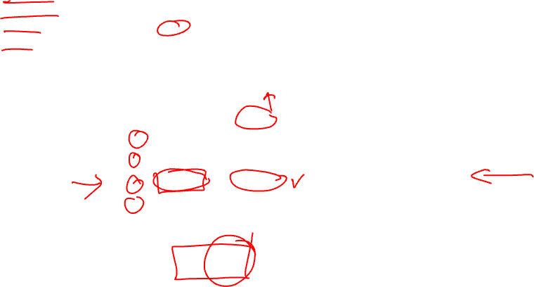
Logical Address Translation: Illustration
Assume: User Code Segment = 0 Global Data Segment = 1 Heap Segment = 2 Stack Segment = 3
7500
Global Data Segment
6000
Memory Access
< Segment Id, Offset >
5700
User Code Segment
Base
Base
Limit
Limit
0
0
3500
2200
3500
Heap Segment
1
2900
1
6000
1500
2
2
2400
1100
2400
3
3
0
1300
1300
Stack Segment
segment table
segment table
< 2, 500 >
< 2, 1600 >
0
Physical Memory
Notes:
UPDATE: Reverse the memory range?

Slide 31

Segmentation: Hardware Support
S
Limit
Base
Physical Memory
Segment Table
<
Yes
+
CPU
No
S
O
Addressing Error!

Slide 32
Segmentation: Summary
Pros:
Each segment is an independent contiguous memory space
➔ Naturally matches programmer’s view of memory
➔ More efficient bookkeeping
➔ Segments can grow/shrink and be protected/shared independently
Cons:
Segmentation requires variable-size contiguous memory regions
➔ can cause external fragmentation

Slide 33
Segmentation with paging

Slide 34
Segmentation with Paging: Basic Idea
The intuitive next step is to combine segmentation with paging
Basic Idea:
Each segment is now composed of several pages instead of a contiguous memory region
Essentially, each segment has a page table
Segment can grow by allocating new page then add to its page table and similarly for shrinking

Slide 35
Segmentation with Paging: Basic Idea
Logical Address Space
GD P#3
Stack Segment
Global Data Segment
User Code Segment
GD P#1
GD P#0
Heap Segment
0
1
0
2
0
0
1
3
1
1
2
2
2
3
GD P#2
User Code
page table
3
3
Global Data
page table
Physical Memory
Heap
page table
Stack
page table

Slide 36
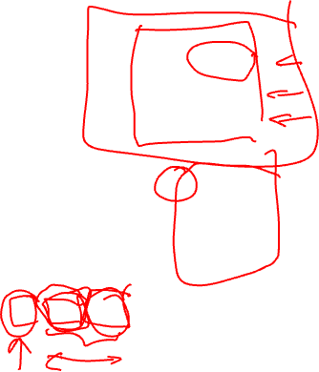
Segmentation with Paging: Illustration
S
Page limit
Pg Table Base
Physical Memory
Segment Table
P
<
Yes
Frame Number
No
Addressing Error!
Page Table
CPU
S
P
O
F
O

Slide 37

Segmentation with Paging
frame 0
1
< 1, 6 >
0
7
2
Process P
3
1
2
Text(0)
2
14
4
Page 0
5
Page 1
6
0
3
...
0
9
Page 2
7
1
2
...
1
13
8
2
1
...
Data(1)
9
Page 0
3
1
...
Stck(2)
10
Page 1
Page 0
0
12
11
12
Heap(3)
13
Page 0
0
6
14
4-byte Page
frame 15
Incomplete diagram, to be filled in during lecture.
Notes:
Possible usage:
Shared code page:
Some code are being used by many processes, e.g. C standard library, system calls etc
Implement Copy-On-Write:
As discussed in "Process Abstraction", parent and child process can share a page until one tries to update a value in it

Slide 38
Summary
Discussed two popular memory management schemes
Both allow the logical address space to be in disjoint physical regions
Paging: split the logical address into fixed size pages
Store in fixed size physical memory frames
Segmentation: split the logical address into variable size segments according to their usage
Stored in variable-sized physical partitions
Segmentation with Paging: the combination of the two

Slide 39
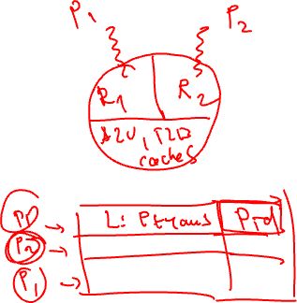
References
Modern Operating System (4th Edition)
Chapters 3.7
Operating System Concepts (9th Edition)
Chapters 8.4, 8.5
Three Easy Pieces
Chapters 16, 18, 19

