Slide 1
COMP 401
Recitation 1
1/17/14

Slide 2
Introduction
Why use IDEs?
How to use it?
Get hands dirty

Slide 3


Why use IDEs?
Integrated development environment (IDE)
http://coding.smashingmagazine.com/2009/02/11/the-big-php-ides-test-why-use-oneand-which-to-choose/

Slide 4
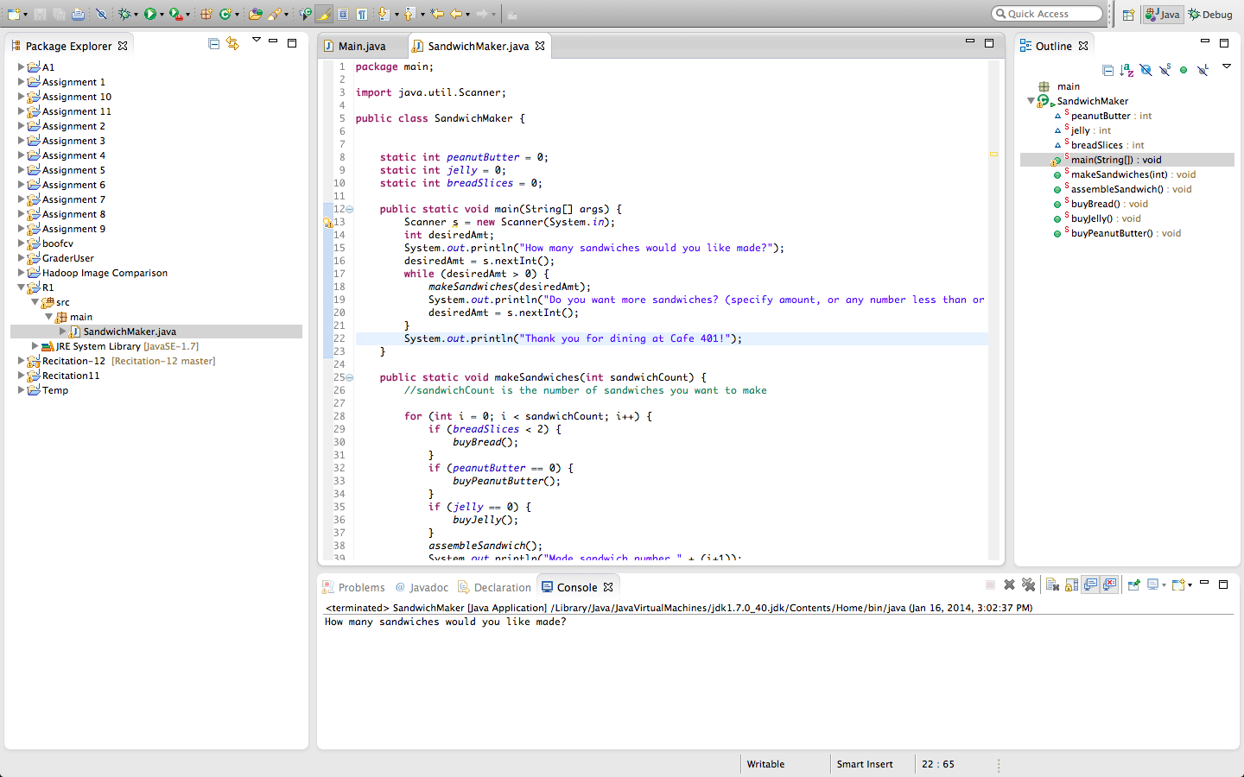

Slide 5
Syntax highlighting

Slide 6
Project management

Slide 7
Console

Slide 8
Why using IDEs?
Syntax highlighting
Project management
Console
Autocomplete
…
If you prefer VIM or Emacs, you can make them like an IDE as well

Slide 9
Example
Install Eclipse via its website
Download the SandwichMaker
Make your first project for the SandwichMaker
Debugging

Slide 10
Recitation Code
https://github.com/chunweiliu/comp401r1

