Slide 1


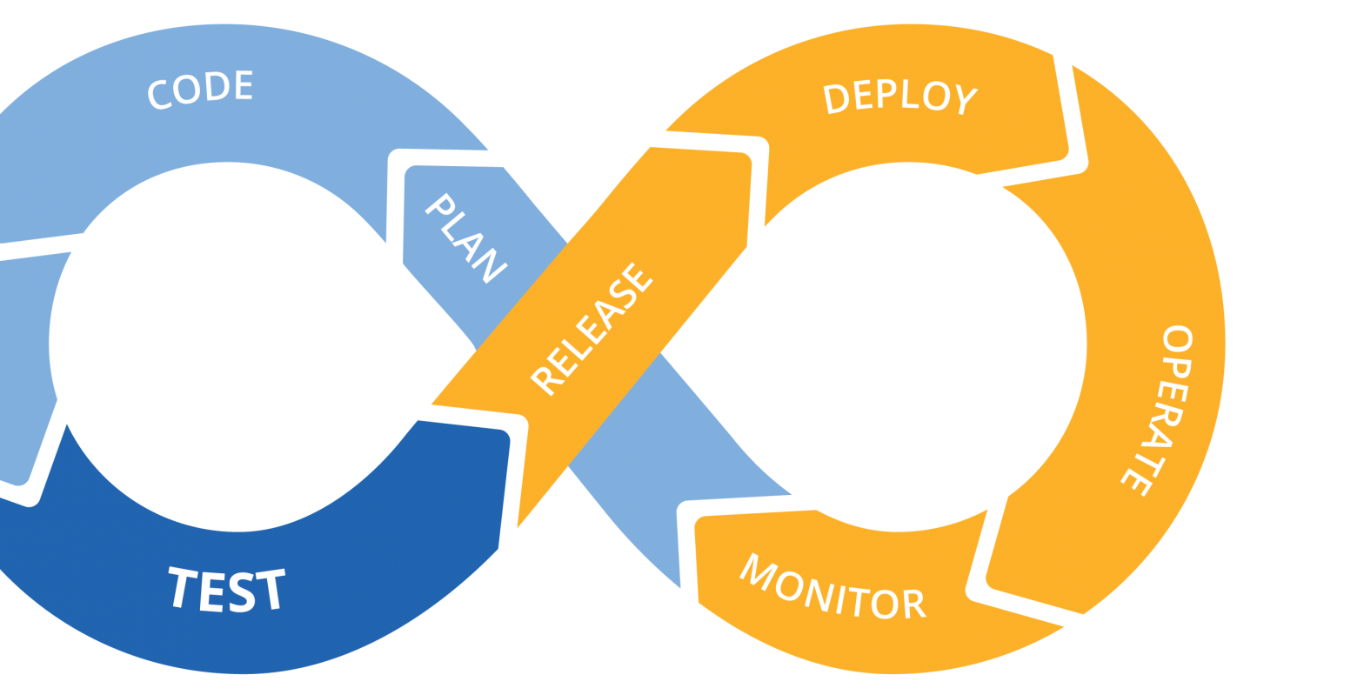





DevOps: CI/CD(Continuous Integration, Continuous Delivery, Continuous Deployment) with CircleCI

Slide 2
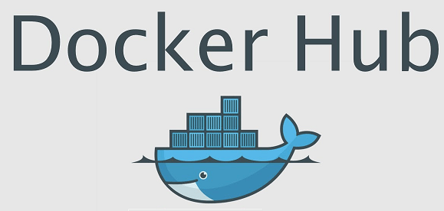


4. Build code, Run Test, Build image
2. Notify
5. Push Image
3. Pull Code
6. SSH
1. Push Code
7. Pull Image
8. Run App.

Slide 3
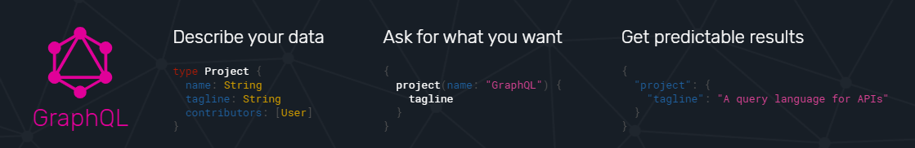
GraphQL
Notes:
1. 描述已經很多人介紹過 raspeberry OS 的安裝. 瀏覽網頁帶過
2. 設定 vncserver 遠端登入
3. 介紹 電路圖 , raspberry 的接角
4. 實際的影片
5. 介紹程式
6. demo

Slide 4
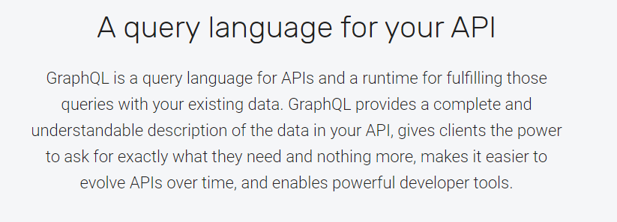
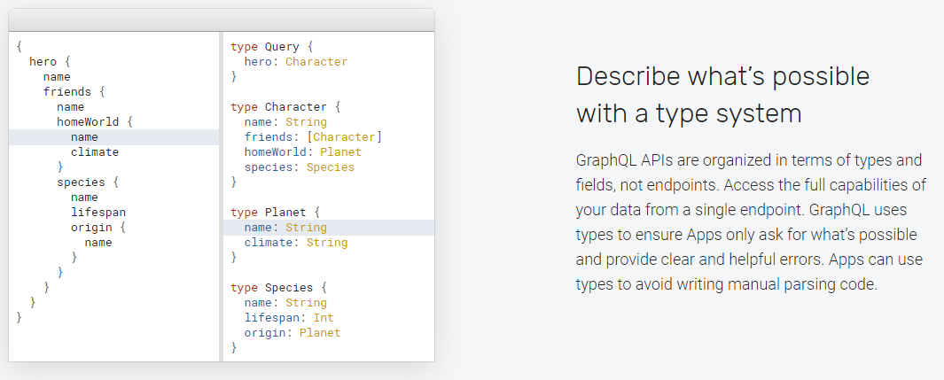

Slide 5
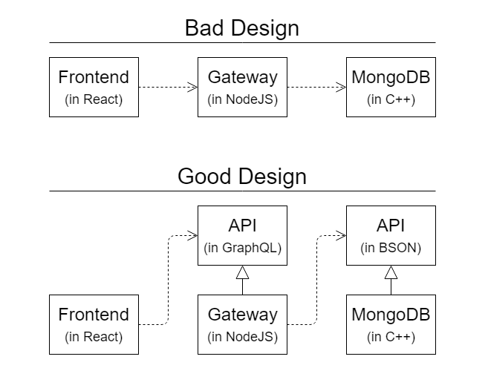
https://github.com/kingbike/typescript-graphql-express-mongoose-crud-circleCI

Slide 6


MongoDB + Node.js
+
TypeScript
mongoose
Notes:
MongooseJS Essentials - Learn MongoDB for Node.js

