Slide 1
IBM MNIST Challenge
Chunzi Wang
April 14

Slide 2
Table of Contents
Prediction Results
Exploratory Analysis - Digits

Slide 3

Prediction Results
Notes:
Mean absolute error. Expected utility score.

Slide 4
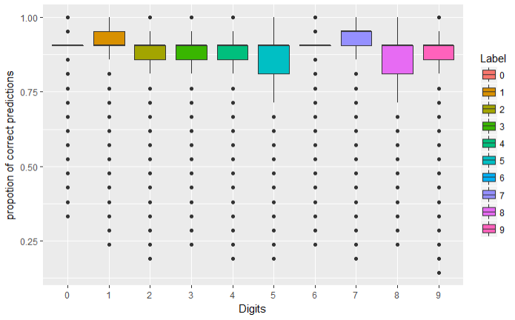
Exploratory Analysis - Digit
Distribution of correct predictions for every digit

Slide 5
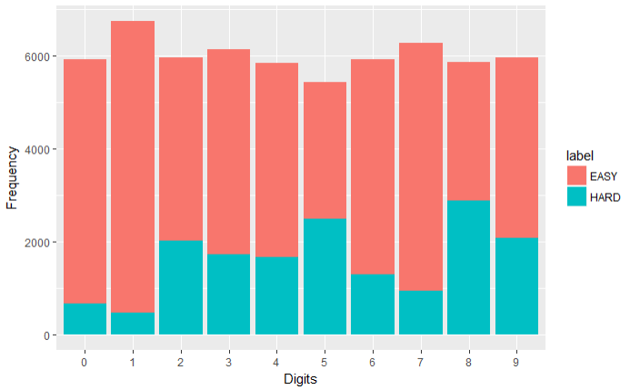
Exploratory Analysis - Digit
1 and 0 are the easiest to predict
6 and 7 are easy to predict
8,5,9,2,3,4 are harder to predict

Slide 6

Thanks for Watching

