Slide 1
UK DYNAMO USERGROUP
INAUGURAL HACKATHON
HACKSTREET BOYS

Slide 2
UK DYNAMO USERGROUP
INAUGURAL HACKATHON
HACKSTREET BOYS
presenting

Slide 3
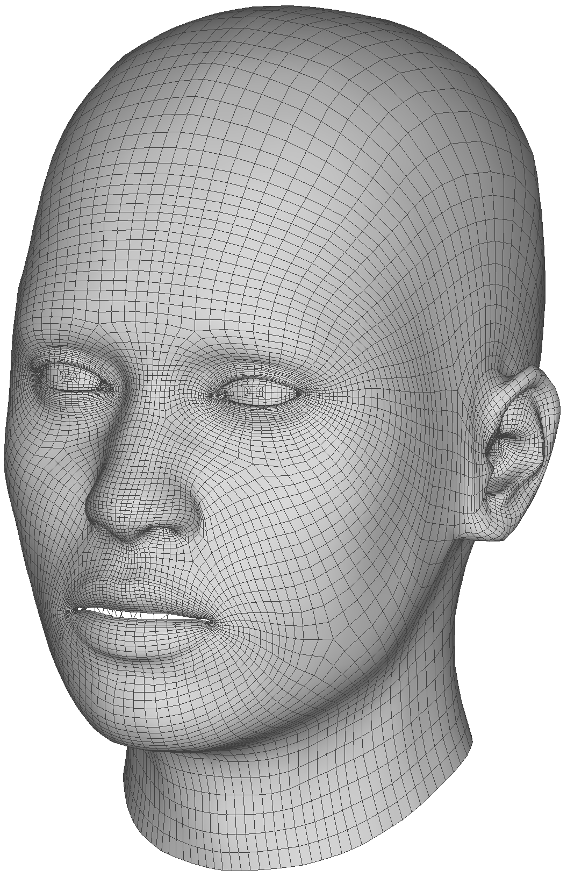
MESH BY FACE

Slide 4


Slide 5
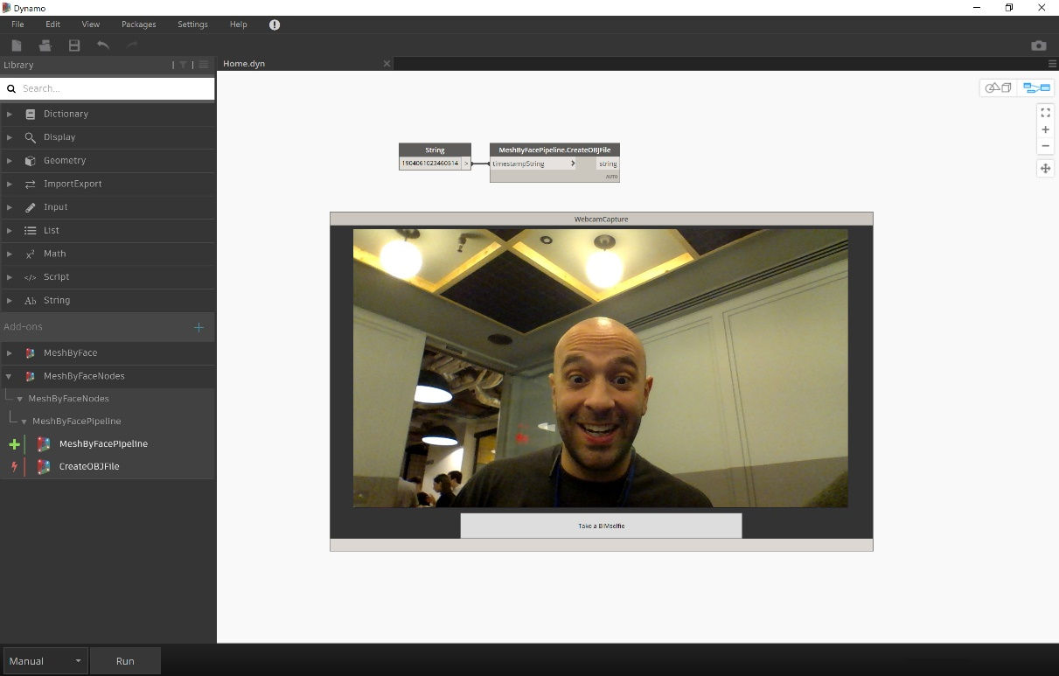
Live feed to Dynamo
Zero Touch Node

Slide 6
Live feed to Dynamo
Zero Touch Node
Take picture
export .jpg

Slide 7
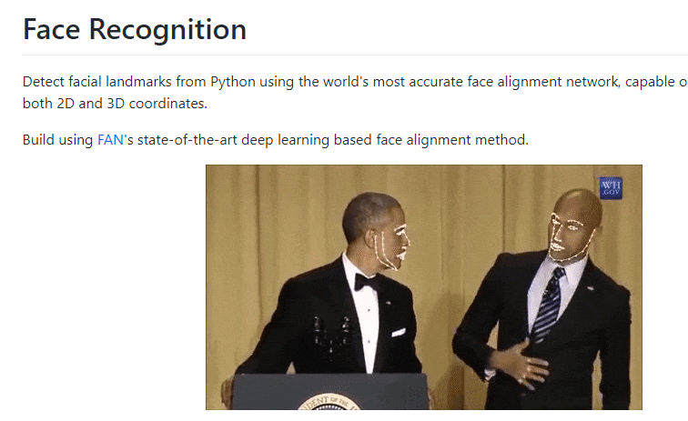
Through Dynamo
Initiate deep learning
Library in Python to run face alignment
Live feed to Dynamo
Zero Touch Node
Take picture
export .jpg

Slide 8
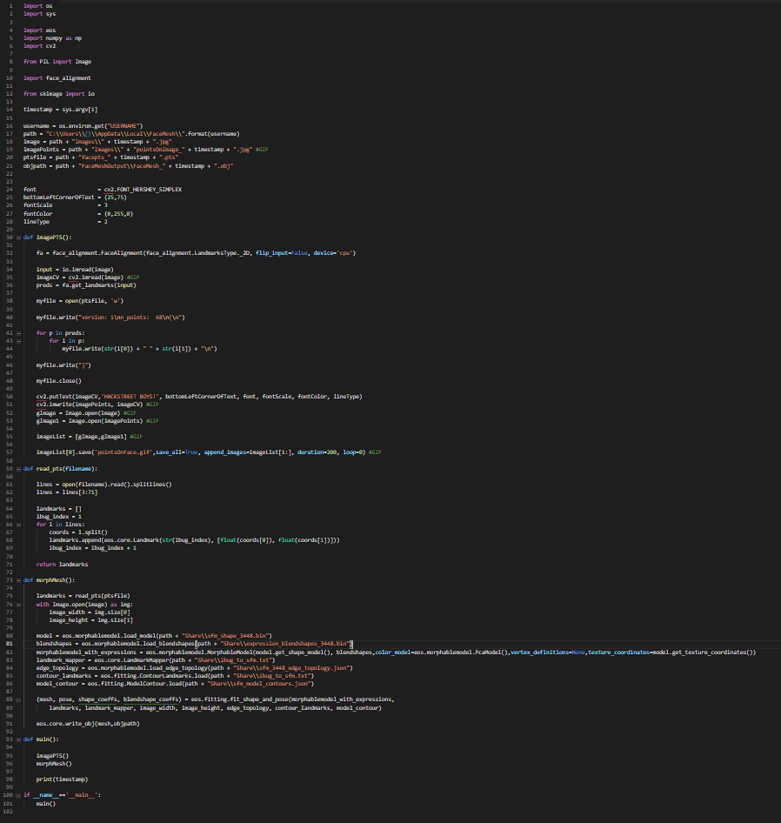
Through Dynamo
Initiate deep learning
Library in Python to run face alignment
Live feed to Dynamo
Zero Touch Node
Take picture
export .jpg
Generate 68 points
Export as iBug .pts file

Slide 9

Through Dynamo
Initiate deep learning
Library in Python to run face alignment
Live feed to Dynamo
Zero Touch Node
Take picture
export .jpg
Generate 68 points
Export as iBug .pts file
Export point Overlay GIF
To Run in Dynamo GUI
Tweet Image to Hackstreet boys

Slide 10
Through Dynamo
Initiate deep learning
Library in Python to run face alignment
Live feed to Dynamo
Zero Touch Node
Take picture
export .jpg
Generate 68 points
Export as iBug .pts file
Morph neutral Mesh using .pts file. Export as .obj
Export point Overlay GIF
To Run in Dynamo GUI
Tweet Image to Hackstreet boys

Slide 11
Through Dynamo
Initiate deep learning
Library in Python to run face alignment
Live feed to Dynamo
Zero Touch Node
Take picture
export .jpg
Generate 68 points
Export as iBug .pts file
Extract rbg values at point from image. Apply to mesh
Align mesh to webcam picture
Import to Dynamo through mesh tookit
Morph neutral Mesh using .pts file. Export as .obj
Export point Overlay GIF
To Run in Dynamo GUI
Tweet Image to Hackstreet boys
Tweet Image to Hackstreet boys

Slide 12
Through Dynamo
Initiate deep learning
Library in Python to run face alignment
Live feed to Dynamo
Zero Touch Node
Take picture
export .jpg
Generate 68 points
Export as iBug .pts file
Extract rbg values at point from image. Apply to mesh
Align mesh to webcam picture
Import to Dynamo through mesh tookit
Morph neutral Mesh using .pts file. Export as .obj
Export point Overlay GIF
To Run in Dynamo GUI
Tweet Image to Hackstreet boys
Tweet Image to Hackstreet boys

Slide 13
Through Dynamo
Initiate deep learning
Library in Python to run face alignment
Live feed to Dynamo
Zero Touch Node
Take picture
export .jpg
Generate 68 points
Export as iBug .pts file
Extract rbg values at point from image. Apply to mesh
Align mesh to webcam picture
Import to Dynamo through mesh tookit
Morph neutral Mesh using .pts file. Export as .obj
Export point Overlay GIF
To Run in Dynamo GUI
Tweet Image to Hackstreet boys
Tweet Image to Hackstreet boys

