Slide 1
Selective subject: „Kalman Filtering in Control- & Communication Applications”

Slide 2
Content:
Ball-plate model
State-space representation
Simulation of KF using Matlab
Implementation of KF on MCU
Results

Slide 3
Content:
Ball-plate model
State-space representation
Simulation of KF using Matlab
Implementation of KF on MCU
Results

Slide 4
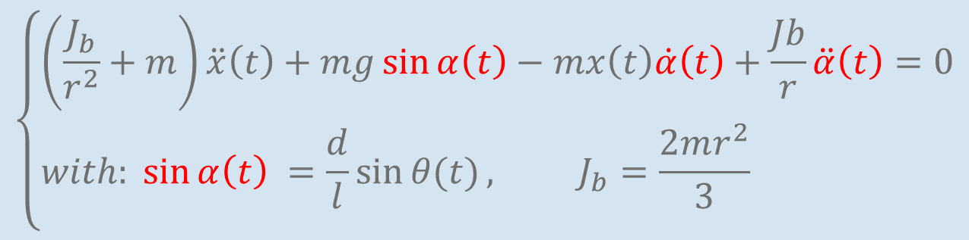
1. Ball-plate model:
$$\left\{\begin{aligned}&\left(\frac{J_{b}}{r^{2}}+m\right)\ddot{x}\left(t\right)+mg\sin{α\left(t\right)}−mx\left(t\right)\dot{α}\left(t\right)+\frac{Jb}{r}\ddot{α}\left(t\right)=0 \\ &with: \sin{α\left(t\right) =\frac{d}{l}\sin{θ(t)}}, J_{b}=\frac{2mr^{2}}{3} \\ &\end{aligned}\right.$$

Slide 5
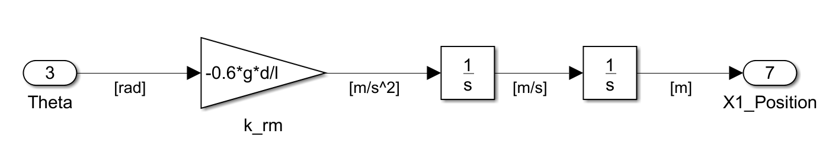

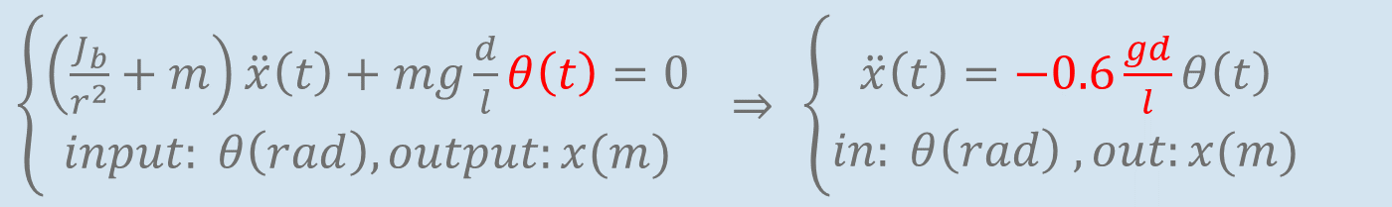
1. Ball-plate model:
With $α\left(t\right) small$: linearize$\left\{\begin{aligned}\sin{α\left(t\right)}=α\left(t\right) \\ \dot{α}\left(t\right)=0; \ddot{α}\left(t\right)=0\end{aligned}\right.$
$\left\{\begin{aligned}\left(\frac{J_{b}}{r^{2}}+m\right)\ddot{x}\left(t\right)+mg\frac{d}{l}θ\left(t\right)=0 \\ input: θ\left(rad\right), output:x(m)\end{aligned}\right.$ $⇒$ $\left\{\begin{aligned}\ddot{x}\left(t\right)=−0.6\frac{gd}{l}θ\left(t\right) \\ in: θ\left(rad\right) , out:x(m)\end{aligned}\right.$

Slide 6
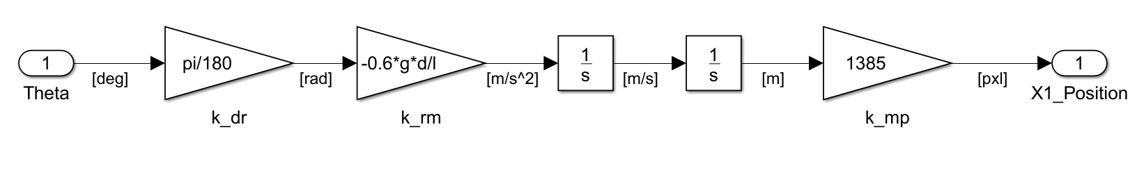
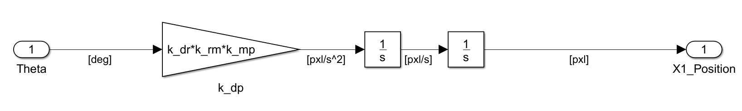
1. Ball-plate model:
Gain | k_rm | k_dr | k_mp | k_dp
Value | -0.8829 | 0.01745 | 1385 | -21.2651

Slide 7
Content:
Ball-plate model
State-space representation
Simulation of KF using Matlab
Implementation of KF on MCU
Results

Slide 8
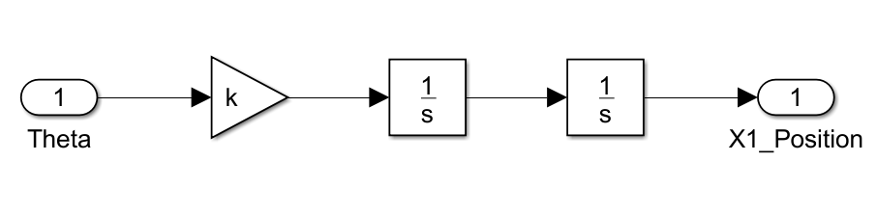
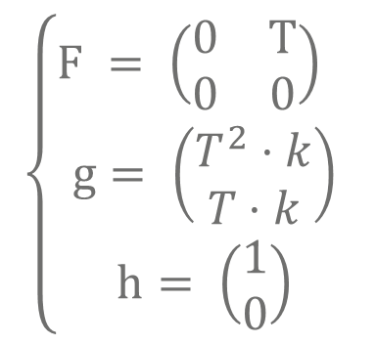
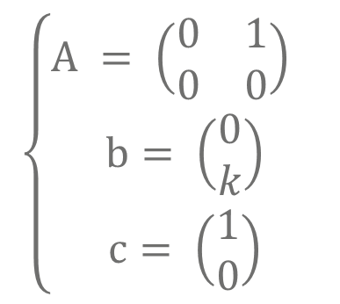
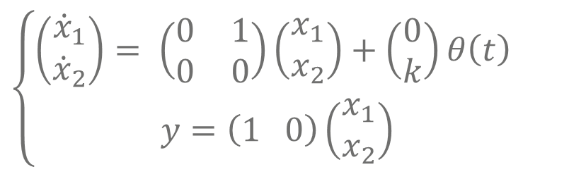
2. State-space representation: 2nd order
$$\left\{\begin{aligned}A = \left(\begin{matrix}0 & 1 \\ 0 & 0\end{matrix}\right) \\ b= \left(\begin{matrix}0 \\ k\end{matrix}\right) \\ c= \left(\begin{matrix}1 \\ 0\end{matrix}\right)\end{aligned}\right.$$
$$\left\{\begin{aligned}\left(\begin{matrix}{\dot{x}}_{1} \\ {\dot{x}}_{2}\end{matrix}\right)= \left(\begin{matrix}0 & 1 \\ 0 & 0\end{matrix}\right)\left(\begin{matrix}x_{1} \\ x_{2}\end{matrix}\right)+\left(\begin{matrix}0 \\ k\end{matrix}\right)θ\left(t\right) \\ y=\left(1 0\right)\left(\begin{matrix}x_{1} \\ x_{2}\end{matrix}\right)\end{aligned}\right.$$
$$\left\{\begin{aligned}F = \left(\begin{matrix}0 & T \\ 0 & 0\end{matrix}\right) \\ g= \left(\begin{matrix}T^{2}⋅k \\ T⋅k\end{matrix}\right) \\ h= \left(\begin{matrix}1 \\ 0\end{matrix}\right)\end{aligned}\right.$$
Input | Output | Gain k | Known as | value
Radian | Meter | k_rm | kbb | -0.8829
Radian | Pixel | k_rp | - | -1222.8
Degree | Meter | k_dm | - | -0.0154
Degree | Pixel | k_dp | kga | -21.2651

Slide 9
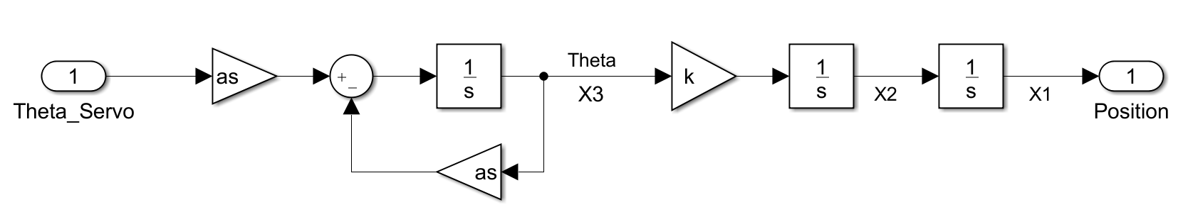
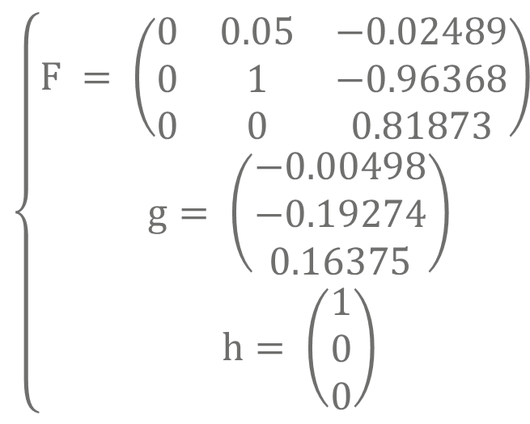
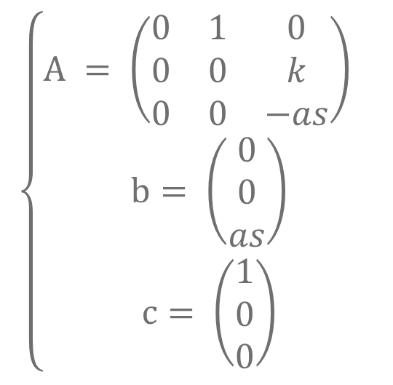
2. State-space representation: 3rd order
$$\left\{\begin{aligned}A = \left(\begin{matrix}0 & 1 & 0 \\ 0 & 0 & k \\ 0 & 0 & −as\end{matrix}\right) \\ b= \left(\begin{matrix}0 \\ 0 \\ as\end{matrix}\right) \\ c= \left(\begin{matrix}1 \\ 0 \\ 0\end{matrix}\right)\end{aligned}\right.$$
$$\left\{\begin{aligned}F = \left(\begin{matrix}0 & 0.05 & −0.02489 \\ 0 & 1 & −0.96368 \\ 0 & 0 & 0.81873\end{matrix}\right) \\ g= \left(\begin{matrix}−0.00498 \\ −0.19274 \\ 0.16375\end{matrix}\right) \\ h= \left(\begin{matrix}1 \\ 0 \\ 0\end{matrix}\right)\end{aligned}\right.$$
Note: these values are in Deg-Pxl model

Slide 10
Content:
Ball-plate model
State-space representation
Simulation of KF using Matlab
Implementation of KF on MCU
Results

Slide 11
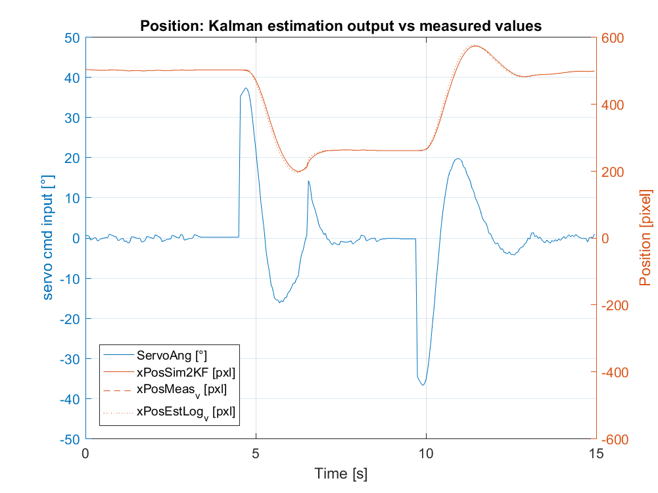
3. Simulation using Matlab Linear 2nd order
abc

Slide 12
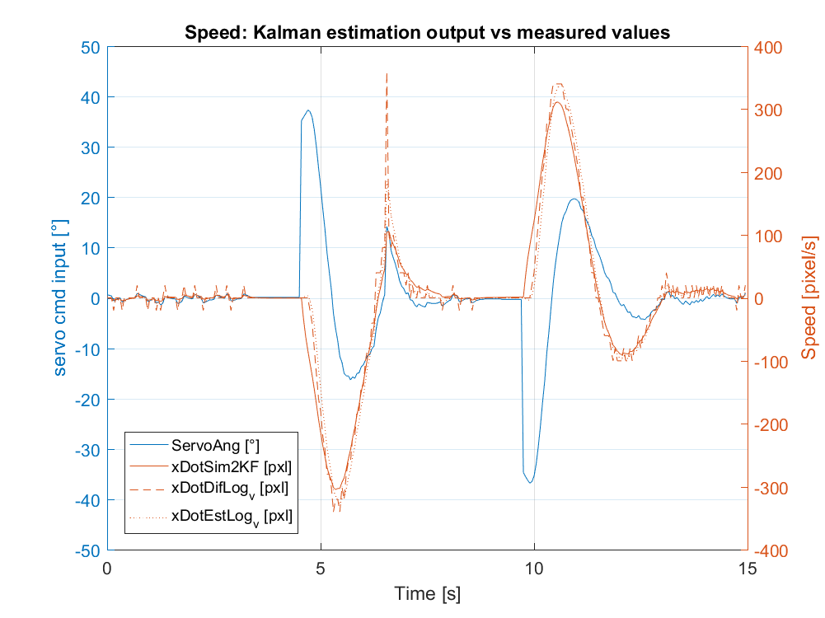
3. Simulation using Matlab Linear 2nd order
abc

Slide 13
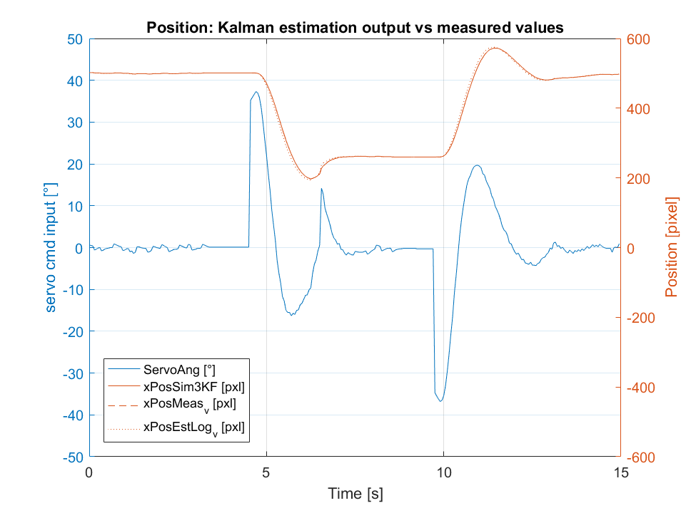
3. Simulation using Matlab Linear 3rd order
abc

Slide 14
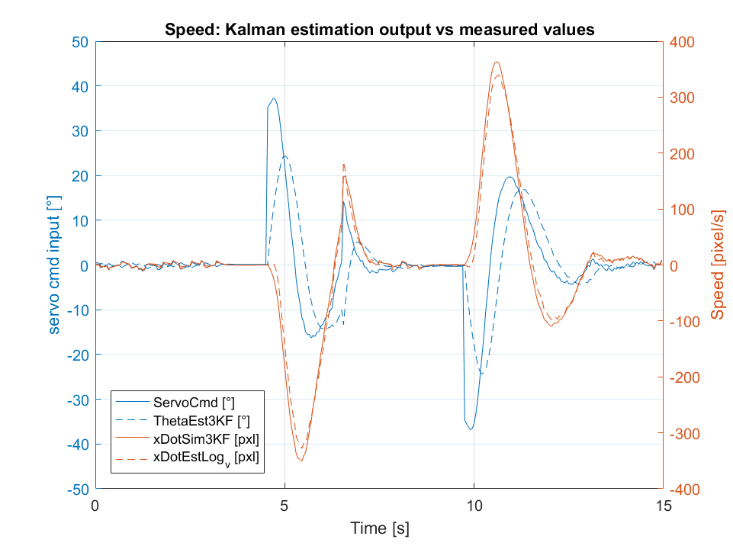
3. Simulation using Matlab Linear 3rd order
Blue: Plate angle is delayed
Orange: Speed estimation is closer to the logged data.

Slide 15
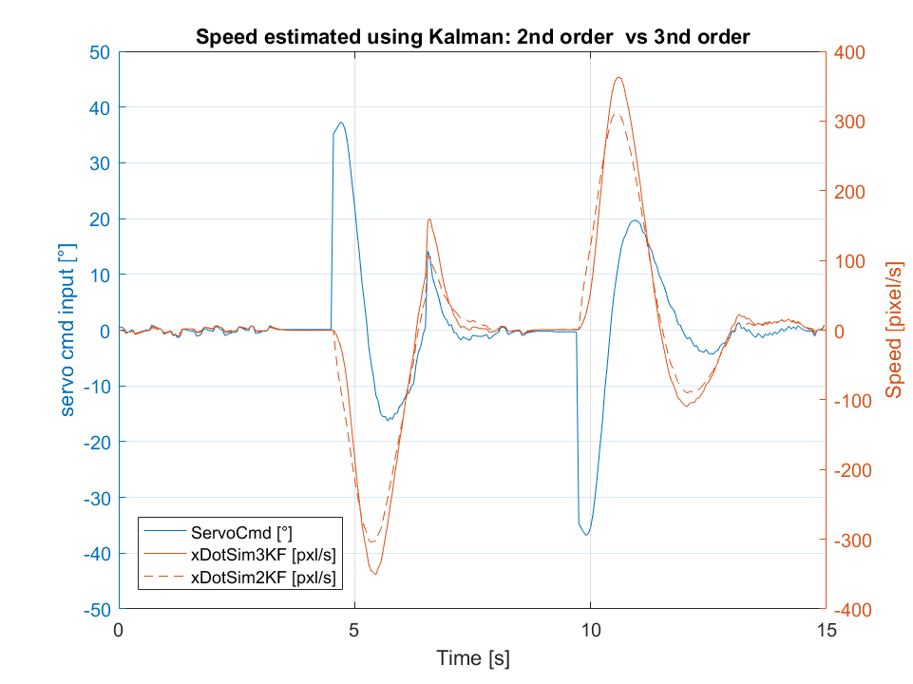
3. Simulation using Matlab 3rd vs 2nd order
abc

Slide 16
Content:
Ball-plate model
State-space representation
Simulation of KF using Matlab
Implementation of KF on MCU
Results

Slide 17
4. Implementation on MCU Code structure

Slide 18
4. Implementation on MCU Interrupts’ flowchart

Slide 19
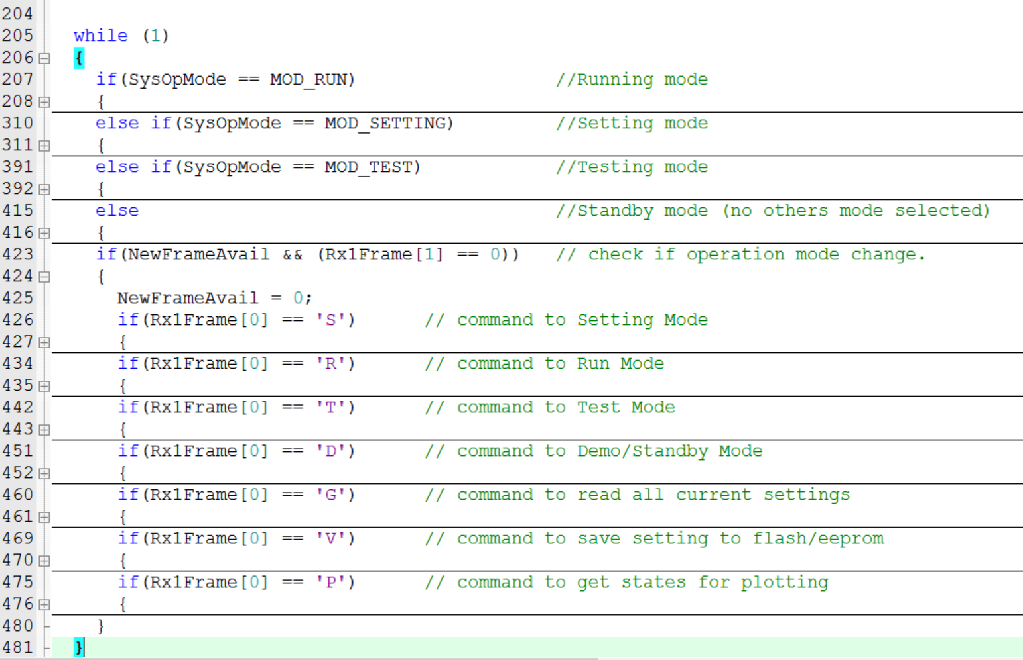
4. Implementation on MCU main function

Slide 20
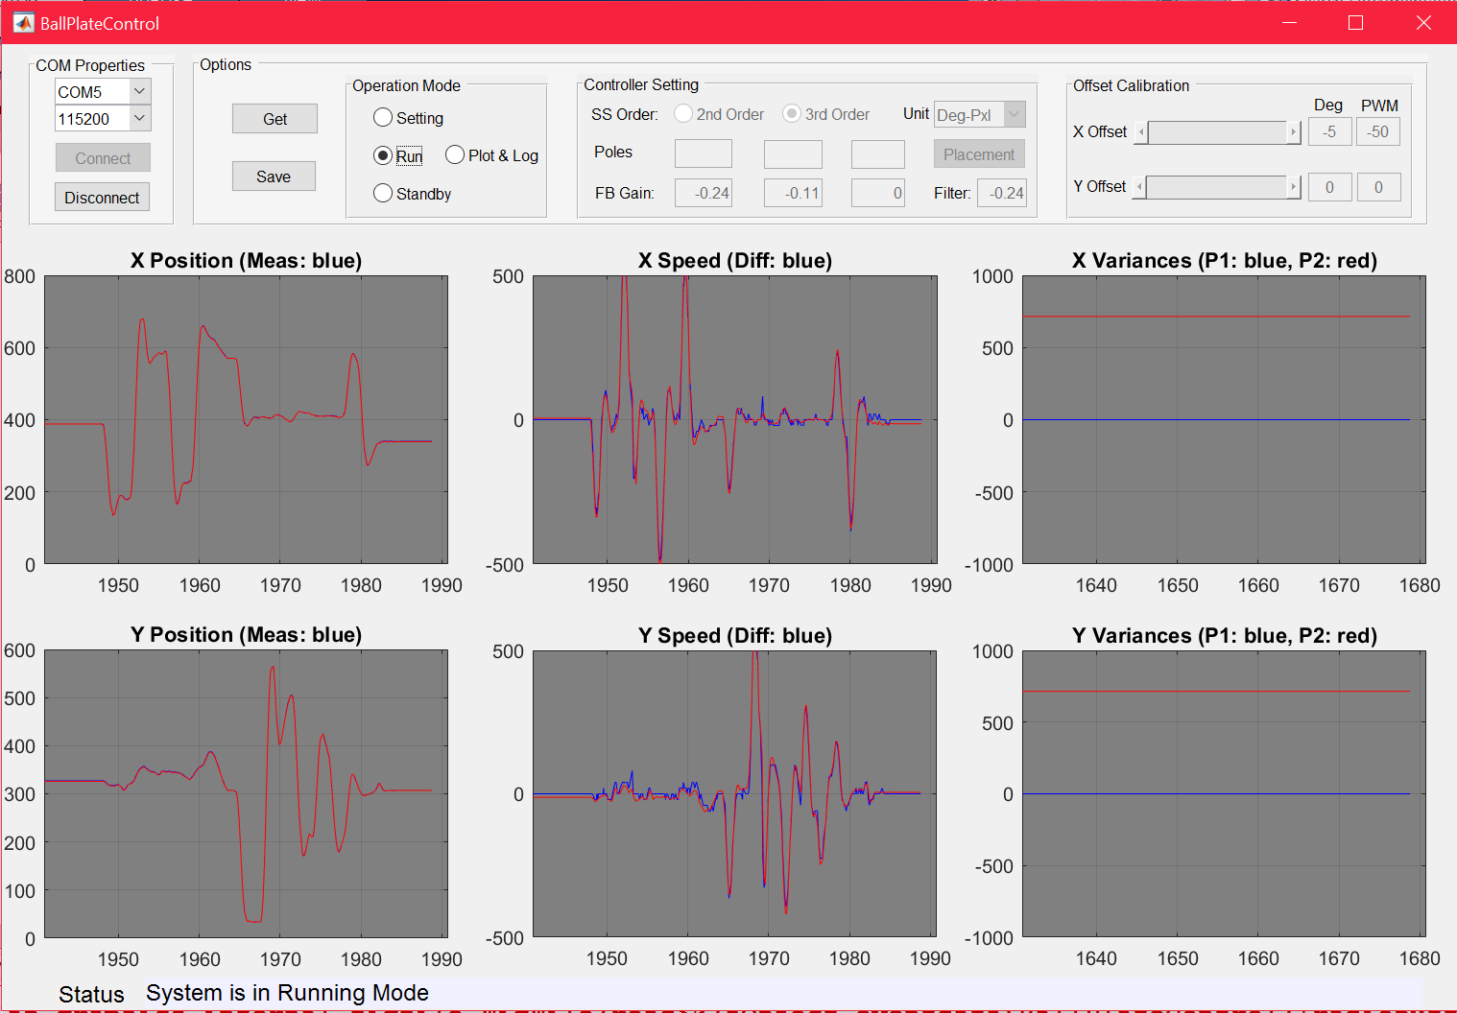
4. Implementation on MCU GUI

Slide 21
Content:
Ball-plate model
State-space representation
Simulation of KF using Matlab
Implementation of KF on MCU
Results

Slide 22
5. Results Video

Slide 23
Selective subject: „Kalman Filtering in Control- & Communication Applications” Thanks for your attention! Q&A…

