Slide 1
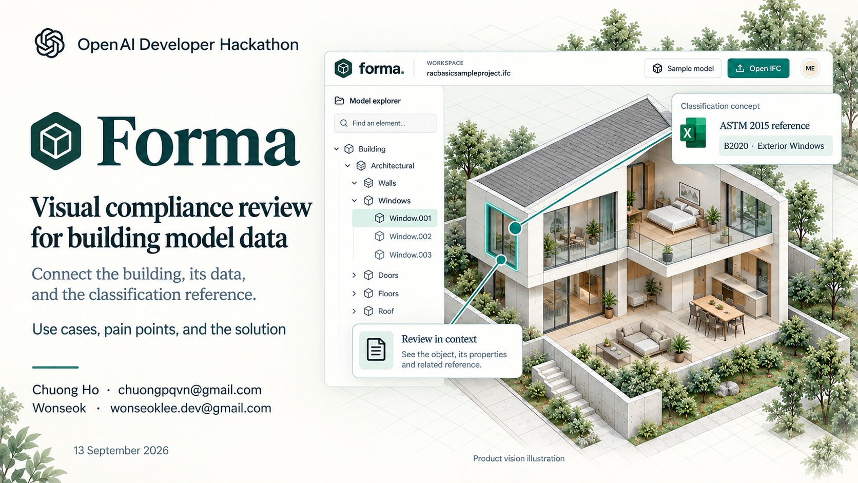
Notes:
[object Object]

Slide 2
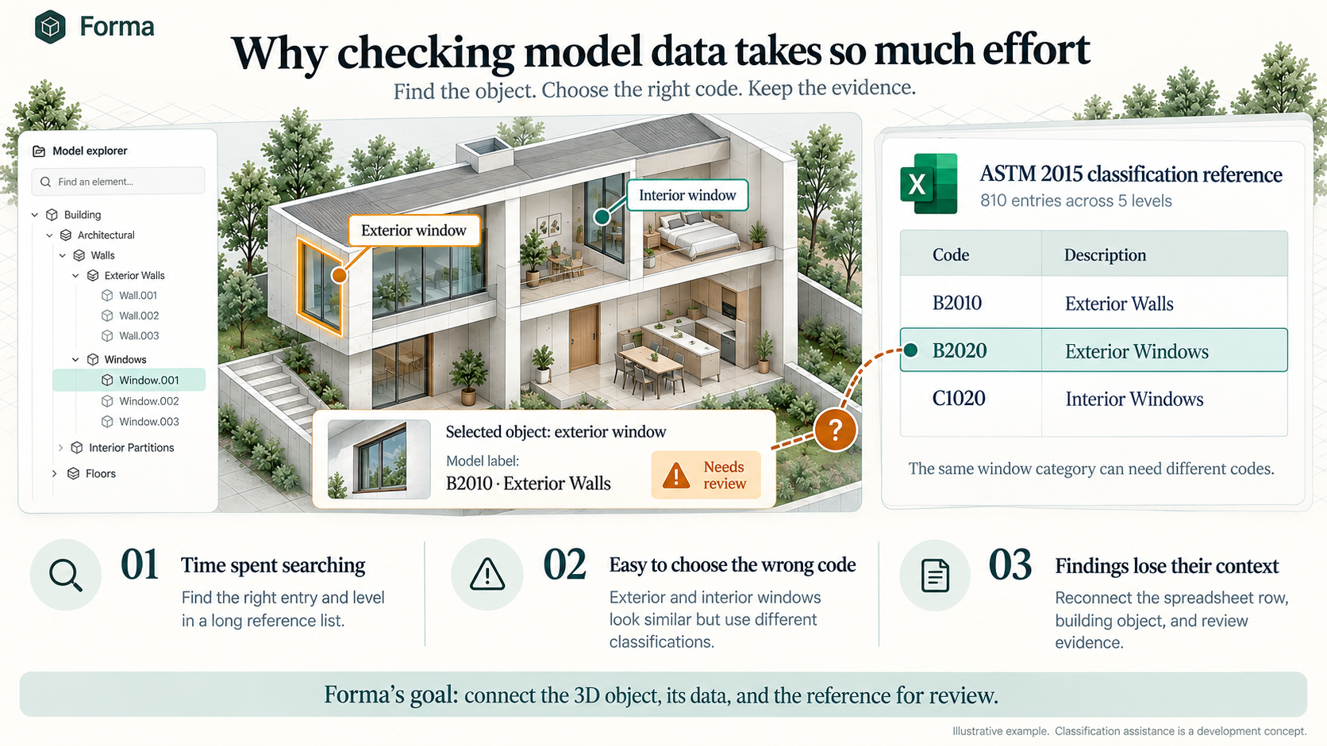
The problem: model data is hard to verify
Illustrative workflow in development. Classification compliance supports model-data review.
6
Notes:
Main example, 45 seconds. The selected object is an exterior window. In this illustrative scenario its model label is B2010, Exterior Walls. The workbook lists B2020, Exterior Windows, on ASTM 2015 row 195. Forma is intended to present the mismatch and propose a classification for designer review. This image is supplied by the user and represents a concept, not a detected issue in the sample IFC. Source: ASTM-UniFormat.xlsx ASTM 2015 A186:B186 and A195:B195; user-supplied visual. Classification consistency does not establish building-code safety compliance.

Slide 3
Live demo sequence
01 | Open the sample IFC model
02 | Select an object and inspect properties
03 | Ask about the selected element
04 | Isolate it and inspect the 3D view
05 | Draft and save a review issue
06 | Filter the sheet and export Excel
Notes:
[object Object]

Slide 4
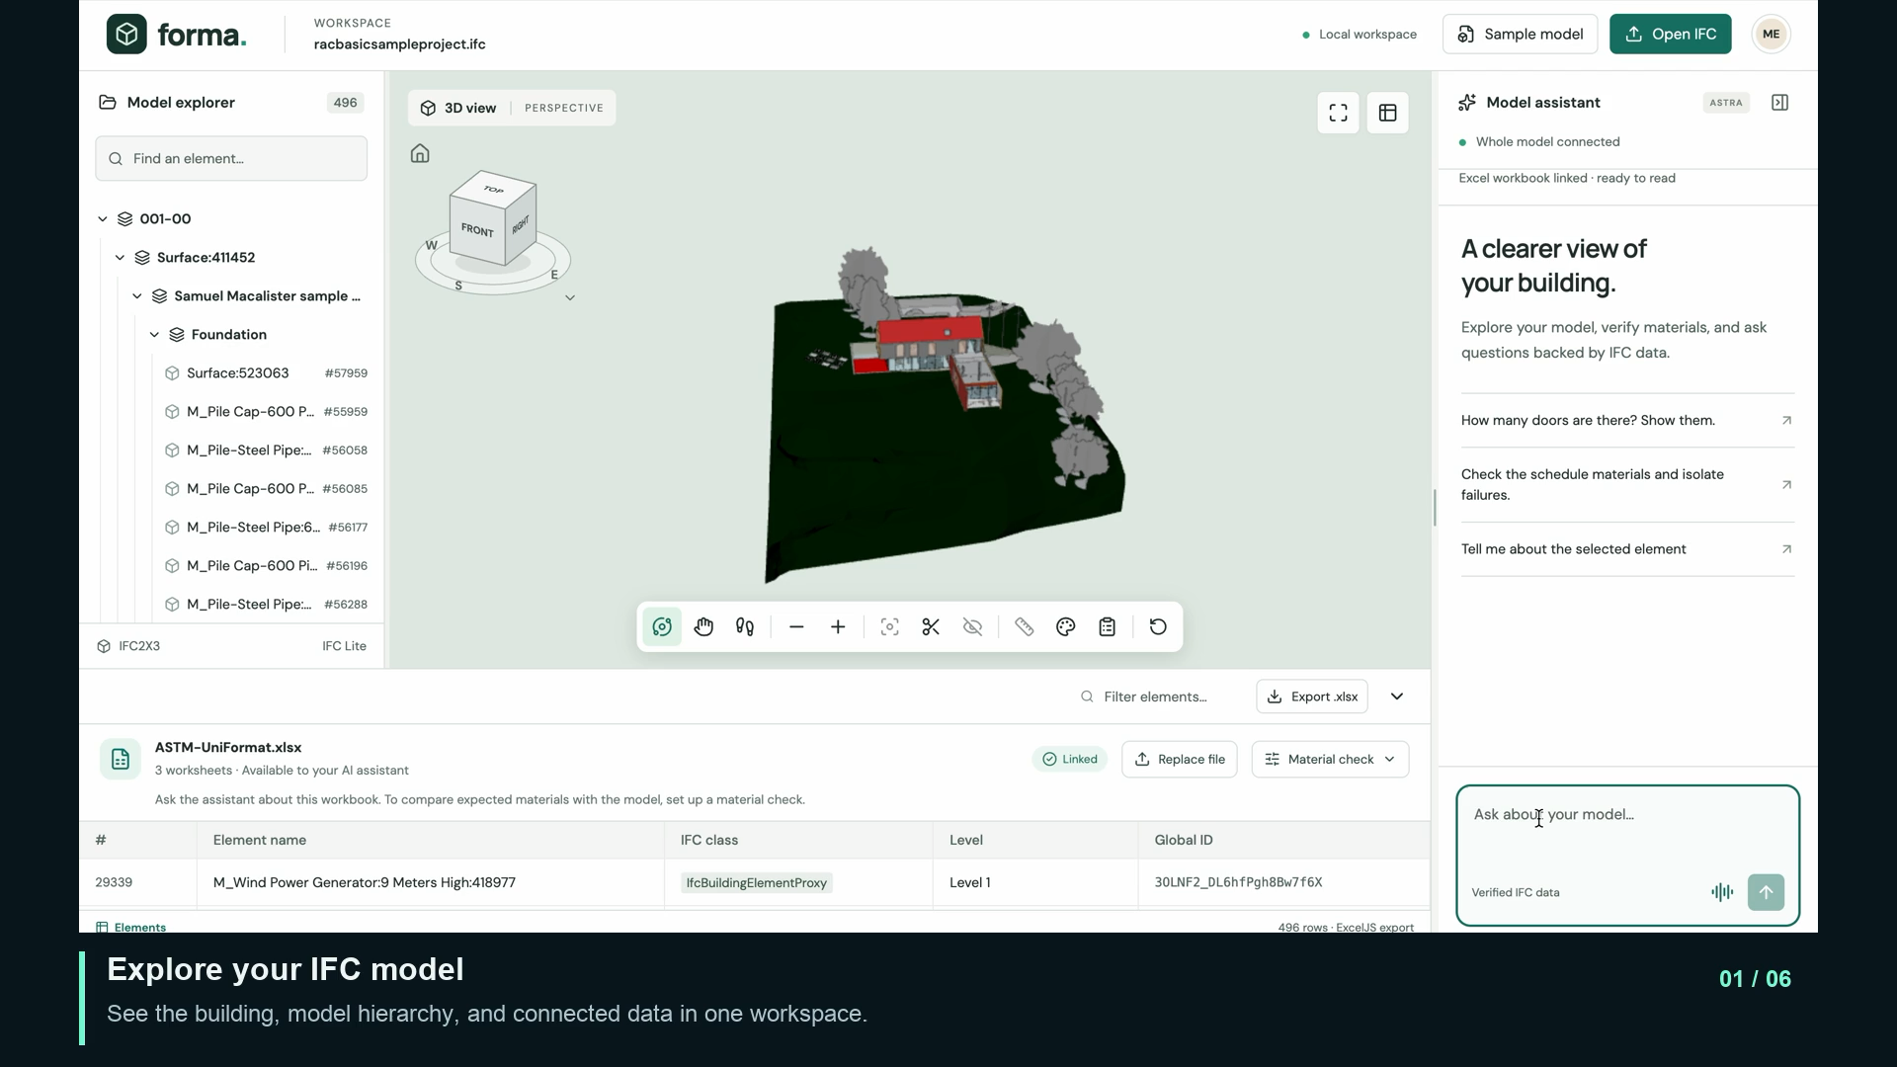
DEMO
/Users/me/Downloads/repos/hackathon-openai-astra/marketing/output/recording-short.mp4

Slide 5
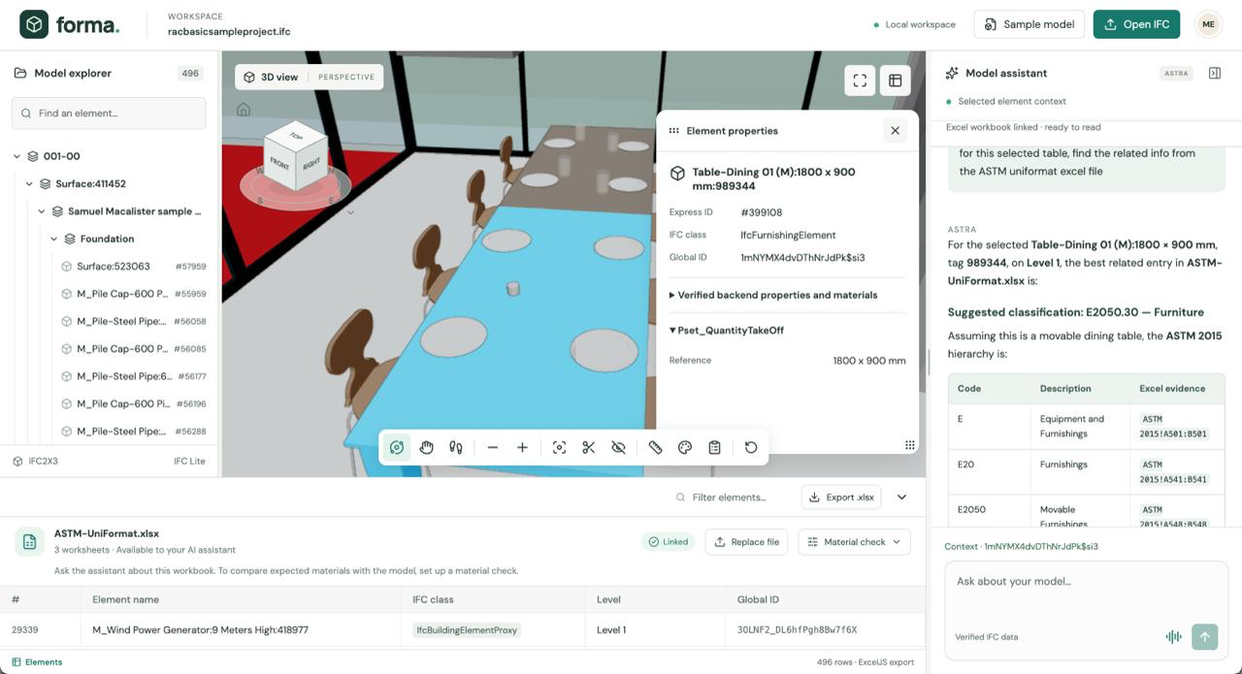
DEMO

Slide 6
Who Forma helps
Architects and modelers
Design reviewers
Cost estimation teams
Check an object’s classification
Find missing or mismatched data
Prepare a consistent element list
Inspect a window in 3D, compare its label with the reference, and review a suggested correction.
Locate the affected element and keep the finding with a saved viewpoint.
Review the model data, filter the relevant elements, and export the list to Excel.
Classification suggestions and approved model updates are the development target.
3
Notes:
Use cases, 35 seconds. Walk through three users: architects identify and correct object data, reviewers record traceable findings, and estimators reuse filtered element lists. Current prototype supports visual inspection, local review issues and export. AI classification checks and write-back are planned.

Slide 7
Manual review vs. Forma
Construction model review before cost estimation
Review activity | Manual workflow | With the app
Find and inspect objects | Cross-check model and schedules | Linked 3D view, tree, and properties
Record review findings | Capture screenshots and notes | Save issues with their viewpoints
Prepare element data | Compile an element list by hand | Filter model data and export Excel
Illustrative effort per review | 100 hours / US$400 labor | 10 hours / US$200 labor
90 hours saved/Model
90% less review time/model
Benefits: easier data verification, traceable reviews, and a clearer handoff to estimators.
Illustrative scenario, not measured: 8h vs. 4h at US$50/h. Gross labor savings exclude app and AI costs.
10
Notes:
[object Object]

Slide 8
The problem: model data is hard to verify
A building can look right
while its data is wrong
Missing or incorrect classifications make it harder to understand what each element represents.
Review happens across
separate tools
Modelers compare geometry, properties, and standards by hand. Estimators need the same information for a reliable handoff.
Notes:
Pain points, 35 seconds. A visually convincing building model can still contain missing or mismatched classifications. Reviewers need to reconcile object identity, location, and the standard reference. Explain these as target user problems, not measured error rates. Estimators depend on consistent element categories for downstream work. Sources: user project brief; ASTM-UniFormat.xlsx Instructions A2 and ASTM 2015 A7:H7.

Slide 9
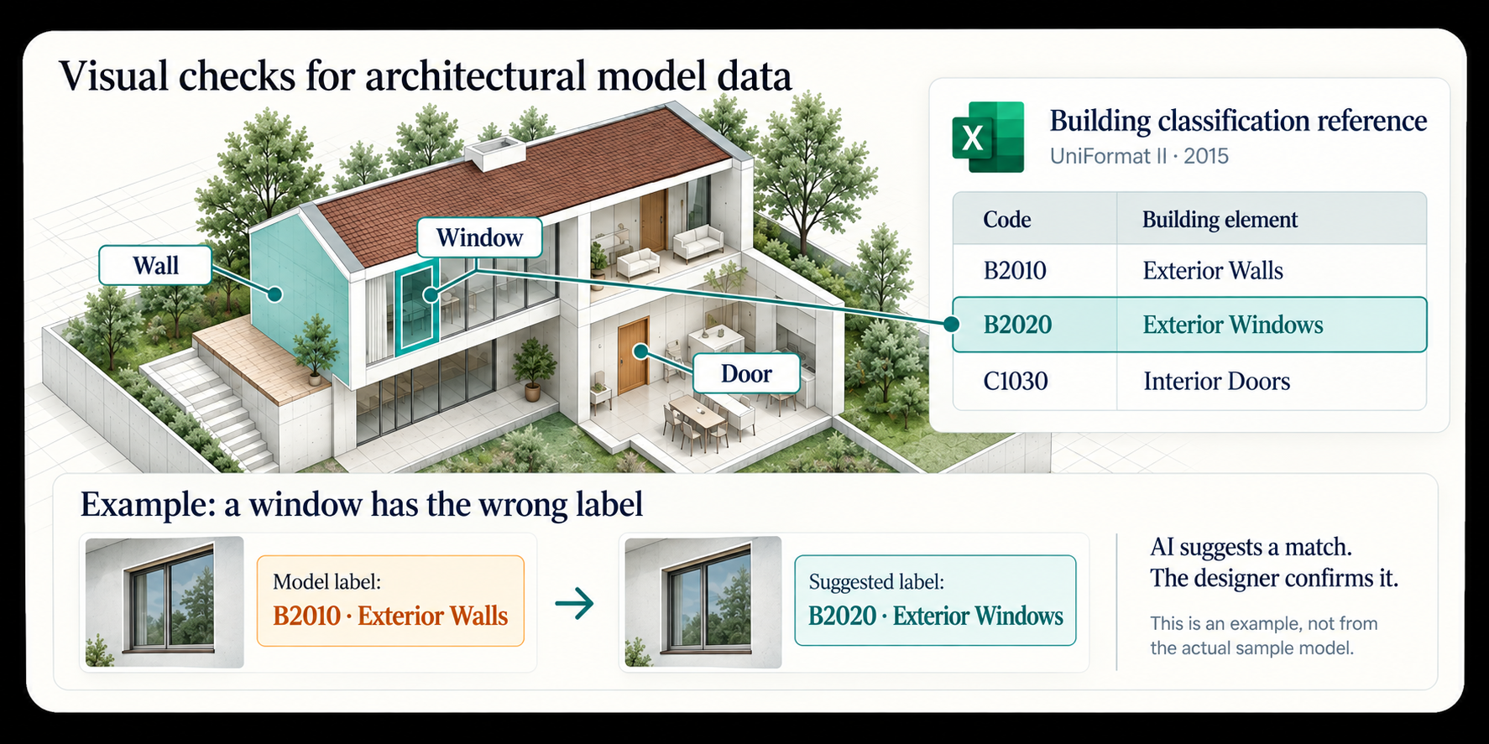
The problem: model data is hard to verify
Illustrative workflow in development. Classification compliance supports model-data review.
6
Notes:
Main example, 45 seconds. The selected object is an exterior window. In this illustrative scenario its model label is B2010, Exterior Walls. The workbook lists B2020, Exterior Windows, on ASTM 2015 row 195. Forma is intended to present the mismatch and propose a classification for designer review. This image is supplied by the user and represents a concept, not a detected issue in the sample IFC. Source: ASTM-UniFormat.xlsx ASTM 2015 A186:B186 and A195:B195; user-supplied visual. Classification consistency does not establish building-code safety compliance.

Slide 10
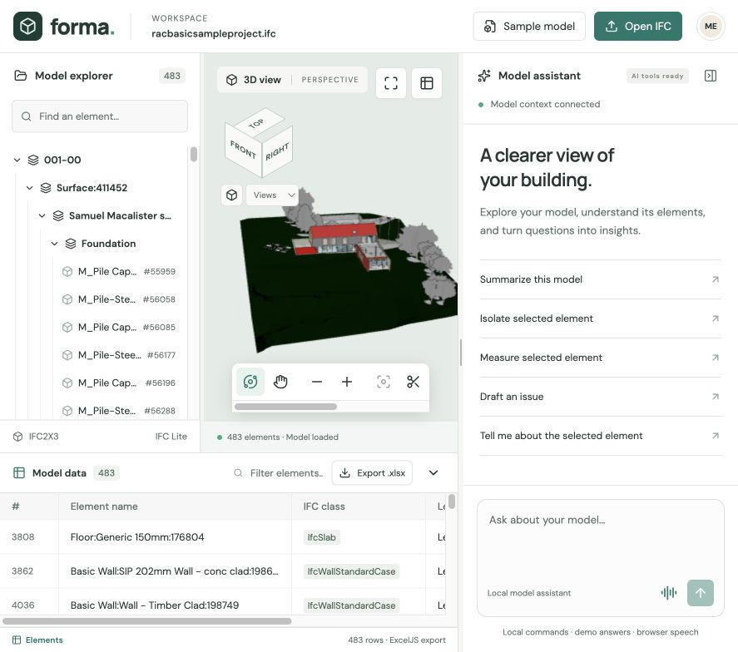
The current workspace
A connected view of the model
Select an element in the tree, 3D scene, or data sheet.
Inspect its properties, zoom in, or isolate it for review.
The bundled sample loads 483 elements.
Notes:
[object Object]

Slide 11
The solution: check each object in context
1. Identify the building part
Select a wall, window, or door and inspect its model properties.
2. Compare its classification
Use the selected UniFormat edition to find the appropriate code and description.
3. Explain the mismatch
Show the current label beside the suggested classification and its reference.
4. Review the correction
The designer confirms the match before changing the model data.
Notes:
Solution, 35 seconds. The Excel file is a classification database. It contains Instructions, ASTM 1997 and ASTM 2015 sheets. Use one reference edition consistently. Automated classification comparisons and write-back are development targets. Geometry, context and properties help distinguish similar categories, such as interior and exterior doors. The workbook does not itself provide dimensional, fire-safety or accessibility requirements. Source: assets/ASTM-UniFormat.xlsx.

Slide 12



Astra capabilities planned for Forma
GPT-Live-1
Discuss the current model through natural conversation while keeping the selected object in context.
Visual Understanding
Connect questions about the visible 3D scene with IFC element properties and review evidence.
Agents API
Use model tools to inspect properties, change the view, and prepare an issue for human review.
Notes:
[object Object]

Slide 13
Prototype status and next steps
Working today
IFC import, linked selection, scene controls, Excel export, and local review issues.
Tool foundation
10 WebMCP tools expose model data, scene state, measurements, and issue actions.
Next integration
Connect live Astra, add standards reasoning, and persist approved mappings.
Notes:
[object Object]

Slide 14
Clearer model data
for construction teams
Thank you
Forma
Questions and live demo
Notes:
[object Object]

Slide 15

Forma
Open AI Developer - Hackathon
Visual compliance review for building model data
Use cases, pain points, and the solution
Chuong Ho · chuongpqvn@gmail.com
Wonseok · wonseoklee.dev@gmail.com
13/09/2026
Notes:
[object Object]

