Slide 1

Astra-IFC-
Compliance
Hackathon project demo
AI-assisted model review
For modeling and cost estimation teams
Chuong Ho · Chuongpvn@gmail.com
Wonseok · wonseoklee.dev@gmail.com
Notes:
Opening, 20 seconds: Astra-IFC-Complience helps modeling and cost estimation teams inspect building model entities and review the data behind them. We aim to combine model conversation with standards-based mapping and compliance review. Preserve the project name as supplied. Sources: user project brief. Cover photo retained from the chosen Simple Dark Mode template.

Slide 2
Model data review before estimation
Modeling teams
Check an object’s identity and properties in its 3D context.
Resolve missing or inconsistent information before handing the model to estimators.
Cost estimation teams
Review which elements belong in the estimate.
Inspect classifications and export the filtered element list for further work.
Notes:
Problem, 25 seconds: Focus on the handoff between modelers and estimators. The goal is to make it easier to establish what an element is and whether its data is suitable for downstream work. Do not claim measured time or cost savings. Sources: user brief; frontend/src/lib/model.ts; frontend/src/App.tsx.

Slide 3
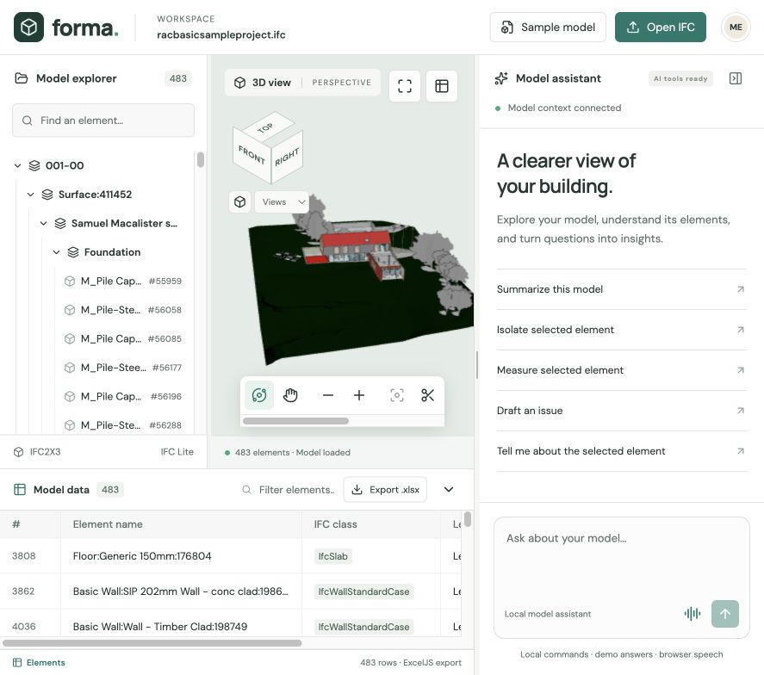
The current workspace
A connected view of the model
Select an element in the tree, 3D scene, or data sheet.
Inspect its properties, zoom in, or isolate it for review.
The bundled sample loads 483 elements.
Notes:
Product, 30 seconds: The application currently uses the Forma name in its interface. Show that the tree, geometry, and sheet refer to the same element. Zoom and isolate help investigate it. Source: actual screenshot captured from localhost on 13 September 2026; frontend/src/App.tsx; frontend/src/lib/viewer.ts. 483 elements appeared in the sample during this capture.

Slide 4
AI-assisted mapping and compliance
1. Read the standard
Use the supplied ASTM UniFormat workbook as the reference for mapping.
2. Propose a mapping
AI suggests a classification using the object’s properties and context.
3. Review the evidence
Ask why the mapping fits and identify missing data before accepting it.
4. Confirm and update
A modeler approves the mapping before updating the model data.
Notes:
Target workflow, 30 seconds: Describe this as the planned AI mapping workflow. The repository contains assets/ASTM-UniFormat.xlsx, but the current frontend does not implement standard ingestion, AI classification updates, or model write-back. A classification mapping is not itself proof of regulatory compliance. Compliance conclusions need the applicable requirement and supporting property evidence. Sources: user brief; assets/ASTM-UniFormat.xlsx; frontend/src/lib/model.ts.

Slide 5
Astra: intended hackathon use
GPT-Live-1
Discuss the current model through natural conversation while keeping the selected object in context.
Visual Understanding
Connect questions about the visible 3D scene with IFC element properties and review evidence.
Agents API
Use model tools to inspect properties, change the view, and prepare an issue for human review.
Notes:
Astra, 30 seconds: These correspond to the requested categories: Best use of GPT-Live-1, Best example of Visual Understanding, and Best use of Agents API. This slide describes intended use, not award wins. The repository has browser tool registration, but it does not establish a direct GPT-Live-1 or Agents API connection. Built-in chat uses mock responses and browser speech. If a separate external Astra session is used for judging, demonstrate that session. Sources: frontend/src/lib/webmcp.ts; frontend/src/components/ChatPanel.tsx; frontend/src/mock-api/index.ts; frontend/README.md.

Slide 6
Live demo sequence
01 | Open the sample IFC model
02 | Select an object and inspect properties
03 | Ask about the selected element
04 | Isolate it and inspect the 3D view
05 | Draft and save a review issue
06 | Filter the sheet and export Excel
Notes:
Live demo, approximately 90 seconds: Open Sample model. Select a wall from the model tree. Inspect its properties. Ask Tell me about the selected element. Type Isolate selected element to demonstrate the local command. Restore with Show all. Use Draft an issue, enter a meaningful title, review it, and save. Reopen the saved issue to restore its viewpoint. Filter the sheet and choose Export .xlsx. General chat answers are mocked, so do not present them as live Astra reasoning. Sources: frontend/src/lib/review.ts; frontend/src/components/ChatPanel.tsx; frontend/src/lib/model.ts.

Slide 7
Prototype status and next steps
Working today
IFC import, linked selection, scene controls, Excel export, and local review issues.
Tool foundation
10 WebMCP tools expose model data, scene state, measurements, and issue actions.
Next integration
Connect live Astra, add standards reasoning, and persist approved mappings.
Notes:
Status, 25 seconds: The review tool layer exposes ten tools. It registers when the browser provides modelContext and otherwise falls back to local tools. Measurement returns approximate world-axis bounding boxes in metres, not exact quantities for estimating. Review issues persist in browser local storage. Next work includes live model integration, standard-backed reasoning, and approved mapping persistence. Sources: frontend/src/lib/webmcp.ts; frontend/src/lib/review.ts; frontend/README.md.

Slide 8
Manual review vs. Astra-IFC-Complience
Construction model review before cost estimation
Review activity | Manual workflow | With the app
Find and inspect objects | Cross-check model and schedules | Linked 3D view, tree, and properties
Record review findings | Capture screenshots and notes | Save issues with their viewpoints
Prepare element data | Compile an element list by hand | Filter model data and export Excel
Illustrative effort per review | 8 hours / US$400 labor | 4 hours / US$200 labor
4 hours saved
50% less review time
US$200 saved
Benefits: easier data verification, traceable reviews, and a clearer handoff to estimators.
Illustrative scenario, not measured: 8h vs. 4h at US$50/h. Gross labor savings exclude app and AI costs.
8
Notes:
Allow 35 seconds. Compare the same construction model review scope with and without the app. Manual workflow is an illustrative baseline, not a measured industry benchmark. The app supports linked object inspection, local issues with saved viewpoints, and filtered XLSX export. Example assumptions: manual review 8 hours, app-assisted review 4 hours including human verification, and US$50 per staff-hour. Calculation: (8 - 4) = 4 hours saved; 4 / 8 = 50% reduction; 8 × 50 = US$400 manual labor; 4 × 50 = US$200 app-assisted labor; gross labor savings US$200 per review. These are scenario values, not actual measured product performance or guaranteed savings. Net savings would subtract software, AI, setup and training costs. This is review labor cost, not a reduction in construction materials or total project cost. Potential benefits include less copying, easier verification and traceable review context. No quantified rework, error-rate or construction-cost reduction is established. Automated standards mapping and live AI integration remain planned as described earlier. Sources: user request; frontend/src/App.tsx; frontend/src/lib/model.ts; frontend/src/lib/review.ts. Validate with timed manual and app-assisted reviews of the same model and scope.

Slide 9
Model review with
visible evidence
Thank you
Astra-IFC-Complience
Questions and live demo
Notes:
Close, 15 seconds: Our focus is helping modelers and estimators inspect the same objects and review the same evidence. Invite questions about the live model, tool actions, and standards mapping workflow. Source: user project brief.

