Slide 1
Examples
The system in action

Slide 2



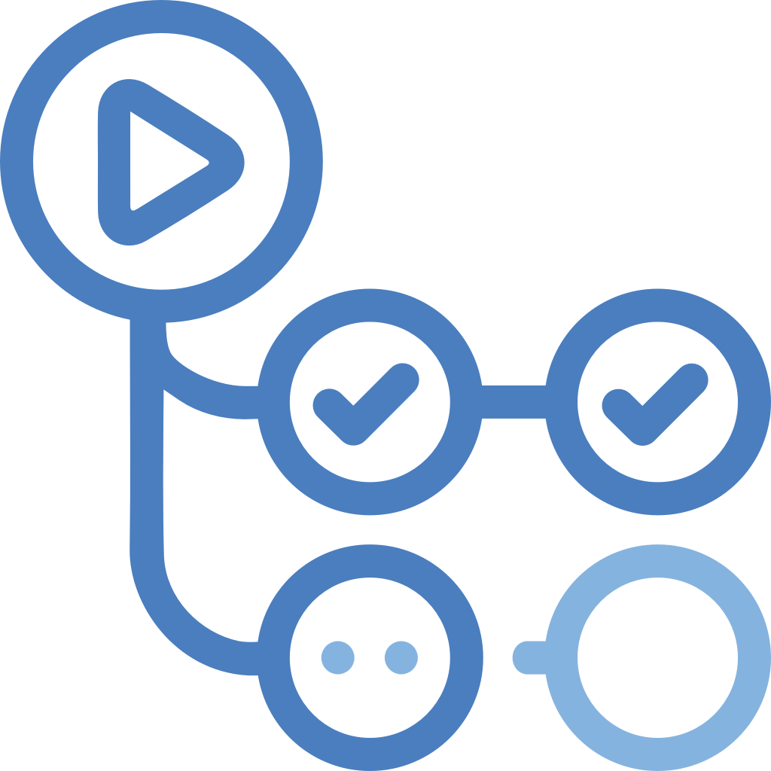


CI/CD FLOW
AzureCloud
Git push
Trigger
Push
Git users
Github
Github Actions
ACR
Pull
Deploy
AKS

Slide 3




USER FLOW
AzureCloud
Users
FrontDoor
Application Gateways
AKS
SignalR
Service Bus

